Slide 1
Database Connectivity
Web Programming and Testing

Slide 2

Objectives
The objective of this session is the following:
The students are able to elaborate the role of persistent data storage in a web application.
The students are able to interact with relational database.

Slide 3
Outlines
Motivation
Persistence data storage
Examples in PHP: native and PDO-based

Slide 4
Motivation

Slide 5
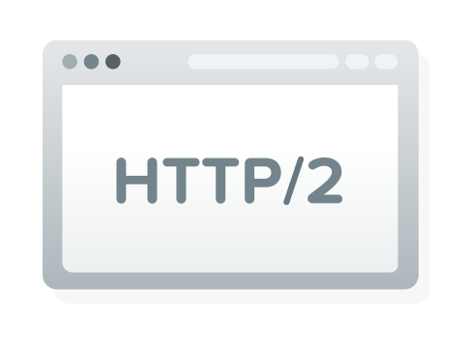
Web 2.0: Interactivity
Web 2.0 is minimal: dynamic content.
User should be able to contribute.
Server-side processing is needed.
+ persistence data storage.

Slide 6
General Workflow

Slide 7
Persistence Data Storage

Slide 8
Persistence Data Storage
The storage that store data emerges from user and application interactivity.
Forms of persistence data storage:
Database (relational or non-relational).
Plain-text (XML, JSON).
We could do DDL and DML.

Slide 9
From This Point Forward
Focus on relational database as the primary data storage.
PHP is the platform used as our vehicle.

Slide 10
Database Connectivity
Connectivity can be achieved via three approaches:
Native driver, plainly using the vendor’s library.
PDO (PHP Data Object), a standard interfaces.
ORM (Object-Relational Mapping), will be discussed later.

Slide 11
Native Driver
Specific database vendor provides its own APIs.
Different vendor might provide different set of APIs.
Advantage:
Plain with less abstraction layer.
Faster over any other options.
Disadvantage:
Moving from one to another vendor is hard.
More time to learn specific vendor APIs.

Slide 12
PDO (PHP Data Object)
PDO provides a generic set of standard APIs running on top of vendor PDO implementations.
Advantage:
An extra abstraction layer hides complexity down the road.
Moving from one to another vendor is easy.
Less time to learn since PDO gives standard.
Disadvantage:
An extra abstraction increase processing time.

Slide 13
ORM (Object-Relational Mapping)
Running on top of PDO, proposing a specific point of view.
Active record, data mapper, etc.
Advantage:
Everything PDO has.
Seeing data in object-oriented sense.
Disadvantage:
An extra abstraction increases processing time.

Slide 14
Comparison

Slide 15
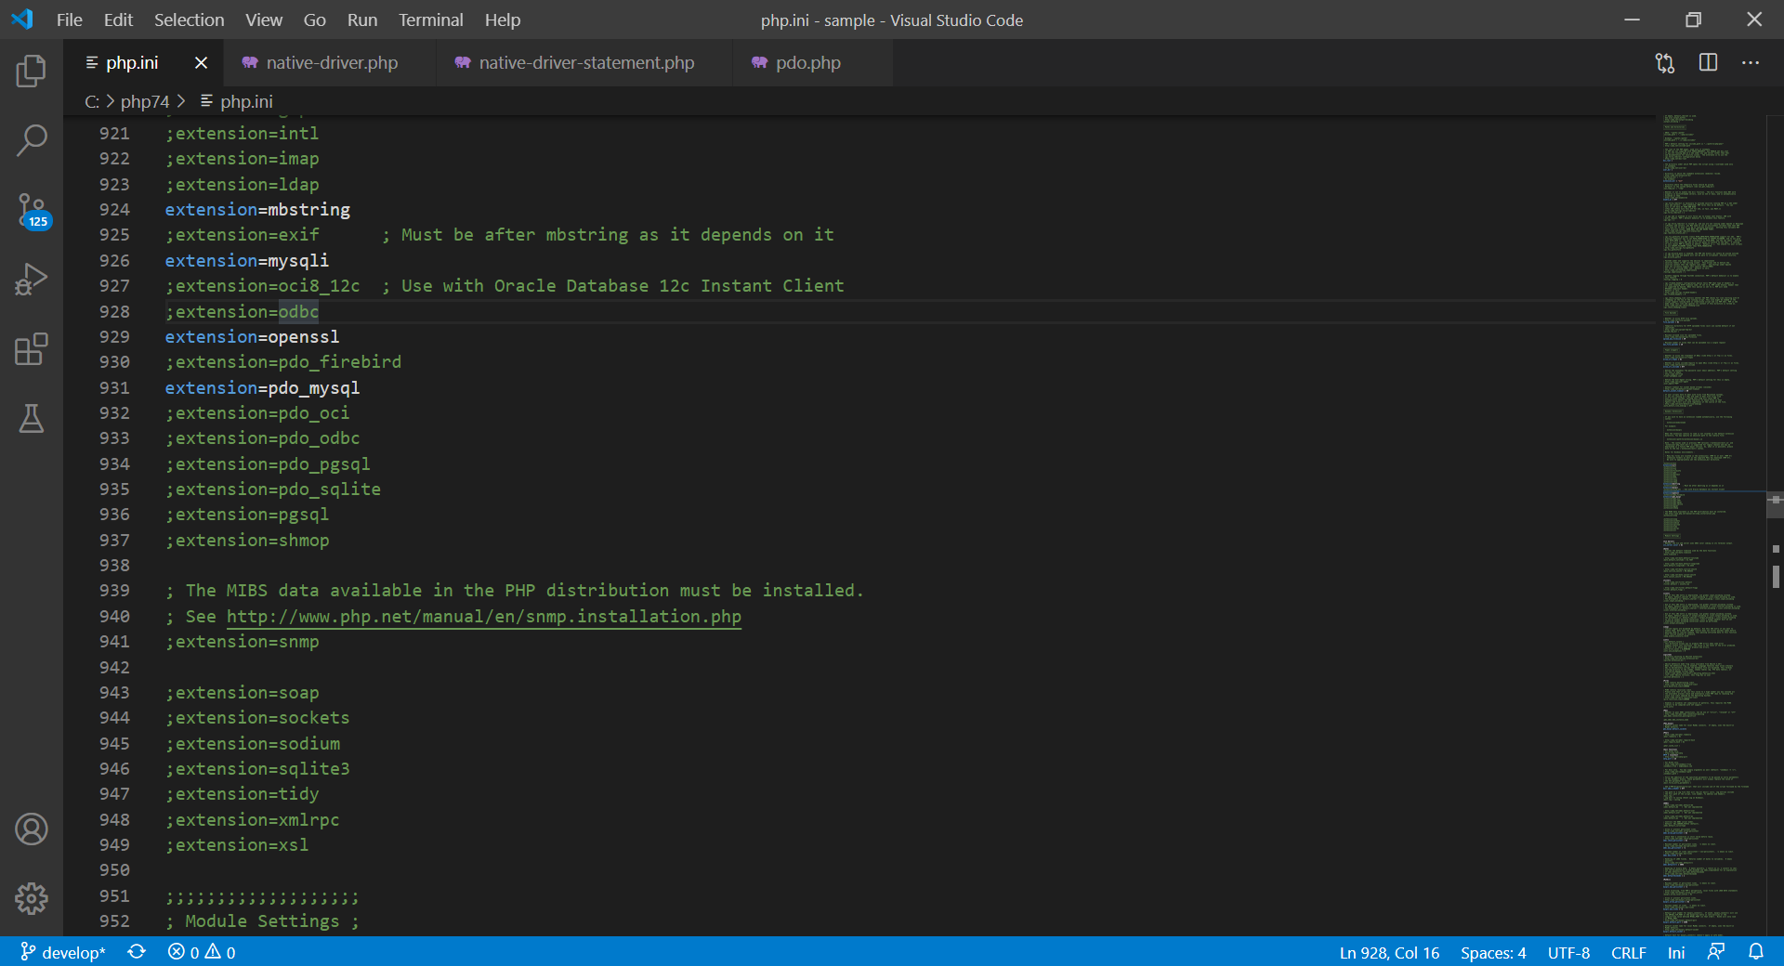

Slide 16
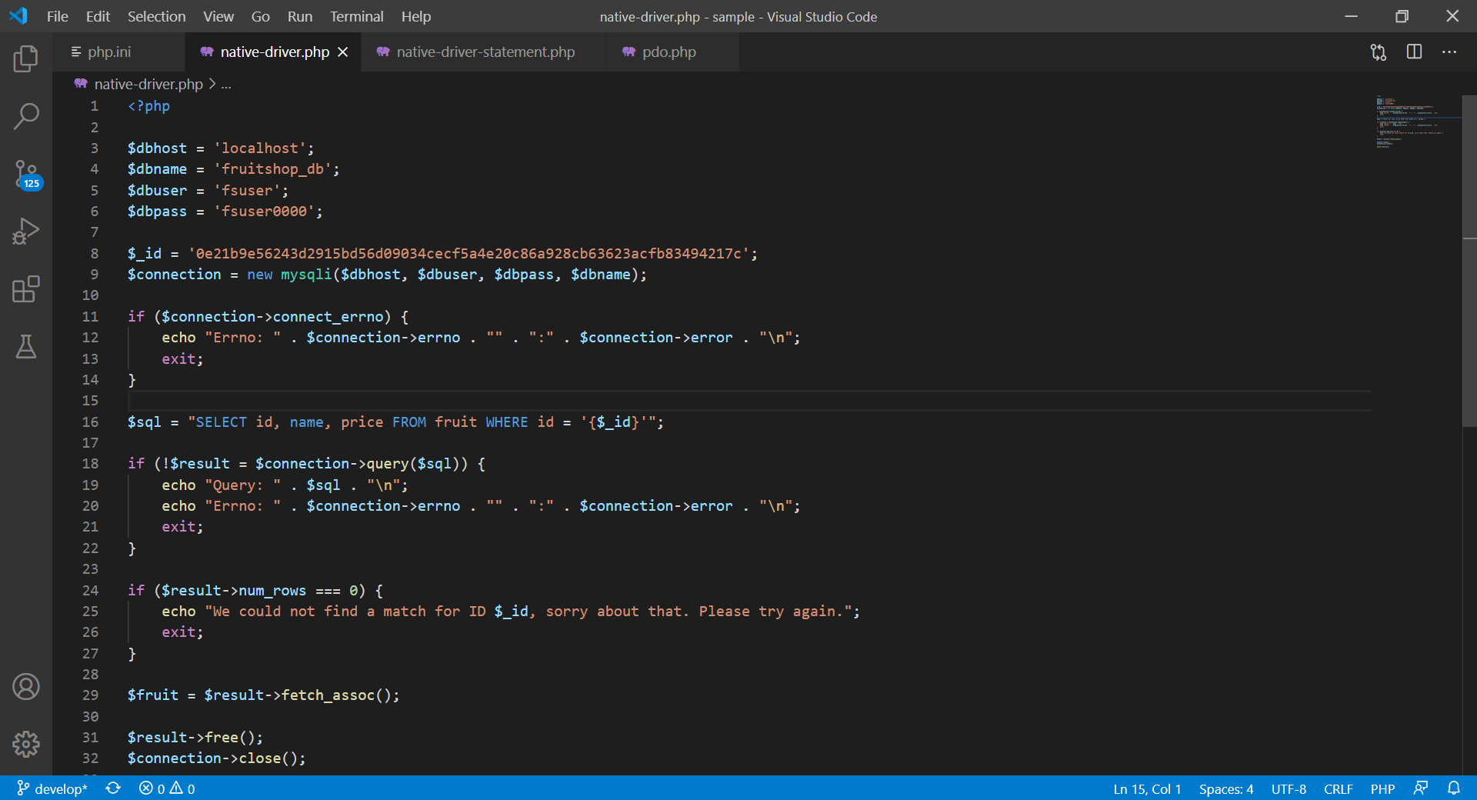

Slide 17
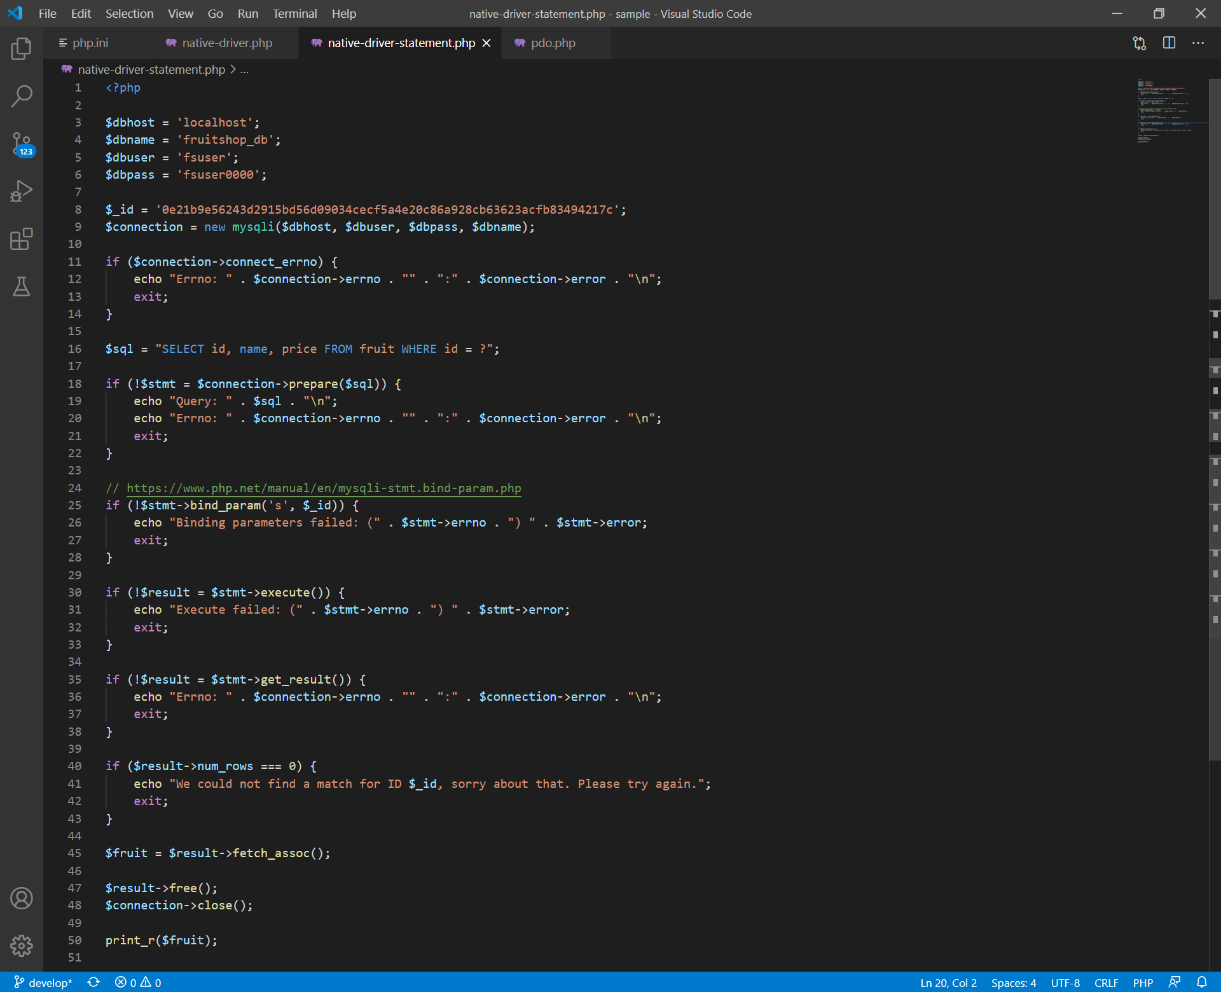

Slide 18
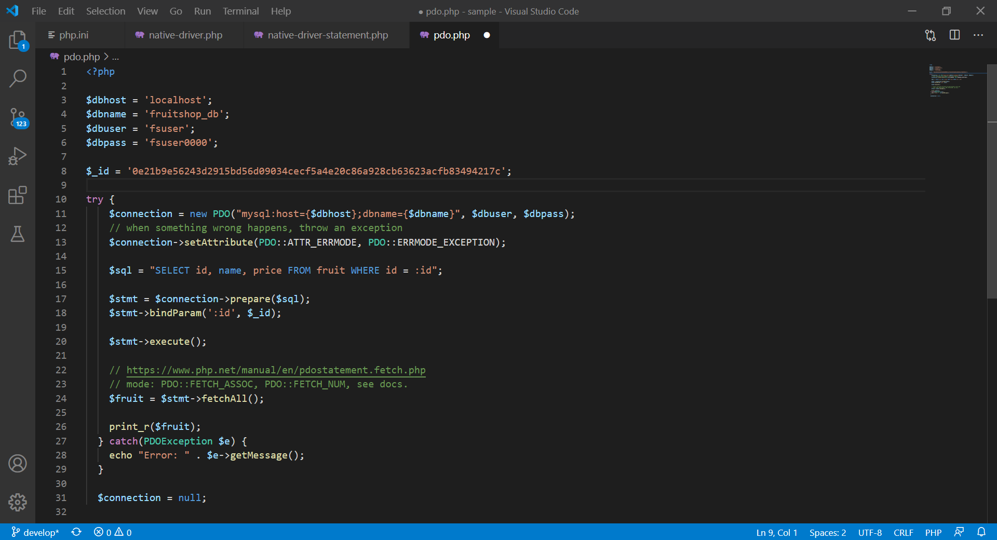

Slide 19

To-dos
Implement database connectivity into your project.
Always use PDO whenever possible.
Some questions:
Is it possible to have multiple connections to different database vendors in a single file?
And, could you read tuples from one of the two and write them to the other?
ORM will be discussed in another time.

Slide 20
References
Srinivasan, M. (2012). Web Technology: Theory and Practice. Pearson.
Tatroe, K., et. al. (2020). Programming PHP. O'Reilly.
PHP Manual https://www.php.net/manual/en/

