Slide 1
Code Modularity & External Library
Web Programming and Testing

Slide 2

Objectives
The objective of this session is the following:
The students are able to elaborate the benefit of developing solution in modular manner.
The students are able to select and use external library to speed up development.

Slide 3
Outlines
Motivation
Code modularity.
External library and code dependency.
Note: we use PHP to show examples.

Slide 4
Motivation

Slide 5

Complexity
It is very likely to have a complex solution to tackle complex problem.
Much harder to maintain (adding or modify features).
Bug-fixing could be a nightmare.
Less reusable.
Who in the world would like to continue a messed up project?

Slide 6
Modularity

Slide 7
Modularity
Modularity is a degree where codes are written into a group of independent units.
The unit can be in the form of functions, classes, modules, library, etc.
A modular system or software should be:
low in coupling or dependency between units.
high in cohesion inside the unit.

Slide 8
Modularity: Benefit
Much maintainable.
Small-scaled problem domain.
Easier for testing.
Much more reusable.
Less duplicate codes.
The module can be exported into useful library for other project development.

Slide 9

Modularity in Functions
Repeated routines should be written into functions with specific usage.
Enrich the function behaviors via parameters.
Function parameters in PHP.
Accepts ordinary data type or special type.
Like: numbering, string, object, function, etc.
Forcing strictness.
Anonymously, strictly.

Slide 10
Modularity in Classes
Furthermore, functions can be redesigned and grouped into fully-equipped classes.
All OO concepts are applicable in PHP.
With different syntax and sugar.
Later, a class can be namespaced.
Virtually, similar to package in Java with slightly different concept.

Slide 11

Importing Files
For the sake of modularity codes could be:
written into functions and classes,
stored in different files (& different directory).
To use the codes, functions and classes stored in other files, an import is required.
PHP provides two options with two variants for every option.
include() and include_once()
require() and require_one()

Slide 12
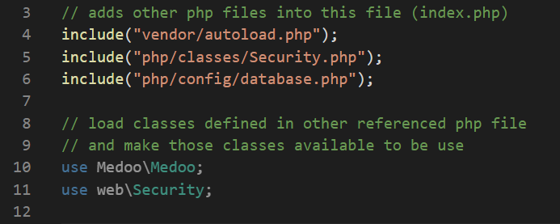
Importing Files
include

Slide 13

Namespacing
Namespacing is simply a way to group units with unique alias or name.
Multiple classes could be registered under one namespace.
Classes with the same namespace are not necessarily live in the same directory.
But encouraged to.
Classes, registered in a namespace, must be uniquely named.

Slide 14
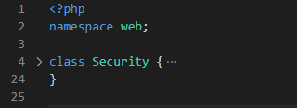
Namespacing
include

Slide 15
External Library & Code Dependency Management

Slide 16
Benefits and Drawbacks
Benefits:
Avoiding code rewriting (reuse).
Best practices done by the community.
Faster development.
Drawbacks:
Extra learning curve.
Dependency (tight-coupling).
Additional layer of processing & complexity.
No silver bullet.

Slide 17
Code Dependency Management
Goals:
Guarantee all the required libraries are available for application to live flawlessly.
Ensure that the project is always using the current version of library.
Avoid conflict between libraries.
Package manager.
e.g. NuGet, RubyGems, npm, pip, Composer.

Slide 18

Dependency manager for PHP
Existing dependency managers:
PEAR (PHP Extension and Application Repository),
PECL (PHP Extension Community Library),
Composer (the most popular at the moment).
Composer is a project-level dependency manager. Very similar to pip, npm or bundler.

Slide 19
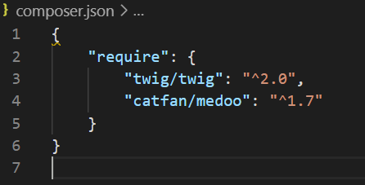
Composer
It is a package dependency manager that:
takes care the required package in a project.
ensures all required package are in place and ready to use.
is configurable through a JSON file.
composer.json
different configuration for production and development envs.

Slide 20

To-dos
Understand deeply the benefit of practicing code modularity.
Use some external library, such as:
Twig template engine.
Medoo PDO-related library
Next time, web framework.

Slide 21
References
Srinivasan, M. (2012). Web Technology: Theory and Practice. Pearson.
Tatroe, K., et. al. (2020). Programming PHP. O'Reilly.
PHP Manual https://www.php.net/manual/en/
Composer documentation. https://getcomposer.org/doc/
Twig documentation. https://twig.symfony.com/doc/2.x/
Medoo documentation. https://medoo.in/doc

