Slide 1
SOAP-Based Services
Web Programming and Testing

Slide 2

Objectives
The objective of this session is the following:
The students are able to elaborate the use of services and the motivation behind it.

Slide 3
Outlines
Flashback.
SOAP-based service.

Slide 4
Flashback

Slide 5
Service and API Contract
A service is a software program that makes its functionality available via a published API that is part of a service contract.
The API specification is defined in a contract. It contains:
How to consume the API,
The parameters specifications, and
What kind of output is expected.

Slide 6
SOAP-based Services

Slide 7

SOAP Specification
SOAP: Simple Object Access Protocol.
Services that complies to SOAP specification (guideline).
The specification is defined in W3C.
https://www.w3.org/TR/soap12/
What’s in the specs?
Basic: SOAP, WSDL, and UDDI ← our focus
Extended: WS-Security, WS-Policy, WS-I

Slide 8
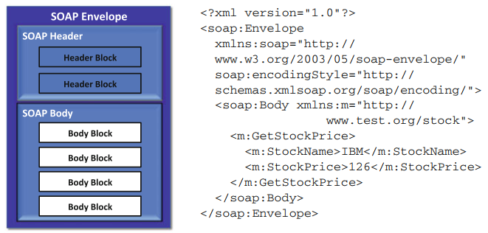
SOAP Message
SOAP Messages
Both request and response are enveloped (formatted) in a well defined XML-format.

Slide 9

WSDL
WSDL: Web service Definition Language.
Defines the end point service.
Contains the specification of the service (the contract).
The available operations, the required parameters, type of the return value, the end point address, etc.
Also XML-based.
WSDL is mandatory to develop a SOAP-WS client.
In most cases, the client’s stub is generated from the WSDL.

Slide 10
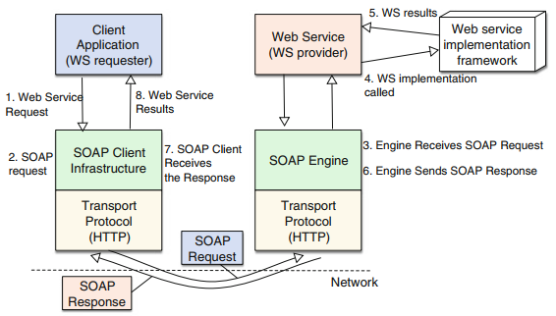
General Workflow

Slide 11

To-dos
SOAP-based services are commonly found in legacy applications and rarely in newly developed ones.
In the next meeting we would discuss about REST-based services.
Your project will go to this direction.

Slide 12
References
Srinivasan, M. (2012). Web Technology: Theory and Practice. Pearson.
Erl T. (2016). Service-Oriented Architecture: Analysis and Design for Services and Microservices. Pearson

