Slide 1
Designing REST Services
Web Programming and Testing

Slide 2

Objectives
The objective of this session is the following:
The students are able to develop REST-based services. On this session, we focus on the design phase especially the URI and resource hierarchy.

Slide 3
Outlines
Flashback.
Design phase.
URI Design:
General URI Rules.
Domain Rules.
Resource Modeling.
Query String.

Slide 4
Flashback

Slide 5
Service and API Contract
A service is a software program that makes its functionality available via a published API that is part of a service contract.
The API specification is defined in a contract. It contains:
How to consume the API,
The parameters specifications, and
What kind of output is expected.

Slide 6
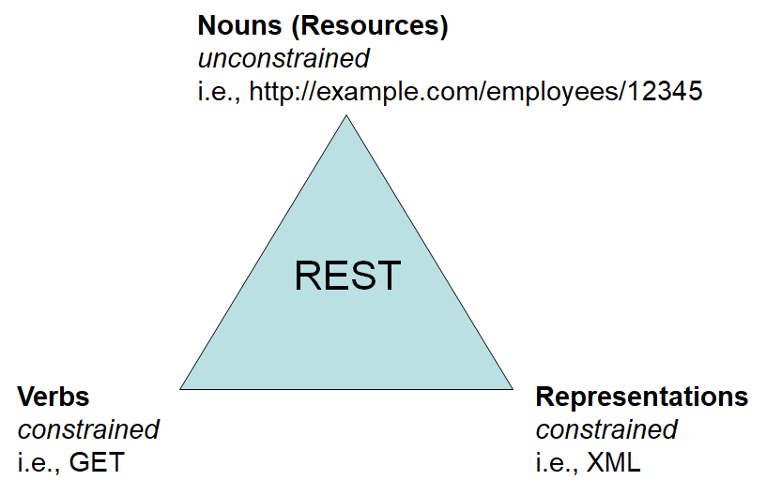
REST
REST: REpresentational State Transfer.
Is an architectural pattern.
It runs on top of the HTTP infrastructure.
To be discussed:
The resource and identifiers.
Representation: XML, JSON, etc.
Semantics: HTTP verbs (methods) and HTTP response codes.

Slide 7
The Design Phase

Slide 8
Design Phase is Important
A service is published for other parties.
In some case, the developer does not have any idea how many consumers would actually use it.
Changing a published service could be a true nightmare for the consumers sometimes.
A carefully crafted service would last.
However, a changing behavior is a normal thing.

Slide 9
Fatal Changes
transferFund(String _target, BigInteger _amount){
...
}
transferFund(BigInteger _amount, String _target){
...
}

Slide 10
URI vs. URL
Unified Resource Identifier.
Resource: any concept or interact-able object.
Resource Identifier: a unique naming given to a particular resource that make it addressable.
URI: a format to uniquely identify resources.
What is URL? How it is different to URI?
URI is about the resource naming.
URL is about how to access the resource.

Slide 11
URI Format
Services are designed for machines to use and humans to understand.
URI format:
The scheme could be HTTP/S, FTP, etc.
The query and fragment are optional.
scheme://domainname/path[?query][#fragment]

Slide 12
URI: For Machines or Humans?
Look at the following examples:
Which one of the above URIs is …
Suitable for machines?
Suitable for humans?
What about for both? Machines and humans?
api.lib.si-playground.com/books/1449310508
api.lib.si-playground.com/7e1a-43da-4925-8238-d579

Slide 13
URI Design: General URI Rules

Slide 14
General URI Rules
Rule #1: Forward slash “/” indicates resource hierarchical relationships.
Rule #2: No trailing forward slash “/”.
api.lib.si-playground.com/books/1449310508/chapters
api.github.com/repos/sigurita/hello-world/commits
api.lib.si-playground.com/books/1449310508/borrow/
api.github.com/repos/sigurita/hello-world/commits/

Slide 15

General URI Rules
Rule #3: Hyphens “-” for a better readability.
Rule #4: Underscore “_” should be avoided.
Visually, underscore is “unseen” in hyperlink output.
api.lib.si-playground.com/books?q=restful-api

Slide 16
General URI Rules
Rule #5: Use lowercase in the URI path for consistency.
#1 is fine.
#2 is identical to #1.
#3 is not identical to neither #1 nor #2.
api.lib.si-playground.com/books/1449310508
1
API.LIB.SI-PLAYGROUND.COM/books/1449310508
2
api.lib.si-playground.com/Books/1449310508
3

Slide 17
General URI Rules
Rule 6: Extension should not be included.
api.lib.si-playground.com/books/1449310508.json

Slide 18
URI Design: Domain Rules

Slide 19
Domain Rules
Rule #7: Consistent subdomain names.
Changing subdomain will surely affect the existing endpoints.
Rule #8: Consistent subdomains names for developer portal (documentations are essential in REST-based services).
api.lib.si-playground.com
docs.github.com

Slide 20
URI Design: Resource Modeling

Slide 21
Resource Hierarchy
There are four types of resource:
Document: a unique record or an instance.
Collection: a grouped of documents (like directory) managed by the service provider.
Store: similar to collection but managed by the service consumer.
Controller:

Slide 22
Resource Hierarchy: Document
A document represents a unique record or an instance.
It may contains a sub-concept or resources.
e.g. a specific book is a document, yet it has multiple chapters in it. Each chapter is a distinct sub-concept.
api.lib.si-playground.com/books/1449310508
api.lib.si-playground.com/books/1449310508/chapters/3

Slide 23
Resource Hierarchy: Collection
A collection is a resource ‘directory’ managed by the provider.
It may contains a sub-collection.
An example.
A library provides a collection of book information wrapped in the /books path.
A book author may offer his/her new book information to be stored in the collection.
Since the collection is managed by the provider, the consumer has no control over the acceptance of the offer.
api.lib.si-playground.com/books

Slide 24
Resource Hierarchy: Store
A store is a resource ‘directory’ managed by the consumer.
Similar to collection, a store may contains a sub-store.
An example.
A book author may add or remove any chapter of his/her book registered in the library.
The author has a complete control over its resource.
api.lib.si-playground.com/books/1449310508/chapters

Slide 25
Resource Hierarchy: Controller
A controller is a procedural concept or action executed on the resource-level.
It specifies what the consumer could do over the resource.
POST /books/1449310508/request
PATCH /books/1449310508/borrow
PATCH /books/1449310508/return

Slide 26
Resource Naming Rules
Rule #9: Singular noun for document.
Rule #10: Plural noun for collection.
Rule #11: Plural noun for store.
Rule #12: Verb or verb phrase for controller.
Rule #13: Identity may be used in the store.
api.lib.si-playground.com/books/{ISBN-10}/chapters

Slide 27
Resource Naming Rules
Rule #14: CRUD controller should be avoided.
This example should not be followed.
Instead, use the corresponding HTTP methods.
api.lib.si-playground.com/books/1449310508/update
PUT /books/1449310508

Slide 28
URI Design: Query String

Slide 29
Query String Rules
Query is used for specifying extra parameters while consuming a service.
It is occasionally used for document filtering.
It is located right after the path section.
Behind the controller.
Rule #15: Use the query to set the pagination, filtering criteria, or some other things.
scheme://domainname/path[?query][#fragment]
GET api.lib.si-playground.com/books?q=restful-api&page-size=10

Slide 30
To-dos
Next time we will discuss more on the semantic aspects, both the HTTP request verbs and HTTP response codes.
Afterwards, we will discuss about the representational aspect.
Explore the GitHub APIs.

Slide 31
References
Srinivasan, M. (2012). Web Technology: Theory and Practice. Pearson.
Erl T. (2016). Service-Oriented Architecture: Analysis and Design for Services and Microservices. Pearson
Massé, M. (2012). REST API Design Rulebook. O’Reilly
GitHub REST API Documentation. https://docs.github.com/

