Slide 1
Designing REST Services: HTTP Verbs
Web Programming and Testing

Slide 2

Objectives
The objective of this session is the following:
The students are able to develop REST-based services. On this session, we focus on the design phase especially the use of HTTP verbs.

Slide 3
Outlines
Semantic in REST Request-Response Interactivity.
HTTP Verb Rules.

Slide 4
Semantic in REST Request-Response Interactivity

Slide 5
Semantic?
REST APIs are meant to be easily understood and more self-explanatory.
To achieve such thing, HTTP request verbs and response codes are utilized.
Another level of semantic, hypermedia, is spared for a later discussion.

Slide 6

Request-Response Cycle
web application server
response
browser
HTTP Response
database
request
https
://
api.example.com/path?query
.
.
HTTP Request
client
server

Slide 7
HTTP verb
Path
HTTP version
Decomposing HTTP Request
> GET /users/sigurita HTTP/1.1
> Host: api.github.com
> User-Agent: curl/7.55.1
> Accept: application/vnd.github.v3+json
>
Host domain name
Additional header key
body payload is empty
The request uses GET method, meaning it will not cause state change the requested resource.
In this example, the request does not attach any data in the body payload.

Slide 8
HTTP version
HTTP status code
The data format used in the body payload
Decomposing HTTP Response
< HTTP/1.1 200 OK
< date: Thu, 19 Nov 2020 02:15:20 GMT
< content-type: application/json; charset=utf-8
< server: GitHub.com
< status: 200 OK
< Accept-Ranges: bytes
< Content-Length: 1318
<
{
"login": "sigurita",
"id": 35382893,
"node_id": "MDQ6VXNlcjM1MzgyODkz",
// omitted ...
"created_at": "2018-01-12T20:52:23Z",
"updated_at": "2020-11-12T03:47:23Z"
}
The size of the data in the body payload
The response retuns 200 status code, meaning everything goes fine (OK).
The response also bring the state of the requested resource in the form of JSON.
Data in the body payload

Slide 9
HTTP Verb Rules

Slide 10
HTTP Verb | Purpose
HEAD | Retrieve the resource state meta data
GET | Retrieve the resource state and its meta data
POST | Create a new resource in a collection
PUT | Create or modify a resource in a store
PATCH | Similar to PUT but for partial modification
DELETE | Remove a resource
OPTIONS | Retrieve the resource availability
TRACE | Sending a loopback, for debugging purposes
https://www.rfc-editor.org/rfc/rfc2616.txt

Slide 11
HTTP Verb Rules
Rule #16: GET and POST should not be used to tunnel other request methods.
e.g. Using GET request to remove a resource or POST to modify it.
Rule #17: GET method must be used to retrieve a resource’s state representation.
A GET request consists of header only without any payload (body).

Slide 12
HTTP Verb Rules
Rule #18: HEAD should only be used to retrieve a resource state meta data not the whole state.
Similar to the GET request but expecting the header section only.
Rule #19: POST must be used in the case of creating new resource in a collection.
Very likely to attach the corresponding data along with the request.
Rule #20: POST must be used to invoke a controller on a particular resource.

Slide 13
HTTP Verb Rules
Rule #21: PUT must be used to both create or modify a resource in a store.
Very likely to attach the corresponding data along with the request.
Rule #22: PATCH is an alternative to the PUT.
Used when the modification is partial.
Will cause a small traffic compared to the PUT.

Slide 14
HTTP Verb Rules
Rule #23: DELETE should be used to remove a resource or to make it unavailable.
Applicable to resource that resides in both collection or store.
Rule #24: OPTIONS request should be used to retrieve metadata that describe a resource’s available interactions.
The response may include a payload to further describe each interaction.

Slide 15
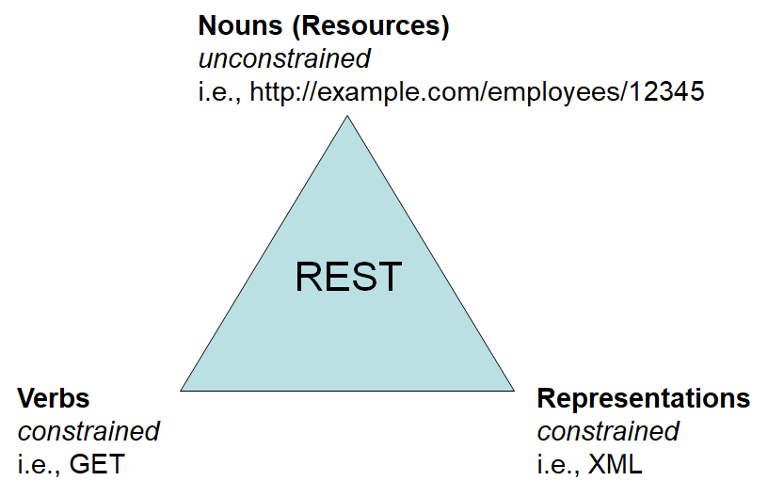
To-dos
Next time we will discuss more on the semantic aspects, both the HTTP response codes.
Afterwards, we will discuss about the representational aspect.
Explore the GitHub APIs.

Slide 16
References
Srinivasan, M. (2012). Web Technology: Theory and Practice. Pearson.
Erl T. (2016). Service-Oriented Architecture: Analysis and Design for Services and Microservices. Pearson
Massé, M. (2012). REST API Design Rulebook. O’Reilly
GitHub REST API Documentation. https://docs.github.com/

