Slide 1
Designing REST Services: HTTP Status Codes
Web Programming and Testing

Slide 2

Objectives
The objective of this session is the following:
The students are able to develop REST-based services. On this session, we focus on the design phase especially the use of HTTP status codes.

Slide 3
Outlines
Semantic in REST Request-Response Interactivity.
HTTP Status Codes.

Slide 4
Semantic in REST Request-Response Interactivity

Slide 5

Request-Response Cycle
1xx, 2xx, 3xx, 4xx, 5xx
web application server
response
browser
HTTP Response
database
request
https
://
example
.
com
/
dir
/
index
.
html
HTTP Request
client
server
HEAD, GET, POST, PUT, DELETE, …

Slide 6
HTTP verb
Path
HTTP version
Decomposing HTTP Request
> GET /users/sigurita HTTP/1.1
> Host: api.github.com
> User-Agent: curl/7.55.1
> Accept: application/vnd.github.v3+json
>
Host domain name
Additional header key
body payload is empty
The request uses GET method, meaning it will not cause state change the the requested resource.
In this example, the request does not attach any data in the body payload.

Slide 7
HTTP version
HTTP status code
The data format used in the body payload
Decomposing HTTP Response
< HTTP/1.1 200 OK
< date: Thu, 19 Nov 2020 02:15:20 GMT
< content-type: application/json; charset=utf-8
< server: GitHub.com
< status: 200 OK
< Accept-Ranges: bytes
< Content-Length: 1318
<
{
"login": "sigurita",
"id": 35382893,
"node_id": "MDQ6VXNlcjM1MzgyODkz",
// omitted ...
"created_at": "2018-01-12T20:52:23Z",
"updated_at": "2020-11-12T03:47:23Z"
}
The size of the data in the body payload
The response retuns 200 status code, meaning everything goes fine (OK).
The response also bring the state of the requested resource in the form of JSON.
Data in the body payload

Slide 8
HTTP Status Codes

Slide 9
HTTP Status Code
Every response is summarized in the form of HTTP status code.
The status code is added in the response header.
HTTP status codes:
100 family is used for informational purposes.
200 family is used when things go as expected.
300 family for redirections.
400 family is used to indicate errors caused by the client.
500 family is used to indicate errors caused by the server

Slide 10
Status Code | Meaning
1xx | Informational
2xx | Successful execution
3xx | Redirection
4xx | Unsuccessful request caused by the consumer
5xx | Unsuccessful request caused by the provider
https://www.rfc-editor.org/rfc/rfc2616.txt

Slide 11
HTTP Status Code Rules
Rule #25: 200 (OK) indicates that the request is completely executed without problems.
Response to general GET, HEAD, DELETE, and OPTIONS methods.
Rule #26: 201 (Created) indicates that a resource is successfully created.
Response to POST and PUT methods.

Slide 12
HTTP Status Code Rules
Rule #27: 202 (Accepted) indicates a successful start of an asynchronous action.
It could also mean the request has been inserted to the queue.
Used in AJAX call (discussed later).
Rule #28: 204 (No Content) should be used when the payload is intentionally left out.
The API decides to not sending any data in the payload.
Incomplete or no representational resource available.
Used when deleting or removing a resource.

Slide 13
HTTP Status Code Rules
Rule #29: 301 (Moved Permanently) indicates the targeted resource has been moved to another path (URI).
A new URI should be returned.
The next request should not use the moved URI.
Rule #30: 302 (Found) the URI is working but the requested resource is not available at the moment, it was moved for another path (URI).
The URI should work again in the future.
It is a general option of 303 or 307.

Slide 14
HTTP Status Code Rules
Rule #31: 303 (See Other) indicates the URI is working as intended with a URI as the response resource.
The consumer may create a new request to the response URI.
e.g. when a payment is done then a URI to the receipt resource is returned to the consumer.

Slide 15
HTTP Status Code Rules
Rule #32: 304 (Not Modified) indicates that the consumer already has the latest version of the resource state.
Rule #33: 307 (Temporary Redirect) the given URI is not available at the moment as a temporary replacement, another URI is given to the consumer.

Slide 16
HTTP Status Code Rules
Rule #34: 400 (Bad Request) indicates a general failure that is caused by the consumer.
e.g. incomplete or incorrect data fails the validation process.
Rule #35: 401 (Unauthorized) indicates that the consumer has no rights to access the resource due its wrong credential.
Invalid credential.
Expired access token.

Slide 17
HTTP Status Code Rules
Rule #36: 403 (Forbidden) indicates that the consumer has no rights to access the resource due its permission.
Incompatible role, permission, and resource.
Rule #37: 404 (Not Found) indicates that the URI is not valid or simply does not exist.

Slide 18
HTTP Status Code Rules
Rule #38: 405 (Method Not Allowed) indicates that the request method is not available for the URI.
e.g. invoking a controller URI with GET method.
Rule #39: 406 (Not Acceptable) indicates that the requested media type is not available.
e.g. the consumer asks for a representational of a resource in XML, but the provider cannot produce such format.

Slide 19
HTTP Status Code Rules
Rule #40: 415 (Unsupported Media Type) indicates that the payload attach on the request is not supported.
e.g. the consumer sends an XML formatted payload, but the provider only accept JSON.
Some more 4xx status codes.
409 (Conflict).
412 (Precondition Failed).
etc.

Slide 20
HTTP Status Code Rules
Rule #41: 500 (Internal Server Error) indicates that the API fails due to problems on the provider side.

Slide 21
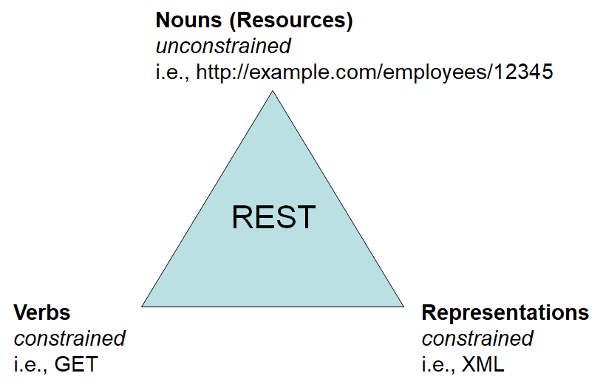
To-dos
Next time we will discuss the representational aspect.
Explore the GitHub APIs.

Slide 22
References
Srinivasan, M. (2012). Web Technology: Theory and Practice. Pearson.
Erl T. (2016). Service-Oriented Architecture: Analysis and Design for Services and Microservices. Pearson
Massé, M. (2012). REST API Design Rulebook. O’Reilly
GitHub REST API Documentation. https://docs.github.com/

