Slide 1
Testing: An Introduction
Web Programming and Testing

Slide 2
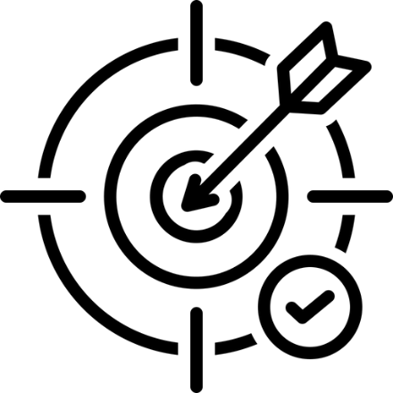
Objectives
The objective of this session is the following:
The students are able to reason the importance of testing.

Slide 3
Outlines
When Things Went Wrong.
Testing.

Slide 4
When Things Went Wrong

Slide 5
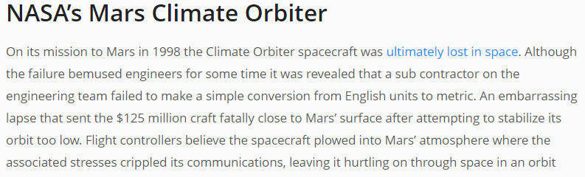
When Things Went Wrong

Slide 6
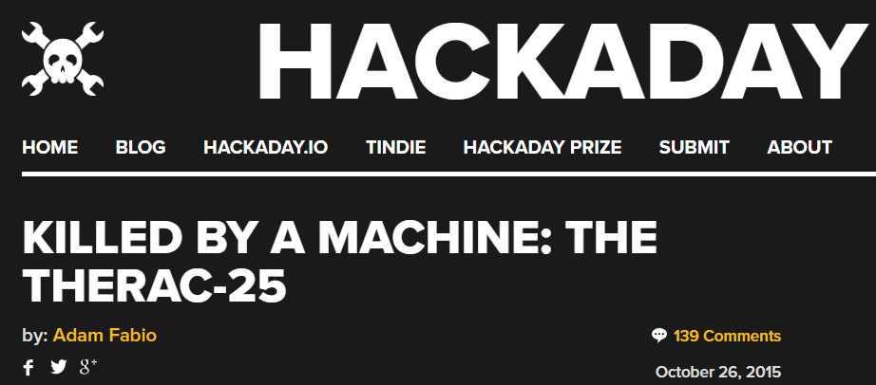
When Things Went Wrong

Slide 7
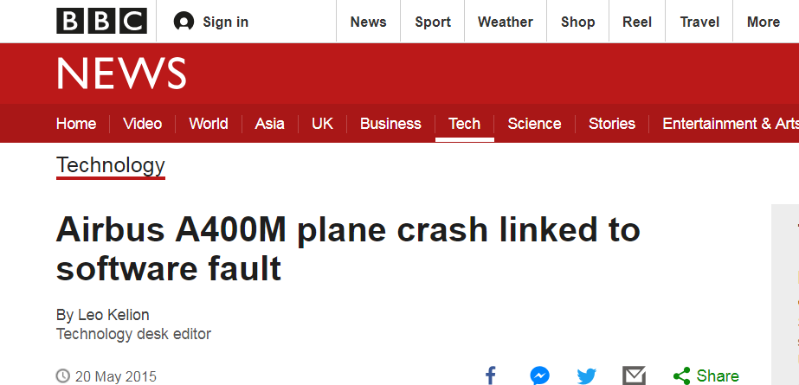
When Things Went Wrong

Slide 8
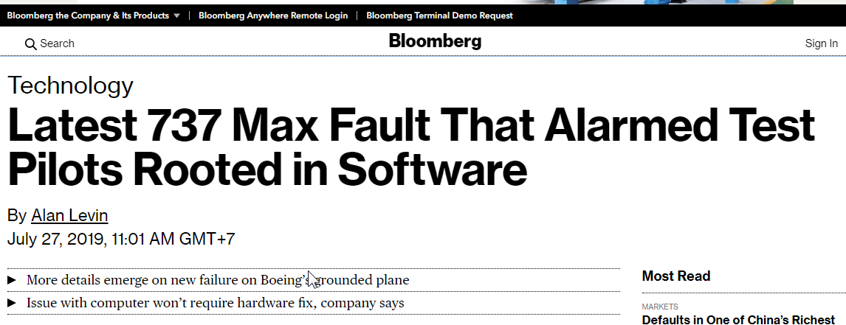
When Things Went Wrong

Slide 9
Will You …
ride an untested autonomous vehicle?
sit on an untested auto-piloted plane?
use an untested ATM machine?
be okay to be injected an untested vaccine?
If I know, I won’t.
Why?
I am not sure it might not work as expected.

Slide 10
What is the reason to conduct testing?
A fault brings consequences, sometimes they are life threatening.

Slide 11
Some Terminologies
Error: something that occurs unintendedly and leads to one or more faulty or defective spots (incorrect codes).
Fault: a static defect in the software (also known as bug).
Failure: an external incorrect behavior with respect to the requirements or another description of the expected behavior. A failure is raised when a faulty spot is executed.
Latent fault: a fault that hasn’t produced a failure yet.

Slide 12
An Illustration
A programmer writes a program. An error occurs in the process of writing a program. A fault is the manifestation of one or more errors. A failure occurs when a faulty piece of code is executed leading to an incorrect state that propagates to the program’s output.
The programmer might misinterpret the requirements and consequently write incorrect code. Upon execution, the program might display behavior that does not match with the expected behavior implying thereby that a failure has occurred.

Slide 13
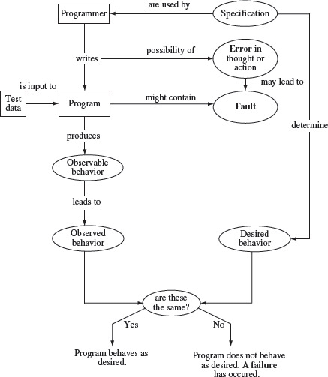
Errors, Faults, and Failures in the process of programming and testing

Slide 14
Testing

Slide 15
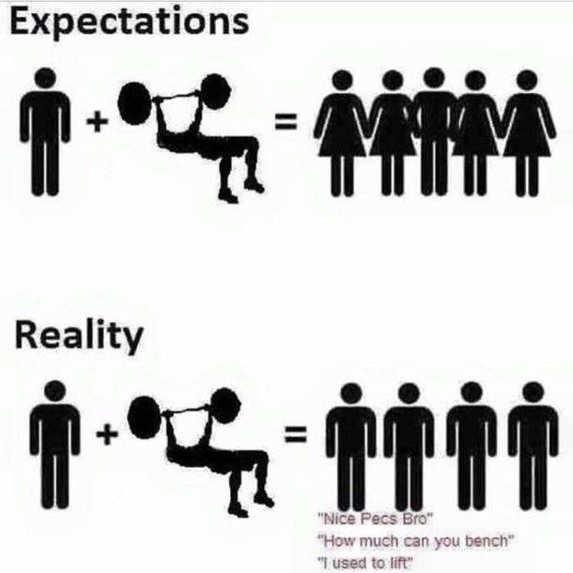
What Is Testing, Really?
Testing is the process of comparing what it is with what it ought to be.
Testing can show only the presence of failures, not their absence.
System under test (SUT).

Slide 16
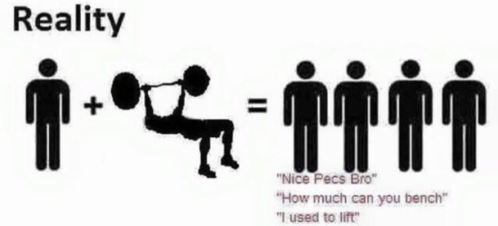
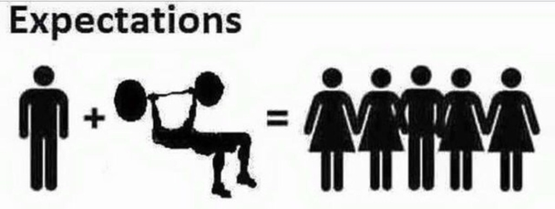
Basic Testing Process
Compare
Equal?
As expected
Not as expected.
A failure has occurred

Slide 17


Testing
To find bugs (fault) by checking its behavior.
Can be done without design knowledge.
Can be automated.
Debugging
To fix (remove) bugs.
Can’t be done without design knowledge.
Automation is not possible.

Slide 18
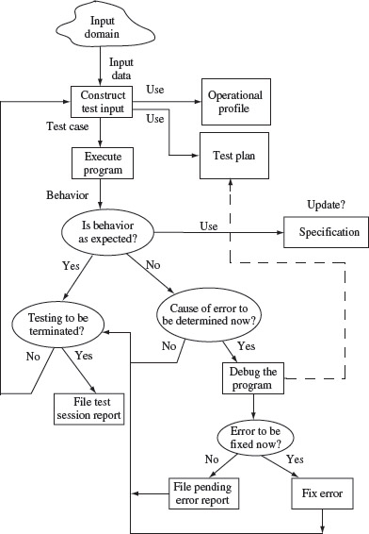
Testing and Debugging Cycle

Slide 19

Software Correctness
A software is tagged with correct when it is consistent to the specification.
Correctness can be verified by testing all the possible input configurations for all possible conditions.
Unfortunately this is not always practical.
Testing increase the confidence in the software’s correctness.

Slide 20
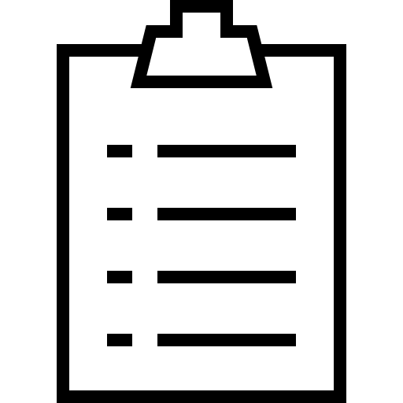
To-dos
Next time we will discuss about testing methods, test generation approaches, and API testing.
Find some possible impacts when your APIs are left untested.

Slide 21
References
Srinivasan, M. (2012). Web Technology: Theory and Practice. Pearson.
Mathur, A. P. (2013). Foundations of Software Testing. Pearson

