Slide 1
Test Generation
Web Programming and Testing

Slide 2

Objectives
The objective of this session is the following:
The students are able to generate test cases based on the requirements.

Slide 3
Outlines
Types of testing.
Test Generation.
Test Generation: Approach.
Get our hands dirty.

Slide 4
Types of testing

Slide 5
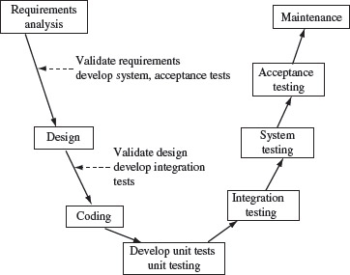
Testing in SDLC: V-Model
Each step has its own testing.
Formal & rigorous.
High quality solutions.
There are others:
Waterfall, spiral, agile.

Slide 6
Static vs. Dynamic Testing
Static Testing
Does not require code execution.
High labor (expensive).
Might reveal inefficient routines.
Ends in a high quality codes.
Techniques: Peer review, code complexity measurement, etc.
Dynamic Testing
Requires code executions.
Cheaper, since it can be designed to be automated, randomized, …
Checks the effectiveness of the solution being tested.
Techniques: Black-box and white-box testing, model-based specification, etc.

Slide 7
Our Focus
In this course, we put our focus on:
Achieving a correct solution (effectiveness).
Dynamic testing → Black-box testing.
Source of test generation: requirements.
Black-box testing is an objective-based testing.
What this “thing” should do? Let’s test it.
Input-output configurations are based on the requirements.
Detailed, clear, and unambiguous requirements are extremely helpful.

Slide 8
Test Generation

Slide 9
Some Terminologies
Test case (TC): is a set of input and output.
A testing is labelled as passed when the actual execution with the given input configuration produces output that matches the expected output. Otherwise, it’s labelled as failed.
No false positive or false negative result.
Test suite (TS): is a set of TCs.
The TCs inside a TS are related one to the another.
Test plan: describe the goal, the object, the procedures, the TCs, of a testing.

Slide 10
Test Generation
Very important!
Enough TCs increase our confidence.
When is enough?
How to generate the required TCs?
Key success factor: requirements.

Slide 11
Test Generation
Correct software → when it does exactly what it is expected to do without any failure. Perfecto!
How many TCs are required?
Depends on the requirment’s complexity.
When every possible input-output configurations are tested flawlessly.
Sometimes it is possible, sometimes it is not.
When it is not possible:
Could the testers find some configurations that represent the while possibility? Yes.

Slide 12
Test Generation: Approach

Slide 13
Test Generation Approach
Randomly generated (Random Testing).
The inputs are generated randomly (naïve approach).
Boundary value analysis → our focus.
Testing stuffs around the boundaries.
Equivalence partitioning.
When there is a set of classification, or category or partition dividing the input domain.
E.g. kids, teenager, adult, etc.
… and many more.

Slide 14
Boundary Value Analysis
"Bugs lurk in corners and congregate at boundaries“– Boris Beizer
The fact is most bugs were simply faulty boundary values.
Rules:
Say there is an input variable, x.
The domain value is {x_{min}, …, x_{max}}
x_{min} – 1, x_{min}, x_{min} + 1
x_{max} – 1, x_{max}, x_{max} + 1
(x_{min} + x_{max})/2

Slide 15
Boundary Value Analysis
Example, say a variable hh is aimed to represent a 24-hour.
hh_{min} = 0
hh_{max} = 23
Our test data would be:
hh_{min} – 1, hh_{min}, hh_{min} + 1
hh_{max} – 1, hh_{max}, hh_{max} + 1
(hh_{min} + hh_{max})/2
-1, 0, 1
22, 23, 24
12

Slide 16
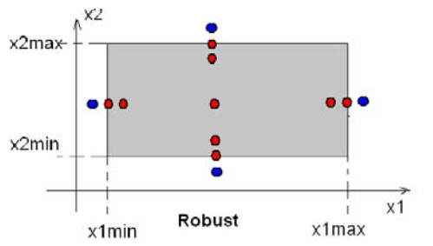
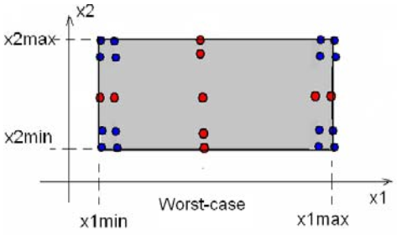
Boundary Value Analysis
Rules for multiple variables.
Say there are input variables, x1 and x2.
The domain values are {x1_{min}, …, x1_{max}} and {x2_{min}, …, x2_{max}}.

Slide 17
Boundary Value Analysis
Challenge:
There are three variables, hh, mm, ss.
hh represents a 24-hours;
mm represents a 60-minutes; and
ss represents a 60-seconds.
What is the input combinations?

Slide 18
Get our hands dirty

Slide 19
Test Cases
Your test case should mention:
The test case identifier.
The input configuration and the expected output.
The step-by-step procedures.
Some description about the test.
Also, if there is a assumption, say it.
During the test, note:
The actual output and the verdict (passed or failed).
Also, mention who did the test, and when he/she did it.

Slide 20
Test Cases
Say we have a requirement:
The customer should be able to login with their credentials (combination of email and password).
Only customers who have confirmed their emails are allowed to login.
Based on the requirement, how should your test cases look like?
Or what should be tested, where to start?

Slide 21
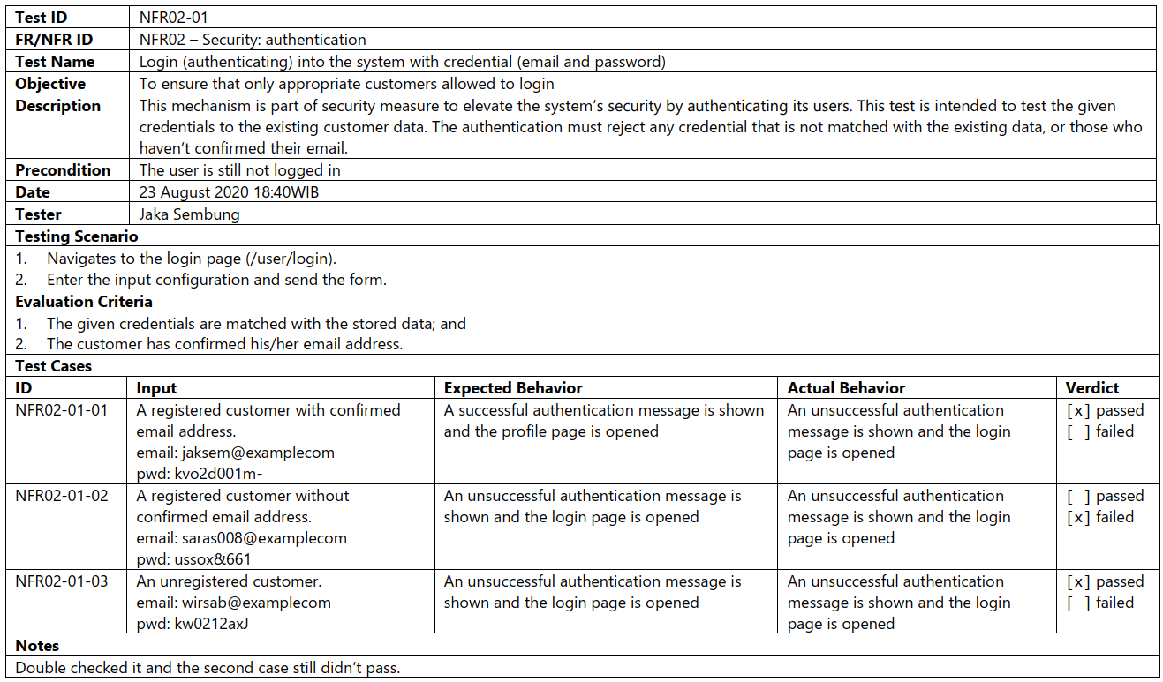

Slide 22
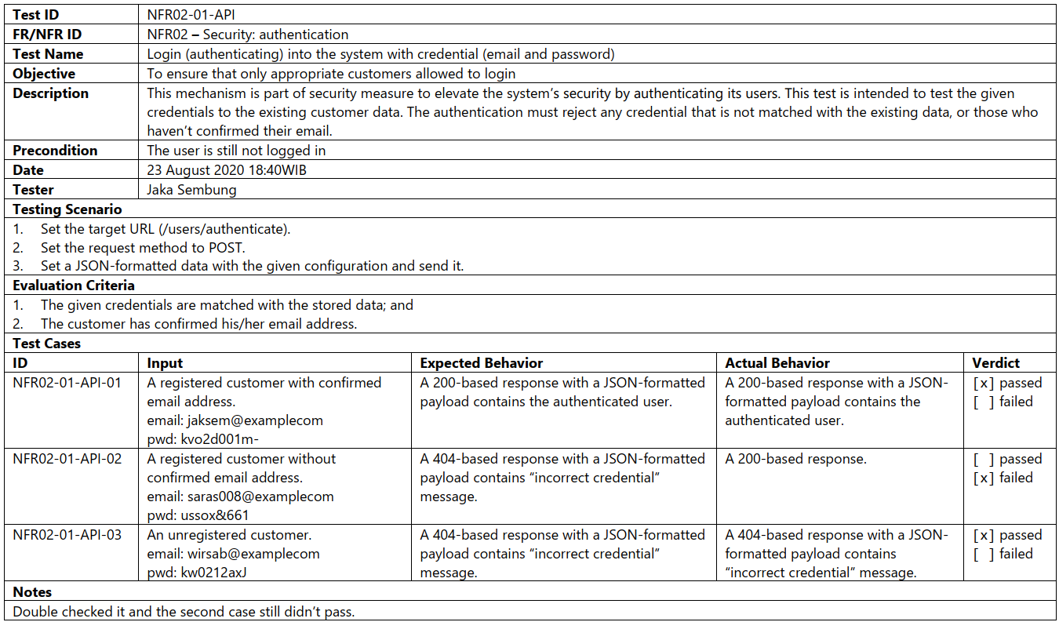

Slide 23

To-dos
Design some test cases for your APIs.
Conduct the testing.

Slide 24
References
Srinivasan, M. (2012). Web Technology: Theory and Practice. Pearson.
Mathur, A. P. (2013). Foundations of Software Testing. Pearson

