Slide 1
Cloud- Based IoT Health Monitoring System
REVIEW-2: SYSTEM DESIGN & PARTIAL IMPLEMENTATION
A Secure, Offline-Resilient, Noise-Aware and Explainable Edge–Cloud Anomaly Detection
Framework
Palanati Kushal
2300031426
D. Varun
2300030156
Y. Kishan
2300030979
Dirishala Gopi Krishna
2300030916
PRO J ECT G UI DE
Vijay Raja, Assistant Professor (EmpID: 9523)
23IE4053A | Capstone Project 4
22–24 September 2026

Slide 2
From Dashboard Concept to Trustworthy Monitoring
REVIEW-1 IMPROVEMENTS
ORIGINAL DIRECTION (PROPOSAL)
Generic Cloud-Based IoT Health Monitoring
Focus on sensor acquisition, cloud upload, and dashboard visualization. Assumed continuous connectivity and reliable sensor data.
Primary goal was a functional data pipeline from Raspberry Pi to AWS/Azure.
▼
REFINED DIRECTION (REVIEW-2)
Secure, Offline-Resilient, Noise-Aware Framework
Shift to a local-irst architecture. The edge node (Raspberry Pi) is now responsible for evidence preservation and first-level
interpretation. The system is designed to handle real-world constraints: noisy sensors and intermittent networks.
NOISE AWARENESS
OFFLINE RESILIENCE
EXPLAINABLE ML
SECURITY BY DESIGN
github.com/krtaylor/IoT-Health-Monitor (Ref)

Slide 3
System Requirements and Hardware Boundary
1 . SYSTEM REQUIREMENTS & HARDWARE
FUNCTI ONAL REQUI REMENTS
Scope Boundary
FR-01
Acquire time-stamped physiological and environmental measurements.
The prototype is a monitoring and decision-support tool.
It is not a cl inical diagnostic device. Threshol ds are
engineering parameters, not medical diagnoses.
FR-03
Detect and mark missing, implausible, or noisy sensor values.
FR-08
Generate explainable alerts with reason codes and severity.
HARDWARE STACK
FR-09
Commit observations locally before attempting cloud synchronization.
Component | Purpose
Raspberry Pi 4 | Edge Node / Gateway
MAX301 02 | Heart-Rate & SpO2
DHT1 1 /MQ-Series | Environment
MicroSD 64GB | Local SQLite Store
FR-1 2
Ensure idempotent cloud ingestion using unique event identifiers.
SRS Sections 3–7

Slide 4
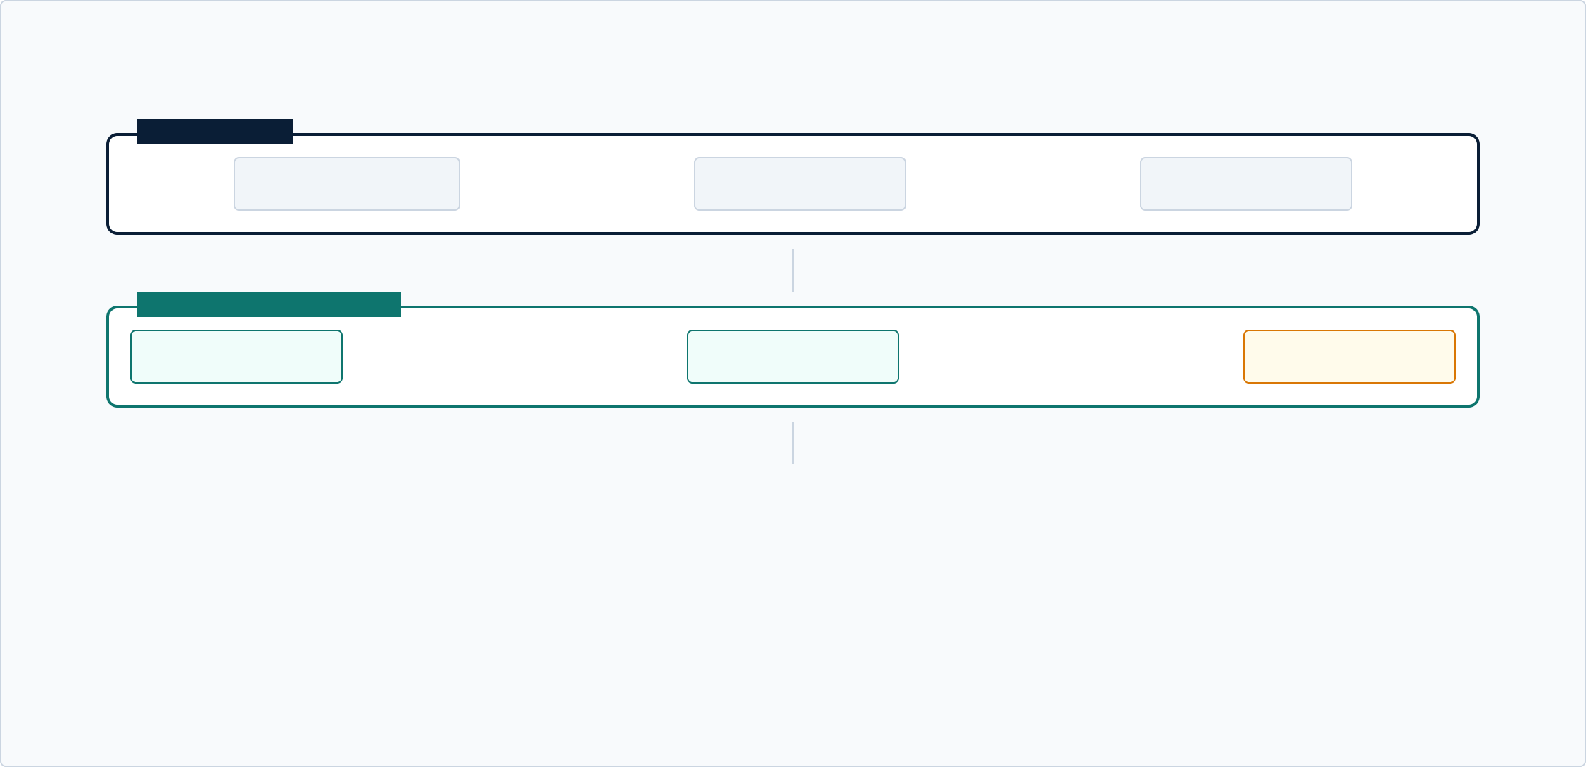
Five- Plane Edge–Cloud Architecture
2. SYSTEM DESIGN & ARCHITECTURE
SENSI NG PLANE
MAX301 02 (Vitals)
DHT1 1 (Env)
MQ-Series (Gas)
EDGE PLANE (RASPBERRY PI )
Collector & Filter
▶
Decision Engine
▶
SQLite Queue
CLOUD PLANE
I ngestion API
Cloud DB
Caregiver Dashboard
Security Plane: Device Identity
TLS Encryption • Authenticated API • Audit Logging
SRS Section 4 | architecture.mmd
Slide 4

Slide 5


Noise-Aware and Explainable Decision Path
3. ALGORITHM & MODEL IMPLEMENTATION
1
Quality Gate
# Explainable Decision Record
{
"quality_status": "ACCEPTABLE", "processed_value": 98.2,
"baseline": 97.0,
"deviation": 1.2, "severity": "NORMAL", "reason_codes": [],
"explanation": "Within baseline."
}
# Anomaly Case
{
"severity": "REVIEW",
"reason_codes": ["deviation_from_baseline"],
"explanation": "Decision based on: deviation_from_baseline."
}
Checks missingness, physical pl ausibil ity, and short-window stabil ity.
Marks sampl es as INVALID, LOW, or ACCEPTABLE.
2
Robust Filtering
Appl ies a median fil ter over a short window to reduce isol ated spikes
whil e preserving raw data for audit.
3
Hybrid Decision
Combines transparent basel ine rul es with optional Isol ation Forest
scores. Generates reason codes and severity.
Thesystemprioritizestransparency:caregiversseeexactlywhyanalertwasraised.
SRS Section 11 | edge_monitor.py
Slide 5

Slide 6
Offline Resilience and Synchronization
4. HARDWARE INTERFACING & PROTOTYPE
System Operating States
Write-Before-Send Ordering
Observations are committed to the l ocal SQLite queue before any network
request. This ensures that a network fail ure cannot erase the event.
NORMAL
*
DEGRADED (Oline)
Idempotent Synchronization
Every record has a unique event_id. The cl oud API honors this ID,
preventing dupl icate records during retries after reconnection.
*
RECOVERING
*
Graceful Degradation
SAFE-STOP
Loss of connectivity reduces remote visibil ity but does not stop l ocal
monitoring or erase evidence.
SRS Section 10 | data_lifecycle.mmd
Slide 6

Slide 7
Partial Implementation Evidence
4. PARTIAL PROTOTYPE
Edge Core Module
VERIFIED
Implementation Boundary
class LocalStore:
def add(self, event_id, sample, decision): self.db.execute("INSERT OR IGNORE...")
The current Review-2 artifact demonstrates the hardware-agnostic edge core. This
verifies the data model, local persistence, and decision logic.
class HybridDetector:
def evaluate(self, sample): status = self._quality(sample) processed = median(history)
Not yet demonstrated:
Physical sensor integration (MAX301 02)
Live cloud ingestion API
Caregiver dashboard UI
I solation Forest model training
$ python3 edge_monitor.py
[
{
"sensor": "spo2", "quality_status": "ACCEPTABLE", "sync_status": "PENDING"
}
] PY_COMPILE=PASS
edge_monitor.py | edge_smoke_output.txt
Slide 7

Slide 8
Team Roles and Review–1 Improvements
5. MODERN TOOLS & TEAMWORK
Member | Role | Review-2 Module
Palanati Kushal (2300031 426) | HARDWARE INTEGRATION | Raspberry Pi & Sensor Interfacing
Y. Kishan (2300030979) | EDGE SOFTWARE | Local Persistence & Decision Engine
D. Varun (23000301 56) | CLOUD PLATFORM | Ingestion API & Sync Logic
Dirishala Gopi Krishna (230003091 6) | SYSTEM INTEGRATION | Architecture & Traceabil ity
Key Improvements since Review–1
Refined generic "cloud dashboard" into a failure-aware framework.
Added explicit noise-awareness and quality-gating logic.
Formalized o2ine resilience through write-before-send SQLite queue.
I mplemented explainable alerts with reason codes and severity.
Team Roles | Sprint 1–2 Backlog

Slide 9
Review–2 Test Matrix
INDIVIDUAL TEST RESULTS
ID | Scenario | Expected Result | Status
T-02 | Event I D creation | Unique I D assigned before sync attempt | PASS
T-03 | SQLite insertion | Observation is locally durable | PASS
T-04 | I nvalid sample | I NVALI D status; no high-confidence alert | PASS
T-06 | Baseline deviation | Deviation and rule reason recorded | PASS
T-09 | Write-before-send | Local record exists on network timeout | PASS
T-01 | Sensor acquisition | Normalized sample from physical sensor | PENDING
T-1 0 | Network outage | State becomes DEGRADED; queue grows | PENDING
T-1 2 | Duplicate retry | Already-present event not duplicated | PENDING
Next Sprint: Physical sensor integration, Cloud API deployment, and Dashboard UI development.
SRS Section 15 | Test Register

Slide 10
Review–2 Ask: Demonstrate the Core, Defend the Boundary
REVIEW-2 CONCLUSION
Key Takeaways for the Panel
✔ We have refined the project into a failure-aware edge–cloud framework.
✔ The edge-core module is verified for quality-gating and local persistence.
✔ The system boundary is strictly non-diagnostic and engineering-led.
✔ We are ready to proceed with physical integration and cloud deployment.
Reference Repository: github.com/krtaylor/IoT-Health-Monitor
23IE4053A | Capstone Project 4

