Slide 1
Lending Club Case Study
By
Arghajit Das &
Vaibhav Gupta

Slide 2
Project Description
The project tasks us with using analytics to examine bank loan data. We will perform Exploratory Data Analysis (EDA) to understand how consumer attributes influence default tendencies.
EDA helps identify patterns and strong indicators of loan defaults. Our responsibilities include managing missing data, spotting outliers, and addressing any data imbalances.
We are required to explain results from univariate, segmented univariate, and bivariate analyses, gaining insights into variable relationships and their impact on defaults.
The final objective is determining the factors that banks should consider before issuing new loans

Slide 3
Univariate Analysis

Slide 4
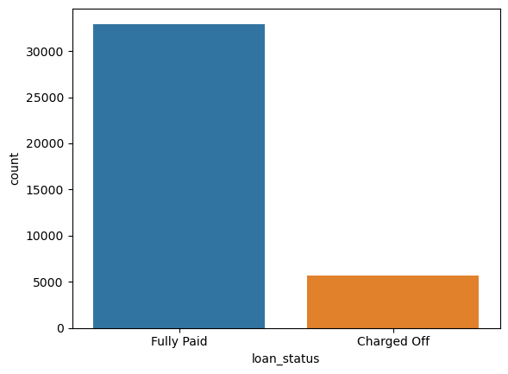
Fully Paid Vs Charged Off Loans
Observation: About 15% on total loans have defaulted
Recommendation: Loans should be granted only after careful consideration of factros given in later in this presentation

Slide 5
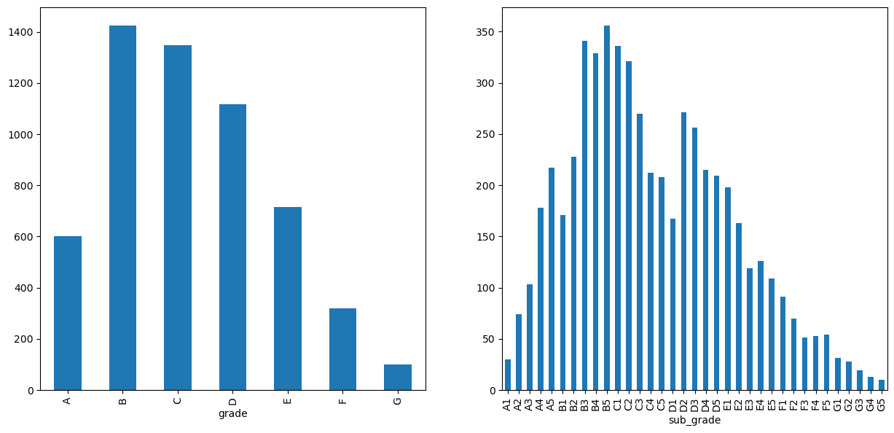
Loan Grade & Sub-grade
Observation: Maximum loan charge-offs are from loans with Grade as B and Sub-Grade as B5
Recommendation: Loans of Grade B and Sub-grade B5 should be issue less to minimize the number of loan defaults

Slide 6
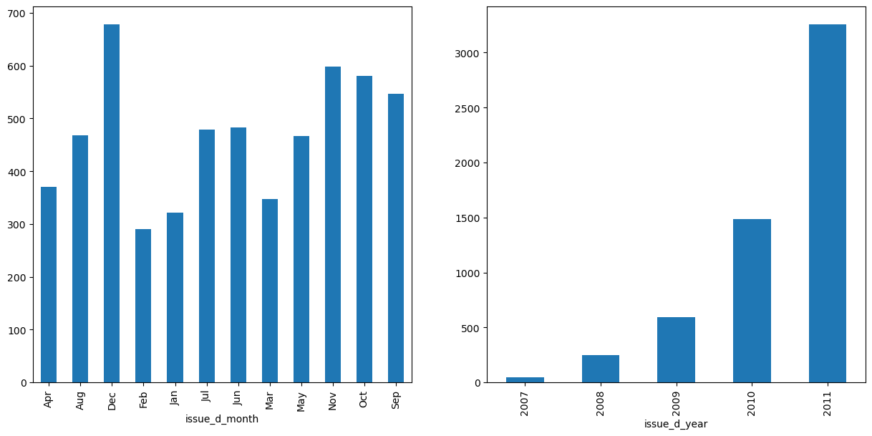
Loan Issue Month
Observation: Loans sanctioned/issued in Dec & year 2011 had maximum possibility of getting charged-off.
Recommendation: Loans should be carefully issued during the end of year.

Slide 7
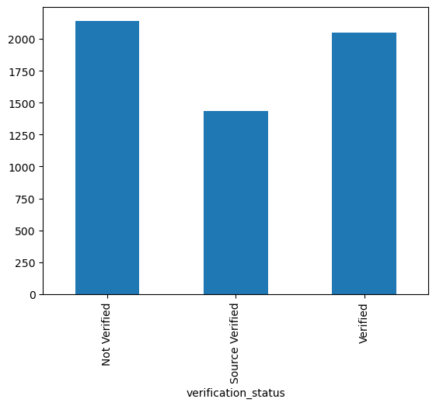
Loan Verification Status
Observation: Not Verified loans are more likely to be charged off
Recommendation: Loans should be issued only after proper verification of the application is done

Slide 8
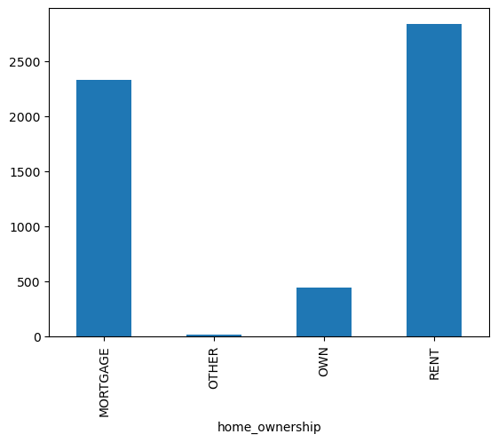
Home Ownership
Observation: Most of the Loan applicants who defaulted lived in a Rented accommodation
Recommendation: Implement a more rigorous risk assessment process for loan applicants residing in rented accommodations.
Consider additional factors or criteria specific to renters to better evaluate their creditworthiness.

Slide 9
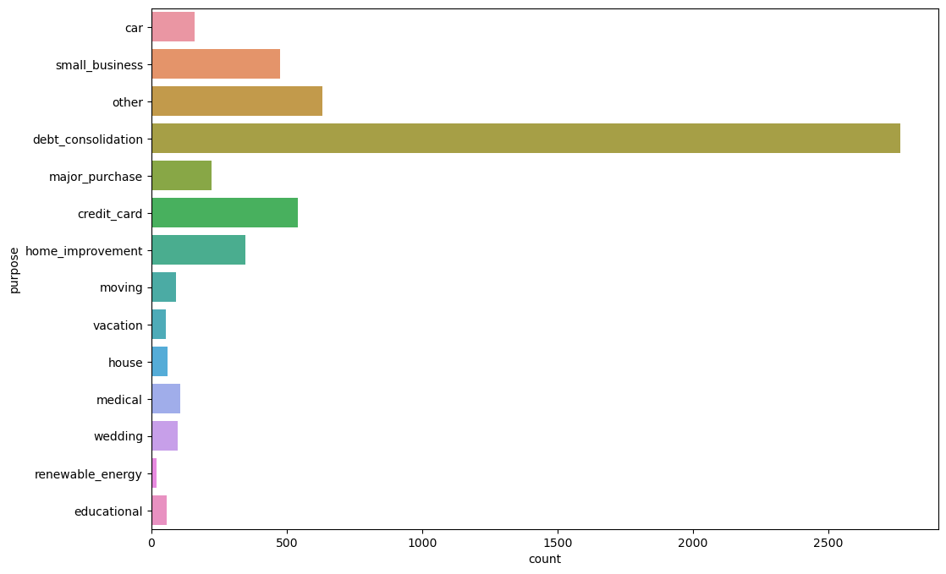
Purpose of Loan
Observation: Most of the Loan applicants who defaulted we taking loan for debt consolidation
Recommendation: Consider implementing more thorough financial counselling and screening for loan applicants seeking
funds for debt consolidation to better assess their ability to manage and repay loans effectively.

Slide 10
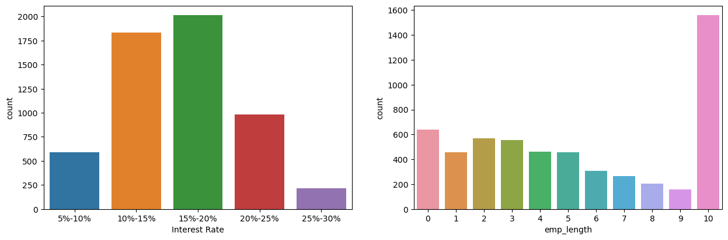
Interest Rate and Work Experience
Observation: Most loan charged-off was when interest rate between 15-20% and when Emp experience was 10 years.
Recommendation: To mitigate charge-offs, evaluate the feasibility of implementing risk-adjusted interest rates and
additional scrutiny for applicants with 10 years of employment experience, particularly when interest rates fall
within the 15-20% range.

Slide 11
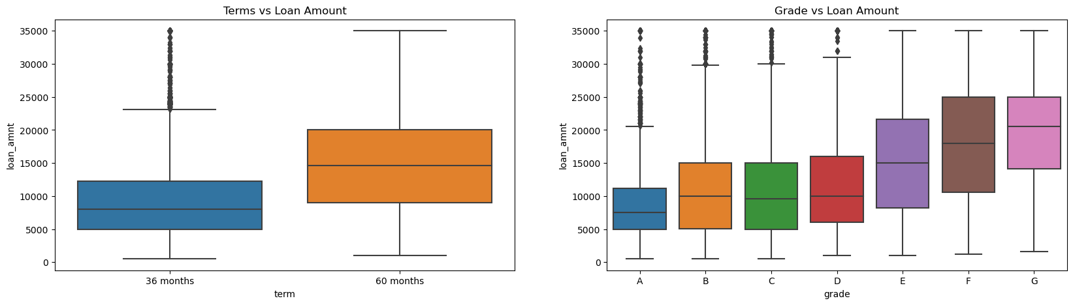
Grade and Loan Amount
Observation: Higher amount loans have high tenure i.e, 60 months. Grade 'F' and 'G' have taken max loan amount.
As Grades are decreasing the loan amount is increasing.
Recommendation: Address the elevated risk associated with higher loan amounts by implementing risk-based loan
limits and considering more conservative tenure options, particularly for applicants with Grade 'F' and 'G’,
where maximum loan amounts are observed, signaling potential financial strain and increased default risk.

Slide 12
Bivariate Analysis

Slide 13
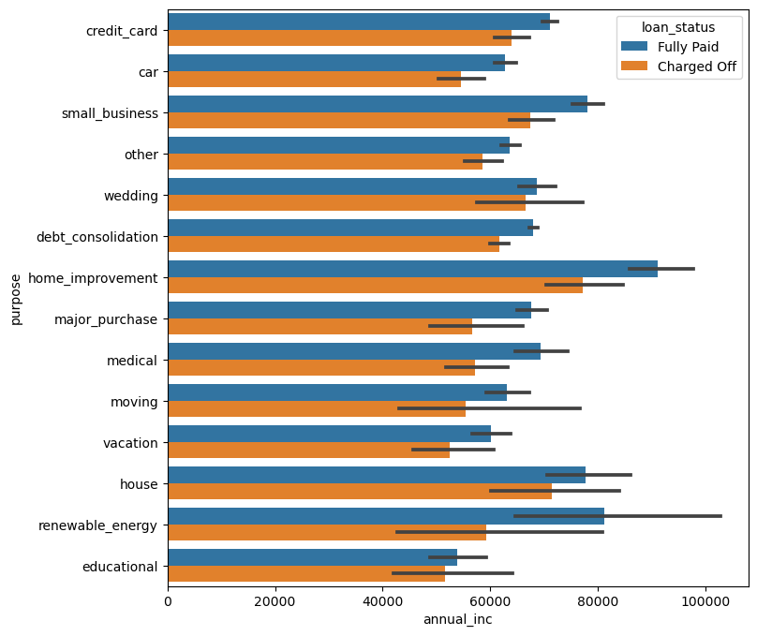
Annual Income Vs Purpose
Observation: Most Charged off loans were the once where income was betwen 50k and 80K and loan purpose
was home_improvement.
Recommendation: To minimize charge-offs, tailor risk assessment criteria for loan applicants with incomes ranging
from 50k to 80k seeking funds for home improvement, potentially implementing more thorough financial evaluations
and targeted counseling to enhance their ability to meet repayment obligations.

Slide 14
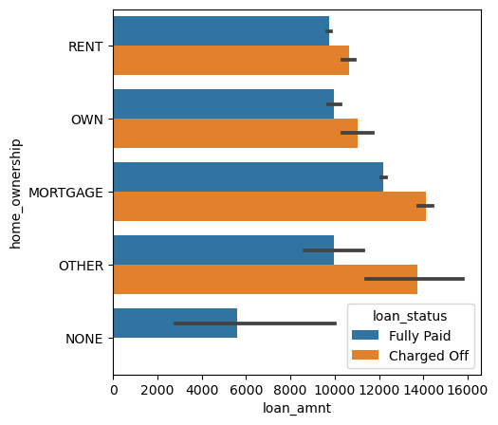
Loan Amount and Home ownership
Observation: Most Charged off loans were the once where loan amount was between 10k & 15k and ownership was Mortgage.
Recommendation: To mitigate charge-offs, consider implementing stricter approval criteria for mortgage-owned loans
falling within the 10k to 15k range, potentially reassessing the risk associated with this specific loan amount and
ownership combination.

Slide 15
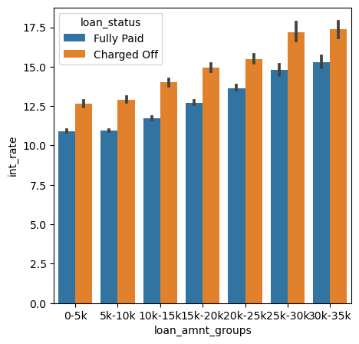
Loan Amount and Interest Rate
Observation: Loans with higher interest rate tend have more charge off specially when loan amount is between 25k to 35K
Recommendation: To remediate the higher charge-off risk associated with loans with elevated interest rates,
consider implementing risk-adjusted interest rate structures.

Slide 16
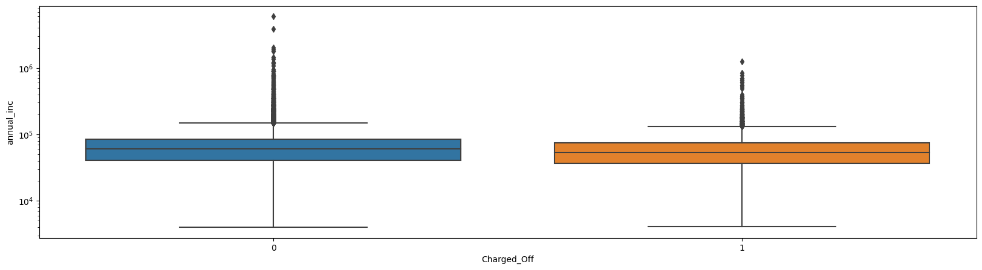
Lower Annual Income
Observation: People with lower annual income are more prone to be charged off .
Recommendation: Set realistic credit score thresholds that consider various aspects of an individual's financial profile,
enabling a more accurate assessment of credit risk.

Slide 17
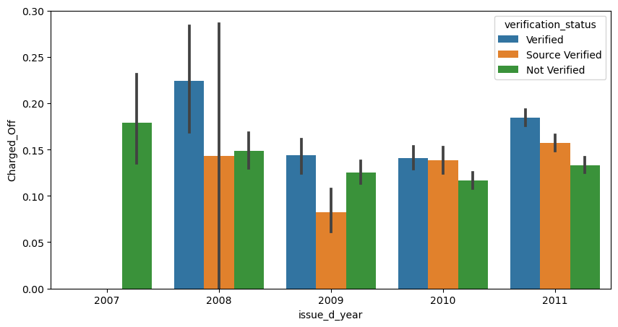
Loan Issue year and Charge off
Observation: Loans that underwent verification processes exhibit a higher rate of charge-offs.
Recommendation: Regularly analyze data on verified loans to identify patterns and potential areas for improvement.
Establish a feedback loop to integrate lessons learned into future verification processes.

Slide 18
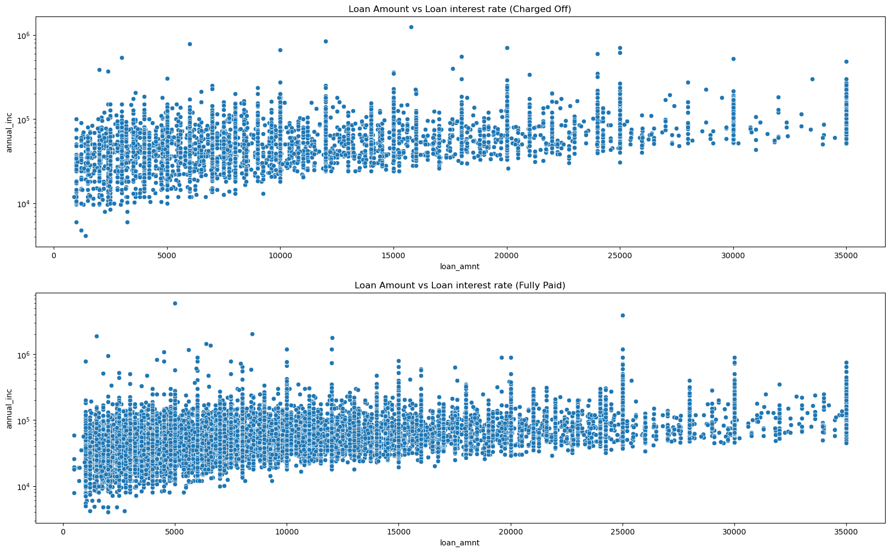
Loan Amount and Annual Income
Observation: Charged Off & Fully Paid loans has similar pattern

Slide 19
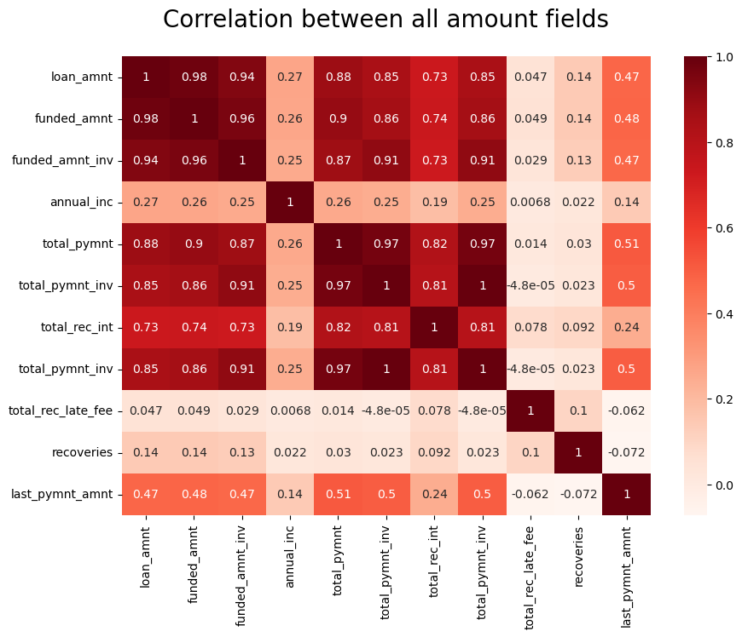
Correlations
Observation: There is a high co-relation between loan _amount, funded_amt, total_payment
but they co-relate less with annual_income

Slide 20
Analysis Conclusion

Slide 21
Key Factors to consider for Loan issuance to avoid loan defaults
Grade 'B' and Sub-Grade 'B5' loans consistently exhibit the highest charge-offs, highlighting a critical risk area for lenders.
The Approved Loan Amount Percentage, indicating that a majority of loans were fully funded, reflects a positive trend in the lending portfolio.
Loans within the 5000−10000 range face a heightened risk of charge-offs, emphasizing the need for careful assessment in this loan bracket.
Loans sanctioned in December 2011 pose an elevated risk of charge-offs, suggesting potential external factors influencing loan defaults during that specific time frame.
Overall, key risk factors contributing to charge-offs include not verified status, rented accommodations, debt consolidation loan purposes, interest rates ranging from 9% to 14.5%, and Grade 'F' and 'G' loans with higher amounts and longer tenures.

