Slide 1
EBCIDIC TO ASCII
Venkat Dasari | Solutions Consultant

Slide 2
Objective
Convert EBCIDIC Files to ASCII

Slide 3
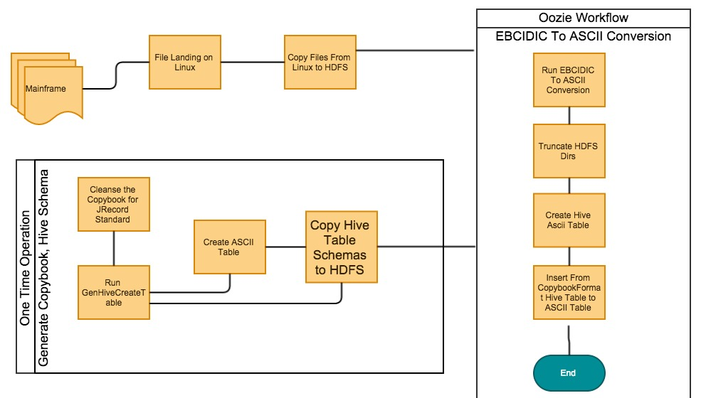
Diagrammatic Representation of the Flow

Slide 4
Steps for Conversion
One time Steps:-
Do a Maven Clean Install of copybook.inputformat.
Add the generated jar to the hdfs path.
Add the copybook files and dat files to hadoop
Create another hive table which is similar to the generated one, except that it should be STORED AS the desired input format, and the location of the new ascii file
Enter the Hive shell
Add jar /user/admin/jar_files/copybookInputFormat.jar
set copybook.inputformat.cbl.hdfs.path=‘/user/admin/copybook/schema/AM00.TXT’
Hive –f createAM*Tbl.hql
Hive –f createAM*_AsciiTbl.hql
Insert into table createAM**_ASCIITbl select * from AM**Tbl
mvn clean install
hadoop fs –copyFromLocal copybookInputFormat.jar /user/admin/jar_files/
hadoop fs –copyFromLocal AM*.TXT /user/admin/copybook/schema/
hadoop fs –copyFromLocal *.dat /user/admin/copybook/dat/AM**/
java -jar copybookInputFormat.jar GenHiveCreateTable CopybookInputFormat/copybook.inputformat/barclays_copybook/AM08.TXT createAM08.hql AM08Tbl /user/admin/copybook/dat/AM08/ /user/admin/copybook/schema/AM08.TXT
create external table AM**_ASCIITbl…….. STORED AS TEXTFILE LOCATION ‘/user/admin/copybook/ascii/AM**/

Slide 5
Limitations And Assumptions
Each File has its own Copybook
File is split by its format before landing on Linux
Any Copybook with “redefines” clause or “occurs 0 to n times” clause will not work at this point of time.
Create a coordinator which will run based on the name of the file as an event in that directory.
To Address the redefines and occurs limitations
We can try converting the Gen Splitter C code to CopybookInputFormat and re-use it.
Third Party libraries, from the likes of Cloudera’s partner, SyncSort to address the limitation.
Copybooks might needs to be reformatted when using third parties

Slide 6
SyncSort and Sqoop
Sqoop provides a new connector, which will import it directly from Mainframes to HDFS, converting it from EBCIDIC to ASCII On the fly.
Avro conversions can also be specified.
SyncSort DMX-h Release 8 also provides several options to load the dataset parallely(like sqoop), supports conversions to Avro, Parquet;Can also leverage Spark API to access mainframe data and associated COBOL copybooks.

Slide 7
Appendix
Sqoop to Mainframe
http://blog.cloudera.com/blog/2014/10/how-sqoop-1272-can-help-you-move-big-data-from-mainframe-to-apache-hadoop/
SyncSort DMX-h Release 8
http://www.syncsort.com/en/Products/DMXh8

Slide 8
Open Issues
Validation of the conversion needs to be done

Slide 9
Thank you
Venkat Dasari

