Slide 1
Classification of COVID-19 based on CT scans using CNN and GA
Dasari Madhava 19074032
Repala Sudhamsh 19075062
Bonigala Vinay Kumar 19075022

Slide 2
Overview
The problem that we are trying to solve
Approach
Dataset
CNN
GA
Classifier
Results
Inference
Demo
Individual Contributions

Slide 3
The Problem ?
COVID has infected more than 265 million people around the world and is responsible for more than 5 million deaths
Use of Computed Tomography (CT) has shown to be promising for evaluating patients suspected of COVID-19 infection
But … analysis of a CT scan is complex, and requires a specialist to do it

Slide 4
Our Solution !
Basic Approach :
methodology for detecting COVID-19 from CT images
Detailed Approach : ( steps )
We use a CNN architecture to extract features from CT images
Then do features selection using Genetic Algorithm
Finally , classification is performed using classifier
So it can be used as part of a computer-aided diagnostic system, and can serve as a second opinion for a specialist in diagnosing patients with COVID-19.

Slide 5
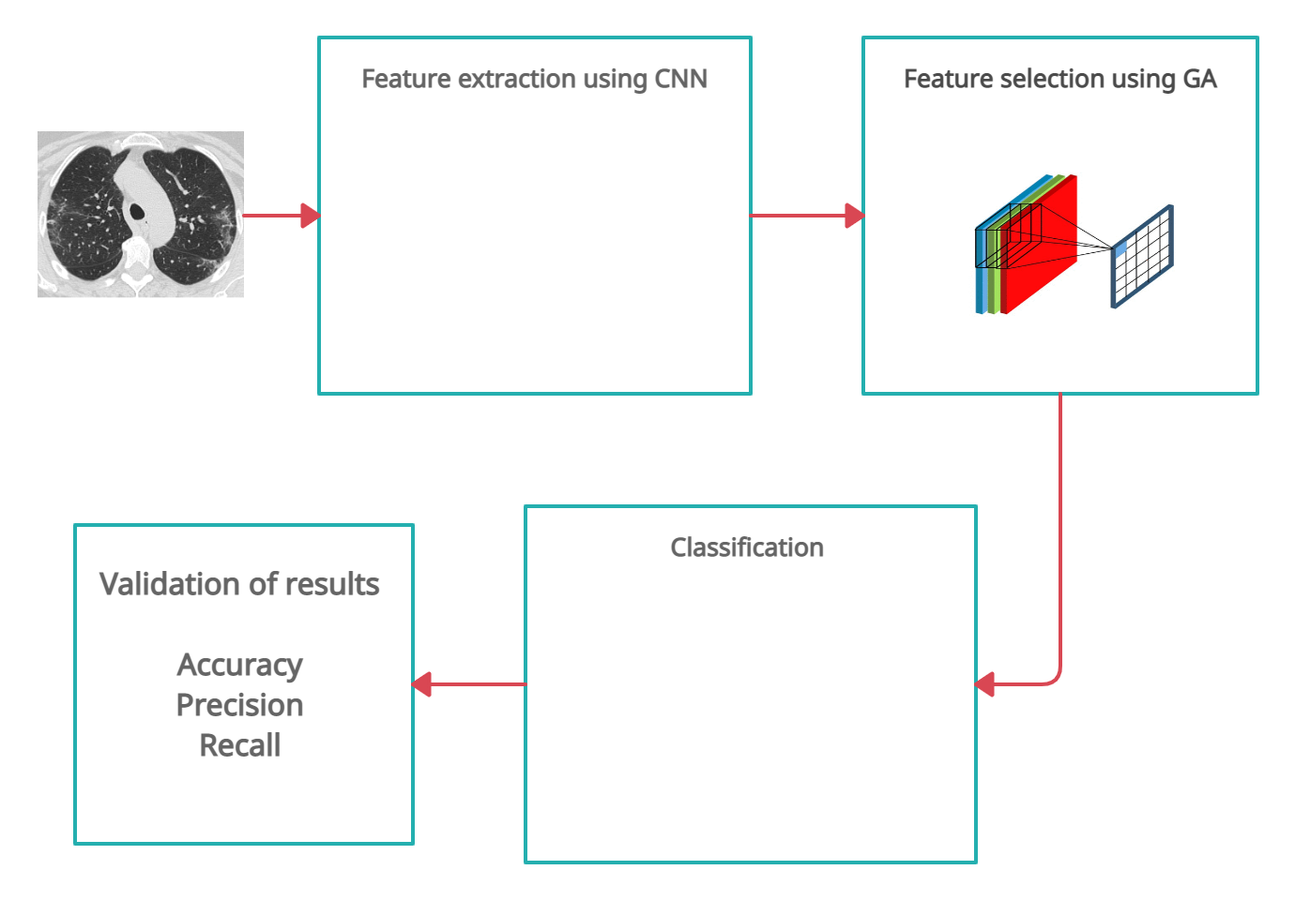
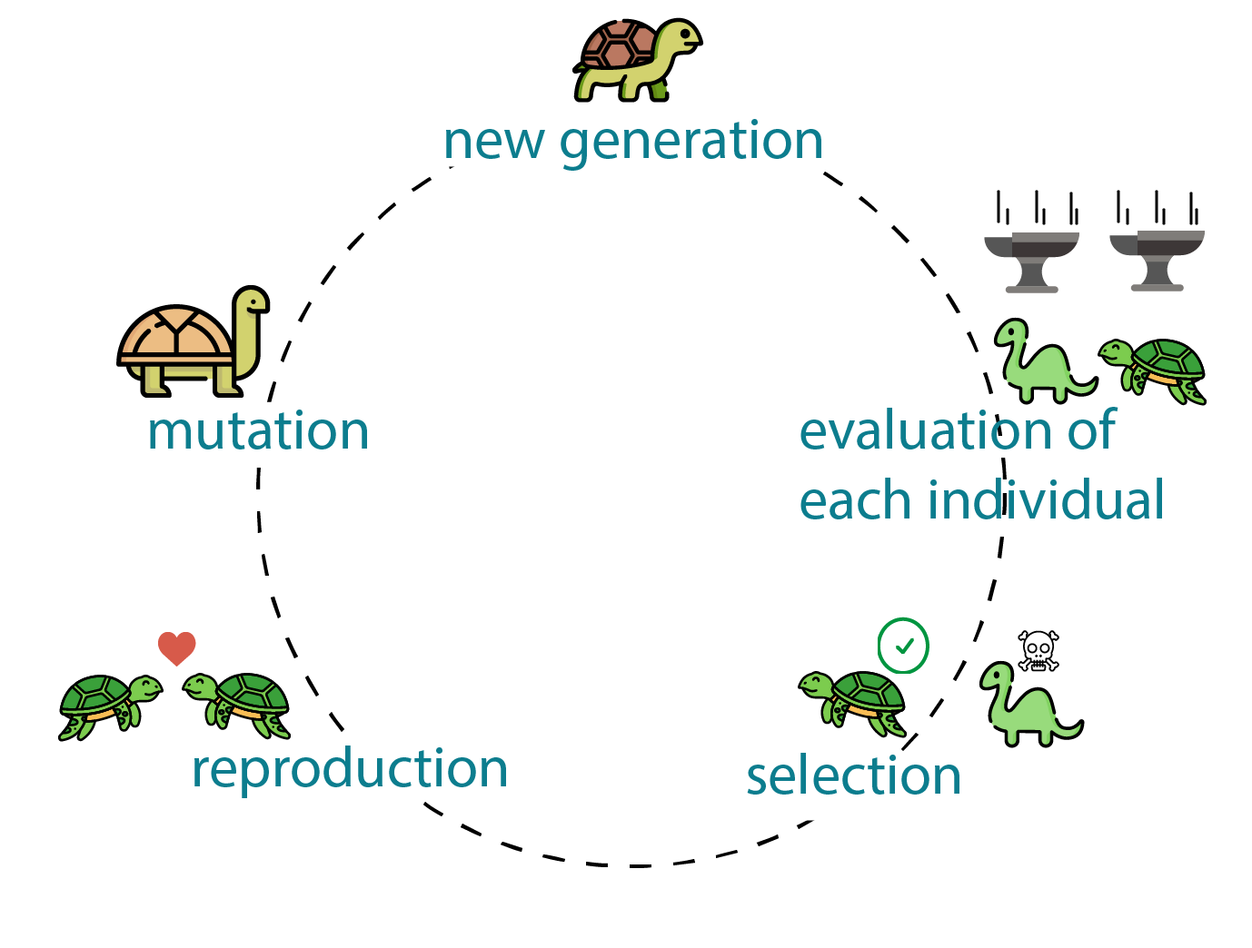
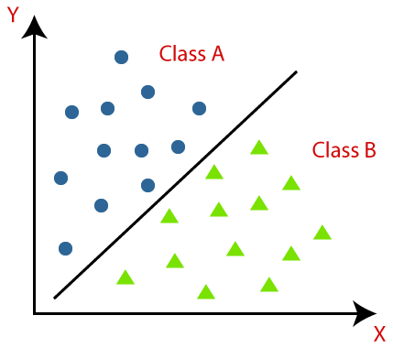
Methodology

Slide 6
Dataset
Dataset used : SARS-COV-2 Ct-Scan Dataset
( A large dataset of CT scans for SARS-CoV-2 (COVID-19) identification )
Contains :
Note : These data have been collected from real patients in hospitals from Sao Paulo, Brazil
Type | Number
Positive for COVID-19 | 1252 CT scans
Negative for COVID-19 | 1229 CT scans
 | 2481 ( total )

Slide 7
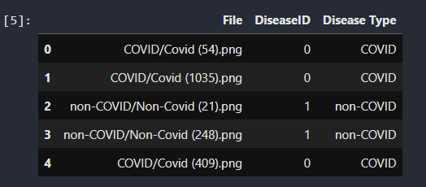
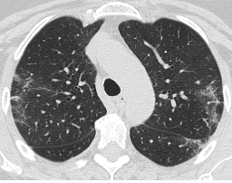
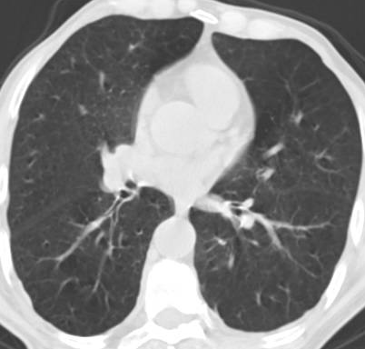
A closer look into the Dataset…
Covid | Non-covid

Slide 8
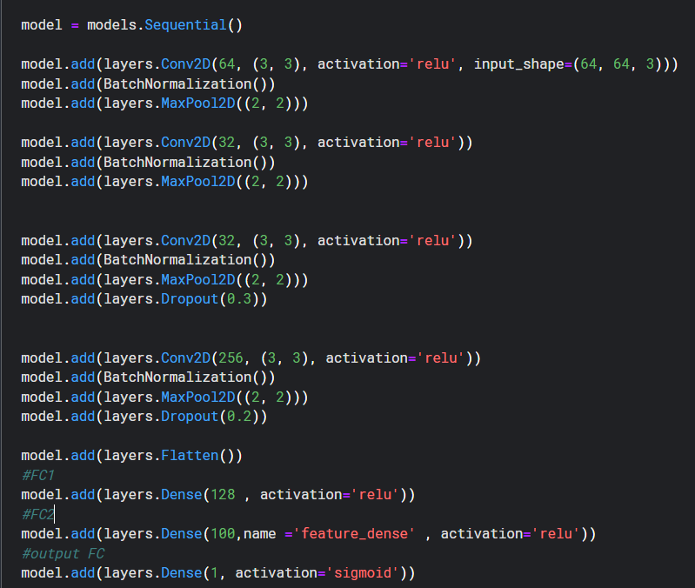
CNN
Architecture

Slide 9
Why only this Architecture ?
Several CNN architectures are already established which were designed to be robust when trained on large datasets, but they tend to overfit , when trained on smaller datasets
Since the image datasets contained only 2,481 images, we decided to create a CNN architecture from scratch in order to :
Achieve High accuracy
To avoid overfitting
To create less complex architecture that required less hardware.

Slide 10
Other points ..
In addition to the standard layers of a CNN, batch normalization, regularization, and dropout operations were applied to reduce overfitting.
Our network has low complexity, as it contains only a few layers and consequently requires low processing power.
90% of dataset was used to train the architectures, and 10% as a validation set.

Slide 11
CNN : Hyperparameters
Hyperparameter | Value
Learning rate | 0.001
First Fully Connected Layer | 128
Second Fully Connected Layer | 100
No of features extracted : 100

Slide 12
Then why Genetic Algorithm ?
But the number of features extracted by the CNN is not always essential, as the number of features is directly related to the architecture used , especially when few images are available for training
Working with a reduced set of features can offer benefits in several ways : lower processing times , reduction in the number of correlated, irrelevant, or noisy variables.
Moto : also to understand how GA works in case of feature selection and compare it with the case when we use only CNN

Slide 13
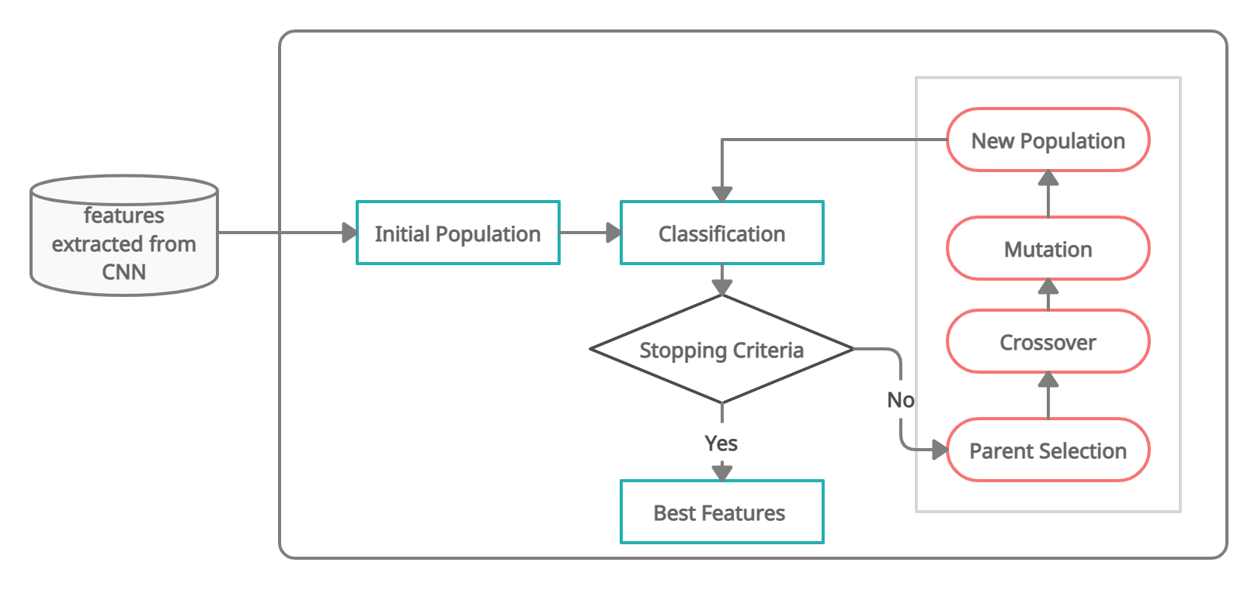
Genetic Algorithm : Working

Slide 14
Genetic Algorithm : Individual
Individual
1 | 0 | 1 | 1 | 0 | 1
f1 f3 f4 f6
f1 f2 f3 f4 f5 f6
1.1 | 2.1 | 3.1 | 4.1 | 5.1 | 6.1
7.1 | 8.1 | 9.1 | 10.1 | 11.1 | 12.1
13.1 | 14.1 | 15.1 | 16.1 | 17.1 | 18.1
19.1 | 20.1 | 21.1 | 22.1 | 23.1 | 24.1
1.1 | 3.1 | 4.1 | 6.1
7.1 | 9.1 | 10.1 | 12.1
13.1 | 15.1 | 16.1 | 18.1
19.1 | 21.1 | 22.1 | 24.1
All features
Selected features

Slide 15
Genetic Algorithm : Details
Initial population | 20
Encoding Scheme | Binary Encoding
No of generations | 30 ( stopping criteria )
Size of the individual | no of features extracted ( 100 )
Fitness Calculation | Using Classification accuracy ( Logistic Reg )
Selection technique | Tournament selection ( tournament size = 3 )
Crossover | two point crossover
Mutation | flipping
Mutation probability | 0.05

Slide 16
Genetic Algorithm : Sample output
gen avg min max
0 0.969998 0.961177 0.975296
1 0.971812 0.96269 0.975293
2 0.972492 0.966211 0.9761
3 0.973855 0.971257 0.976206
4 0.974636 0.970247 0.977257
5 0.975998 0.972264 0.977265
6 0.976752 0.973277 0.977281
7 0.977029 0.973277 0.977296
8 0.977004 0.974788 0.977306
9 0.977205 0.975295 0.977306
10 0.97728 0.976799 0.977306
Best Accuracy: (0.9773068036282218,)
Number of Features in Subset: 56
Individual: [1, 0, 0, 1, 0, 0, 1, 0, 1, 0, 0, 1, 0, 0, 1, 0, 1, 1, 1, 1, 1, 0, 1, 1, 1, 0, 0, 0, 1, 0, 1, 0, 1, 1, 1, 0, 0, 1, 1, 1, 1, 1, 1, 0, 0, 1, 1, 0, 0, 1, 1, 1, 0, 0, 1, 1, 1, 0, 0, 1, 0, 1, 1, 1, 1, 0, 1, 0, 0, 1, 1, 0, 1, 1, 1, 1, 0, 1, 1, 0, 0, 1, 0, 0, 1, 0, 0, 1, 0, 1, 0, 1, 1, 1, 0, 1, 0, 1, 0, 0]
Feature Subset : [0, 3, 6, 8, 11, 14, 16, 17, 18, 19, 20, 22, 23, 24, 28, 30, 32, 33, 34, 37, 38, 39, 40, 41, 42, 45, 46, 49, 50, 51, 54, 55, 56, 59, 61, 62, 63, 64, 66, 69, 70, 72, 73, 74, 75, 77, 78, 81, 84, 87, 89, 91, 92, 93, 95, 97]

Slide 17
Classification
Consist of categorizing the CT images as COVID-19 and Non-COVID-19 cases using Logistic Regression

Slide 18
Results
Metric | value
Accuracy | 0.9773
Precision | 0.9746
Recall | 0.9796
F1 score | 0.9777

Slide 19
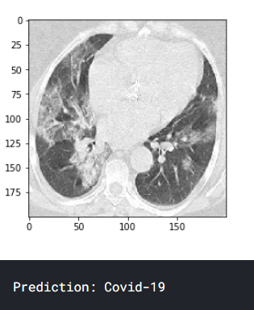
Demo
Input →
Output →

Slide 20
Inferences
Optimization of the hyperparameters of the CNN produced better features, which improved the final result
GA resulted in improvement of results, it helped in achieving a significant reduction in the dimensionality in the feature files , that made classification process more faster
Our architecture is efficient and has low complexity which means it requires less processing power than other traditional models

Slide 21
Individual Contributions
Dasari Madhava | Feature selection using GA , ppt
Repala Sudhamsh | Feature extraction using CNN , hyperparameter optimization
Bonigala Vinay Kumar | Classification , data preprocessing , literature survey

Slide 22
Thank You !

