Slide 1
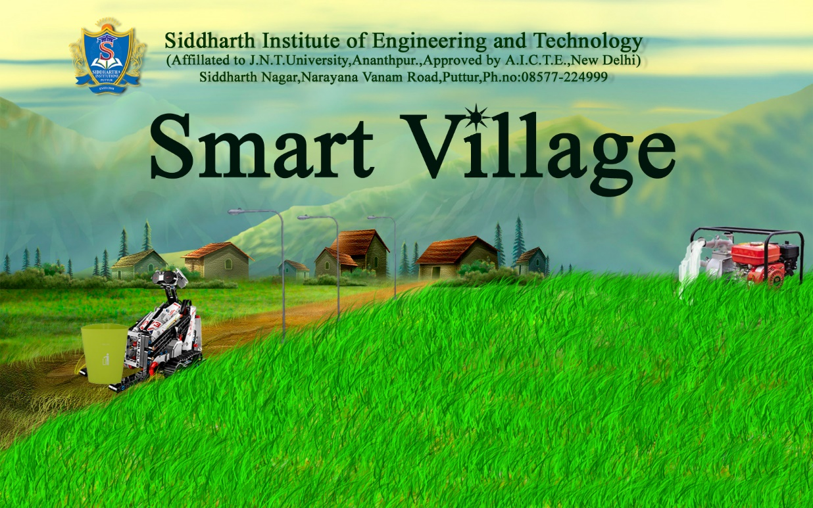
By,
Arjun D(CSE),
Chandra Sekhar P(CSE),
Sonam Rani Singh G G(CSE),
Teenu Krishna Mohan R(CSE).

Slide 2
Description
Automation of manual works in villages like management of Agriculture, street lights and waste management.
Water supply for agriculture based on the levels of water in the field and moisture in soil sensed using Water Sensor and Soil Moisture Sensor.
Water supply can be done when the power is supplied, sensed using a Rectifier Circuit.
Street lights can be switched as per timings and Intensity of light using the Light Dependent Resistor LDR.

Slide 3
Waste management can be done by knowing that the dust bins are filled using an Ultrasonic Sensor that measures depth of the bin.
When the bin is filled a command is sent to a Robot to pick up the bin from its place.
All the values read from different sensors are sent to the server by an Aurdino UNO.

Slide 4
Need’s
Villages are the back bone of India. Development of the country depends on villages with more productivity.
Utilization of technology in village level reduces burden on people and wastage of valuable resources which helps in conservation of resources.
Power supply in villages is uneven in timing. So, farmers wait for the power to supply water and sometimes miss their turn.
Different crops need different levels of moisture content based on the crop either dry or wet crops. So, moisture content should be accounted.

Slide 5
Water supply for agriculture using motors sometimes cause electrical accidents resulting Electrocution or loss of life.
Power usage may be inefficient in villages like, people not switching street lights accordingly.
Dumping of waste in surroundings results in spreading of dreadful diseases like malaria, dengue etc.,

Slide 6
Hardware Components
Technologies Used
Arduino UNO board
Ethernet Shield
Soil moisture sensor
Water sensor
Ultrasonic sensor
LDR(Light Dependent Resistor)
Lego Mindstorm EV3
Transformer
Capacitor
Regulator
Jumper wires
Resistor
Bridge Rectifier
LED(Light Emitting Diode)
Aurdino IDE
Embedded ‘C++’ for aurdino
Java
PHP
Android
MySQL
Apache server
Android Studio

Slide 7
Benefits and Advantages
Benefits of smart villages are unanimous and acceptable
Through effective utilization of power for homely and agricultural purposes reduce cost of production and management.
Water managed efficiently helps in conservation of valuable resource which help in drought conditions.
Proper supply of water for the crop makes growth of a healthy crop with more quantity and profits.
Waste management makes clean and beautiful surrounding with healthy climate and sanitation, also helps to reduce the spread of dreadful diseases.

