Slide 1
Project On
Automatic Exhaust with Dust Sensor

Slide 2
Guide:
Dr. S. Usha Rani
Team Members:
N. Kailash Preetham-14691A0476
C.Nagendra-14691A04B3
B. Naga Rammohan-14691A04B1
D.Navakishore-14691A04B6

Slide 3
Concepts
Abstract
Introduction
Objectives
Components
Block Diagram
Working procedure
Software & Tools used
Applications and Advantages
Conclusion.

Slide 4
Abstract
The automatic exhaust with dust sensor is having a dust sensor, which can sense dust particles of the order of millimeters also. As soon as any dust particle is found, it automatically turns on the exhaust. The system serves two purposes; first it can detect and hence inform us about any dust particle present around us.
This is very important at several places like semiconductor manufacturing, medical research etc. Secondly, it avoids energy consumption as the exhaust runs only when it is required to run.

Slide 5
Introduction
In Current Technology, pollution is increasing rapidly and in our surroundings, also dust particles are increasing due to these problems many of the people injured like breathing problem, asthma, lung cancer, chronic obstructive pulmonary disease, and emphysema. Because of these reasons and problems, we are doing this automatic exhaust with dust sensor project to reduce or avoid these problems.
In the current market already one device(Air XD real-time dust measurement system) is there related to our project but this device only detect the dust particles in the air and it will display the dust levels on the screen and it will inform us by using buzzer.

Slide 6
Cont….
In this project, we are dust sensor which senses the dust particles in the air of the order of millimeters also. As soon as any dust particle is found, it automatically turns on the exhaust. And it will inform us by using a buzzer and the results are displayed are on the LCD screen. The fan will run by using the motor driver(LM7805) which is interfaced with Atmega168 microcontroller.

Slide 7
Objectives
The major objectives of our developed system are,
Detect the dust particles.
Dust sensor, which can sense/detect dust particles of the order of millimeters also.
It informs us about any dust particle preset around us with digital output.

Slide 8
Components
Micro Controller(ATMEGA328P)
Dust Sensor
Exhaust Fan
16*2 LCD Display
Transformer
Rectifier
LM7805-Voltage Regulator
Capacitor(1000uf)
Relay.

Slide 9
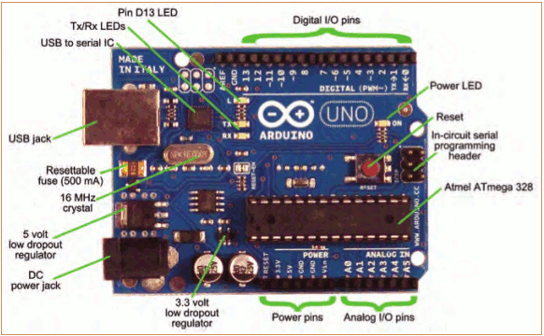
Arduino

Slide 10
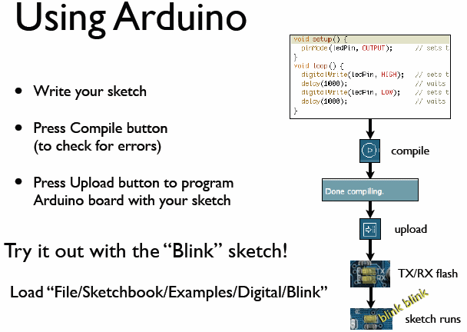

Slide 11
LCD
LCD (Liquid Crystal Display) screen is an electronic display module and find a wide range of applications. A 16x2 LCD display is very basic module and is very commonly used in various devices and circuits. These modules are preferred over seven segments and other multi segment LEDs.
A 16x2 LCD means it can display 16 characters per line and there are 2 such lines. In this LCD each character is displayed in 5x7 pixel matrix. This LCD has two registers, namely, Command and Data.
A command is an instruction given to LCD to do a predefined task like initializing it, clearing its screen, setting the cursor position, controlling display etc. The data register stores the data to be displayed on the LCD. The data is the ASCII value of the character to be displayed on the LCD. Click to learn more about internal structure of a LCD.

Slide 12
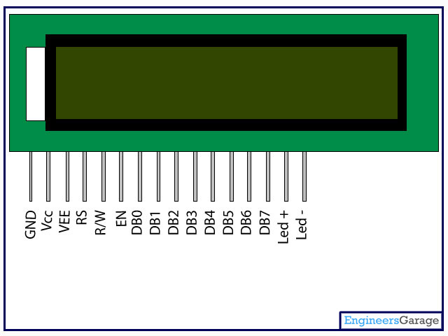
Pin Diagram:
Pin Description:
Pin No | Function | Name
1 | Ground (0V) | Ground
2 | Supply voltage; 5V (4.7V – 5.3V) | Vcc
3 | Contrast adjustment; through a variable resistor | V_{EE}
4 | Selects command register when low; and data register when high | Register Select
5 | Low to write to the register; High to read from the register | Read/write
6 | Sends data to data pins when a high to low pulse is given | Enable
7 | 8-bit data pins | DB0
8 |  | DB1
9 |  | DB2
10 |  | DB3
11 |  | DB4
12 |  | DB5
13 |  | DB6
14 |  | DB7
15 | Backlight V_{CC} (5V) | Led+
16 | Backlight Ground (0V) | Led-

Slide 13
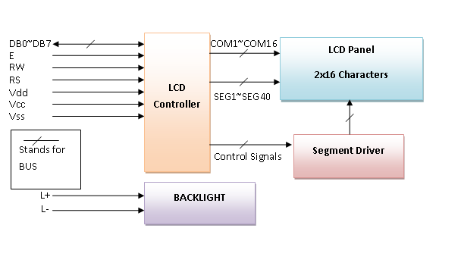
Block Diagram of LCD Display

Slide 14
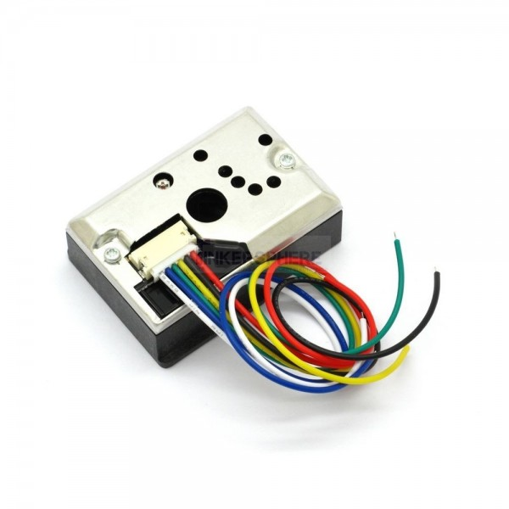
DUST SENSOR

Slide 15
Features of GP2Y1010AU0F
Compact ＆ thin package (46 × 30 × 17.6mm)
With application of pulse output system, the device can detect even single house dust.
House dust and cigarette smoke can be distinguished.
Objects to detect
House dust
Cigarette smoke

Slide 16
Working of Dust Sensor
The basic way of sensing dust is through photometry and this method uses IR LED emitter and photovoltaic diode (Photo diode) receiver, the sensor will have Air flow path and the IR LED and Photo diodes are placed near to the Air flow path and pulse signal will make IR LED to glow, due to the dust particles in Air it may scattered and received by photo diode, finally the signal is amplified and processed to get difference level and it can be measured as dust density level.

Slide 17
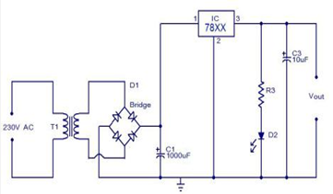
POWER SUPPLY
A power supply is a device which delivers an exact voltage to another device as per its needs. There are many power supplies available today in the market like regulated, unregulated, variable etc., and the decision to pick the correct one depends entirely on what device you are trying to operate with the power supply.

Slide 18
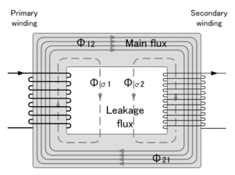
Transformer
A transformer is an electrical device that transfers energy between two circuits through electromagnetic induction.
A transformer may be used as a safe and efficient voltage converter to change the AC voltage at its input to a higher or lower voltage at its output.

Slide 19
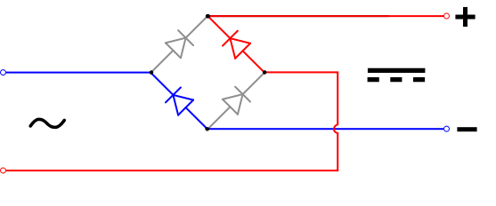
Rectifier
A rectifier is an electrical device that converts alternating current (AC), which periodically reverses direction, to direct current(DC), which flows in only one direction. The process is known as rectification.
A diode bridge is an arrangement of four diodes in a bridge circuit configuration that provides the same polarity of output for either polarity of input.

Slide 20
Filters
Electronic filters are analog circuits which perform signal processing functions, specifically to remove unwanted frequency components from the signal, to enhance wanted ones, or both.
TYPES
ACTIVE FILTER
PASSIVE FILTER

Slide 21
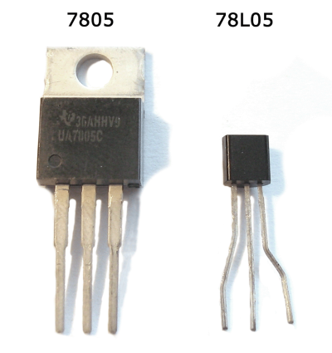
Regulator
A voltage regulator is designed to automatically maintain a constant voltage level. A voltage regulator may be a simple “Feed-forward" design or may include negative feedback control loops.
It may use an electromechanical mechanism, or electronic components. Depending on the design, it may be used to regulate one or more AC or DC voltages.

Slide 22
Relay
What is relay
Relays are simple switches which are operated both electrically and mechanically. Relays consist of a n electromagnet and also a set of contacts. The switching mechanism is carried out with the help of the electromagnet.
Why is relay used?
The main operation of a relay comes in places where only a low-power signal can be used to control a circuit. It is also used in places where only one signal can be used to control a lot of circuits.
They were used to switch the signal coming from one source to another destination. After the invention of computers they were also used to perform Boolean and other logical operations. The high end applications of relays require high power to be driven by electric motors and so on. Such relays are called contactors.

Slide 23
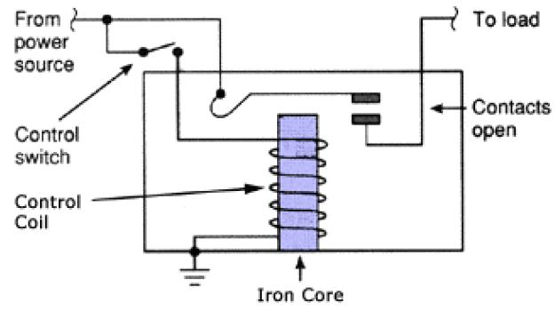
HOW RELAY WORKS?
The working of a relay can be better understood by explaining the following diagram given below.

Slide 24
The diagram shows an inner section diagram of a relay. An iron core is surrounded by a control coil. As shown, the power source is given to the electromagnet through a control switch and through contacts to the load. When current starts flowing through the control coil, the electromagnet starts energizing and thus intensifies the magnetic field. Thus the upper contact arm starts to be attracted to the lower fixed arm and thus closes the contacts causing a short circuit for the power to the load. On the other hand, if the relay was already de-energized when the contacts were closed, then the contact move oppositely and make an open circuit.

Slide 25
Block Diagram
POWER SUPPLY
ARDUINO MICRO-CONTROLLER
LCD
DUST SENSOR
RELAY
EXHAUST FAN

Slide 26
Working Procedure
The Automatic exhaust with dust sensor is having a dust sensor with digital output. If any dust particle enters into its cavity, its output becomes high and hence the microcontroller comes to know about it. The exhaust fan is connected to a motor driver, which runs the fan, hence the microcontroller turns on the fan via a motor driver. The system is powered up by a dc power supply of 12V/9V, 1A. It consists of a transformer(which step-up or step-down AC voltages OR increase/decrease the AC voltages levels...), bridge rectifier and a filter; hence it can be provided either DC or AC(which is the function of rectifier)

Slide 27
Software & Tools Used
Embedded C Programming
Keil Software

Slide 28
Applications & Advantages
Applications:
This is very important at several places like
Semiconductor manufacturing Industry,
Manufacturing Industries,
Medical research
Smoke type fire alarm application by different sensor adjustments.

Slide 29
Applications:
Detection for dust in air, indoor air quality monitoring.
Air conditioner
Air purifier.
Air Cleaner.

Slide 30
Advantages:
it avoids energy consumption as the exhaust runs only when it is required to run.
Low cost.
Less energy consumption.
Easy to maintain.
Construction is Easy.
Reliable

Slide 31
Conclusion
This project is very useful in manufacturing industries (like semiconductor, chip designing etc..) and medical research.
The system can be future upgraded and can be connected with an alarm system if required. It can have a GSM system to intimate the user remotely.

Slide 32
THANK YOU

Slide 33

ANY QUERIES

