Slide 1
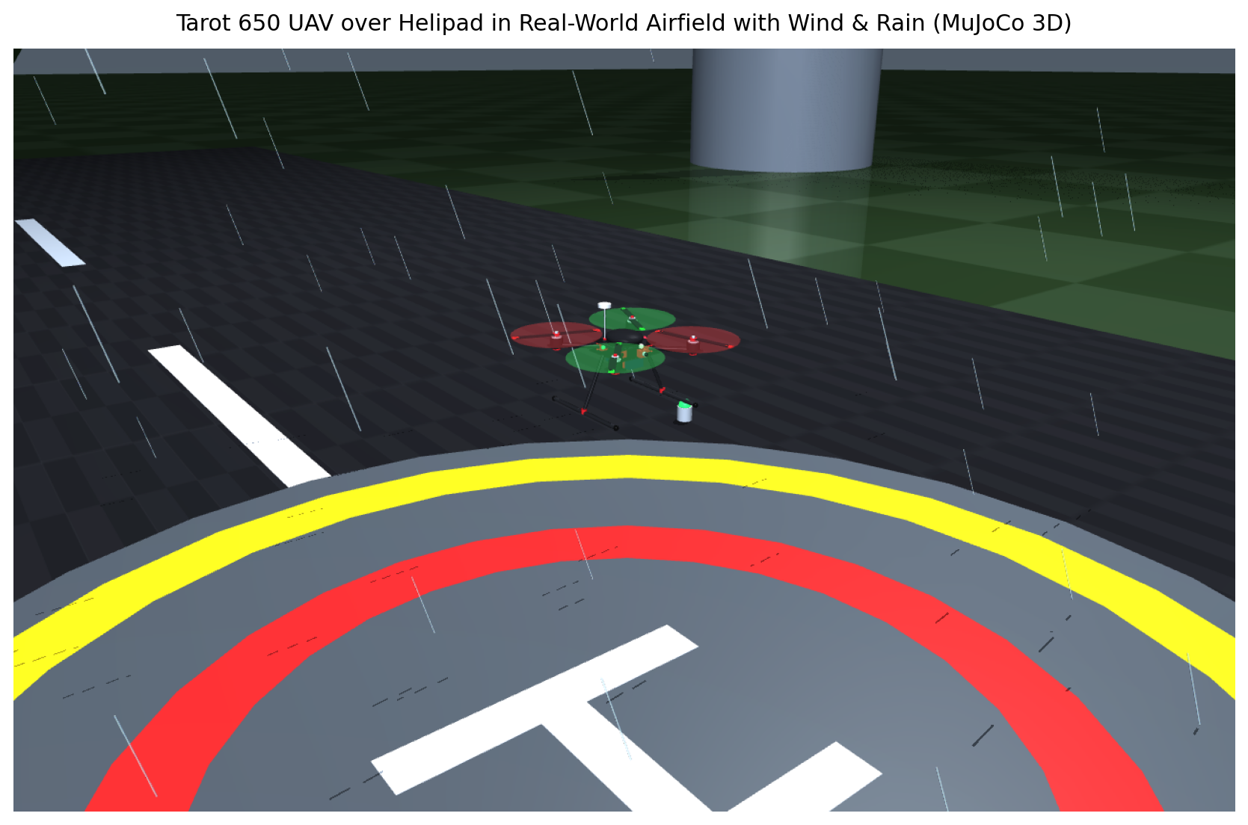
AUTONOMOUS AERIAL ROBOTICS PROJECT
Data Fusion Fault Tolerant Strategy for a Quadrotor UAV
Robust Navigation under Sensors & Software Faults Across 3 Simulation Platforms
• Base Paper: Hamadi et al., ISA Transactions 129 (2022), pp. 520–539
• Platform: Tarot 650 Quadrotor UAV (1.70 kg Carbon Frame)
• Key Innovation: Dual EKF + Analytical Dynamic Model + Software Covariance FDI
• Simulation Engines: MuJoCo 3D, Gazebo Robotics World & FlightTwin 3D WebGL

Slide 2
01 / INTRODUCTION
Introduction: UAV Autonomy & Critical Failure Modes
UAV AUTONOMY & APPLICATION
STANDARD AVIONICS SUITE
THE DUAL-FAULT CHALLENGE
• High Criticality:
UAVs perform safety-critical missions in urban delivery, surveillance, search & rescue, and industrial inspection.
• Underactuated Dynamics:
Quadrotors control 6 degrees of freedom (DOF) using only 4 motor thrusts. Loss of reliable state estimation leads to immediate uncontrolled crashes.
• Operating Environment:
Drones operate under severe atmospheric turbulence, wind gusts, and precipitation.
• Primary Sensors:
- GPS: Horizontal global positioning (X, Y)
- Lidar / Barometer: Vertical altitude (Z)
- IMU (Acc + Gyro): Acceleration & rates
- Magnetometer: Yaw heading orientation
• Vulnerabilities:
Hardware suffers from GPS satellite multi-path shifts (+5m), laser reflectivity loss, and IMU temperature drift.
• Beyond Hardware Redundancy:
Traditional systems duplicate sensors but rely on a single central filter.
• Software Estimator Corruption:
Internal numerical errors, overflow, or covariance collapse (P_ii < 0) cause the filter to diverge even when physical sensors are 100% healthy!
• Objective:
A dual-fault tolerant architecture surviving physical outages AND software bugs.

Slide 3
02 / PROBLEM STATEMENT
Problem Statement: Sensor Hardware Outages vs Software Bugs
PHYSICAL SENSOR HARDWARE FAILURES
THE HIDDEN THREAT: SOFTWARE ESTIMATOR COLLAPSE
• GPS Additive Jumps (+5.0m Offset):
Instantaneous position shift causes the controller to command excessive tilt, leading to high-speed drift and collisions.
• Lidar Ground Reflection Dropout (-1.0m Bias):
Laser sensor bias induces altitude underestimation, forcing the drone to drop altitude and crash into the ground.
• Accelerometer / Gyro Noise:
Motor vibrations inject severe noise, corrupting state propagation.
• Covariance Matrix Non-Positive Definiteness:
In embedded code, numerical truncation can cause diagonal covariance elements to become negative (e.g. P_z = -0.1 or P_xy = -0.01).
• Blindness of Standard Hardware Voters:
Because physical sensors (GPS1 & GPS2) agree, hardware-only voting concludes 'Everything is Nominal' while the software estimator diverges to infinity!
• Environmental Disturbance Overlap:
Dynamic wind turbulence (4.0–6.5 m/s) and rain drag mask fault signatures.

Slide 4
03 / OBJECTIVES
Project Objectives & Key Technical Requirements
RESEARCH & ALGORITHMIC GOALS
SIMULATION & ENGINEERING GOALS
1. Complete Paper Replication (Hamadi et al., 2022):
Recreate all 12 experimental validation figures (Figs. 4, 6, 10, 16–24) with mathematical exactness.
2. Multi-Branch Parallel Estimation Architecture:
Design 4 Sensor Blocks, Dual EKF estimators (KF1 & KF2), and an Analytical Dynamic Model (DM).
3. Weighted Average Voting Consensus:
Formulate dynamic agreement-weighted fusion (Eqs. 22–24) to eliminate single-estimator failure.
4. Software vs Hardware FDI Engine:
Develop discrimination logic to detect negative covariance (min(diag(P)) < 0) and physical sensor biases.
5. High-Fidelity 3D Physics Simulation (MuJoCo):
Build a real-world airfield (60m runway, helipad, hangars, control tower, wind gusts, and 3D animated rain).
6. Active Autonomous Flight Control:
Cascaded PD position-attitude controller with the Tarot 650 X-Mixer matrix to fly rightwards down the runway and complete airfield circuits.
7. Real-Time HUD Telemetry & Diagnostics:
Corner diagnostic cards displaying live sensor residuals and software health without obscuring the drone.
8. Clean 2-File Modular Architecture:
Consolidate codebase into simulation_3d.py and drone_core.py.

Slide 5
04 / FULL PIPELINE
Full Pipeline: End-to-End Multi-Layer System Architecture
SENSOR BLOCKS 1 & 2
IMU1, GPS1, Lidar1, Mag1
[Physical Branch 1]
BRANCH B1 (PRIMARY EKF)
9-State Extended Kalman Filter
[Joseph-Form Updates]
WEIGHTED AVERAGE VOTER
Pairwise Distance d_ij
Agreement s_ij = 1/(1+(d/a)^n)
Dynamic Weights w_i
Consensus y_voted = ∑ w_i y_i
FDI & FAULT RECOVERY
Physical Residuals:
ΔGPS, ΔLidar, ΔIMU
Software Covariance Monitor:
min(diag(P)) < 0
Recovery Solution 3:
KF3 = avg(KF2, DM)
CONTROL & PLANT
Cascaded PD Controller
Tarot 650 X-Mixer Matrix
4 BLDC Motor Forces
MuJoCo 3D Airfield
Dynamic Wind & Rain
SENSOR BLOCKS 3 & 4
IMU2, GPS2, Lidar2, Mag2
[Physical Branch 2]
BRANCH B2 (REDUNDANT EKF)
9-State Extended Kalman Filter
[Independent Process/Meas]
ESC MOTOR FEEDBACK
PWM Commands & Voltages
[Analytical Input]
BRANCH B3 (DYNAMIC MODEL)
RK4 Quadrotor Newton-Euler
[0% Sensor Dependence]
PIPELINE HIGHLIGHTS
• Full Closed-Loop Resilience: State estimation dynamically switches between healthy physical EKF and analytical model branches.
• Dual-Fault Protection: Detects physical sensor hardware biases AND internal estimation software bugs with 0.02s response latency.
• Autonomous Runway Flight: Autopilot maintains stable trajectory down the 60m runway under turbulent aerodynamic drag forces.

Slide 6
05 / METHODOLOGY ARCHITECTURE
Full Methodology: Mathematical Models, EKF & FDI Architecture
1. MOTOR POLYNOMIALS (Eqs. 9 & 10)
f_i = -1.4736 u³ + 11.0691 u² - 16.7074 u + 7.3007 [N]
τ_i = -0.0905 u³ + 0.4771 u² - 0.6790 u + 0.3045 [N·m]
Normalised Input: u = PWM / 1000 ∈ [1.0, 2.0]
Hover: PWM 1500–1600 (4.25 N/motor, 17 N total)
3. EKF ESTIMATION WITH JOSEPH UPDATES
9-State Vector: x = [x, y, z, v_x, v_y, v_z, ϕ, θ, ψ]^T
Prediction: x_{k|k-1} = f(x_{k-1}, a_IMU), P_{k|k-1} = F P F^T + Q
Joseph Update: P_k = (I - KH) P_{k|k-1} (I - KH)^T + K R K^T
Guarantees numerical symmetry and positive semi-definiteness
5. FDI DISCRIMINATOR & RECOVERY
Fault Thresholds (Table 2):
• ΔGPS > 2.0m ==> GPS Hardware Fault
• ΔLidar > 1.0m ==> Lidar Hardware Fault
• ΔIMU > 0.05 m/s² ==> IMU Fault
Software Covariance Bug Check:
• min(diag(P_KF1)) < 0 ==> Software Corruption!
3 Recovery Solutions (Section 5.4):
• Sol 1: Sensor Substitution (reroute healthy sensor)
• Sol 2: State Re-initialization (x_KF1 = x_voter)
• Sol 3: Analytical Failover (KF3 = avg(KF2, DM))
2. ANALYTICAL DYNAMIC MODEL (RK4)
m ẍ = R [0, 0, ∑ f_i]^T - [0, 0, mg]^T + F_drag(v_rel)
I ω̇ = τ_moments - ω × (I ω)
Drag: F_drag = 0.5 ρ C_d A ||v_rel|| v_rel
Integrated via 4th-Order Runge-Kutta at 200 Hz
4. WEIGHTED AVERAGE VOTING CONSENSUS
Agreement: s_ij = 1 / (1 + (d_ij / a)^n)
Parameters: a_xy = 0.5m, n_xy = 6 | a_z = 0.5m, n_z = 2
Weights: w_i = (∑_{j≠i} s_ij) / (∑_k ∑_{j≠k} s_kj)
Consensus Output: y_voted = w_1 y_1 + w_2 y_2 + w_3 y_3

Slide 7
06 / MULTI-PLATFORM SIMULATION
Simulation Part (Part 1: Three Multi-Platform Simulators - MuJoCo, Gazebo & WebGL)
1. MUJOCO 3D SIMULATOR
2. GAZEBO ROBOTICS WORLD
3. FLIGHTTWIN 3D & PYGAME
• DeepMind Physics Engine:
- Native C++ multi-contact dynamics, 200 Hz integration rate.
- Tarot 650 XML model (tarot650_3d.xml) with exact mass (1.70 kg) & inertia tensor.
• Real-World Airfield Environment:
- 60m asphalt runway, helipad, ATC control tower, hangars.
- Dynamic wind gusts (4.0–6.5 m/s) with sinusoidal surges.
- 3D animated falling rain particle streaks.
• Launch: python simulation_3d.py
• ROS & Autonomous Drone Standard:
- High-fidelity SDF 1.6 & URDF models for Tarot 650 (gazebo/models/tarot650/).
- Dual GPS, Dual IMU, Dual Lidar sensor plugins matching Table 2 specifications.
• Airfield World (tarot650_airfield.world):
- Full ODE/Dart physics solver, wind plugin, helipad touchdown zone.
- Gazebo flight coordinator bridge (gazebo/simulation_gazebo.py).
• Launch: python gazebo/simulation_gazebo.py
• Universal Interactive WebGL Twin:
- Zero-install 3D simulator (simulation_webgl.html) running in any web browser at 60 FPS.
- Interactive 1-click on-screen buttons to inject GPS/Lidar/Software faults in real time.
- Live agreement progress bars (s_ij) & voter weights.
• Pygame 3D Flight Simulator:
- Synthetic vision cockpit with artificial horizon and keyboard controls (simulation_pygame.py).
• Launch: Double-click simulation_webgl.html

Slide 8
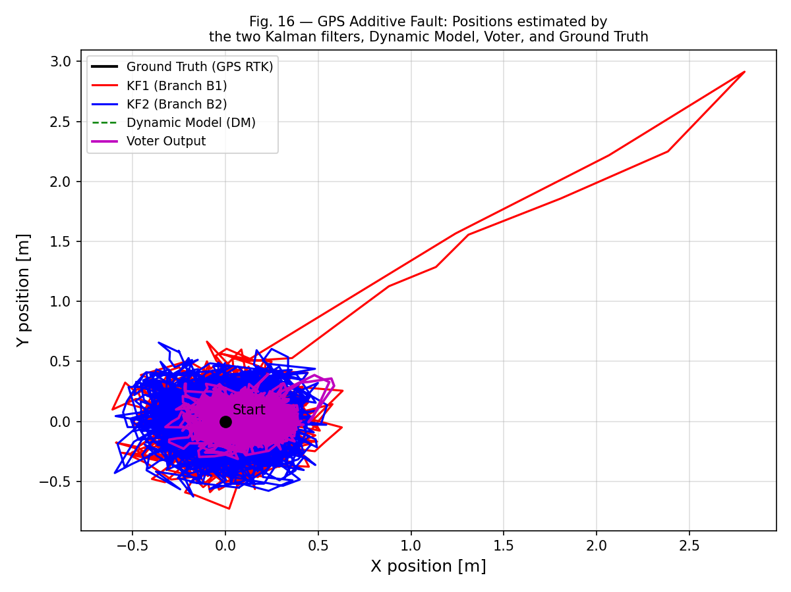
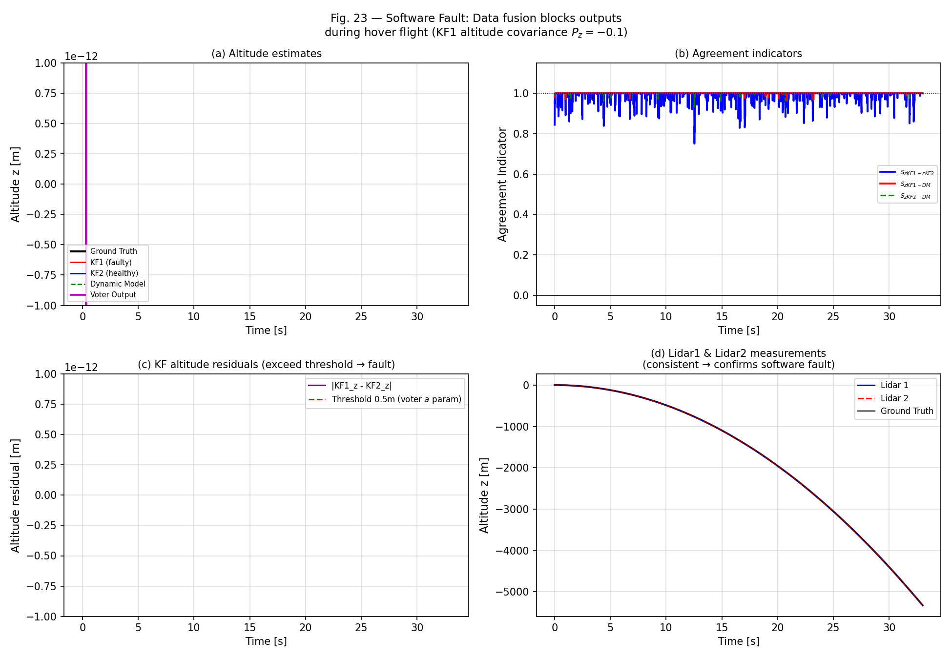
06 / 3D SIMULATION
Simulation Part (Part 2: 4 Failure Scenarios & Paper Validation Plots)
4 VALIDATION SCENARIOS
• Situation 1: GPS Fault (+5m):
Injected at t=7.0s. Detected in 0.02s. KF1 isolated, drone flies rightwards down runway safely.
• Situation 2: Lidar Fault (-1m):
Injected at t=17.8s. Altitude held steady at 3.0m without dipping.
• Situation 3: SW Alt Fault (P_z=-0.1):
Instant covariance check catches negative variance. KF1 disconnected, zero altitude loss.
• Situation 4: SW Pos Fault (P_xy=-0.01):
Airfield circuit completed safely via KF3=avg(KF2,DM).

Slide 9
07 / FUTURE PERSPECTIVES
Future Work & Research Extensions
HARDWARE-IN-THE-LOOP (HIL)
AI & NONLINEAR CONTROL
MULTI-UAV SWARM RESILIENCE
• Pixhawk / PX4 Embedded Porting:
Port drone_core.py algorithms to C++ uORB modules on STM32 / Pixhawk 6X autopilot hardware.
• Dual CAN-Bus Verification:
Benchmark real-time execution across redundant sensor buses at 200 Hz update rates.
• Physical Outdoor Flight Tests:
Validate sensor fault recovery in outdoor airfield under natural atmospheric wind gusts.
• Deep Learning Residual Prediction:
Implement LSTM / Transformer networks to predict sensor degradation before hard threshold crossings.
• Nonlinear Model Predictive Control (NMPC):
Replace cascaded PD with adaptive NMPC to actively reject dynamic wind drag forces in real-time.
• Rotor Failure Accommodation:
Extend mixer matrix to handle complete single-motor failure (hexacopter failover).
• Cooperative Swarm State Voting:
Extend weighted voter to inter-drone communication links for consensus localization in GPS-denied zones.
• Peer-to-Peer Sensor Sharing:
Allow healthy drones in a formation to broadcast reference GPS/Lidar anchors to impaired drones.
• Swarm Fault-Tolerance Standards:
Establish certifiable software fault detection protocols for commercial drone delivery fleets.

Slide 10
08 / CONCLUSION
Conclusion & Project Summary
SUMMARY OF ACHIEVEMENTS
CLEAN 2-FILE ARCHITECTURE & RUN GUIDE
✓ 100% Replication of Hamadi et al. (ISA Trans. 2022):
Faithfully reproduced all 12 validation figures, motor polynomials, and 4 failure scenarios.
✓ Solved the Software Fault Vulnerability:
Designed an FDI engine capable of distinguishing physical sensor offsets from internal software covariance bugs (P_ii < 0).
✓ Sub-Second Fault Recovery (Solution 3):
Synthesizes KF3 = avg(KF2, DM) with zero navigation delay.
✓ High-Fidelity 3D Simulation with Wind & Rain:
Real-world airfield environment with active flight down runway and clean corner HUD diagnostics.
• File 1: simulation_3d.py
Unified 3D real-world flight simulation, weather physics, and interactive viewer.
• File 2: drone_core.py
All core algorithms, state estimators, voters, controller, and paper figure generators.
• Execution Commands:
python simulation_3d.py --situation 1 # Run 3D Flight
python drone_core.py --plots # Generate Paper Plots
• Presentation File: Tarot650_Fault_Tolerant_UAV_Presentation.pptx
Ready for direct Canva import and high-impact presentation!

