Slide 1
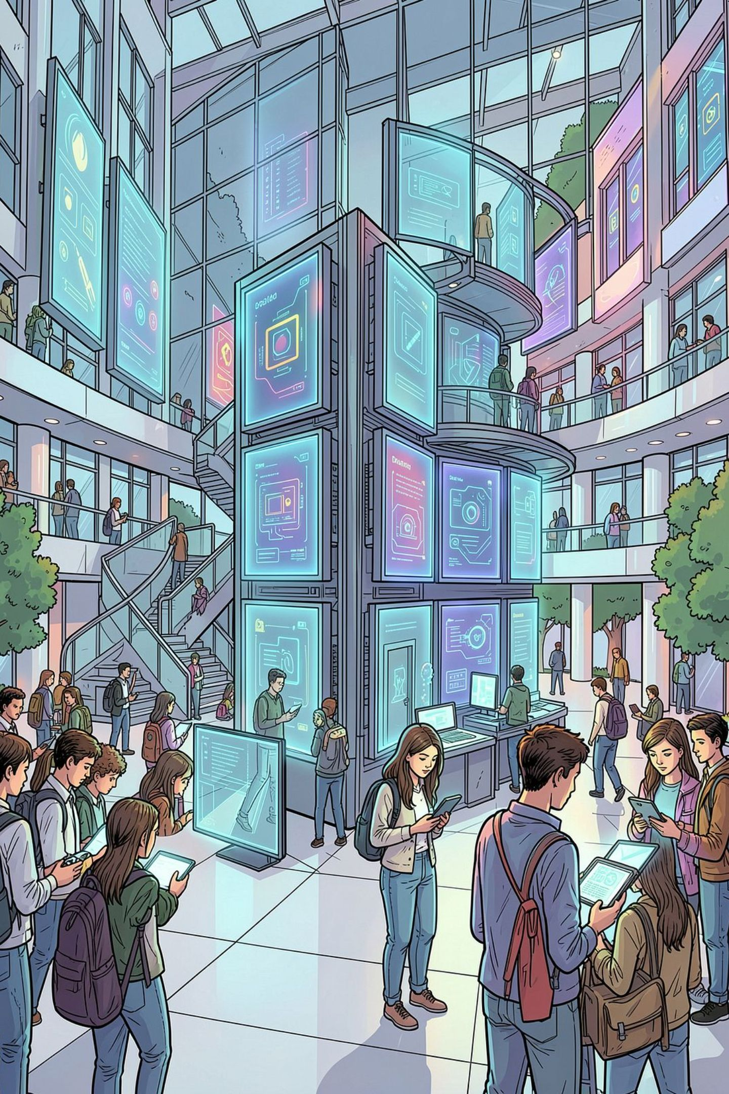
AI-Enabled Student Complaint Redressal Portal
A centralized, intelligent platform for submitting, managing, prioritizing, and resolving student grievances — powered by AI, NLP, and real-time tracking.
ACADEMIC INNOVATION
GRIEVANCE MANAGEMENT
AI-POWERED
DASARI SOWMYA SREE
323129512009

Slide 2

The Problem with Traditional Complaint Systems
No Centralized Tracking
Complaints submitted via paper or email disappear into silos with no visibility into status or ownership.
Delayed Responses
Manual routing causes bottlenecks. Students wait weeks without acknowledgment or updates.
No Prioritization
Urgent academic grievances are treated the same as minor inquiries, causing critical issues to stall.
Zero Accountability
Without audit trails or performance metrics, departments face no pressure to resolve issues promptly.

Slide 3
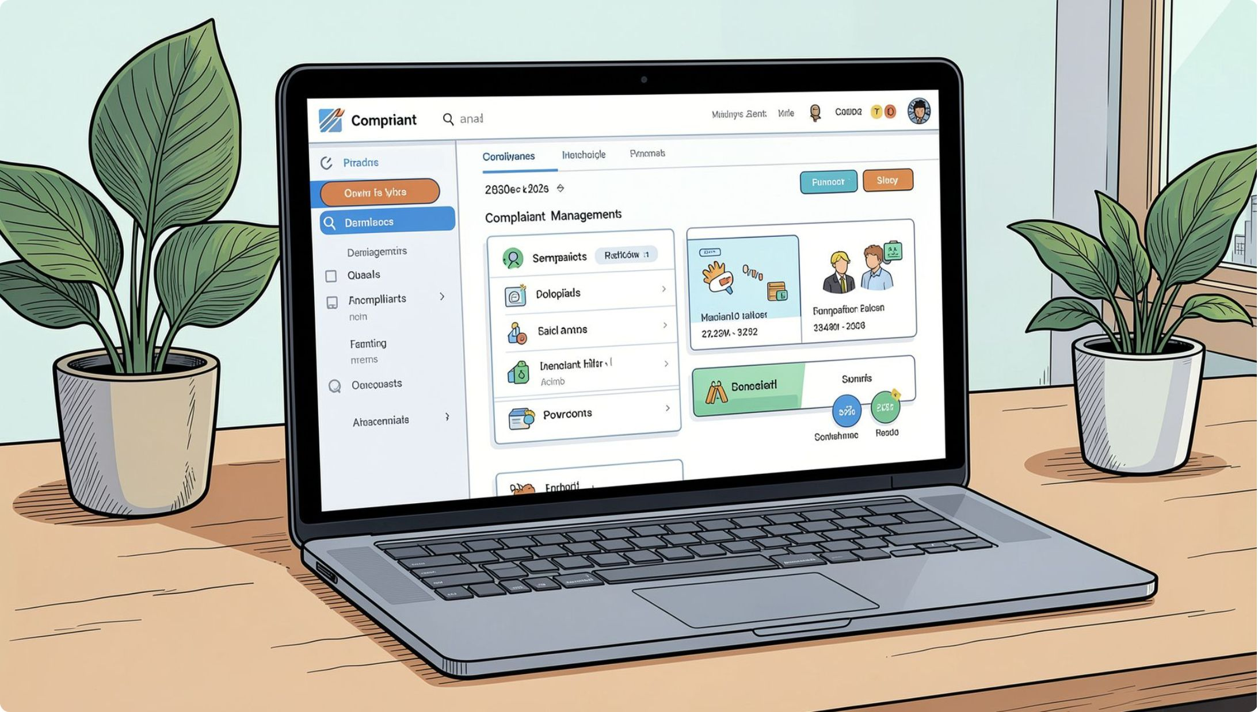
The Proposed Solution
An AI-enabled Complaint Redressal and Resolution Tracking Portal replaces fragmented processes with a single, intelligent platform — from first submission to final resolution.
Centralized Submission
Students submit complaints online with document uploads, replacing paper and email.
AI-Powered Classification
NLP automatically categorizes and routes complaints to the correct department.
Priority-Based Management
Urgency scoring ensures critical issues are escalated and resolved first.
End-to-End Transparency
Real-time status tracking and notifications keep students informed at every stage.

Slide 4

System Architecture & Core Modules
Student Interface
Web portal and document upload
AI Engine
NLP classification and scoring
Workflow Automation
Routing, assignment, escalation
Department Dashboard
Resolution tracking and updates
Admin Analytics
Reports and performance monitoring
The portal's architecture is organized into five interconnected layers, each handling a distinct stage of the grievance lifecycle — from initial submission through AI processing and automated routing to departmental resolution and administrative oversight.
Core Modules
Complaint Registration
AI Classification Engine
Priority Manager
Workflow Automation
Notification System
Admin Dashboard

Slide 5
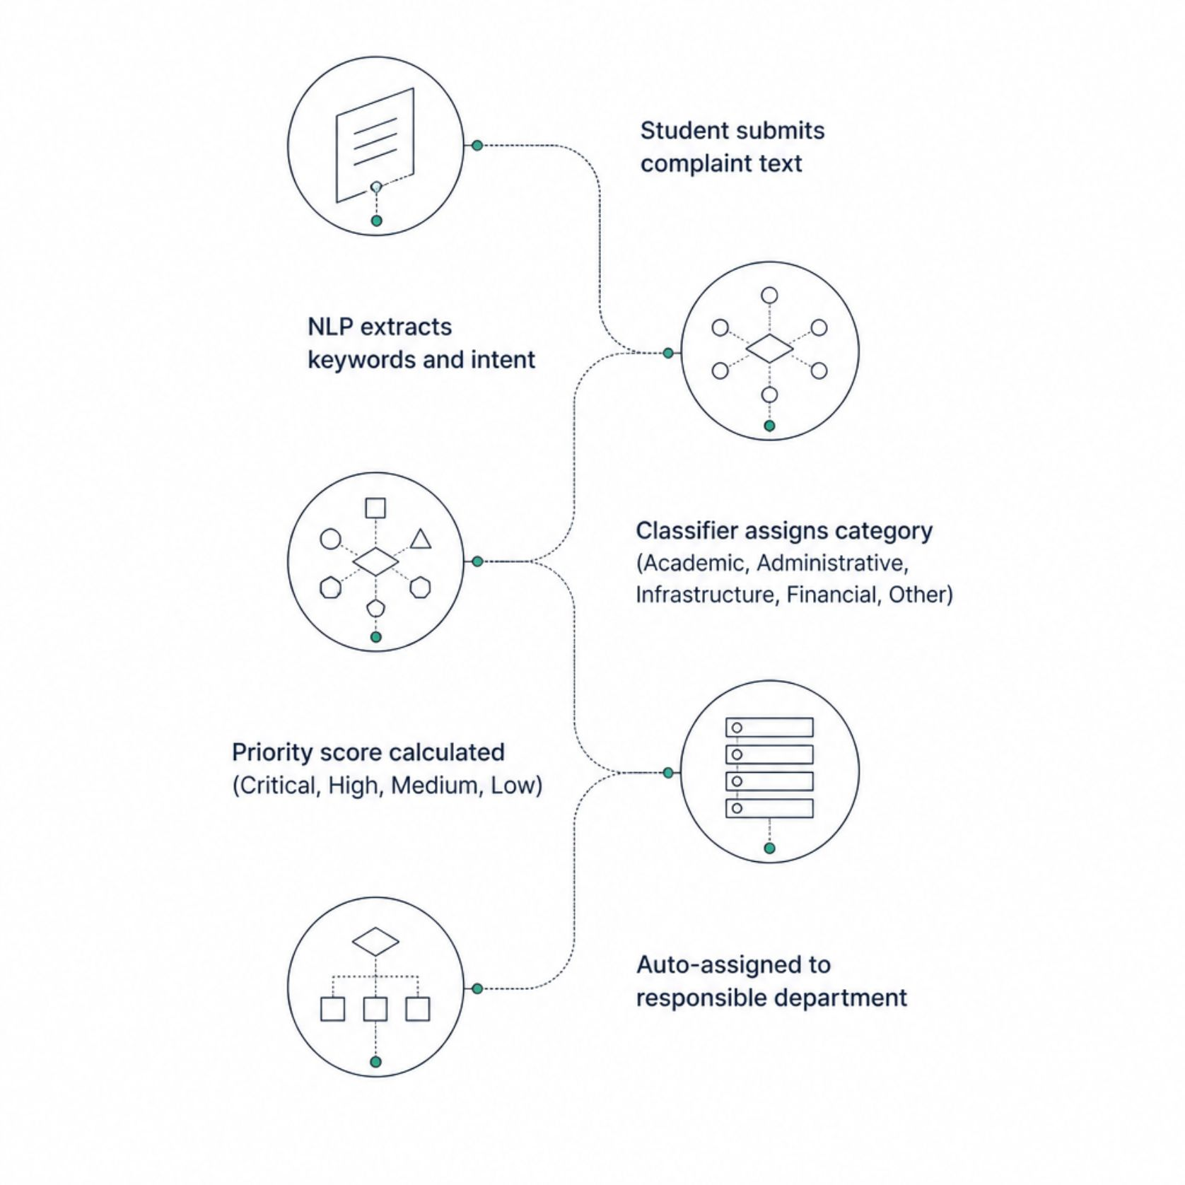
AI-Powered Complaint Classification
How NLP Drives Accuracy
Natural Language Processing analyzes the semantic meaning of each complaint, extracting intent, sentiment, and key entities to determine the correct category and urgency level — eliminating manual sorting errors.
Intent Recognition
Sentiment Scoring
Auto-Routing
Identifies the nature of the grievance from unstructured text.
Detects urgency and emotional tone to influence priority.
Instantly assigns complaints to the correct department.

Slide 6
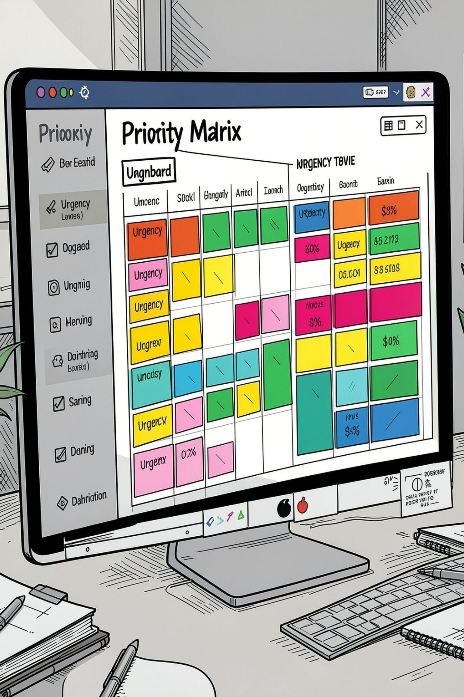
Priority-Based Issue Management
🔴 Critical
Immediate action required. Auto-escalated within 1 hour. Examples: safety, exam disputes.
🟠 High
Resolved within 24 hours. Examples: financial aid, registration blocks.
🟡 Medium
Resolved within 3 business days. Examples: facility issues, scheduling conflicts.
🟢 Low
Resolved within 7 days. Examples: general inquiries, feedback requests.

Slide 7



Portal Features by User Role
Students
Department Staff
Administrators
Submit complaints with document uploads
Track real-time status and history
Receive automated notifications
Provide post-resolution feedback
View assigned complaints by priority
Update resolution status and notes
Escalate complex issues
Access departmental performance data
Manage departments and user roles
Monitor response times and SLAs
Generate institutional reports
Analyze recurring issue patterns

Slide 8
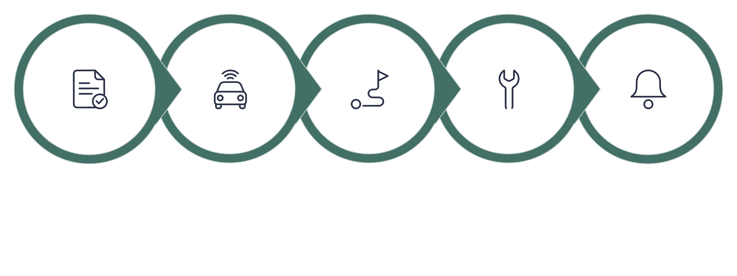
Complaint Lifecycle & Workflow
Submit
Classify
Assign
Resolve
Notify
Every complaint follows a structured, auditable lifecycle — from initial submission through AI classification, departmental assignment, resolution, and student feedback. Automated notifications are triggered at each stage, ensuring students are never left without visibility into their grievance's progress.

Slide 9

Measurable Benefits
3x
90%
Faster Resolution
Auto-Classification
Automated routing and prioritization dramatically cut resolution time versus manual processes.
AI accurately categorizes the majority of complaints without human intervention.
100%
40%
Transparency
Less Admin Effort
Every student has full visibility into complaint status from submission to closure.
Workflow automation significantly reduces manual workload for administrative staff.
The portal also strengthens accountability through audit trails, enables data-driven institutional decisions, and improves student satisfaction by ensuring no grievance goes unheard.

Slide 10
The Road Ahead: Future Enhancements
AI Chatbot Assistant
Multilingual Processing
24/7 conversational support for complaint guidance and status inquiries.
NLP models supporting regional languages for inclusive access.
Mobile Application
Cloud & ERP Integration
Native iOS and Android apps with push notifications and offline submission.
Seamless connection with institutional ERP, SIS, and cloud infrastructure.
Predictive Analytics
Voice-Based Submission
Identify recurring institutional issues before they escalate using trend modeling.
Speech-to-text complaint intake for accessibility and convenience.

