Slide 1
Types of interviews for Analytics / Data Science roles
Analytics Interviews
Technical
Behavioural
Skill assessment
Guess estimates
Case studies
Puzzles

Slide 2

Solving Guess-estimates

Slide 3
Solving Guess-estimates
It is the approach that matters – not the exact numbers
However, you should cross-validate numbers once you have them.
Always, I repeat always go top down.
Draw neat segmentation & diagrams
Keep a few common starting points / proxies on your finger tips
Population of your country, across the globe, GDP of your country
Analyze all possible uses of the subject
E.g. Tennis ball; B2B & B2C markets
Call out assumptions and possible blind spots

Slide 4
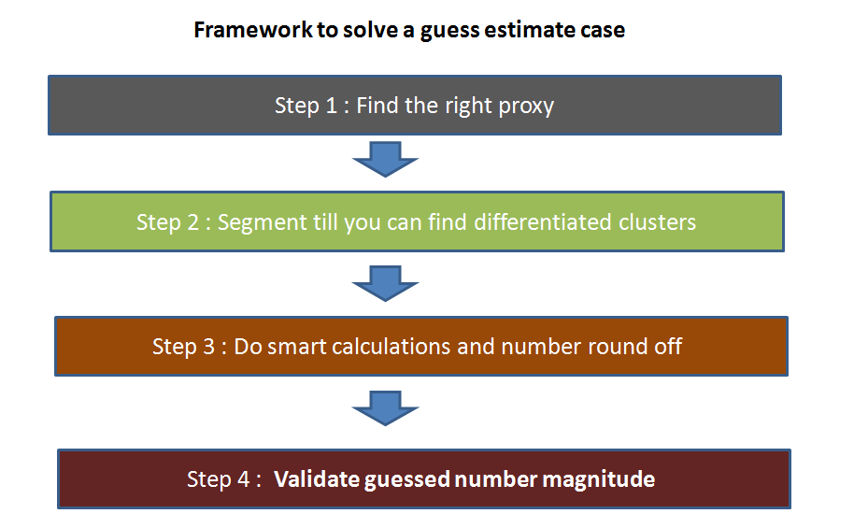
Framework to solve guess estimates

Slide 5
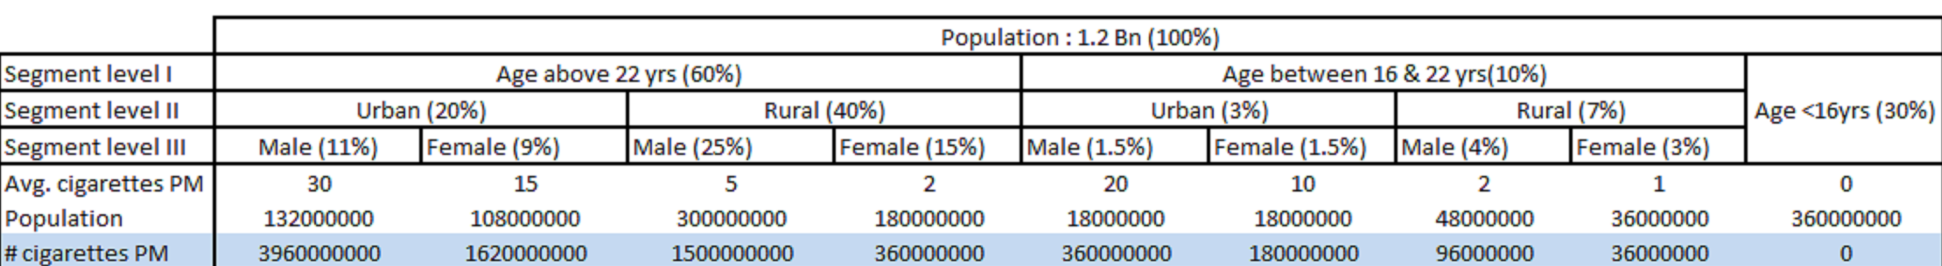
Guess-estimate example
Estimate number of cigarettes consumed in India

Slide 6
Guess estimate example - Assumptions / Considerations
The rural population consumes far lesser cigarettes than urban because of the purchasing power difference.
Male consume more cigarettes than female in both urban and rural populations.
Children below 16 years consume a negligible number of cigarettes.
Male to Female ratio in Urban is closer to 1 than that of Rural.
Male to Female ratio in younger generations is closer to 1 than that of older. This is because of the increase in awareness level.
Bulk of population start smoking after getting into a job and hence the average number cigarettes are higher in older groups.

Slide 7
A few other practice questions
Number of tennis balls used in India
Catch – Usage of tennis balls
Number of tablet used in India
Catch – B2B market (airlines, educational institutes etc.)

Slide 8
A few other examples to practice
Number of aircrafts in the air at this moment in time
Proxy – Airlines / Airports
Segment – Commercial + Cargo + Defense
Number of emails being sent across the globe at this moment in time
Proxy – Population
Segment – Professional + Personal + Spam
Amount of toll collected at Gurgaon toll at NH8
Proxy – Traffic pattern – Waiting time
Segment – Commercial and Personal
Market size for Pink Skateboards in France
Traffic between Bangalore and Chennai?

Slide 9
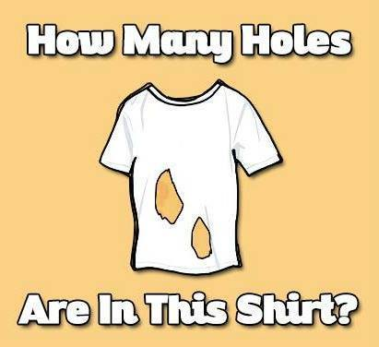
Puzzles

Slide 10
Frankly, puzzles are an unfair way to judge a candidate
You can know them before hand
At times, you just get it – without having a framework essentially
Don’t necessarily correlate with real life scenario
This also turns out to be an advantage for people who solve them

Slide 11
Puzzle 1
Two trains X and Y (80 km from each other) are running towards each other on the same track with a speed of 40km/hr. A bird starts from the train X and travels towards train Y with constant speed of 100km/hr. Once it reaches train Y, it turns and starts moving toward train X. It does this till the two trains collides with each other. Find the total distance travelled by the bird?
Time to solve – 1 minute
Answer – 100 kms

Slide 12
Puzzle 2
You have two beakers – one of 4 ltr and other of 5 ltr. You are expected to pour exactly 7 ltr in a bucket. How will you complete the task?
Time to solve – 2 minute
Answer – 100 kms

Slide 13
Puzzle 3
There are 5 pirates in a ship. Pirates have hierarchy C1, C2, C3, C4 and C5.C1 designation is the highest and C5 is the lowest. These pirates have three characteristics : a. Every pirate is so greedy that he can even take lives to make more money. b. Every pirate desperately wants to stay alive. c. They are all very intelligent.
There are total 100 gold coins on the ship. The person with the highest designation on the deck is expected to make the distribution. If the majority on the deck does not agree to the distribution proposed, the highest designation pirate will be thrown out of the ship (or simply killed). Only the person with the highest designation can be killed at any moment. What is the right distribution of the coins proposed by the captain so that he is not killed and does make maximum amount?
Time to solve – 15 minute

Slide 14
Puzzle 3
Solution : The solution of this problem lies in thinking through what will happen if all the pirates were thrown one by one and then thinking in reverse order.
Let us name pirates as A,B,C,D and E in hierarchy (A being highest).
If only D and E are left at end, D will simply give 0 coins to E and still escape because majority cannot be reached. Hence, even if E gets 1 coin he will give his vote to the distributor.
If C, D and E are there on the deck, C will simply give one coin to E to get his vote. And D simply gets nothing. Hence, even if D gets 1 coin he will give his vote to the distributor.
If B,C,D and E are there on the deck, B will simply give one coin to D to get his vote. C & E simply gets nothing.
If A,B,C,D and E are there on the deck, A simply gives 1 coin each to C and E to get their votes.
Hence, in the final solution A gets 98 coins and only C & E get 1 coin each.

Slide 15
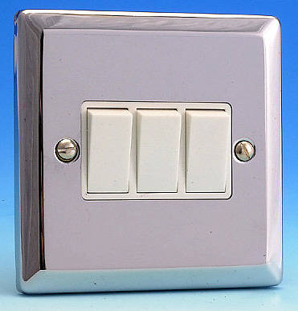

Room 1
Room 2

Slide 16
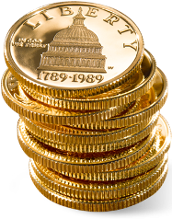

Slide 17
Additional puzzles to practice
Find the defective coin stack:
You have 10 stacks of 10 coins each. Each coin weights 10 gms. However, one stack of coins is defective and each coin in that stack weights only 9 gms.
What is the minimum number of weights you need to take to find which stack is defective? How?

Slide 18
Additional puzzles to practice
Find the fastest horses:
There are 25 horses. We have to find out the fastest 3 horses. In one race maximum 5 horses can run. How many such races are required in minimum to get the result?
Lie Tribe and Truth Tribe:
There are two tribes in Mars, Lie tribe and Truth Tribe. Lie tribe always speaks lie, True tribe always speaks truth. You meet three mars people and ask
From First Person: What tribe you belong to?, he replies something in his language which you don’t understand.
Second person tells that he is saying that he belongs to Lie Tribe.
Third person says that second person is lying.
What tribe does the third person belong to?

Slide 19
Additional puzzles to practice
You have 20 blue balls and 14 red balls in a bag. You put your hand in and remove 2 at a time. If they’re of the same color, you add a blue ball to the bag. If they’re of different colors, you add a red ball to the bag. (assume you have a big supply of blue & red balls for this purpose. note: when you take the two balls out, you don’t put them back in, so the number of balls in the bag keeps decreasing). What will be the color of the last ball left in the bag?

Slide 20
Case studies

Slide 21

Solving case studies
Case interviews are broad, two-way discussions rather than one-way tests. You will be assessed more on how you go about dealing with the problem rather than on the specific answers you come up with.

Slide 22
Case studies - A few things to remember
Structure, structure and structure!
Focus on frameworks
Call out assumptions
Think out loud – it is the thinking process, which matters
Lay out things neatly on paper

Slide 23
Flow of a typical case study
Start with a general question – test candidate on white space thinking
Provide specific numbers and ask for calculations / suggestions
Tweaks in problems to make it more interesting

Slide 24
Case study - example
Scenario:
You have just joined a new bank as a campaign manager. In this role, you will be responsible for sending out campaigns to potential customers.
Your manager tells you that there is a meeting in an hour, where you will need to decide, which service provider to choose for next campaign.
What factors would you consider?

Slide 25
Answers to avoid
Anything out of hat:
We will look at delivery rate and decide; (or)
We will go ahead with vendor, where we have better relationship
Instead lay out a framework and then explain factors:
ROI = Return / Cost = (Number of mails x Delivery rate x response rate x value) / (Number of mails x cost per mail)
Then layout the factors:
Capacity to deliver, cost to deliver, quality of delivery, brand awareness

Slide 26
Case study - example
Your new campaign is going to go out in a week time. You need to mail high quality marketing material to an identified set of customers. There are 2 options to send out this material:
Which option would you go with?
Service | Delivery rate | Cost (INR) / mail sent | Response rate | Life time value of a customer
A | 70% | 5 | 1% | 2000
B | 90% | 8 | 1.5% | 2000

Slide 27
Case study - example
Equation:
Return on campaign = Life time value of customer / Cost
= (1000 x 70% x 1% x 2000 / 1000 x 5) = 2.8 (for service A)
= (1000 x 90% x 1.5% x 2000 / 1000 x 8) = 3.375 (for service B)
Service | Delivery rate | Cost (INR) / mail sent | Response rate | Life time value of a customer
A | 70% | 5 | 1% | 2000
B | 90% | 8 | 1.5% | 2000

Slide 28
Case study - example
Possible re-evaluations
Post feedback from you, service A reviewed its service and is now ensuring a minimum delivery to 85% people – would you still stay with current partner?
Return on A now becomes: (1000 x 85% x 1% x 2000 / 1000 x 5) = 3.4
Possible shortcut = 2.8 x (85% / 70%)
Another smart solution – Given that the return is now very similar, we should look at other factors like compliance, quality of delivery, professionalism

Slide 29
Case study - example
Another complexity
Upon discussions with Service B, you realize that they only deliver in Metro and Tier 1 cities does not deliver to rural areas. For like to like comparison – their delivery rates are 95%. Which one would you now prefer?

Slide 30
Case study - summary
Will typically start from a broad question and would narrow down
Look out for cues from your interviewer
Keep a broad approach until and unless asked to narrow down
Structure, structure and structure!
Work in a manner that can be re-used later on

Slide 31
Few additional case studies available on the internet to practice
http://www.analyticsvidhya.com/blog/2014/02/interesting-analytics-case-study/
http://www.slideshare.net/Shelly38/case-interview-these-interviews-will-give-you-an-opportunity

Slide 32

Things to avoid in an analytics interview

Slide 33
Things to avoid in an analytics interview
Hygiene factors:
Reaching late
Messed up document folder - When someone asks you for the CV, it takes you more than 10 seconds to pull it out.
Not writing your case study solution in a structured fashion.
Common mistake
Keep re-usability in mind
If it is a coding assignment, not indenting and commenting your code. Same principle as the last point. It also shows, how much of your work would be re-usable by others.
If you have done something wrong, defending it rather than accepting it and correcting it.
Error / typo in a CV or a non-updated CV

Slide 34
Things to avoid in an analytics interview
Numerical abilities:
Using calculators / excel too often
Not taking shortcuts when they are available
Not triangulating numbers once they have been calculated.
Curiosity / Motivation:
Not asking enough good questions during the interview rounds or outside.
Not asking for clarity in an ambiguous / amorphous situation
Lack of energy at any point in time during the process.
Discomfort in doing white board discussions during the interview.

Slide 35
Things to avoid in an analytics interview
Problem solving:
Not suggesting unconventional solutions
Suggesting too complex solutions to simple business problems
Thinking about the problem on a single track (usually data driven solutions) rather than holistically (e.g. Marketing, Operations, etc.)

Slide 36
What should you expect through this workshop?
Understand what is an analytics interview?
How is it different from other interviews you may have faced?
What is the employer trying to evaluate you on?
How to prepare for analytics interview?
Case study and resources

Slide 37
Questions?

