Slide 1
GDP Assignment
IIITB Data Science Course I, Module 6
By: Hari Thapliyal

Slide 2
Part IA: GDP Analysis of Indian States

Slide 3
Task 1
Remove the rows: '(% Growth over the previous year)' and 'GSDP - CURRENT PRICES

Slide 4
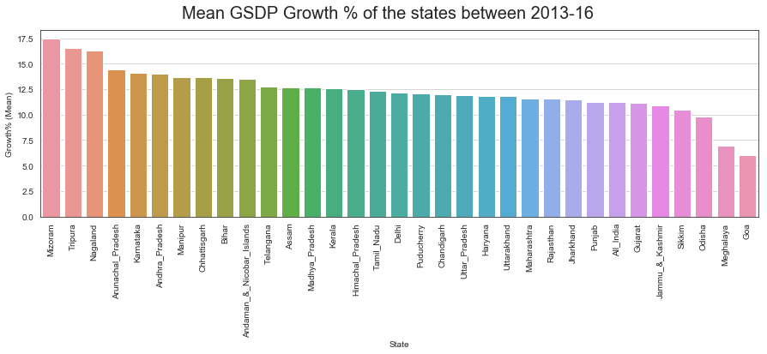
Calculate the average growth of states over the duration 2013-14, 2014-15 and 2015-16
Task 2
6 States
Has GDP Growth rate less than national average

Slide 5
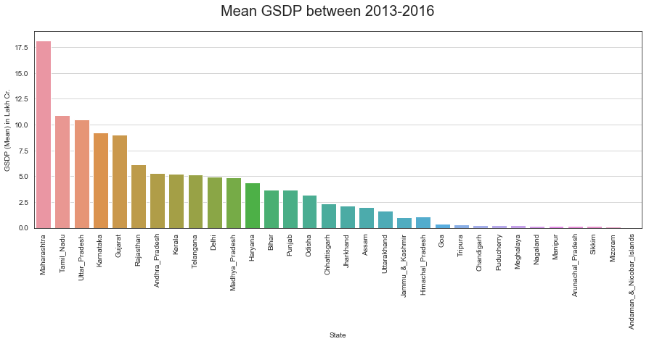
Mean GSDP of the states between 2013-16
Extra
5 States
Generates 50% of the GDP

Slide 6
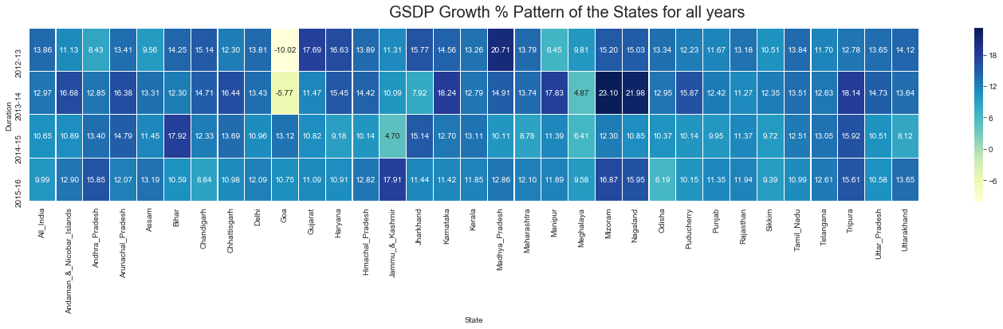
States have been growing consistently fast, and have been struggling on GDP?
Task 3

Slide 7
States have been growing consistently fast, and have been struggling on GDP?
Task 3
Growing | Maintaining | Ups & Downs | Declining
Andhra Goa (except 15-16) Manipur (except 13-14) Meghalaya (except 12 13) Telangana (except 15-16) | Delhi Puddu (except 13-14) Rajasthan (except 12-13) Tripura (except 13-14) Up (except 13-14) Uttrakhand (except 14-15) Up down | Andman & Nico Assam Bihar Himchal Pradesh Jammu & Kashmir Jharkhand Kerala Madhya Pradesh Maharastra Naga Punjab | Chandigarh Chattisgarh Gujarat Haryana Karnataka Odisa Sikkim (expcept 13-14) Tamil Nadu All India

Slide 8
Curiosity exercise
Task 4
My home state is Uttrakhand
What has been the average growth rate of your home state : 11.80
How does it compare to the national average over this duration?
  All India average growth is 11.20. My state is marginally better than national average

Slide 9

Plot the total GDP of the states for the year 2015-16
Task 5

Slide 10
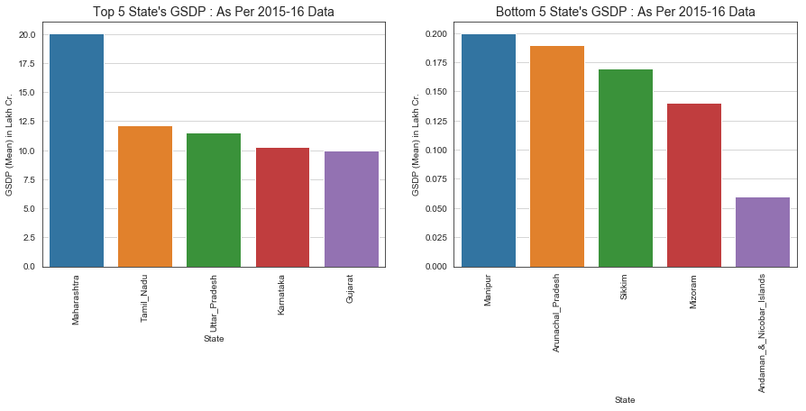
Identify the top-5 and the bottom-5 states based on total GDP
Task 6
All bottom 5 states are very small states. Except A&N Island all the NE States

Slide 11
Part IB: GDP Analysis of Indian States

Slide 12
Guidelines from IIITB
Task1: Perform the analysis only for the duration : 2014-15.
Task2: Filter out the Union Territories (Delhi, Chandigarh, Andaman and Nicobar Islands etc.) for further analysis since they are governed directly by the centre, not state governments.

Slide 13
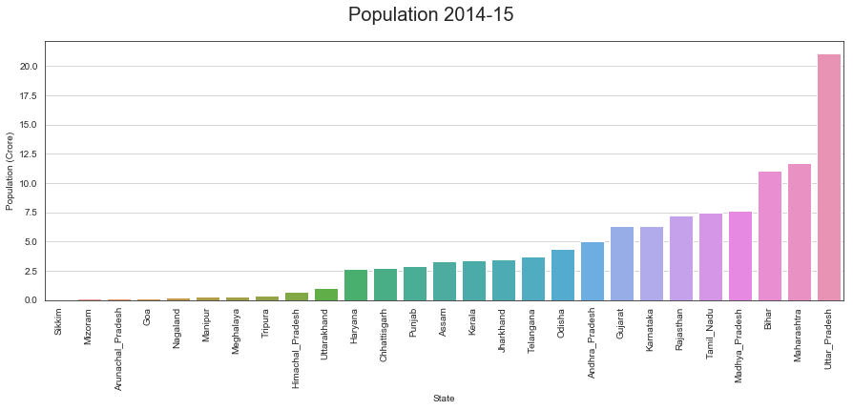
Population
Insight
58%
Population of India lives in 6 States

Slide 14
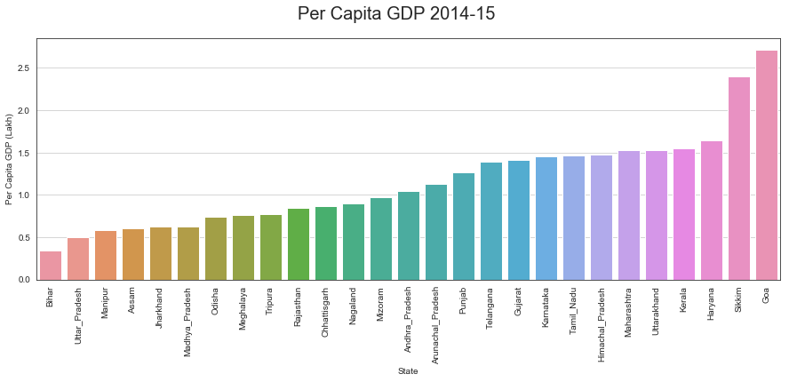
Plot the GDP per capita for all the states
Task 3
55%
Of the States has Per Capita GDP less than National Average
1.15 Lakh
National Average Per Capita GDP
Bihar & UP
2 large and
poor states

Slide 15
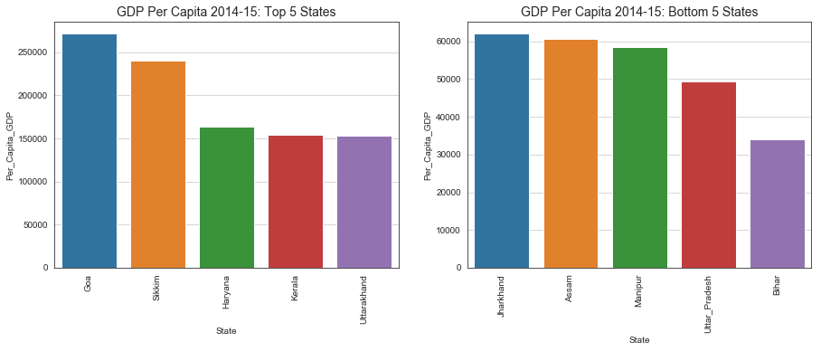
Top-5 and Bottom-5 States based on GDP per capita.
Task 4
Lessor the Population Higher the Per Capita GDP

Slide 16
Highest per capita GDP to the Lowest per capita GDP Ratio
Task 5
Max Per Capita Income is 271793.0 (Goa)
Min Per Capita Income is 33954.0 (Bihar)
Ratio of Max/Min Per Capita Income is 8.0

Slide 17
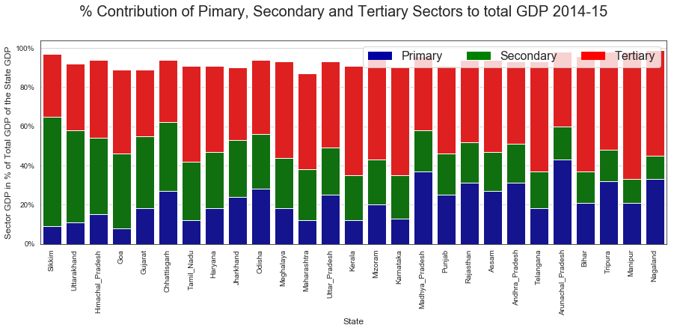
% Contribution of primary, secondary and tertiary sectors as a percentage of total GDP for all the states.
Task 6
Top 5
Primary Industry States
Arunanachal, MP, Nagaland, Tripura, Rajasthan
Top 5
Secondary Industry States
Sikkim, Uttrakhand, HP, Goa, Gujarat
Top 5
Tertiary Industry States
Manipur, Bihar, Telangana, Kerala, Karnataka

Slide 18
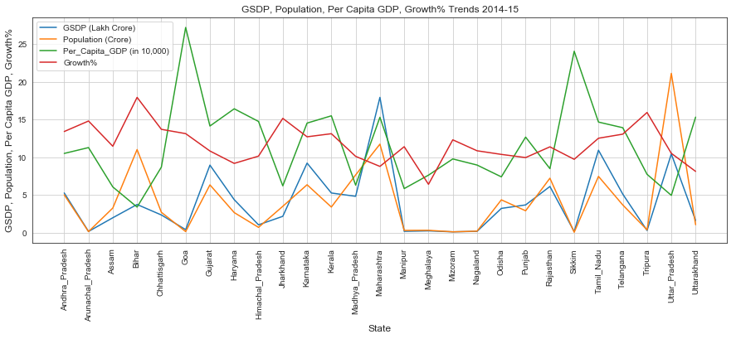
One metrics is not enough to measure the business success of a state
Extra

Slide 19
Categorize the states into four categories based on GDP per capita
Task 7
C1, C2, C3, C4 - C1 would have the highest per capita GDP, C4 the lowest. The quantile values are 0.20,0.5, 0.85, 1.
These subcategories of the states created based on the above given Percentile range of the Per Capita GDP as of 2014-15
C1 Category States: Uttarakhand, Kerala, Haryana, Sikkim, Goa
C2 Category States: Andhra_Pradesh, Arunachal_Pradesh, Punjab, Telangana, Gujarat, Karnataka, Tamil_Nadu, Himachal_Pradesh, Maharashtra
C3 Category States: Madhya_Pradesh, Odisha, Meghalaya, Tripura, Rajasthan, Chhattisgarh, Nagaland, Mizoram
C4 Category States: Bihar, Uttar_Pradesh, Manipur, Assam, Jharkhand

Slide 20
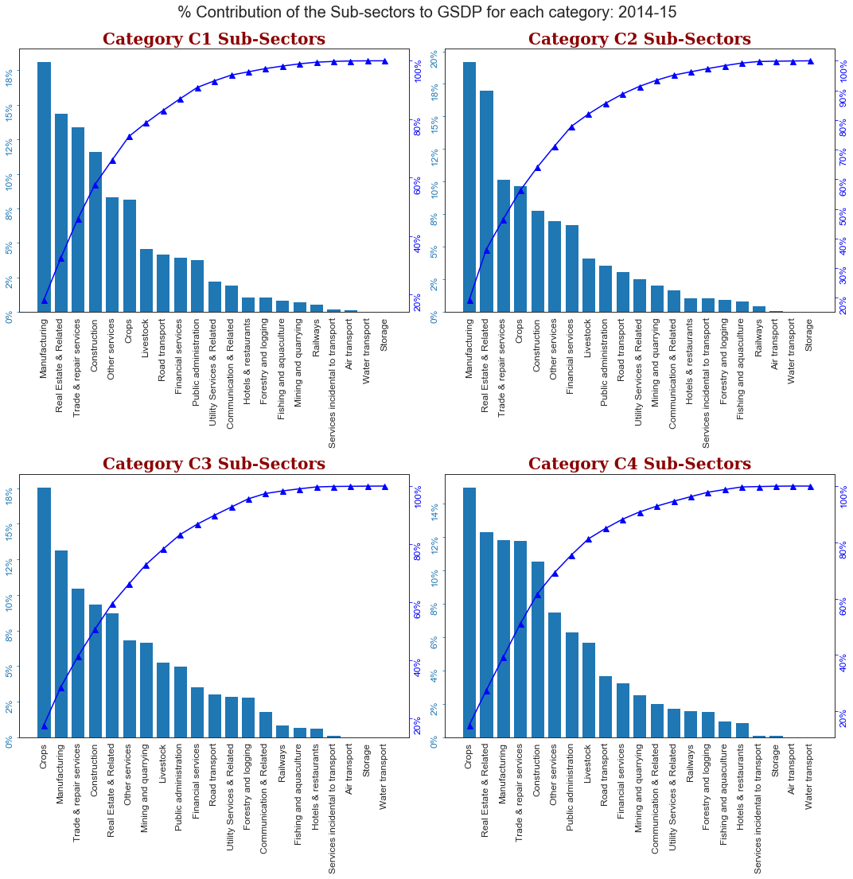
Contribution of all the sub-sectors as a percentage of the GSDP of each category
Task 9

Slide 21
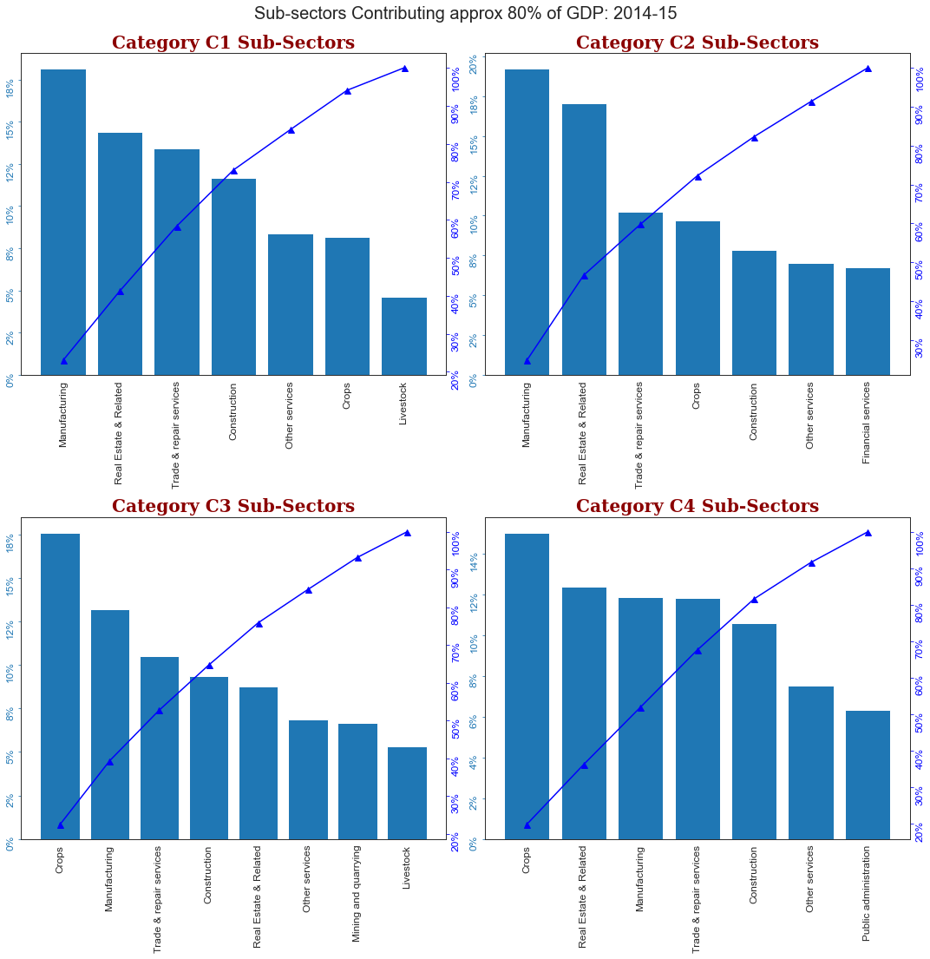
Top sub-sectors contributing approx. 80% of the GSDP of each category
Task 8
Most income for C1 & C2 from Secondary & Tertiary Sector
And C3 & C4 from Primary Sector

Slide 22
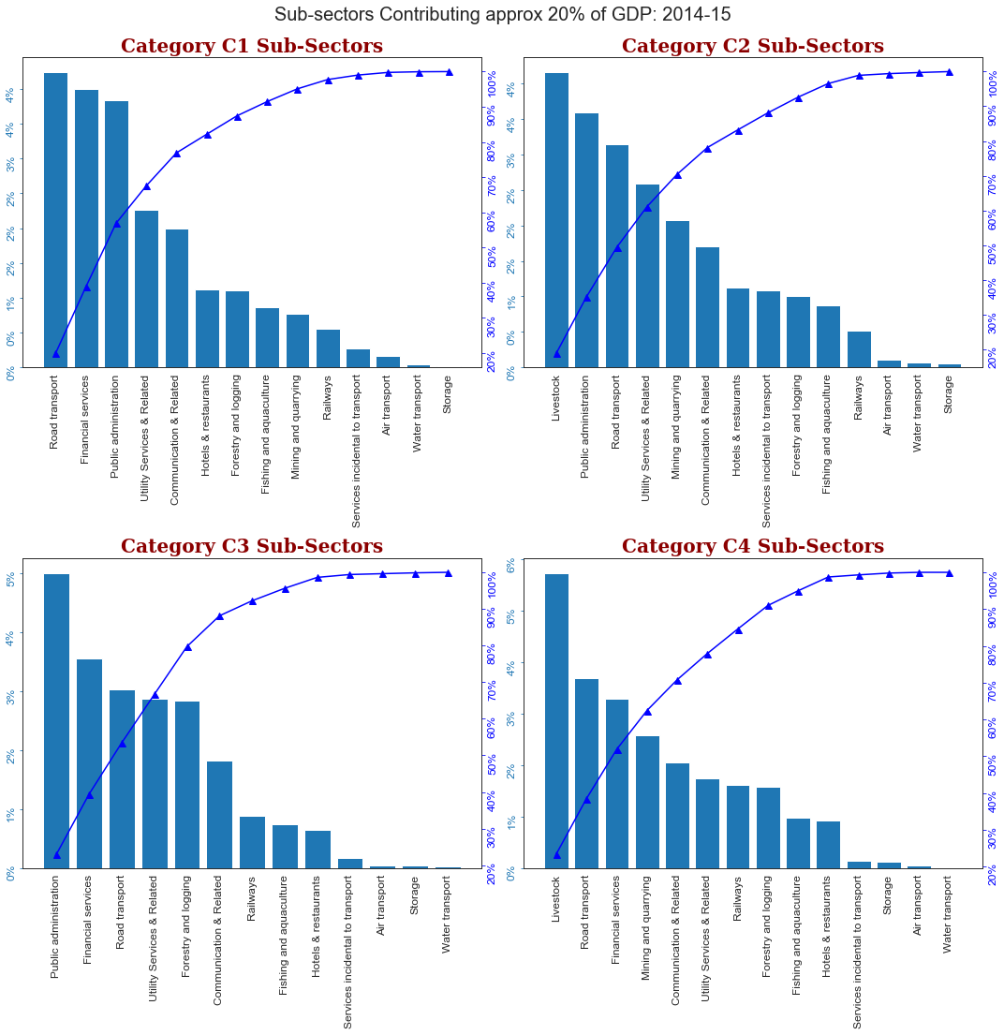
Industries Contributing 20% of GDP
Insight

Slide 23
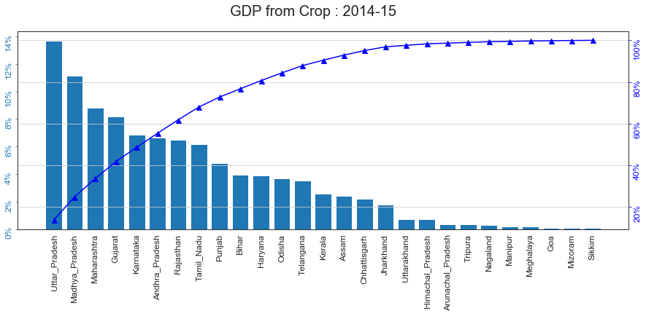
Insight
60% (approx.) Crop GDP from 4 States

Slide 24
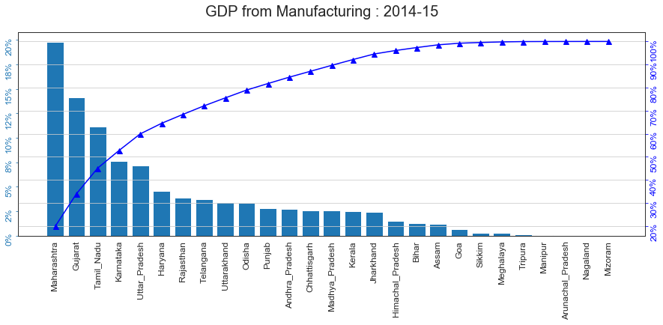
Insight
60% Manufacturing GDP from 5 States

Slide 25
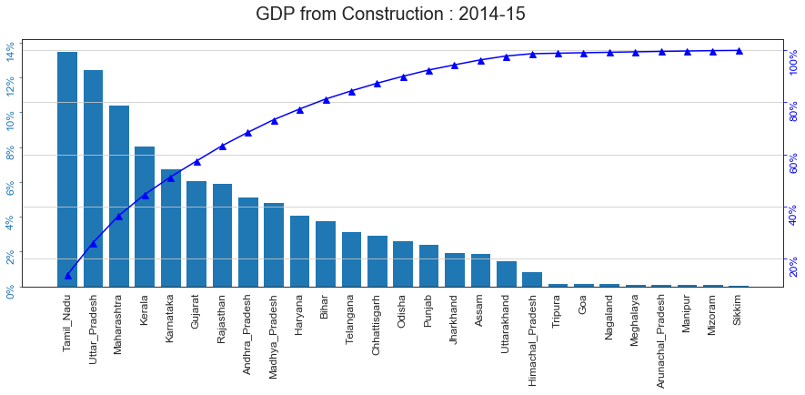
Insight
60% (approx.) Construction GDP from 6 States

Slide 26
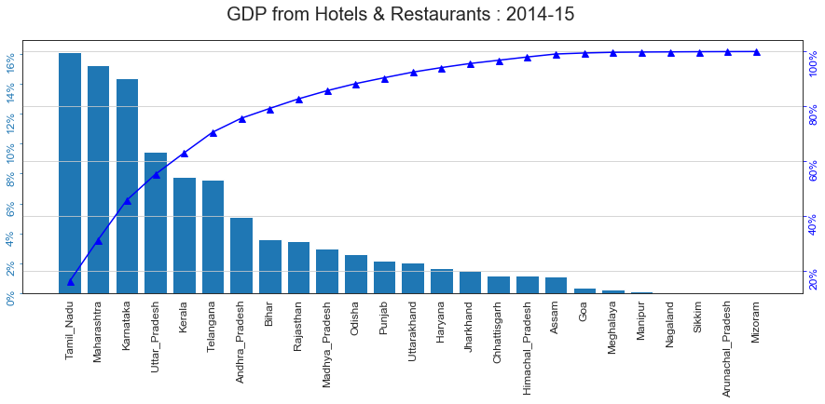
Insight
60% Hotel & Restaurant GDP from 4 States

Slide 27
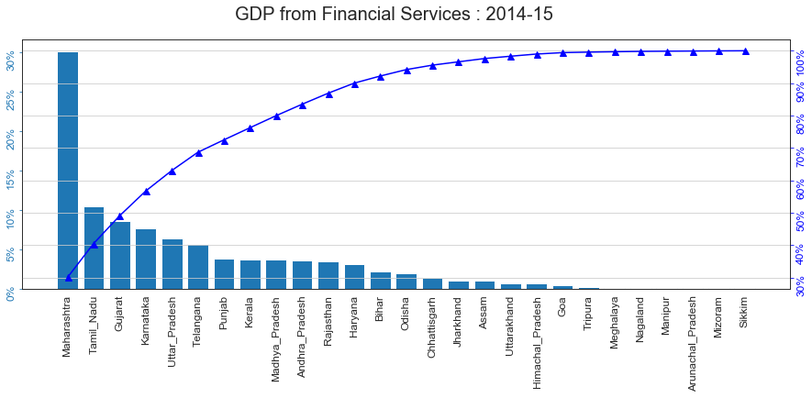
Insight
40% Financial Services GDP from 2 States

Slide 28
Observe non-obvious insights from Previous Analysis
Task 10
Crops | Manufacturing | Construction
Utter Pradesh Madhya Pradesh Maharastra Gurjarat | Maharastra Gujarat Tamil Nadu Karnataka Utter Pradesh | Tamil Nadu Utter Pradesh Maharastra Kerala
Hotel & Restaurants | Financial Services
Tamil Nadu Maharastra Karnataka Utter Pradesh | Maharastra Tamil Nadu Gujarat Karnataka

Slide 29
Write the key insights you observe from this data
Task 2
6 States which has GDP growth rate less than national average
  Gujarat, J & K, Sikkim, Odisha, Meghalaya, Goa
  But Gujrat and Goa has high Per Capita GDP.
5 States Generate 50% of the Total National GDP
  MH, TN, UP, KN, Gujarat
All bottom 5 states are very small states. Except A&N Island all the NE States
58% Population of India lives in 6 States
  UP, MH, Bihar, MP, TN, Rajasthan
Average National GDP is 1.15 Lakh Crore. 55% of the states has Per Capita less than national average
Bihar & UP 2 large and poor states
Generally Lessor the Population Higher the Per Capita GDP of States

Slide 30
Write the key insights you observe from this data
Task 2
Top 5 : Primary Industry States
  Arunanchal, MP, Nagaland, Tripura, Rajasthan
Top 5 : Secondary Industry States
  Sikkim, Uttrakhand, HP, Goa, Gujarat
Top 5 : Tertiary Industry States
  Manipur, Bihar, Telangana, Kerala, Karnataka

Slide 31
State Specific Questions
Extra
Why in spite of large geographical area Karnataka, MP, TN not able to generate more GDP from Crops?
Why naturally so rich and beautiful places like Kerala, Uttrakhand, North East are behind in Hotel & Restaurants which are normally related to tourism?
Kerala 4th Rank in construction can see larger impact in future on manufacturing. Is it so?
How come Secondary education & GDP has so strong relation?

Slide 32
Relevant Important Questions and insights for category separately
Task 11
C1
  What kind of technical training and youth involvement C1 states are do that with lowest population they have highest GDP
  What do they do to arrest the Primary & Upper Primary Edu dropout ?
C2
  C2 has higher per capita GDP compare to C3 but population of C2 is also high compare to C3. What are they doing to engage their youth?
  What do they do to arrest Primary & Upper Primary education dropout?
C3
  Why more subsidy for C3?
  Why even with the low population Secondary education drop is high for C3?
C4
  How come when population is high is Senior Secondary education dropout is exceptional less
  They have approx 8 times population but GDP is not even double of C1
  Why more subsidy for C4?

Slide 33
At least two recommendations for each category to Improve the per capita GDP
Task 12
Recommendations for C1 (100 Percentile)
  Improve Financial Services, Road Transport, Food Processing & Storage related industries
  Move towards rural development
Recommendations for C2 (85 Percentile)
  Improve Hotel & Restaurants, Communication, Public Administration related industries.
  Move towards rural development
Recommendations for C3 (50 Percentile)
  Move towards high manufacturing & Real Estate related industries
  Focus on Reducing Secondary Education dropout rate
Recommendations for C4 (20 Percentile)
  Move towards high manufacturing & Real Estate related industries
  Focus on Reducing Secondary Education dropout rate

Slide 34
Part 2 : GDP and Education Drop-out Rates

Slide 35
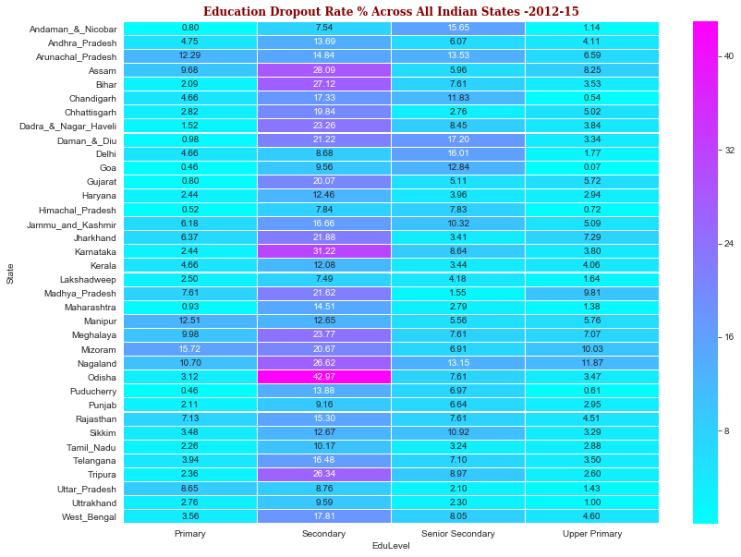
Education Dropout Rate % - 2012-15

Slide 36
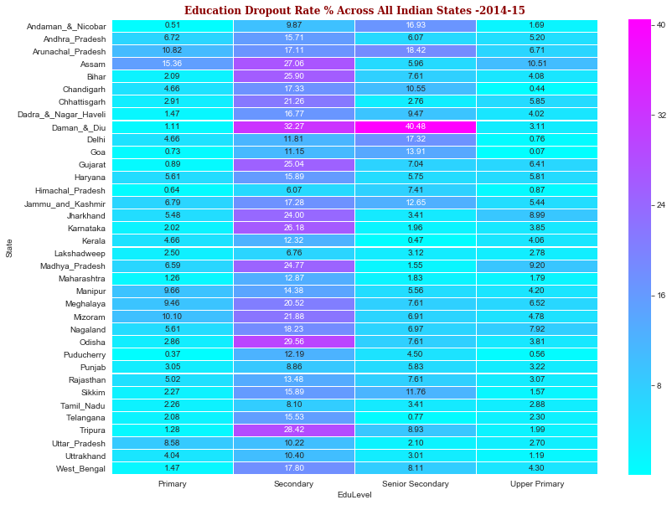
Education Dropout Rate % - 2014-15

Slide 37
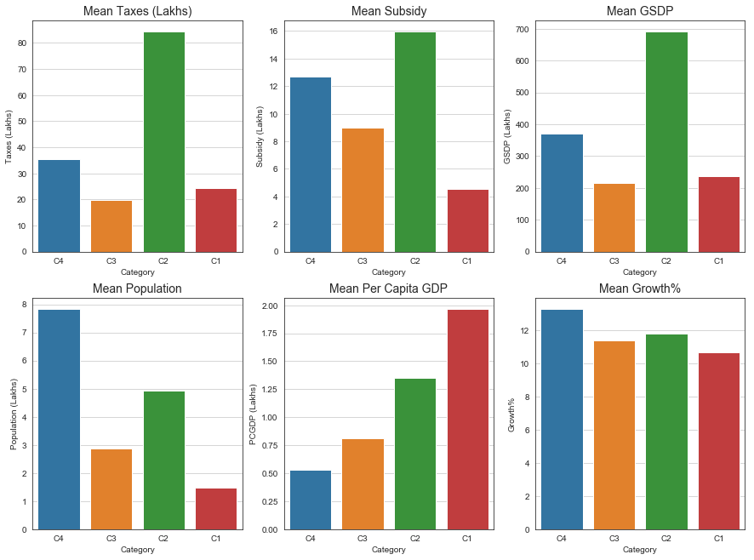
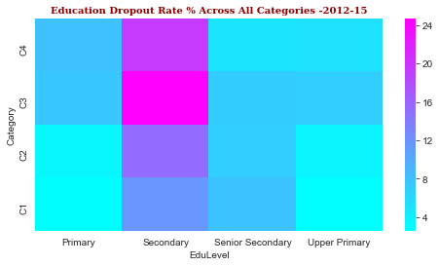
This is Very Interesting Graph
Insight

Slide 38
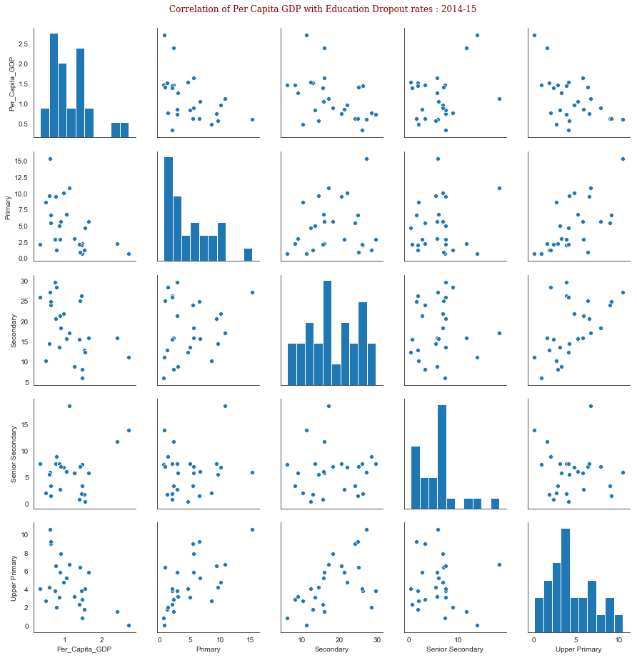
GDP/Capita to Education Dropout
Task 1

Slide 39
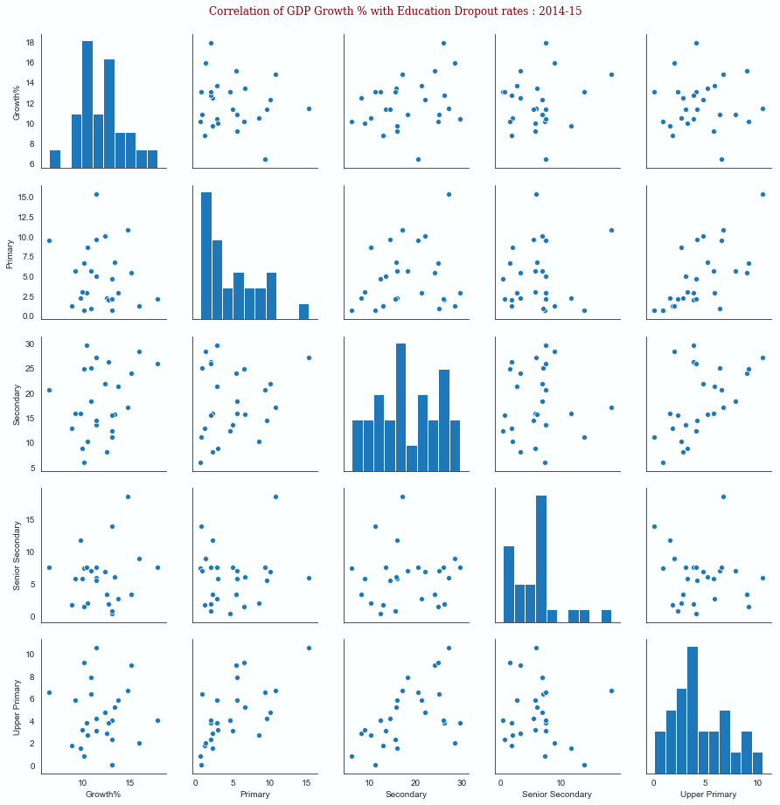
GDP Growth Rate to Education Dropout

Slide 40
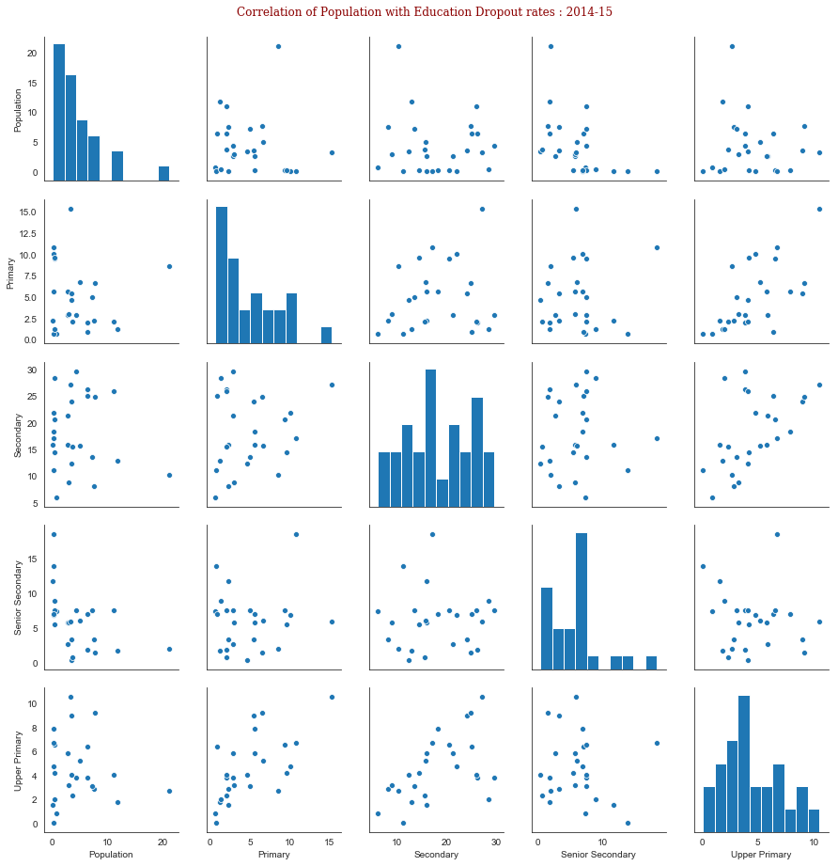
Population to Education Dropout

Slide 41

GSDP to Education Dropout
Extra

Slide 42

Primary Sector GDP to Education Dropout
Extra

Slide 43

Secondary Sector GDP to Education Dropout

Slide 44

Tertiary Sector GDP to Education Dropout

Slide 45
Sector wise Observations
Insight
C1 & C2 Overall Education dropout is less
C3 & C4 Overall Education dropout is very high
C3 & C4 States has unusual high Secondary Edu. Dropout
C3 & C4 States getting more subsidy compare to C1 & C2 states
C4 States has least dropout rate for Senior Secondary and Upper Secondary Edu.
C2 States: GSDP is more but Secondary & Sr. Secondary Education dropout is high of C2 states
C4 States has overall high growth rate
C1 States has lower growth rate
Overall growth rate there is not much significant difference between all 4 categories

Slide 46
Observations of GDP & Edu. Dropout Relation
Insight
Over all Secondary Education dropout is higher across India
In NE & High Population Density states Primary education drop out is more compare to other states
Once people enter into Upper Primary education then drop out rate is very less
In 2014-15 Senior Secondary education drop is unusual in A&N Iceland, Arunanchal and Daman Diu
Across all the states overall education dropout is very high for secondary education in comparison to other categories

Slide 47
Observations of GDP & Edu. Dropout Relation
Insight
Overall dropout and Per Capita GDP has + relationship. However, Senior Secondary dropout and Per Capita GDP has strong + relation
Overall dropout and GDP growth rate has + relationship. However, Secondary dropout and GDP growth rate has stronger +
Primary education dropout and GDP and weak negative relationship
Overall dropout and Population has no strong relationship of any kind
Upper Primary education dropout and Population and has weak positive relationship
Overall dropout and GSDP no strong relationship of any kind. However it is positve for Upper Primary Education dropout
Overall dropout and Primary Sector has + relationship. It is strong for Upper Primary & Secondary
Overall dropout and Secondary Sector has weak + relationship. It is strong for Upper Primary.
Overall dropout and Secondary Sector has weak + relationship
Secondary & Upper Primary dropout and Tertiary Sector has weak + relationship.

Slide 48
Task 3: Form at least one reasonable hypothesis for the observations from the data
Task 3
If we get more technical skill data then we will be able see the impact of that on GDP in a better way
Drop out from traditional schooling may have chosen technical schooling like ITI and it may have improved GDP in the subsequent year(s)
Impact of education drop out on GDP is very less in the same year but more in the consecutive years. Dropout does not mean that people went for production nor it means that they went for technical education. So the relationship between dropout and GDP looks more complex.

Slide 49



