Slide 1
Machine Learning1
Cluster-PCA Assignment)
IIITB Data Science Course 2
By: Hari Thapliyal

Slide 2
Problem Statement
The dataset given has financial, health, population growth, mortality related data of 167 countries of the world. HELP international need to allocate $10 million fund to the countries, who deserves the most. The challenges before us is to identify which 5 countries deserve this fund the most.
We should cluster these countries based on the given data. After we are done with clustering we need to select 5 countries from the created clusters.
Second problems which I tried to solve is if some new country is added in this dataset or values of given parameters of the existing country change then predict in which cluster that particular country should be placed.

Slide 3
Analysis Approach
Creating meaningful fields from % fields
Creating 2 more useful fields - Child_mortality_Fertality_Ratio, Life_expectency_Fertality_Ratio.
Scale the data using standard scaler
Perform PCA and get PCA features
Perform Hopkins Analysis- Data is good for Clustering?
Scree plot to Identify how many PCA will be sufficient to accommodate 90%+ variance
Visualize contribution of each original feature in important PCAs
Create a Dendogram
Perform silhoutte analysis, plot Elbow curve to determine how many clusters will be required
Decide the number of cluster required and assign those to PCA and original data
Determine the mean of gdpp, mortality, income for each cluster
Plot countries using PCA and important variables
Identify 5 countries which need the funding

Slide 4
Results of Principal Component Analysis and Clustering
Identified 4 PCA which can represent 91% of the variation in the dataset

Slide 5
Visualizations of the most Important Results

Slide 6
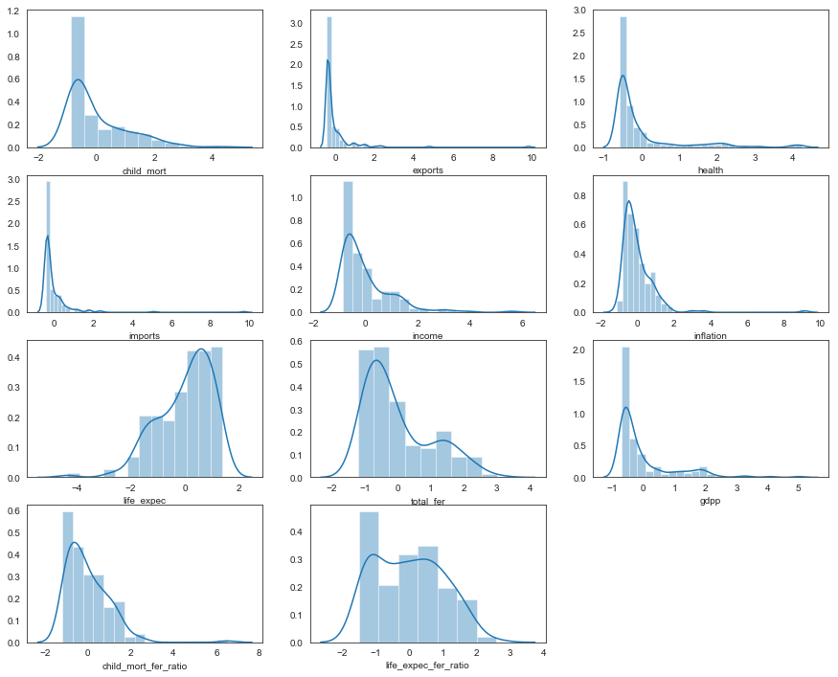
Data Distribution

Slide 7
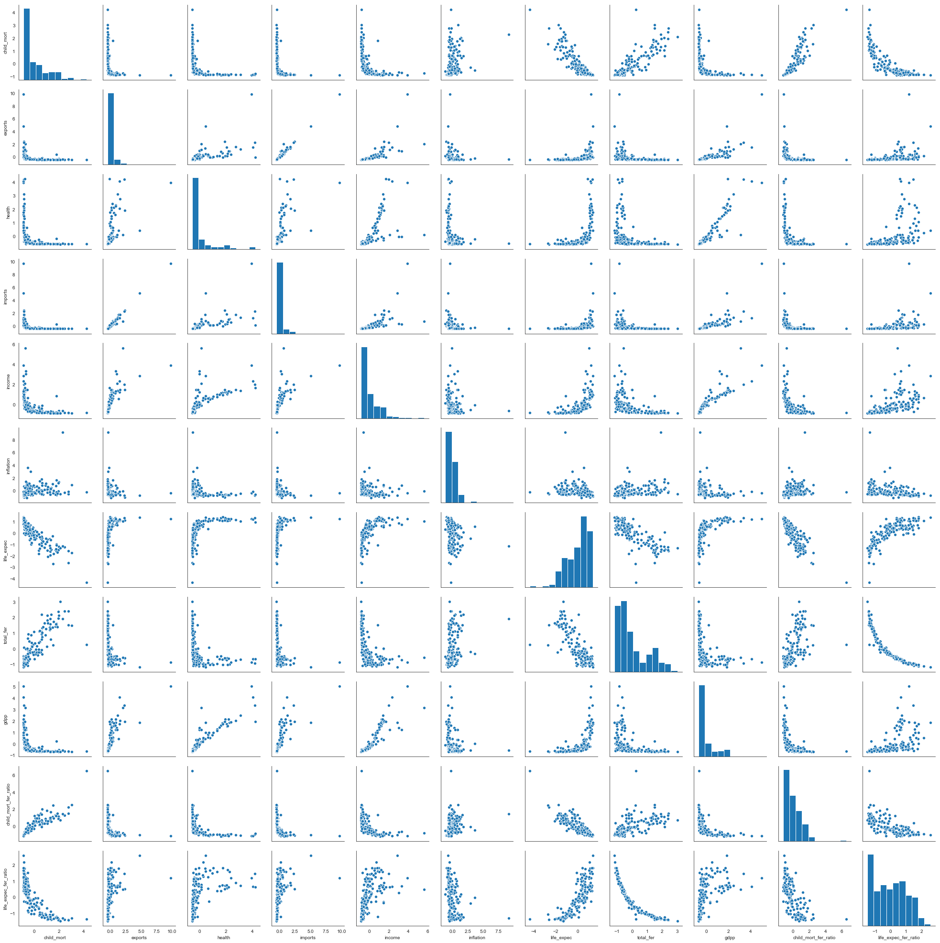
Correlation and Shape of Relation
From Top-bottom, Left-Right Variables name in this correlation graph
child_mort
exports
health
imports
income
inflation
life_expec
total_fer
gdpp
child_mort_fer_ratio
life_expec_fer_ratio

Slide 8
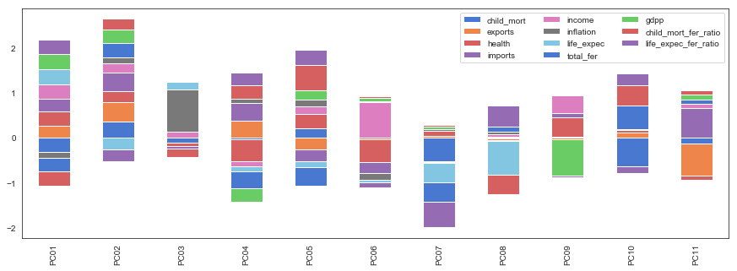
Contribution of Each Feature in PCA

Slide 9
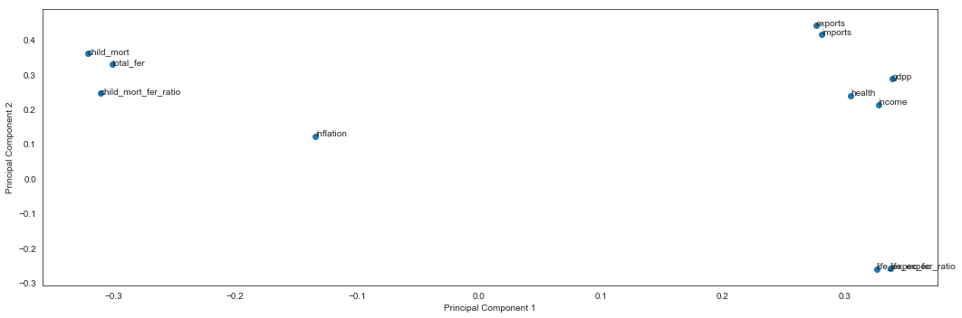
PC1 & PC2 Contribution of Original Features

Slide 10
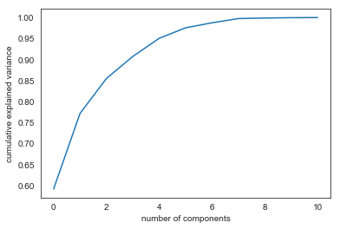
Screeplot
Screeplot –
Plotting the cumulative variance against the original number of components
Shows 4 PCA can explain 91 of variables

Slide 11
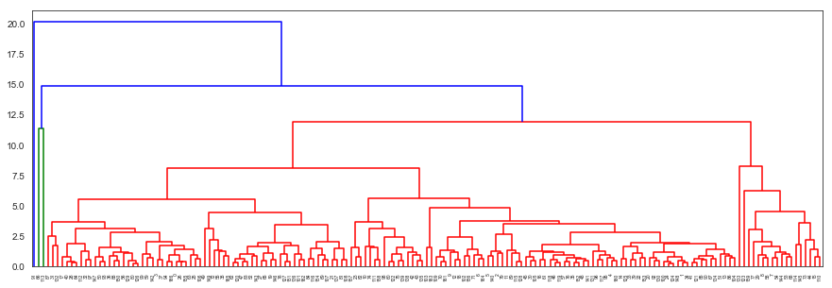
Dendogram Using PCA (Complete)

Slide 12
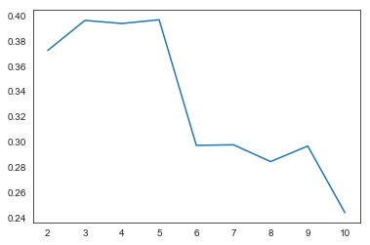
Silhouette Score

Slide 13
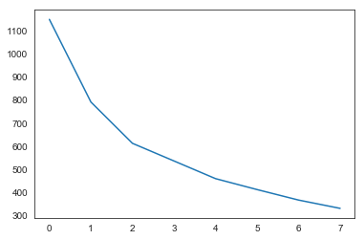
Elbow Curve

Slide 14
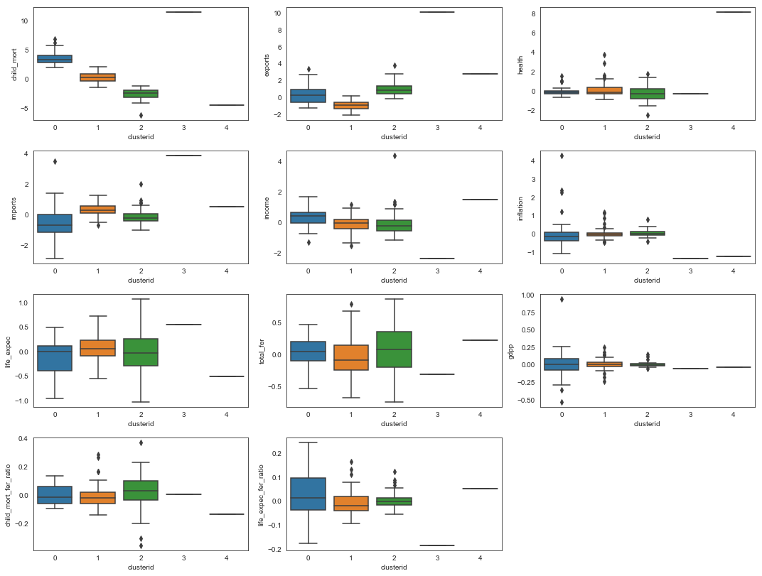
Distribution using PCA 5 Clusters

Slide 15
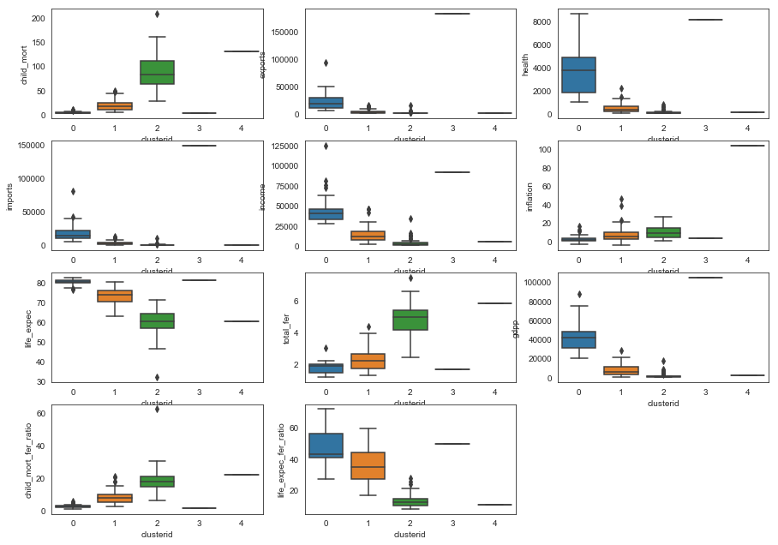
Distribution using Actual Data
7 Clusters

Slide 16
Countries in Clusters
Clusterid : 0
Australia, Austria, Belgium, Brunei, Canada, Cyprus, Czech Republic, Denmark, Finland, France, Germany, Greece, Iceland, Ireland, Israel, Italy, Japan, Kuwait, Malta, Netherlands, New Zealand, Norway, Portugal, Qatar, Singapore, Slovenia, South Korea, Spain, Sweden, Switzerland, United Arab Emirates, United Kingdom, United States
Clusterid : 1
Albania, Algeria, Antigua and Barbuda, Argentina, Armenia, Azerbaijan, Bahamas, Bahrain, Bangladesh, Barbados, Belarus, Belize, Bhutan, Bolivia, Bosnia and Herzegovina, Brazil, Bulgaria, Cambodia, Cape Verde, Chile, China, Colombia, Costa Rica, Croatia, Dominican Republic, Ecuador, Egypt, El Salvador, Estonia, Fiji, Georgia, Grenada, Guatemala, Guyana, Hungary, Indonesia, Iran, Jamaica, Jordan, Kazakhstan, Kyrgyz Republic, Latvia, Lebanon, Libya, Lithuania, Macedonia, FYR, Malaysia, Maldives, Mauritius, Micronesia, Fed. Sts., Moldova, Mongolia, Montenegro, Morocco, Nepal, Oman, Panama, Paraguay, Peru, Philippines, Poland, Romania, Russia, Samoa, Saudi Arabia, Serbia, Seychelles, Slovak Republic, Sri Lanka, St. Vincent and the Grenadines, Suriname, Thailand, Tonga, Tunisia, Turkey, Ukraine, Uruguay, Uzbekistan, Vanuatu, Venezuela, Vietnam

Slide 17
Clusterid : 2
Afghanistan, Angola, Benin, Botswana, Burkina Faso, Burundi, Cameroon, Central African Republic, Chad, Comoros, Congo, Dem. Rep., Congo, Rep., "Cote dIvoire", Equatorial Guinea, Eritrea, Gabon, Gambia, Ghana, Guinea, Guinea-Bissau, Haiti, India, Iraq, Kenya, Kiribati, Lao, Lesotho, Liberia, Madagascar, Malawi, Mali, Mauritania, Mozambique, Myanmar, Namibia, Niger, Pakistan, Rwanda, Senegal, Sierra Leone, Solomon Islands, South Africa, Sudan, Tajikistan, Tanzania, Timor-Leste, Togo, Turkmenistan, Uganda, Yemen, Zambia
Clusterid : 3 Luxembourg
Clusterid : 4 Nigeria

Slide 18
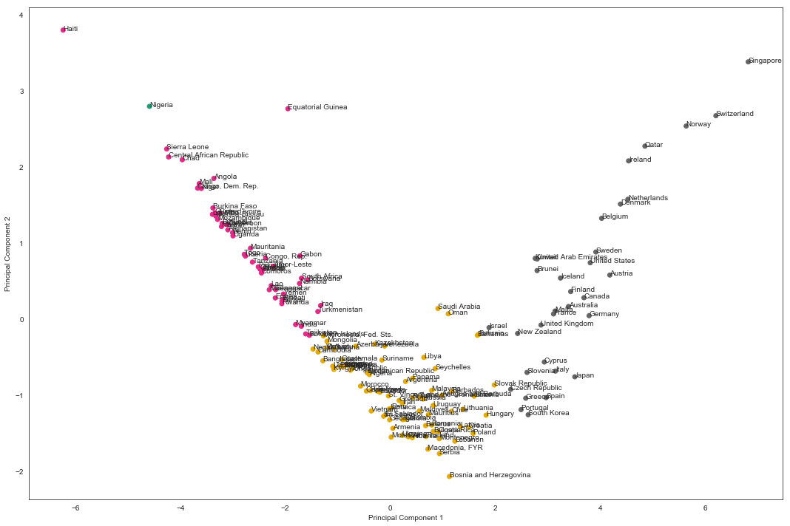
Clustering Using PCA1 & PCA2 Data

Slide 19
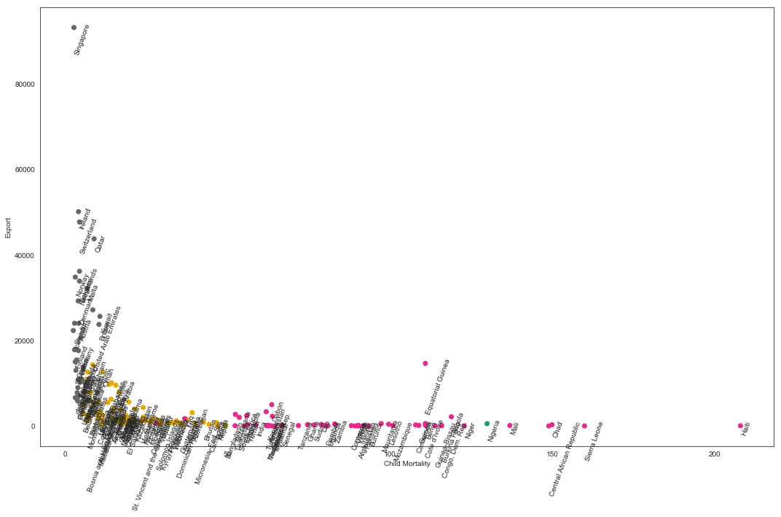
Clustering Using Actual Data

Slide 20
Final List of Countries
Haiti
Sierra Leone
Central African Republic
Chad
Mali

Slide 21
Hopkin Score
Hopkin Score of the created cluster is .854
It means the data in the dataset has high tendency of creating strong, cohesive clusters

Slide 22
Prediction using PCA
Using Hierarchical Clustering
Accuracy on Train Dataset : 0.98
Accuracy on Test Dataset : 0.98
Using KMeans Clustering
Accuracy on Train Dataset : 0.95
Accuracy on Test Dataset : 0.90

Slide 23



