Slide 1
Project Management Training
Tagros Chemicals
Hari Prasad Thapliyal
PMP, PMI-ACP, CSM, MBA, MCA, PGDOM, PGDFM, CIC, PRINCE2-Practitioner
PMO Architect & Project Management Evangelist
Vedavit Project Solutions
Cell: +91-95-3599-9336
Email: hari.Prasad@vedavit-ps.com
Website: www.pmlogy.com
'PMI-ACP', 'PMI', PMP, and 'ACP' are a registered marks of the Project Management Institute, Inc.

Slide 2
Themes
Day 1 : General Understanding
Day 2 : Planning
Day 3 : Managing
Day 4 : Governance
Day 5 : Closing
Copyright 2015 Vedavit Project Solutions

Slide 3
Planning
Project Integration Planning
Project Scope Planning
Project Time Planning
Project Cost Planning
Project Quality Planning
Project Communication Planning
Project Human Resource Planning
Project Risk Management
Project Procurement Management
Copyright 2015 Vedavit Project Solutions

Slide 4
Project Integration Planning
Determine Project Management Methodology
Determine Project Lifecycle
Determine Processes Required to Manage Project
Determine Configuration Management, Tools, Security Permission
Determine Change Management Processes
Copyright 2015 Vedavit Project Solutions

Slide 5
Scope Management
Copyright 2015 Vedavit Project Solutions

Slide 6
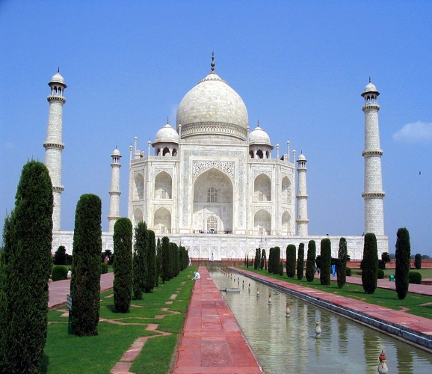
Copyright 2015 Vedavit Project Solutions

Slide 7
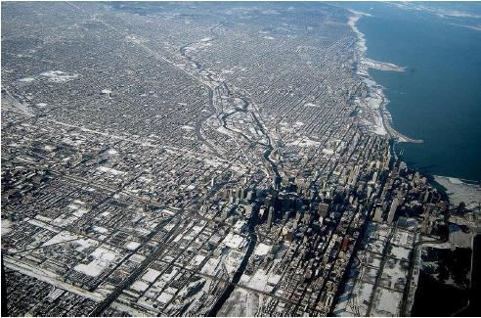

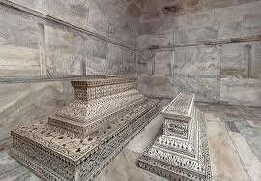
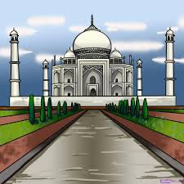
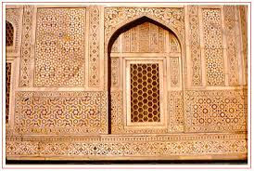
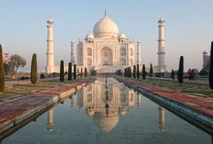
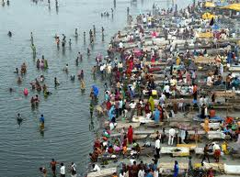
Level of Detailing in Scope
Copyright 2015 Vedavit Project Solutions

Slide 8
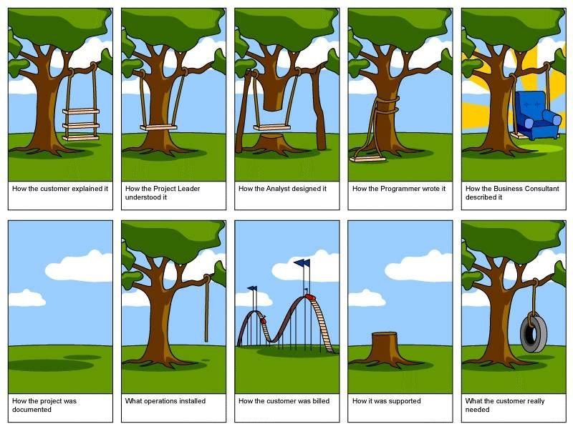
How the customer explained it
How the Project Leader understood it
How the Architect Designed it
How the Programmer wrote it
How the Business Consultant described it
How the project was documented
How operations installed it
What the customer really needed
How the customer was billed
How it was supported
Copyright 2015 Vedavit Project Solutions

Slide 9
Scope
Project Scope "The work that needs to be accomplished to deliver a product, service, or result with the specified features and functions."
Product Scope "The features and functions that characterize a product, service, or result."
Copyright 2015 Vedavit Project Solutions

Slide 10
Requirements
Product requirements (features). Product requirements describe the characteristics of the deliverables. If you were building a bridge, for instance, most of the requirements would be product based. These might include the number of cars the bridge would hold, the strength of the steel, the water level it needs to span, the color of the bridge, etc.
Process requirements (functions). Process requirements describe how people interact with a product and how a product interacts with other products. For example, when you discuss how data gets moved and how business transactions flow from one point to another, you are describing process requirements. If you need to describe the requirements for billing transactions, most of the requirements could end up being process oriented. This would include how billing transactions move from orders to invoicing to accounts receivable. They can describe at what points people look up a status, how people manually update an invoice and what people should do if accounts are out of balance.
Copyright 2015 Vedavit Project Solutions

Slide 11
Project Scope Planning
Establish a process & plan to manage scope (SMP)
Establish a process & plan to manage requirement: collection, elicitation, approval (RMP)
Establish a process & plan to trace requirements throughout the project lifecycle (RMP)
Establish a process & plan for requirement acceptance testing
Determine scope related metrics to manage the scope
Collect Requirements as per SMP & RMP
Analyse Requirements & Develop solution with various possible alternatives
Prepare a detail list of deliverables & related risk
Develop a WBS, WBS Dictionary
Establish control account
Document exclusions
Baseline Scope
Copyright 2015 Vedavit Project Solutions

Slide 12
Tools for Collecting Requirements
Interviews
Focus Groups
Facilitated Workshops
Group Creativity Technique
Group Decision Making Techniques
Questionnaires and Surveys
Observations
Prototypes
Benchmarking
Context diagrams
Document Analysis
Copyright 2015 Vedavit Project Solutions

Slide 13
Project Time Management
Copyright 2015 Vedavit Project Solutions

Slide 14
Project Time Planning
Establish a process and plan to manage time of project activities (ScMP)
Determine which attributes of the activities need to captured to manage them
Define activities as per ScMP
Sequence activities as Activity Attributes
Estimate Activity Resources
Estimate Activity Duration
Develop Schedule
Baseline Schedule
Copyright 2015 Vedavit Project Solutions

Slide 15
Define Activities
Use Scope baseline for this
Prepare a list of activities, milestones, activity attributes
Activity Attribute Example :
  Name, Location, Department, Dependency, Type, Constraints, Tracking Method, WBS Code, Cost, Duration, Resource Requirement, % Complete
Copyright 2015 Vedavit Project Solutions

Slide 16
Sequence Activities
Use lead and lag time properly
Understand dependency type apply them properly
  FS, SS, FF, SF
Use deadlines and time constraints of activities properly
Understand dependency is Hard Logic or Soft Logic
Copyright 2015 Vedavit Project Solutions

Slide 17
Estimate Activity Resources
Estimate skills required to perform activities
Estimate number and type of equipments, support services, material required to perform activities
Whether these resources are available within the organization or need to purchased/hired from outside
If they are available within organization can they be available for your project when and where you need them
Develop a Resource Breakdown Structure and Resource Requirements
Copyright 2015 Vedavit Project Solutions

Slide 18
Estimate Activity Duration
Consider risk around activities
Establish your project calendar (work timings, days in a week, off days of week, holidays, working hours everyday)
Consider availability of resources. Sometimes they are available but not 100%.
Consider productivity of resources. It is never 100%.
Know you are estimating ideal duration, not the actual duration, not the effort
Understand that every activity’s duration cannot be crashed by adding resources.
Methods of duration estimation: PERT, Analogous, Published Data, Parametric
PERT method help you in knowing confidence of your schedule
Finally 24 hours work duration is not 3 days, even if your office works 8 hours a day.
Copyright 2015 Vedavit Project Solutions

Slide 19
Develop Schedule
Analyse Dependencies
Analyse Lead/Lag
Analyse Constraints
Identify Critical Path
Identify Critical Activities
Identify Float of Activities
Understand where applying more resources will help you reducing project duration
Determine how you want to manage buffers
Discuss, negotiate, agree before you baseline schedule
Copyright 2015 Vedavit Project Solutions

Slide 20
Critical Path
ES EF
ES EF
ES EF
ES EF
ES EF
ES EF
Duration 7
Task A
Duration 6
Task C
Duration 3
Task G
LS LF
LS LF
ES EF
LS LF
Duration 2
Task H
Start
Finish
ES EF
ES EF
ES EF
LS LF
Duration 3
Task B
Duration 3
Task D
Duration 3
Task E
LS LF
LS LF
LS LF
ES EF
Duration 2
Task F
Copyright 2015 Vedavit Project Solutions
LS LF

Slide 21
Critical Path – Longest Path, Zero Float
0
0
0
ES EF
ES EF
ES EF
Duration 7
Task A
0
7
Duration 3
Task G
Duration 6
Task C
13
16
7
13
0
7
7
13
13
16
0
LS LF
LS LF
ES EF
LS LF
Duration 2
Task H
16
18
Start
Finish
7
7
7
16
18
ES EF
ES EF
ES EF
LS LF
Duration 3
Task B
0
3
Duration 3
Task D
3
6
Duration 3
Task E
6
9
7
10
10
13
13
16
LS LF
LS LF
LS LF
8
ES EF
Duration 2
Task F
3
5
11
13
LS LF
Copyright 2015 Vedavit Project Solutions

Slide 22
Discussion/Excertise-16
5 Minutes
ES EF
ES EF
ES EF
Duration 4
Task A
Duration 4
Task B
Duration 3
Task C
LS LF
LS LF
LS LF
ES EF
ES EF
Duration 10
Task G
Start
Duration 7
Task D
Finish
LS LF
ES EF
LS LF
ES EF
Duration 5
Task E
Duration 5
Task F
LS LF
LS LF
Copyright 2015 Vedavit Project Solutions

Slide 23
Network Exercise - solution
Critical Path : ADCG
ES EF
ES EF
ES EF
Duration 4
Task A
0
4
Duration 3
Task C
Duration 4
Task B
11
14
4
8
0
4
7
11
11
14
LS LF
LS LF
LS LF
ES EF
ES EF
Duration 10
Task G
14
24
Duration 7
Task D
Start
4
11
Finish
14
24
4
11
LS LF
ES EF
LS LF
ES EF
Duration 5
Task E
0
5
Duration 5
Task F
5
10
4
9
9
14
LS LF
LS LF
Copyright 2015 Vedavit Project Solutions
Notes:
Free float: An activity can be delayed without impacting the start of next activity
Total float: As many alternative path that many total float. Total float is available on non critical path. Activities can be delayed without delaying project
Free float on critical path activities is Zero

Slide 24
Facts/Tips for Critical Path
Total Float is the amount of time the task can delayed without delaying the project finish date.
Free float is the amount of time a task can slip without delaying the early start of any task that immediately follows it
It is possible that a zero float activity may not be on critical path
Longest path & shortest time possible to complete the project
A project can multiple critical paths
Difference between late and early is float
Positive float (the activity can wait to start even after previous activity finishes)
Negative float (the activity must start before previous finishes)
Zero float (the activity must immediately start after the finish of previous one)
Crashing activities to short the overall duration of project
Fast-tracking activities to short the overall duration of project
Be cautious that non-critical activity is not being delayed than the allowed free float
Take care of sub-critical path or non-critical path
Manage critical path resources very closely
Do not overload critical path activity resources
Avoid multitasking for resources working on critical path activities
Copyright 2015 Vedavit Project Solutions

Slide 25
Project Cost Management
Copyright 2015 Vedavit Project Solutions

Slide 26
Project Cost Management- A Thought
If you don't plan, it doesn't work. If you do plan, it doesn't work either. Why plan!
The same work under the same conditions will be estimated differently by ten different estimators or by one estimator at ten different times. So why to estimate!
Any project can be estimated accurately (once it's completed).
Nothing is impossible for the person who doesn't have to do it.
Right answers to wrong questions are just as wrong as wrong answers to right questions.
Copyright 2015 Vedavit Project Solutions

Slide 27
Project Cost Management
Copyright 2015 Vedavit Project Solutions

Slide 28
Project Cost Planning
Establish a process and plan to manage cost of project activities (CMP)
Consider the cost of procurements, risk management activities
Setup cost reporting systems and train project team
Understand different types of cost and their accrual methods
Estimate Cost of Each Activities
Develop project funding requirements
Baseline Project Cost
Copyright 2015 Vedavit Project Solutions

Slide 29
Tools for Cost Management
Analogous Estimating
Parametric Estimating
Bottom-up estimating
Three-point estimates
Reserve Analysis
Cost of Quality
Project Management Software
Vendor Bid Analysis
Group Decision Making Techniques
Funding Requirement Reconciliation
Cost Aggregation
Reserve Analysis
Historical Relationships
Copyright 2015 Vedavit Project Solutions

Slide 30
Cost Management Plan
It includes
  Cost management tools to be used
  Level of accuracy (acceptable range +/- 5%)
  Level of precision (US$ 100.01)
  Units of measure for each resource
  Organizational procedure links
  Process of updating the progress in schedule model
  Control thresholds (an allowed variation before some action need to be taken)
  Rules of performance measurement (baselines, %complete, fixed formula etc.)
  Project cost recording process
  Currency exchange rate fluctuation adjustment process
  Define scheduling reporting format
Copyright 2015 Vedavit Project Solutions

Slide 31
Project Cost Estimation Ranges
Cost estimation may include only Direct Cost or in combination of with Indirect Costs
Class Name | % | Range
Definitive | - 5 -> +5% | 10%
Capital Cost | -15 -> +10% | 25%
Appropriation | -25 -> +15% | 40%
Budget Estimates | -10 -> +25% | 35%
Feasibility | -35 -> +25% | 60%
Order of Magnitude | -50 -> +50% | 100%
Copyright 2015 Vedavit Project Solutions

Slide 32
Project Quality Management
Copyright 2015 Vedavit Project Solutions

Slide 33
Quality Definitions from Quality Gurus
“Quality is Predictability”- Deming
“Conformance to requirements” - Crosby
“Fitness for use” - Juran
“Customer’s opinion”- Feigenbaum
Conformance to “Valid Requirements“.
“Customers' perception of the value of the suppliers” work output.
A perceived degree of excellence with a minimum, usually set forth by the customer.
Best value for money.
Copyright 2015 Vedavit Project Solutions

Slide 34
Project Quality Planning
Understand Quality Expectations of the Stakeholders
Develop Quality Checklist
Understand Cost of Quality
Identify Quality Metrics to measure, improve project/product quality
Develop Quality Assurance Plan & Process
Develop Quality Management Plan & Process
Copyright 2015 Vedavit Project Solutions

Slide 35
Tools for Quality Management
Cost-benefit analysis
Cost of Quality
Seven basic quality tools
Benchmarking
Design of experiments
Statistical sampling
Additional quality planning tools
Meetings
Copyright 2015 Vedavit Project Solutions

Slide 36
Seven basic quality tools
Control Chart
Fishbone Diagram
Pareto Chart
Scattered Diagram
Histogram
Flowchart
Check sheet
Copyright 2015 Vedavit Project Solutions

Slide 37
Cost of Quality
Cost of Conformance | Cost of Non-conformance
Prevention Costs (Build a quality product) Training Document processes Equipment Time to do it right Appraisal Costs (Assess the quality) Testing Destructive testing loss Inspections | Internal Failure Costs (Failures found by the project) Rework Scrap External Failure Costs (Failures found by the customer) Liabilities Warranty work Lost business
Copyright 2015 Vedavit Project Solutions

Slide 38
Human Resource Planning
Establish Project Calendar
Create Role & Responsibilities based on skills required to perform project activities
Develop RACI Chart
Establish/Refine Job Description
Establish Project Organization
Establish Performance Appraisal Systems
Establish Conflict Management System
Establish Staffing Management Plan
Establish Team Building Plan
Establish Training Need and Training Plan
Establish Hiring Systems
Approve human resource management plan
Copyright 2015 Vedavit Project Solutions

Slide 39
Types of Power
  Formal – positional, granted by organizational/upper mgmt
  Expert – power earned through a recognized level of knowledge or skill in a specific area
  Reward – the power to give a positive consequences, like promotions, salary rise etc.
  Penalty – the power to provide negative consequences, like suspension, termination, reprimands
  Referent – power gained when team members admire, and willingly follow an individual as a role model
Copyright 2015 Vedavit Project Solutions

Slide 40
Team Development / Tuckman Model
  Five Stages of Team development
  Forming – Members of the group get to know each other and try to set up some ground rules about behavior
  Storming – Conflicts arise as various members of the group try to exert leadership and the methods of operation are being established
  Norming – Conflicts are largely settled and a feeling of group identity emerges
  Performing – Emphasis now is the task at hand
  Adjourning – The group disbands
  Sequence is followed for each individual/group
Copyright 2015 Vedavit Project Solutions

Slide 41
Conflict Management
Copyright 2015 Vedavit Project Solutions

Slide 42
Conflict Management
  Sources of conflict
  Schedules
  Project Priorities
  Technical Issues
  Personality Conflict
  Cost
  Scarce resources
  Personal work styles
  Administrative Procedures
Copyright 2015 Vedavit Project Solutions

Slide 43
Conflict Management
Characteristics of conflict
Conflict is natural and forces a search for alternatives
Conflict is team issue
Openness resolves conflict
Conflict resolution should focus on issues, not personalities
Conflict resolution should focus on the present not on the past
Copyright 2015 Vedavit Project Solutions

Slide 44
Conflict Resolution
Withdrawal – avoiding, giving up, stop gap, passive reaction, buying time, appropriate for “cooling off” time, no solution. Lose-lose outcome
Smoothing – grudging agreement, avoids conflict, appeasing, friendly atmosphere. No lasting solution, lose outcome
Compromising – bargaining, acceptable agreement, some satisfaction to each party, not ideal solution, trade off, a form of definitive solution. Lose outcome.
Confronting/Problem Solving – approached as an issue to be solved by examining alternatives.
Give and take attitude, open dialog – direct approach, pinpoints problem, develops alternatives, objectively resolves issues, time consuming, ultimate solution, Win-Win outcome
Collaborating – leading to consensus and commitment by incorporating multiple viewpoints and insights from differing perspectives.
Forcing – Uses power, used as a last resort, ill feeling may result, Win-lose outcome. Win-Lose outcome
Copyright 2015 Vedavit Project Solutions
Notes:
Withdraw: Many times collation parties gives warning and then withdraw the support. When one party feel that discussion will not bring any result and another party is strong
Smoothing: When both parties are trying to cover the actual issue to avoid the argument.
Compromising: When both parties leave something in order to achieve some peaceful solution

Slide 45
Conflict Resolution
HIGH
SMOOTHING
(ACCOMMODATING)
PROBLEM-SOLVING
(COLLABORATING)
RELATIONSHIP
ORIENTATION
COMPROMISE
WITHDRAWAL
(AVOIDING)
FORCING
(COMPETING)
LOW
        LOW OBJECTIVE ORIENTATION HIGH
Copyright 2015 Vedavit Project Solutions

Slide 46
Motivational Theories
  Frederick Herzberg's Hygiene & Motivation Factors
  Abraham Maslow’s Hierarchy of Needs
  Expectancy Theorem of Motivation by Victor Vroom
  Job characteristics model of Oldham-Hackman
  Theory X & Y of McGregor
Copyright 2015 Vedavit Project Solutions

Slide 47
Motivational Theories
  Frederick Herzberg
  Hygiene Factors and Motivating Agents (1954)
Hygiene factors
    Supervision
    Company policy and administrator
    Positive working Condition
    Interpersonal relations
    Job Security
    Status
    Compensation
    Personal life
      Presence will not guarantee higher productivity
      Absence will result in poor productivity
Copyright 2015 Vedavit Project Solutions

Slide 48
Motivational Theories
  Frederick Herzberg
  Hygiene Factors and Motivating Agents (1954)
  Motivating factors
      Achievements
      Recognitions
      Work Itself
      Responsibility
      Advancement
      Possibility for growth
      Motivation will not work without Hygiene.
Copyright 2015 Vedavit Project Solutions

Slide 49
Motivational Theories
  Abraham Maslow’s Hierarchy of Needs (1954)
  (In order of priority)
Self Actualization
Self fulfillment, growth, learning
Accomplishment, Respect, Attention, Appreciation
Esteem
Love, affection, approval, friends, association
Social
Security, stability, freedom from threat and physical harm
Safety
Physiological
Air, water, food, house, clothing
Copyright 2015 Vedavit Project Solutions

Slide 50
Motivational Theories
  Expectancy Theorem of Motivation by Victor Vroom
  The extent to which an individual is motivated…
  The level of expectation of their efforts will result in a desired outcome (effort performance linkage)
  (Is the work important?)
  The expectation that good work will be rewarded (Performance-reward linkage)
  (Will I be rewarded?)
  Attractiveness of the reward
  (What is the value of the reward?)
  Motivation will be high when all three factors are high
Copyright 2015 Vedavit Project Solutions

Slide 51
Motivational Theories
  The Oldham-Hackman job characteristics model
  Skill Variety – the number of job skills that the job holder has the opportunity to exercise
  Task Identity – the degree to which your work and its result are identifiable as belonging to you
  Task Significance – the degree to which your job has an influence on others
  Autonomy – the discretion you have about the way that you do the job
  Feedback – the information that you get back about the result of your work
Copyright 2015 Vedavit Project Solutions

Slide 52
Motivational Theories
  McGregor’s Theory X
  The average worker is inherently lazy and needs supervisions
  The average worker dislikes work and avoids work whenever possible
  To induce adequate effort, the supervisor must threaten punishment and exercise careful supervision
  The average worker avoids increased responsibility and seeks to be directed
  Theory X relies on Strict Rules, Performance incentives, Rewards, Threats to job security
Copyright 2015 Vedavit Project Solutions

Slide 53
Motivational Theories
  McGregor’s Theory Y
  Workers are willing to do the job without continuous supervision
  The average worker wants to be active and finds the physical and mental effort on the job satisfying
  Greatest results come from willing participation which will tend to produce self-direction towards goals without coercion and control
  The average worker seeks opportunity for personal improvement and self respect
  Theory Y relies on worker participation in decisions, cordial manager-worker relationships, worker designed job methodology, worker individualism
Copyright 2015 Vedavit Project Solutions

Slide 54
Leadership Theories
  Leadership Theories
      Theory Z of William Ouchi
      Contingency Theory of Fred Fiedler
Copyright 2015 Vedavit Project Solutions

Slide 55
Leadership Theories
Theory Z Proposed by William Ouchi
According to Theory Z, people who don’t fit either Theory X or Theory Y are really a combination of the two.
People who develop a leadership style based on Theory Z, use different styles of leadership with different people, depending on the situation.
Copyright 2015 Vedavit Project Solutions

Slide 56
Leadership Theories
Contingency Theory of Fred Fiedler
  No theory is best theory. Because best depends upon individual manager and organization.
  Built on a combination of Theory Y behaviors and the Hygiene Theory
  People are motivated to achieve level competency and will continue to be motivated by this need even after competency is reached
Copyright 2015 Vedavit Project Solutions

Slide 57
Key to Successful Team Management
Listens to subordinates to diagnose or solve problems
Sets goals and develops short- and long- range action plans
Gives directions about who is to do which tasks to what standards
Provides feedback on task performance
Rewards or disciplines task performance and personal characteristics
Develops subordinates
Copyright 2015 Vedavit Project Solutions

Slide 58
Key to Successful Team Management
  Understanding that team is an Integral Unit of Organization
  A team mission, objective, goals, strategy and role definition
  A leader and an organizational support system
  Managers responsive to needs of team members
  Encourage participation and effective communication
  Foster an atmosphere of trust among team members
  Provide feedback effectively
  A collective culture and style
  Motivate team members with challenges & rewards
Copyright 2015 Vedavit Project Solutions

Slide 59
Project Communication Management
Communication Channels
Copyright 2015 Vedavit Project Solutions

Slide 60
Communication Requirement Analysis
Communication Technology
Communication Models
Communication Methods
Meetings
Copyright 2015 Vedavit Project Solutions

Slide 61
Communication Methods
  Which communication technology should be used depends upon what communication method is the needed
  Three Communication Methods
  Interactive Communication
    Phone, audio/video conferences, moderator lead discussion, workshop
  Push Communication
    Letters, memos, reports, emails, faxes, voice mail, press releases
  Pull Communication
    e-learning, knowledge repository, unknown people
Copyright 2015 Vedavit Project Solutions

Slide 62
Communication Model
Source
Encoding
Message
channel
Decoding
Receiver
Noise
Feedback
Copyright 2015 Vedavit Project Solutions

Slide 63
Project Risk Management
Copyright 2015 Vedavit Project Solutions

Slide 64
Project Risk Management
  Plan Risk Management [PLANNING]
  Identify Risks [PLANNING]
  Perform Qualitative Risk Analysis [PLANNING]
  Perform Quantitative Risk Analysis [PLANNING]
  Plan Risk Responses [PLANNING]
  Control Risks [M&C]
Copyright 2015 Vedavit Project Solutions

Slide 65
Project Risk Management
Copyright 2015 Vedavit Project Solutions

Slide 66
Project Procurement Management
  Plan Procurements [PLANNING]
  Conduct Procurements [EXECUTING]
  Administer Procurements [M&C]
  Close Procurements [CLOSING]
Copyright 2015 Vedavit Project Solutions

Slide 67

Hari P Thapliyal,
PMP, PMI-ACP, MCITP, Princ2 Practitioner, CSM, MBA, MCA, CIC, PGDFM
PMO Architect & Project Management Evangelist
Profile: http://in.linkedin.com/in/harithapliyal
For content related queries please contact me via
hari.Prasad@vedavit-ps.com
This document is proprietary and confidential. It remains the property of Vedavit Project Solutions at all times. No part of this document may be used, reproduced, or transmitted in any form or by any means electronic, including photocopying and recording, for any purpose without express consent of Vedavit Project Solutions.

