Slide 1
Pharmaceutical
Discussion on 05-Feb-2011
With FIL

Slide 2
Major Companies in India
Pfizer
Glaxo
Ranbaxy
Cipla
JK
Sarabhai
Torrent
Dr. Reddy
Hindustan Antibiotics
IDPL

Slide 3
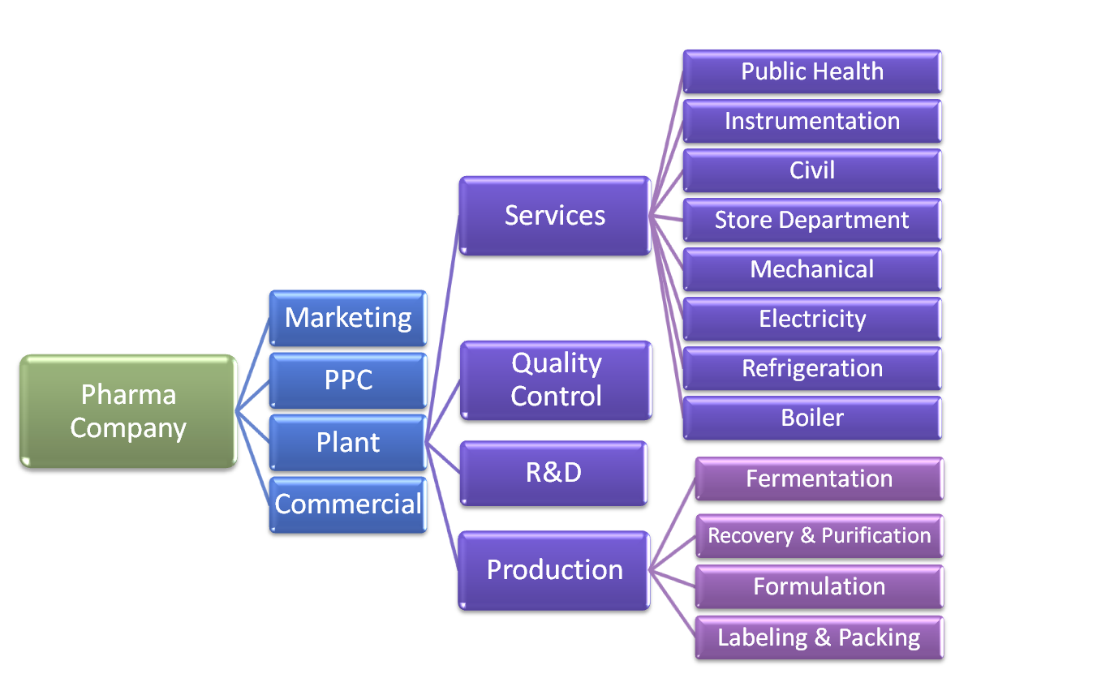
Org Structure

Slide 4
Departments in Plant
Services Department- Service department gives services to production department
Production Department
Research & Development - Substitute the costly raw material, technology change, technology adoption, temperature, pressure, catalyst etc. the purpose of this to reduce cost/ waste & increase effieciency) They own the Pilot Plant
Quality Control Department- Checks the quality of input material and output product. This department has animal house department. For every batch quality control department give approval so that product can be send to commercial department.
  QC department knows that which Pharma Copia (British (BP) , American (USP) or Indian (IP)) is being used or approved for this drug and they do their quality tests as per the pharma Copia
    Majorly using Parma Copia following tests are conducted
      Conduct Potency
      OD (Optical Density)
      Solubility
  Animal house department under Quality Control department will do following tests
    Pyrozen Test- Temperature reduced or increased. It should be +/-1 degree.
    Toxic Test- Heart beat increased or decreased. Heart one beat is called on gamma. This should be +/- 1 gamma is allowed

Slide 5
Units in Production Department
Fermentation unit (output of this is liquid form and goes to recovery and purification unit)
Recovery and purification unit (output of this is either in liquid or powder, it is bulk product)
Formulation (sterile & finishing; put the power or liquid of previous process in sterile area and
  Out is either Parential format (injections), this need to go to sterile area.
  Output can be non-parential format (capsule or tablates), this can be done in non-sterile area
Labeling & Packing Unit
  Quantify, Company name, warning, Mfd date, MRP, Date of expiry, batch no, ingeredents printed. Cutting of strips also happens in this process.
  Packing

Slide 6
Sub-division of Service Department
Public Health (BTP- Biological treatment plant is under this department; biological treatment of plant wastage before throwing into river and take water from river, purifying and supplying to plant)
Instrumentation
Civil
Store Department
Mechanical
  Transfer of material from one vessel to another is possible using following methods
  Compressed Air
  Inert Gas
Giving vaccum to a vessel
  Vaccum pumps
  Ejectors
Electricity
  Executive engineer, Engineer, maintenance engineer, supervisor, electrician, helper
Refrigeration (gives cooling services)
  Cooling services can be given using following methods or plants
  Liquid Nitrogen Plant
  Liquid Hydrogen Plant
  Amonia Plant
Boiler

Slide 7
Example Projects

Slide 8
Project Examples: Pharma Plant
Plant capacity increase/ decrease
Put a separate power plan/ generator
Waste Reduction
Performance Optimization
Raw material handling
Technology Management
  Introduction of new machine

Slide 9
Project Examples: R&D Dept.
Indentifying alternative chemical
Developing alternative process of doing

Slide 10
Project Examples: Commercial Dept

Slide 11
Project Examples: Service Dept.

