Slide 1
Project Integration Management

Slide 2
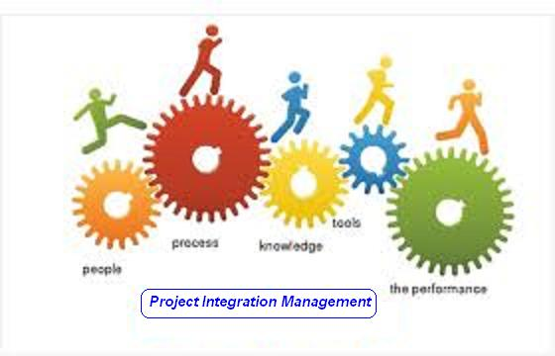

Slide 3
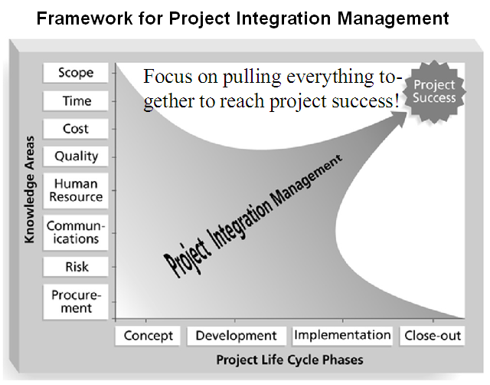

Slide 4
Project Integration Management
  Processes and activities needed to identify, define, combine, unify, and coordinate the various processes and project management activities within the Project Management Process Groups

Slide 5
Project Integration Management
  Develop Project Charter [INITIATING]
  Develop Project Management Plan [PLANNING]
  Direct and Manage Project Execution [EXECUTING]
  Monitor and Control Project Work [M&C]
  Perform Integrated Change Control [M&C]
  Close Project or Phase [CLOSING]

Slide 6
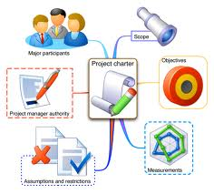
1. Develop Project Charter
Developing the project charter that formally authorizes a project or a project phase.

Slide 7
Develop Project Charter
Project Integration Management
Initiating Process Group
Project statement of work
Business case
Contract
Enterprise environmental factors
Organizational process assets
Expert Judgment
Project Charter

Slide 8
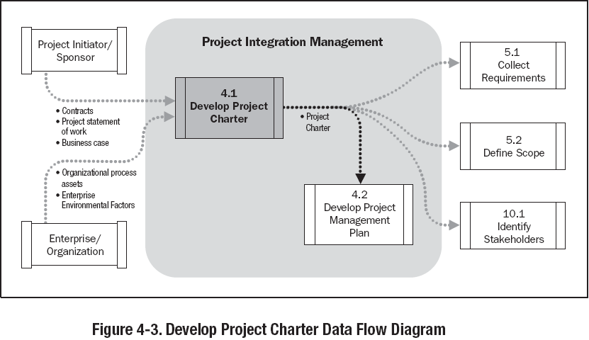

Slide 9
Project Charter Template
  Project purpose or justification
  2. Measurable project objectives and related success criteria
  High – Level Requirements
  High – Level Project description
  High – Level Risks
  Summary milestone schedule
  Summary Budget
  Project approval requirements
  Assigned project manager, responsibility, and authority level
  8. Name and authority of the sponsor or other person(s) authorizing the project charter

Slide 10
Exercise-1
5 Minutes
Prepare Project Charter for your Project

Slide 11

2. Develop Project Management Plan
Documenting the actions necessary to define, prepare, integrate, and coordinate all subsidiary plans into a project management plan.

Slide 12
Develop Project Management Plan
Project Integration Management
Planning Process Group
Project charter
Outputs from planning processes
Enterprise environmental factors
Organizational process assets
Expert Judgment
Project management plan

Slide 13
Components of Project Management Plan
Lifecycle selected for the project and processes
Results of tailoring (PMP processes selected, level of implementation of each selected process, description of TT to be used for those processes, how he selected processes will be used)
How work will be executed
Change management plan
Configuration mgmt plan
How integrity of performance measurement baseline will be maintained
Need and technique for communication among stakeholder
Key management reviews for issues resolution and making decisions
Baselines: Schedule, Cost performance, scope
Subsidiary plans: Scope Mgmt, Requirement Mgmt, Schedule Mgmt, Cost Mgmt, Quality Mgmt, Process Improvement, Human Resource, Communication Mgmt, Risk Mgmt, Procurement Mgmt

Slide 14
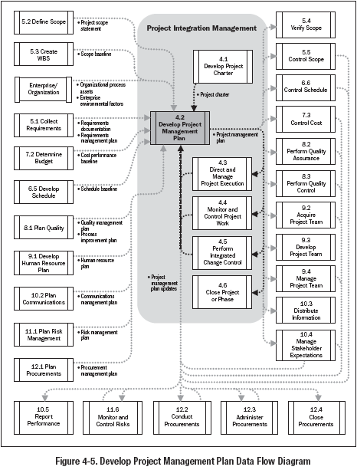

Slide 15
Exercise-2
5 Minutes
  Write name of all type of subsidiary plans for your Project

Slide 16

3. Direct & Manage Project Execution
Performing the work defined in the project Management plan to achieve the project’s objectives.

Slide 17
Direct & Manage Project Execution
Project Integration Management
Executing Process Group
Project management plan
Approved change requests
Enterprise environmental factors
Organizational process assets
Expert judgment
Project management information system
Deliverables
Work performance information
Change requests
Project management plan updates
Project document updates

Slide 18
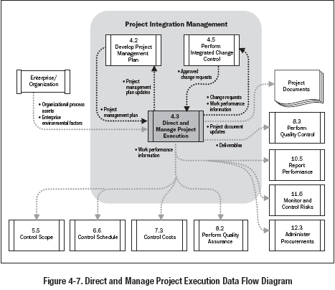

Slide 19
Exercise-3
5 Minutes
  Write name of Deliverables & Name of work performance information for your Project

Slide 20
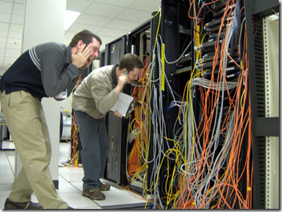
4. Monitor & Control Project Work
Tracking, reviewing and regulating the progress to meet the performance objectives defined in the project management plan.

Slide 21
Monitor & Control Project Work
Project Integration Management
Monitoring & Controlling Process Group
Project management plan
Performance reports
Enterprise Environmental Factors
Organizational Process Assets
Expert Judgment
Change requests
Project management plan updates
Project document updates

Slide 22
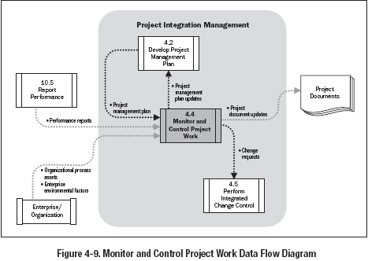

Slide 23
Exercise-4
5 Minutes
  Write type & name of a few change requests for your Project

Slide 24

5. Perform Integrated Change Control
Reviewing all change requests, approving changes and managing changes to the deliverables, organizational process assets, project documents and the project management plan.

Slide 25
Perform Integrated Change Control
Project Integration Management
Monitoring & Controlling Process Group
Project management plan
Work performance information
Change requests
Enterprise environmental factors
Organizational process assets
Expert judgment
Change control meetings
Change request status updates
Project management plan updates
Project document updates

Slide 26
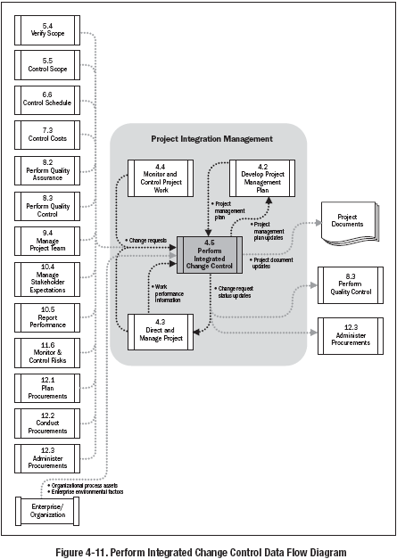

Slide 27
Exercise-5
5 Minutes
  Write change management process for your Project OR
  Prepare a format of change request report for your project

Slide 28

6. Close Project or Phase
Finalizing all activities across all of the project Management Process Groups to formally close the project or a project phase

Slide 29
Close Project or Phase
Project Integration Management
Closing Process Group
Project management plan
Accepted deliverables
Organizational process assets
Expert Judgment
Final product, service or result
Organizational process assets updates

Slide 30
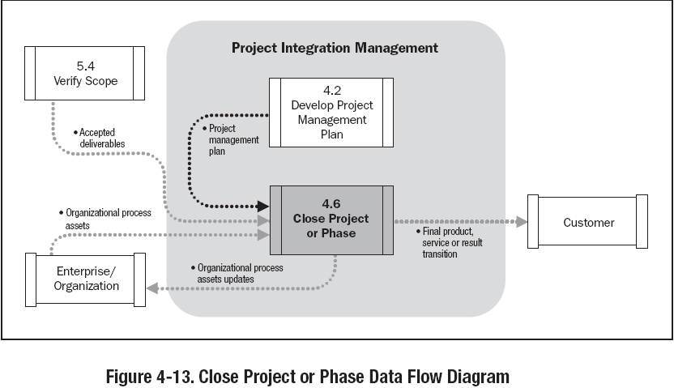

Slide 31
Exercise-6
5 Minutes
  Write name of documents submitted to organization deliveries made to customer for your Project at the end of your project or project phase.

