Slide 1
Project Scope Management

Slide 2


Slide 3
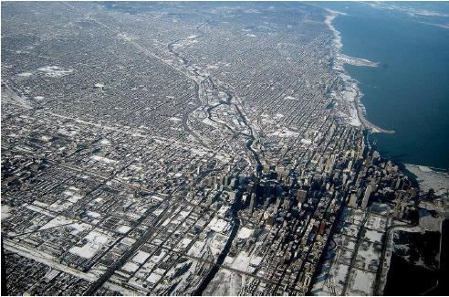
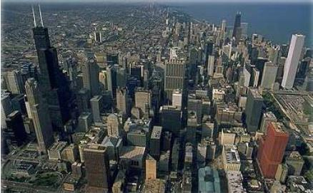

Slide 4
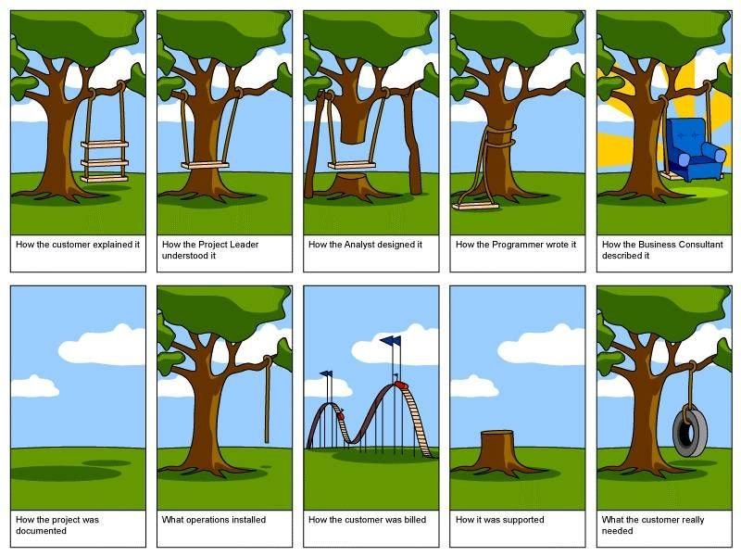
How the customer explained it
How the Project Leader understood it
How the Architect Designed it
How the Programmer wrote it
How the Business Consultant described it
How the project was documented
How operations installed it
What the customer really needed
How the customer was billed
How it was supported

Slide 5
Project Scope "The work that needs to be accomplished to deliver a product, service, or result with the specified features and functions."
Product Scope "The features and functions that characterize a product, service, or result."

Slide 6
Project Scope Management
  Processes required to ensure that the project includes all the work required, and ONLY the work required to complete the project successfully

Slide 7
Project Scope Management
  Collect Requirements [PLANNING]
  Define Scope [PLANNING]
  Create WBS [PLANNING]
  Verify Scope [M&C]
  Control Scope [M&C]

Slide 8

7. Collect Requirements
  Defining and documenting stakeholders’ needs to meet the project objectives.

Slide 9
Collect Requirement
Project Scope Management
Planning Process Group
Project charter
Stakeholder register
Interviews
Focus groups
Facilitated workshops
Group creativity techniques
Group decision making techniques
Questionnaires and surveys
Observations
Prototypes
Requirements documentation
Requirements management plan
Requirements traceability matrix

Slide 10
Collect Requirements
Focus groups
  Guided by moderator, group’s final opinion is taken
Facilitated workshops
    Cross functional stakeholders. Settle their differences like JAD with developers
Group creativity techniques
    Brain storming
    Nominal group techniques: Brainstorming only on most voted
    Delphi Techniques: Only selected experts answers. Who answered what is not shared
    Idea Mapping techniques: Individuals ideas mapped on single map
    Affinity diagrams: Grouping and sorting of ideas for discussion
Group decision making techniques
  Majority, Unanimity, Plurality, Dictatorship

Slide 11
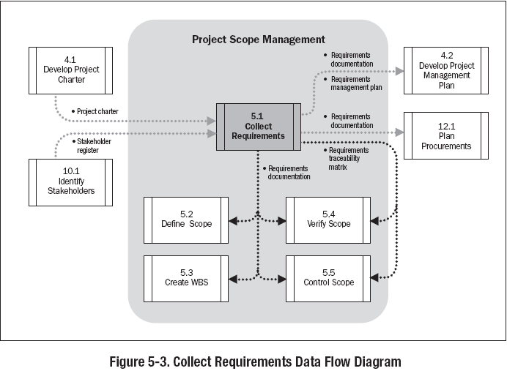

Slide 12
Discussion/Exercise-7
5 Minutes
How to collect, analyze, document, prioritize, manage req; how change should be initiated and impact analysis done; Tracking changes, configuration management activities, RTM structure
  Write Requirement Management Plan for your projects OR
  Write Columns of RTM for your project

Slide 13
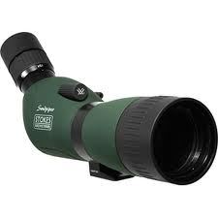
8. Define Scope
Developing a detailed description of the project and product.

Slide 14
Define Scope
Project Scope Management
Planning Process Group
Project charter
Requirements documentation
Organizational process assets
Expert judgment
Product analysis
Alternatives identification
Facilitated workshops
Project scope statement
Project document updates

Slide 15
Define Scope
Product Analysis
  Product breakdown
  System analysis
  Requirement analysis
  System engineering: Deals with multiple complex systems
  Value engineering: Functions, value, cost
  Value analysis: Debate the function and its cost
Alternative Identification
  Alternative way of doing work

Slide 16
Scope Statement
Scope statement has following sections
  Product Scope Description
  Product Acceptance Criteria
  Project Deliverables
  Project Exclusions
  Project Constraints (budget, imposed date, scheduled milestones, contractual provisions)
  Project Assumptions
  Organizational policies
  Available skilled resources

Slide 17
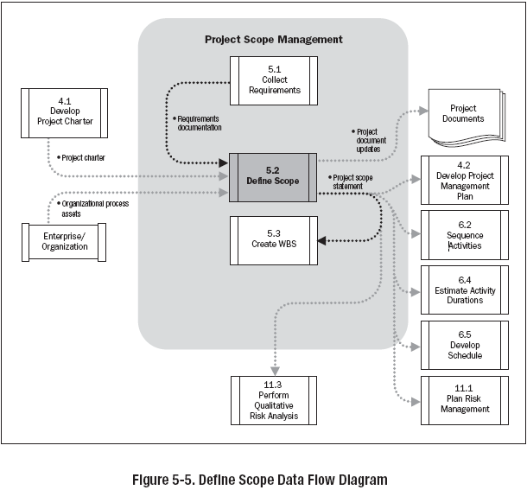

Slide 18
Discussion/Exercise 8
5 Minutes
Product Scope Description, Product Acceptance Criteria, Project Deliverables
Project Exclusions, Project Constraints (budget, imposed date, scheduled milestones, contractual provisions), Project Assumptions, Organizational policies, Available skilled resources
Write Project Scope Statement for your project

Slide 19
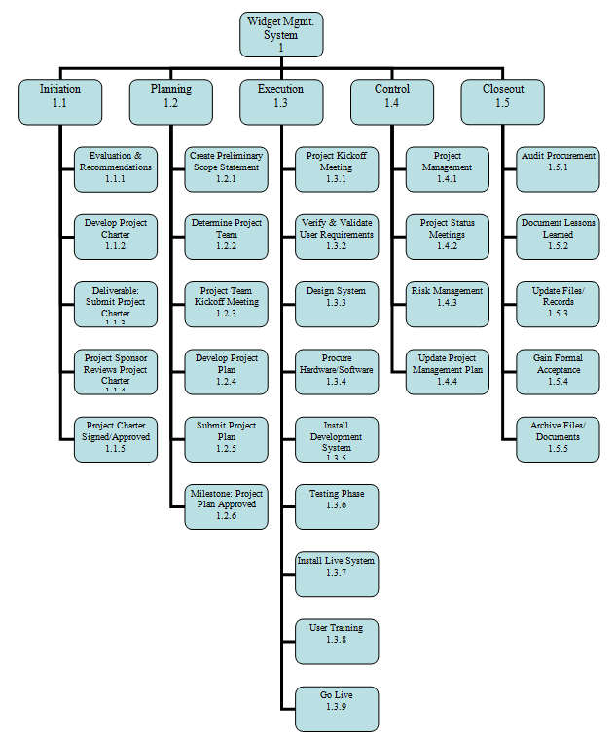
9. Create WBS
Subdividing project deliverables and project work into smaller, more manageable components.

Slide 20
Create WBS
Project Scope Management
Planning Process Group
Project scope statement
Requirements documentation
Organizational process assets
Decomposition
Work breakdown structure
WBS dictionary
Scope baseline
Project document updates

Slide 21
Scope baseline
Scope baseline is part of PMP, Scope baseline includes
  Project Scope Statements
  WBS
  WBS Dictionary

Slide 22
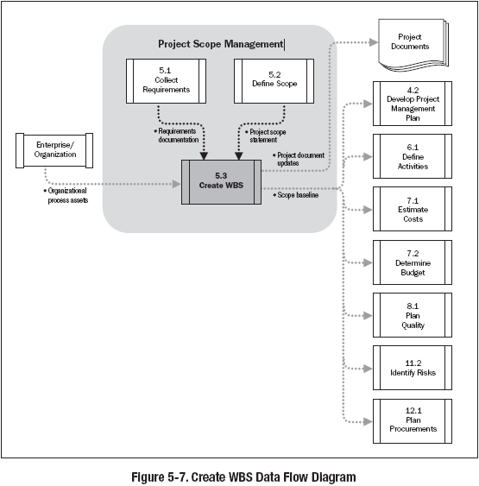

Slide 23
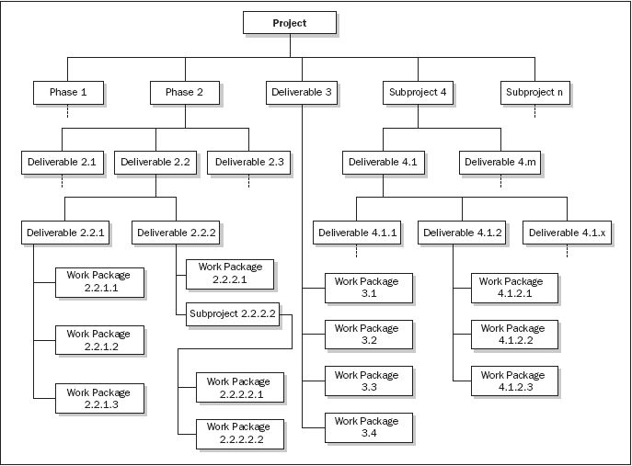
Phase oriented WBS

Slide 24
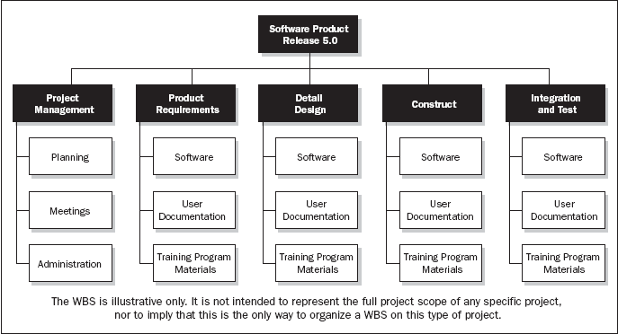
Department oriented WBS

Slide 25
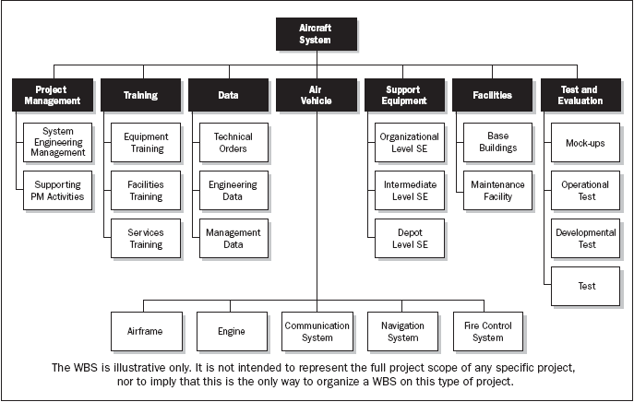
Subproject Oriented WBS

Slide 26
Discussion/Exercise 9
5 Minutes
Write 2 Level WBS & WBS Dictionary with min 5 deliverables for your project

Slide 27

10. Verify Scope
Formalizing acceptance of the completed project deliverables.

Slide 28
Verify Scope
Project Scope Management
Monitoring & Controlling Process Group
Project management plan
Requirement documentation
Requirements traceability matrix
Validated deliverables
Inspection
Accepted deliverables
Change requests
Project document updates

Slide 29
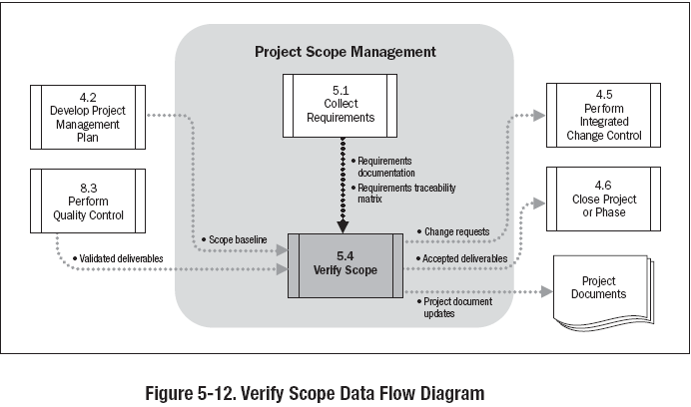

Slide 30
Discussion/Exercise 10
5 Minutes
Write verify scope activities for your project; also write the name of deliverables verified.

Slide 31

11. Control Scope
Monitoring the status of the project and product scope and managing changes to the scope baseline.

Slide 32
Control Scope
Project Scope Management
Monitoring & Controlling Process Group
Project management plan
Work performance information
Requirements documentation
Requirements traceability matrix
Organizational process assets
Variance analysis
Work performance measurements
Organizational process assets updates
Change requests
Project management plan updates
Project document updates

Slide 33
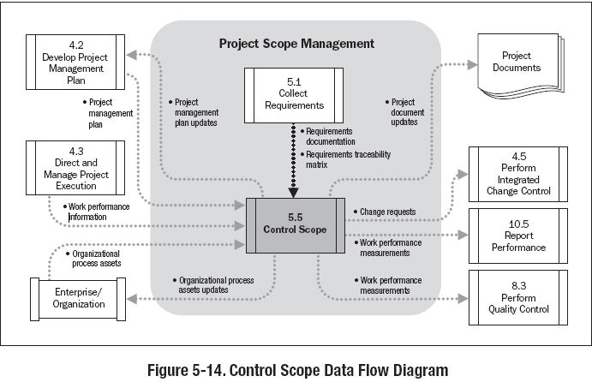

Slide 34
Discussion/Exercise-11
5 Minutes
Write work performance measurement metrics and their values for your project

