Slide 1
Project Cost Management

Slide 2


Project Cost Management

Slide 3
Project Cost Management- A Thought
If you don't plan, it doesn't work. If you do plan, it doesn't work either. Why plan!
The same work under the same conditions will be estimated differently by ten different estimators or by one estimator at ten different times. So why to estimate!
Any project can be estimated accurately (once it's completed).
Nothing is impossible for the person who doesn't have to do it.
Right answers to wrong questions are just as wrong as wrong answers to right questions.

Slide 4
Project Cost Management
  Processes involved in estimating, budgeting, and controlling costs so that the project can be completed within the approved budget

Slide 5
Project Cost Management
  Estimate Costs [PLANNING]
  Determine Budget [PLANNING]
  Control Costs [M&C]

Slide 6
Components of Cost
Cost = Material + Labor
+ Expenses + Overheads
Who estimates Material cost for your project?
Who estimates Labor cost for your project?
Who estimates Expenses cost for your project?
Who estimates Overhead cost for your project?
Where do you adjust the buffer?
Where do earn profit
What is the price?

Slide 7
Types of Cost
  Fixed Cost vs Variable Cost
  Direct labor vs Indirect or Overhead

Slide 8
Types of Cost
Direct cost: purchased, used, consumed in the project directly.
  Material Cost: Used & finished in project. Grocery/ Bricks/ Milks/ Petrol/ Cement/Gifts
  Labor Cost: Pay to regular worker/ consultants
  Overheads Cost: Travelling, External testing, DJ, Audit Fee
Indirect cost: shared cost between project.
  Material: Cleaning material, Fan, Paints,
  Labor: Security Staff Salary, Support staff salary
  Overhead: Travelling, Auditor Fee, Internet, Electricity, Rent

Slide 9
Types of Cost
Sunk Cost- Retrospective cost/ that cannot be recovered/ Cost gone and very low value or zero value was taken out. Plant developed but not of any use now additional money is required but by that money some better work can be done, so not to invest and let already invested money sunk. Software developed but it is not of any use now due any reason.
Perspective Cost- cost to be occurred in future
Allocated Cost- Cost of security service is shared by all division/companies of the building. Spreading the cost among those that use it.

Slide 10
Types of Cost
Apportioned Cost- to find apportioned cost you should know % of each appraised value (land, building, machine)
Value Added Cost- Sale price of a product and cost price of material is value add
Transfer Cost -Cost of transfer or transaction between two entities
Opportunity cost- Value lose because of exercising an option. It is just economic cost. Does not reflect in financial books

Slide 11
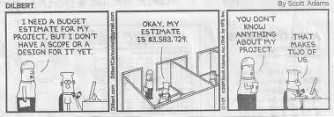
18. Estimate Costs
  Developing an approximation of the costs of the resources needed to complete project activities.

Slide 12
Estimate Costs
Project Cost Management
Planning Process Group
Scope baseline
Project schedule
Human resource plan
Risk register
Enterprise environmental factors
Organizational process assets
Expert Judgment
Analogous estimating
Parametric estimating
Bottom-up estimating
Three-point estimates
Reserve analysis
Cost of quality
Project management estimating software
Vendor bid analysis
Activity cost estimates
Basis of estimates
Project document updates

Slide 13
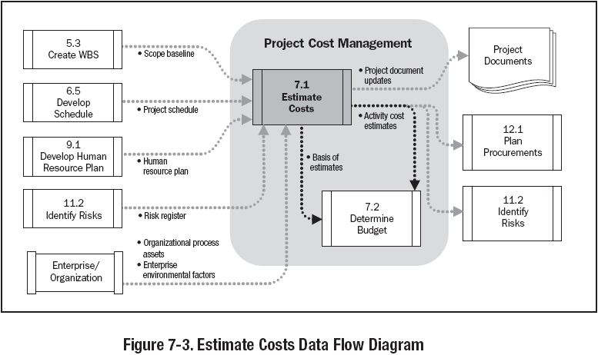

Slide 14
Exercise-18
3 Minutes
Write Activity cost estimates for 5 activities and their basis of estimates for your project

Slide 15
Three Point Estimates
Program Evaluation Review Technique (PERT)
ESTIMATED COST = (Pessimistic + 4*(Most Likely) + Optimistic) / 6

Slide 16
19. Determine Budget
  Aggregating the estimated costs of individual activities or work packages to establish an authorized cost baseline

Slide 17
Determine Budget
Project Cost Management
Planning Process Group
Activity cost estimates
Basis of estimate
Scope baseline
Project schedule
Resource calendars
Contracts
Organizational process assets
Cost aggregation
Reserve analysis
Expert judgment
Historical relationships
Funding limit reconciliation
Cost performance baseline
Project funding requirements
Project document updates

Slide 18
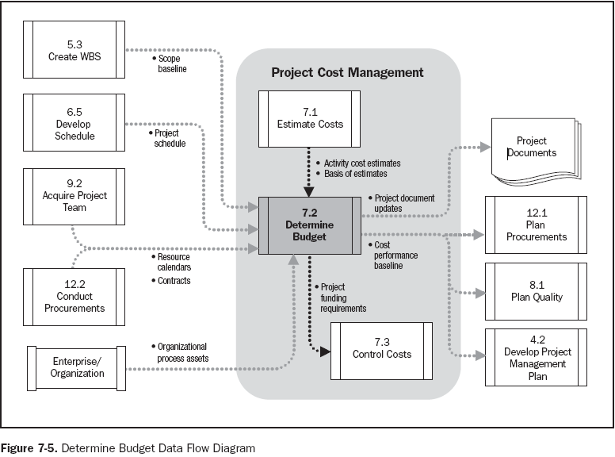

Slide 19
Exercise-19
3 Minutes
Establish cost performance baseline for your project & write funding requirements for your project.

Slide 20
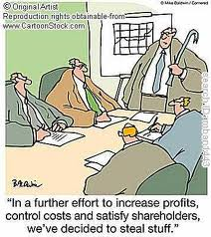
20. Control Costs
  Monitoring the status of the project to update the project budget and managing changes to the cost baseline

Slide 21
Control Costs
Project Cost Management
Monitoring & Controlling Process Group
Project management plan
Project funding requirements
Work performance information
Organizational process assets
Earned value management
Forecasting
To-complete performance index
Performance reviews
Variance analysis
Project management software
Work performance measurements
Budget forecasts
Organizational process assets
Change requests
Project management plan updates
Project document updates

Slide 22
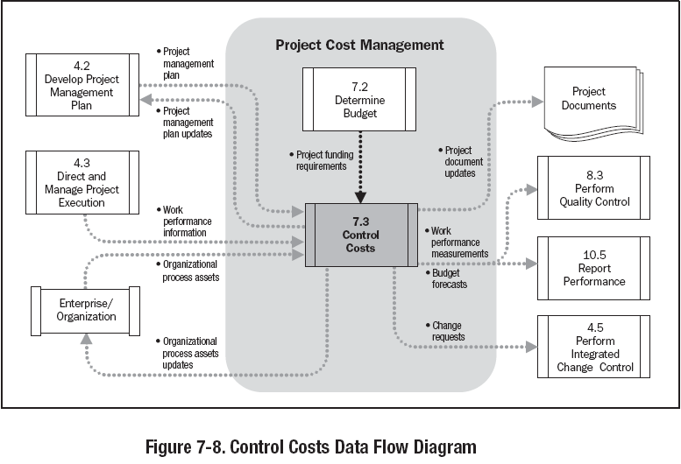

Slide 23
Project Cost Estimation Ranges
Cost estimation may include only Direct Cost or in combination of with Indirect Costs
Class Name | % | Range
Definitive | - 5 -> +5% | 10%
Capital Cost | -15 -> +10% | 25%
Appropriation | -25 -> +15% | 40%
Budget Estimates | -10 -> +25% | 35%
Feasibility | -35 -> +25% | 60%
Order of Magnitude | -50 -> +50% | 100%

Slide 24
Earn Value Management- EVM

Slide 25
Earned Value Management
Planned Value (PV)
Authorized budget assigned to the work to be accomplishes for an activity or work
breakdown structure component.
Earned Value (EV)
Value of work performed expressed in terms of the approved budget assigned to
that work for an activity or work breakdown structure component.
Actual Cost (AC)
Total cost actually incurred and recorded in accomplishing work performed for an
activity or work breakdown structure component.

Slide 26
Earned Value Management – Variance Analysis
Schedule Variance (SV)
SV = EV-PV
Cost Variance (CV)
CV = EV-AC
Schedule Performance Index (SPI)
SPI = EV / PV
Cost Performance Index (CPI)
CPI = EV / AC

Slide 27
Earned Value Management – S Curve
PV
AC
Cost
CV
SV
Progress Review
ΔT
EV
Time

Slide 28
Earned Value Management - Forecasting
Estimate at Completion (EAC)
EAC = AC + bottom up Estimate to Complete (ETC)
EAC forecast for ETC work performed at the budgeted rate
EAC = AC + (BAC – EV)
EAC forecast for ETC work performed at present CPI
EAC = BAC / cumulative CPI
EAC forecast for ETC work considering both SPI and CPI factors
EAC = [(BAC – EV) / (cumulative CPI x cumulative SPI)]

Slide 29
To Complete Performance Index
To-Complete Performance Index (TCPI)
Calculated projection of cost performance that must be achieved on the remaining
work to meet a specified management goal, such as BAC or EAC.
TCPI = (BAC – EV) / (BAC – AC)
Using the Estimate-at-completion formula,
TCPI = (BAC – EV) / (EAC – AC)

Slide 30
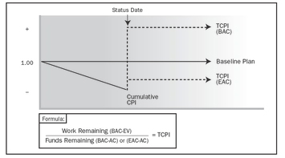
To Complete Performance Index
Source : PMI PMBOK® Fourth Edition

Slide 31
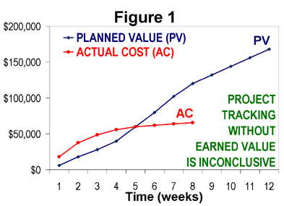

Slide 32
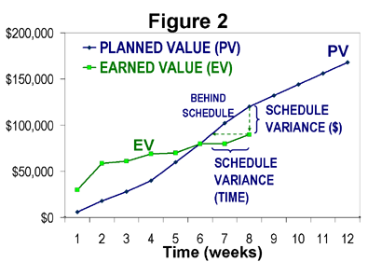

Slide 33
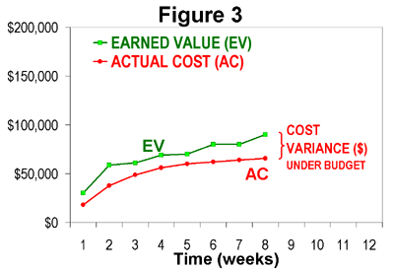

Slide 34
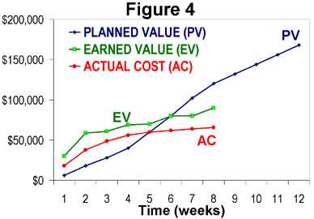

Slide 35
EVM
Cost Variance (CV)
CV = EV- AC
If CV = 0, the Project is proceeding as per plan on cost
CV < 0, the Project is underperforming on cost
CV > 0, the Project is ahead on cost parameters.

Slide 36
EVM
Cost Performance Index (CPI)
CPI = EV/AC
If CPI = 1, the project is on plan, costwise
CPI < 1, the project is underperforming on cost
CPI > 1, the project is overperforming on cost
As PM, CPI tells you how much worth of job you are getting for every $ being spent.

Slide 37
EVM
Schedule Variance (SV)
SV = EV- PV
If SV = 0, the project is on plan, time-wise
SV < 0, the project is BEHIND schedule
SV > 0, the project is AHEAD of schedule
As PM, CPI tells you how much worth of job you are getting for every $ planned.

Slide 38
EVM
Schedule Performance Index (SPI)
SPI = EV / PV
If SPI = 1, the project is on schedule
SPI < 1, the project is BEHIND schedule
SPI > 1, the project is AHEAD of schedule
SPI tells the PM how much worth of job has been completed against planned work

Slide 39
Forecasting - EAC
EAC forecast for ETC work performed at the budgeted rate (Atypical situation)
  EAC = AC + BAC – EV
  It is assumed that
    All future work will be completed at the budgeted rate
    The present variation is a ATYPICAL. and will not apply to the work to be performed in the future.

Slide 40
Forecasting - EAC
EAC forecast for ETC work performed at the present CPI (Typical situation)
  EAC = BAC / Cumulative CPI
  It is assumed that
    All the future work will be completed at the present cost efficiency
    The present variation in cost is typical and will apply to all the works to be performed in the future.

Slide 41
Forecasting - EAC
EAC forecast for ETC work considering both SPI and CPI (I.e. work performed at the present efficiency)
  EAC = AC+ {(BAC-EV) / (cumulative CPI x cumulative SPI)}
  It is assumed that
    All the future work will be performed at the present cost and schedule efficiency
    The present variation in cost and schedule is typical and will apply to all the works to be performed in the future.

Slide 42
Forecasting
Estimate to Complete (ETC)
ETC = EAC – AC
Variance at Completion (VAC)
VAC = BAC - EAC

Slide 43
To complete Performance Index (TCPI)
TCPI can be calculated using BAC or EAC
TCPI using BAC = (BAC-EV) / (BAC-AC)
TCPI using EAC = (BAC-EV) / (EAC-AC)

Slide 44

Case Study — Case 1
PV = $ 1,900
EV = $ 1,900
AC = $ 1,900
This is the ideal situation where everything goes as per plan.

Slide 45

Case Study — Case 2
Here, not considering EVM, it appears we’re in good shape. Expenditures are less than planned.
PV = $ 1,800
AC = $ 1,700
Spending Variance = - $ 100

Slide 46

Case Study — Case 2(a)
PV = $ 1,800
EV = $ 1,500
AC = $ 1,700
CV = EV – AC = - $ 200
SV = EV – PV = - $ 300
CPI = EV/AC = 0.88
SPI = EV/PV = 0.83
With EVM we can see that $400 worth of work is behind schedule! We are 21 percent behind where we planned to be.

Slide 47

Case Study — Case 3
PV = $ 2,900
EV = $ 2,700
AC = $ 2,500
Here, there is Good News, and there is Bad news. Which do you want first?

Slide 48

Case Study — Case 3(a)
PV = $ 2,900
EV = $ 2,700
AC = $ 2,500
SV = -200
SPI = 0.92
The bad news is that our work efficiency slightly low. We are getting only 92 cents of work per dollar done. We’re BEHIND schedule.

Slide 49

Case Study — Case 3(b)
The good news is that we’re overperforming on budget. We’re getting $1.08 worth of work done for each $1.00 spent.
PV = $ 2,900
EV = $ 2,700
AC = $ 2,500
CV = 200
CPI = 1.08

Slide 50
EVM- Exercise- 20A
Exercise – Solution
Activity | Budgeted Man hours | % Complete | Actual Man hours | Earned Value
A | 120 | 75 | 103 | 90
B | 200 | 80 | 190 | 160
C | 100 | 50 | 60 | 50
D | 300 | 90 | 260 | 270
Sum | 720 |  | 613 | 570
 | CPI= Earned Value/Actual Value |  | = 570/613 =.93
 | EAC = BAC/CPI = 720/.93 = 774.32
 | Overall % Complete = (EV/PV)*100 = (570/720)x100 = 79.17
BAC = Budget at Completion
EAC = Estimate at Completion
VAC = Variance at Completion
CV = Cost Variance
SV = Schedule Variance
Cost Performance Index: CPI = EV/AC

Slide 51

EVM- Exercise- 20B
PV = $ 1,700
BAC = 4000
EV = $ 1,500
AC = $ 1,700
What is EAC?

Slide 52
EVM- Exercise- 20C
PV = $ 1,700
BAC = 4000
EV = $ 1,500
AC = $ 1,700
CV = -200 CPI = 0.88
SV = -200 SPI = 0.88
EAC = BAC/CPI = $ 4545
The project is in bad shape with respect to both Cost & Schedule. The Project is now forecast to cost $4545

Slide 53
EVM- Exercise- 20D
PV = $ 1,700
BAC = $ 5000
EV = $ 1,800
AC = $ 1,600
Calculate ETC, EAC, VAC and TCPI

Slide 54
EVM- Exercise- 20E
PV = $ 1,700 BAC = $ 5000
EV = $ 1,800 AC = $ 1,600
CV = 200 CPI = 1.125
SV = 100 SPI = 1.058
EAC = $4444 ETC = $2844 VAC = 556
TCPI using BAC = 5000-1800/5000-1600 = 0.941
TCPI using EAC = 5000-1800/4444-1600 = 1.125
EAC is $4444 and ETC is $ 2844.

Slide 55
EVM- Exercise- 20F
PV = $ 2,000
EV = $ 2,000
AC = $ 2,200
Can you crack this EVM problem?
SV = EV – PV
SV % = SV / PV
CV = EV – AC
CV % = CV / EV
SPI = EV / PV
CPI = EV / AC

Slide 56
EVM- Exercise- 20G
PV = $ 2,000
EV = $ 2,000
AC = $ 2,200
SV = EV – PV = 2000-2000 = 0.00
CV = EV – AC = 2000-2200 = - 200
SPI = EV / PV = 2000/2000 = 1
CPI = EV / AC = 2000/2200 = 0.91
We’re on schedule. But to continue on schedule, it is costing us $1.00 for every 91 cents worth of work. So there is a $200 overrun.

Slide 57
EVM- Exercise- 20H
PV = $ 1,700
EV = $ 1,500
AC = $ 1,900
Let’s see you crack THIS ONE!
SV = EV – PV
SV % = SV / PV
CV = EV – AC
CV % = CV / EV
SPI = EV / PV
CPI = EV / AC

Slide 58
EVM- Exercise- 20I
PV = $ 1,700
EV = $ 1,500
AC = $ 1,900
SV = - $ 200; SV % = - 12 %
CV = - $ 400; CV% = - 27 %
Negative scenario:
We are 12% behind schedule & under-performing on cost by 27%

Slide 59
Case Study — Case 6
PV = $ 1,000
EV = $ 0.00
AC = $ 800
Let’s try one more!!!
SV = EV – PV
SV % = SV / PV
CV = EV – AC
CV % = CV / EV
SPI = EV / PV
CPI = EV / AC

Slide 60
EVM- Exercise- 20J
PV = $ 1,000
EV = $ 0.00
AC = $ 800
SV = - $ 1,000; SV % = - 100 %
CV = - $ 800; CV % = N/A
A tough situation!
Of $1,000 worth of scheduled work, no measurable milestone has yet been accomplished. $800 has been spent just getting started.

Slide 61
EVM- Exercise- 20K
PV = $ 0.00
EV = $ 700
AC = $ 900
Just one last EVM scenario!
SV = EV – PV
SV % = SV / PV
CV = EV – AC
CV % = CV / EV
SPI = EV / PV
CPI = EV / AC

Slide 62
EVM- Exercise- 20L
PV = $ 0.00
EV = $ 700
AC = $ 900
SV = + $ 700; SV % = N/A
CV = - $ 200; CV % = -29 %
Work began
before it was scheduled to start. While $700 worth of work was completed ahead of schedule, it cost $900 to do it. (A 29% overrun.)

