Slide 1
Project Quality Management

Slide 2
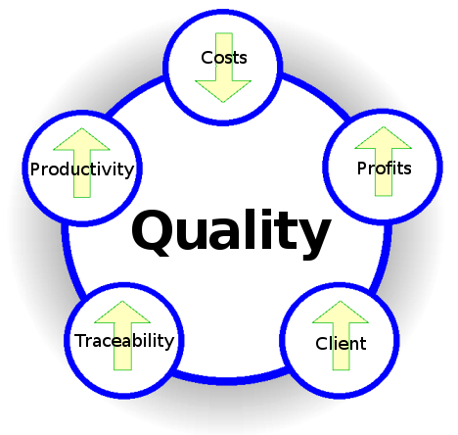
Project Quality Management

Slide 3
Project Quality Management
‘Quality is Predictability’- Deming
‘Conformance to requirements’ - Crosby
‘Fitness for use’ - Juran
‘Customer’s opinion’- Feigenbaum
‘The totality of characteristics of an entity that bear on its ability to satisfy stated and implied need’ - ISO 8402:1994

Slide 4
Project Quality Management
Conformance to “Valid Requirements“.
Customers' perception of the value of the suppliers‘ work output.
A perceived degree of excellence with a minimum, usually set forth by the customer.
Best value for money.

Slide 5
Project Quality Management
  Processes and activities of the performing organization that determine quality policies, objectives, and responsibilities so that the project will satisfy the needs for which it was undertaken

Slide 6
Project Quality Management
  Plan Quality [PLANNING]
  Perform Quality Assurance [EXECUTING]
  Perform Quality Control [M&C]

Slide 7
21. Plan Quality
Identifying quality requirements and/or standards for the project and product, and documenting how the project will demonstrate compliance.

Slide 8
Plan Quality
Project Quality Management
Planning Process Groups
Scope baseline
Stakeholder register
Cost performance baseline
Schedule baseline
Risk register
Enterprise environmental factors
Organizational process assets
Cost-benefit analysis
Cost of quality (COQ)
Control charts
Benchmarking
Design of experiments
Statistical sampling
Flowcharting
Proprietary quality management methodologies
Quality management plan
Quality metrics
Quality checklists
Process improvement plan
Project document updates

Slide 9
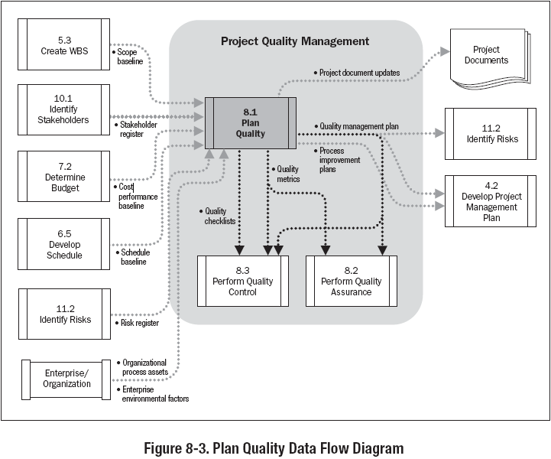

Slide 10
Cost of Quality
Cost of Conformance Cost of Nonconformance
Prevention Costs
(Build a quality product)
Training
Document processes
Equipment
Time to do it right
Appraisal Costs
(Assess the quality)
  Testing
Destructive testing loss
Inspections
Internal Failure Costs
(Failures found by the project)
  Rework
Scrap
External Failure Costs
(Failures found by the customer)
  Liabilities
Warranty work
Lost business
Money spent during the project
to avoid failures
Money spent during and after the project because of failures
Source : PMI PMBOK® Fourth Edition

Slide 11

Cost of Nonconformance- Iceberg
SCRAP
DOCUMENTED
REWORK
WARRANTY
WORK
FAILURE
ANALYSIS
LATE PENALTIES
CONFUSION
OVERTIME
RUSH
DELIVERIES
CUSTOMER
DISSATISFACTION
MISSED
OPPORTUNITIES
PRODUCT
IMAGE
REDESIGN
HIDDEN
REWORK
CORPORATE
IMAGE
LATE
DELIVERIES
DUPLICATION
OF EFFORT

Slide 12
Exercise-21
5 Minutes
Write sections of QMP of your project OR
Write Quality Metrics for your projects, their goal, and threshold values OR
Identify the name of checklists used in your project

Slide 13
22. Perform Quality Assurance
Auditing quality requirements and the results from quality control measurements to ensure appropriate quality standards and operational definitions are used.

Slide 14
Perform Quality Assurance
Project Quality Management
Execution Process Groups
Project management plan
Quality metrics
Work performance information
Quality control measurements
Plan quality and perform quality control tools and techniques
Quality audits
Process analysis
Organizational process assets updates
Change requests
Project management plan updates
Project document updates

Slide 15
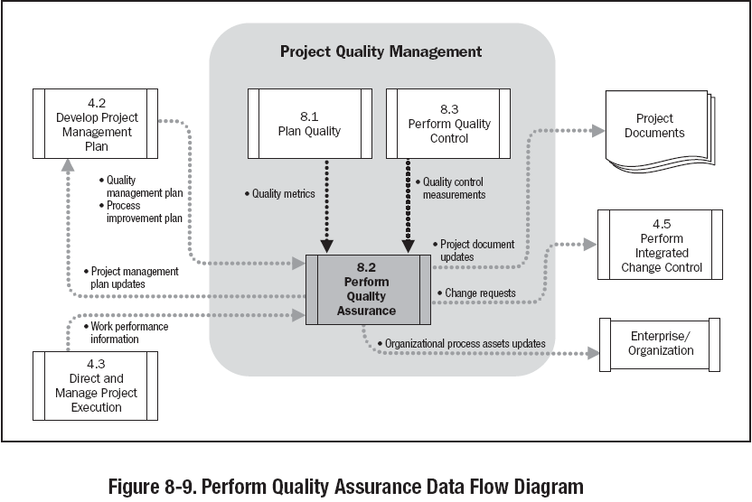

Slide 16
Exercise-22
5 Minutes
Write the number of NCs were discovered in your project corresponding to the processes
Who is responsible to close NCs and report their status
List the corrective or preventive actions suggested by auditors

Slide 17
23. Perform Quality Control
Monitoring and recording results of executing the quality activities to assess performance and recommend necessary changes.

Slide 18
Perform Quality Control
Project Quality Management
Monitoring & Controlling Process Groups
Project management plan
Quality metrics
Quality checklists
Work performance measurements
Approved change requests
Deliverables
Organizational process assets
Cause and effect diagram
Control charts
Flowcharting
Histogram
Pareto chart
Run chart
Scatter diagram
Statistical sampling
Inspection
Approved change requests review
Quality control measurements
Validated changes
Validated deliverables
Organization process assets updates
Change requests
Project management plan updates
Project document updates

Slide 19
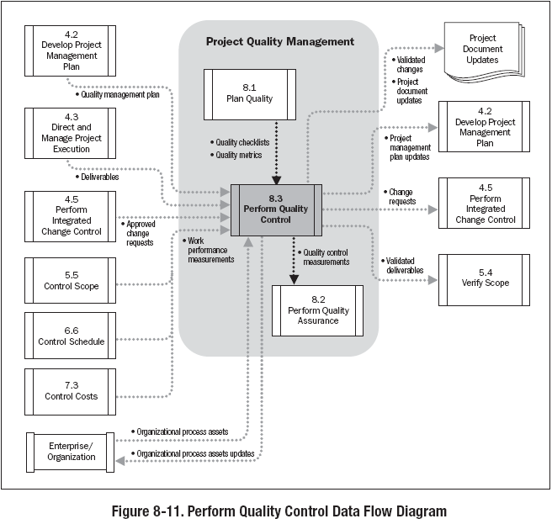

Slide 20
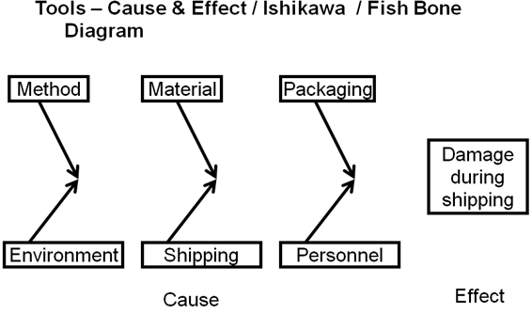
Fish Bone Diagram

Slide 21
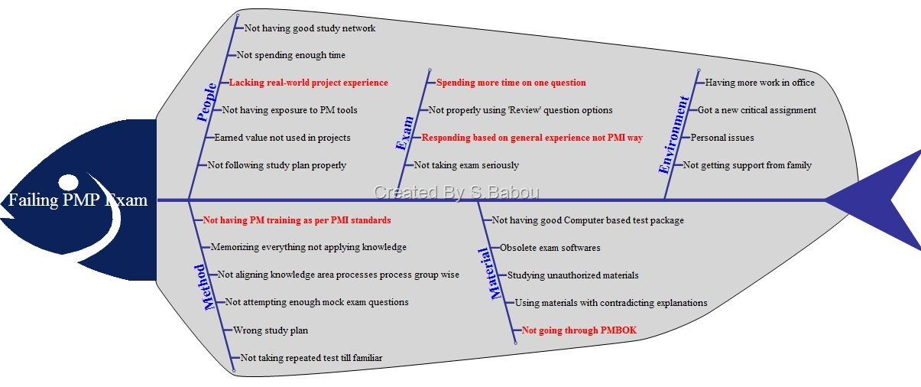
Fish Bone Diagram

Slide 22
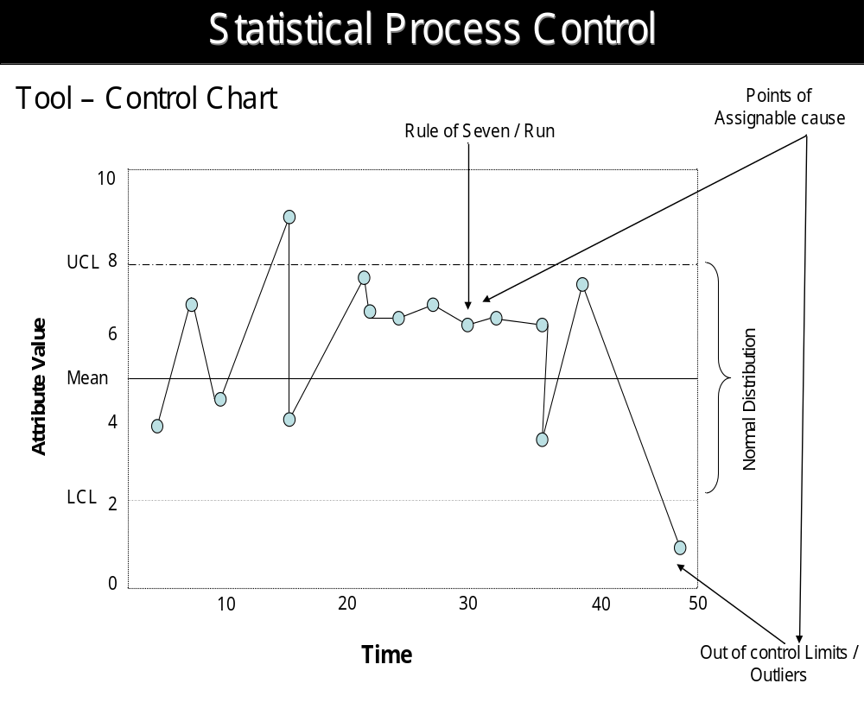
Control Charts

Slide 23
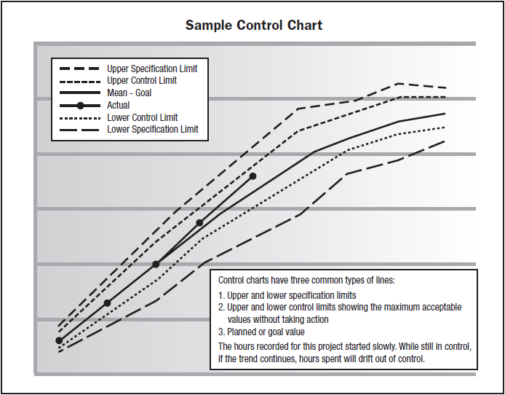
Control Charts

Slide 24
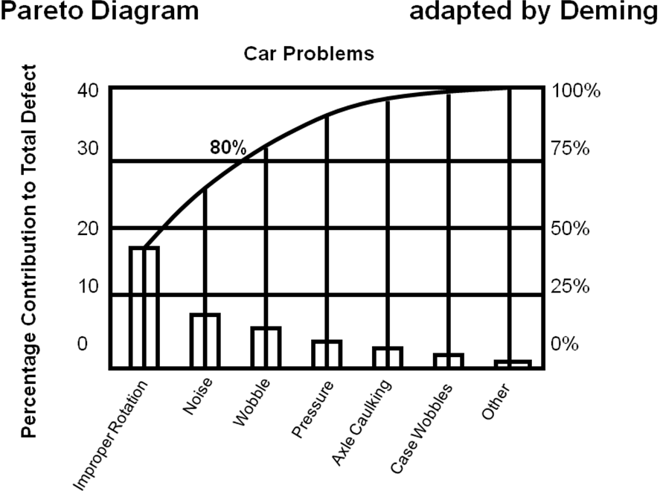
Pareto Diagram

Slide 25
Meaning of Six Sigma
Let’s get real here. Is it truly necessary to go for zero defects? Why isn’t 99.9% defect-free good enough? Here are some examples of what life would be like if 99.9% were "good enough:"
1 HOUR OF UNSAFE DRINKING WATER EVERY MONTH
2 LONG OR SHORT LANDINGS AT EVERY AMERICAN AIRPORTS EACH DAY
400 LETTERS PER HOUR WHICH NEVER ARRIVE AT THEIR DESTINATION
500 INCORRECT SURGICAL OPERATIONS EACH WEEK
3,000 NEWBORNS ACCIDENTALLY FALLING FROM THE HANDS OF NURSES OR DOCTORS EACH YEAR
4,000 INCORRECT DRUG PRESCRIPTIONS PER YEAR
22,000 CHECKS DEDUCTED FROM THE WRONG BANK ACCOUNT EACH HOUR
32,000 MISSED HEARTBEATS PER PERSON PER YEAR
Here are some examples of what life would be like at Six Sigma
13 WRONG DRUG PRESCRIPTIONS PER YEAR
10 NEWBORNS ACCIDENTALLY FALLING FROM THE HANDS OF NURSES OR DOCTORS EACH YEAR
1 LOST ARTICLE OF MAIL PER HOUR

Slide 26
Sigma Values
Sigma | Yield | Defects in Millions
+/-2 | 95.44% | 45600
+/-3 | 99.73% | 2700
+/-6 | 99.9999997% | 0.002
Sigma level (with 1.5 sigma shift) | DPMO | Percentage yield
1 | 691,462 | 30.8550%
2 | 308,538 | 69.1462%
3 | 66,807 | 93.3193%
4 | 6,210 | 99.3790%
5 | 233 | 99.9770%
6 | 3.4 | 99.99966%
7 | 0.019 | 99.999966%

Slide 27
Exercise-23
5 minutes
Write the Quality control activities on your project
List the values of various quality control measures on your project.
List the validated deliverables

