Slide 1
Project Human Resource Management

Slide 2
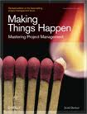
Project HR Management- Make it Happen

Slide 3
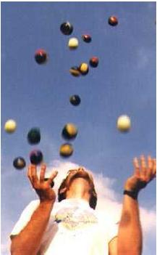
Project HR Management- Balancing All

Slide 4
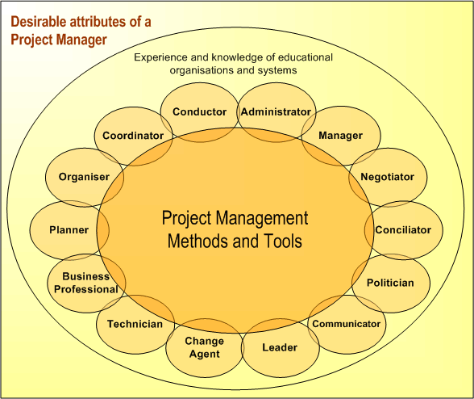
Project Management- Soft skills

Slide 5
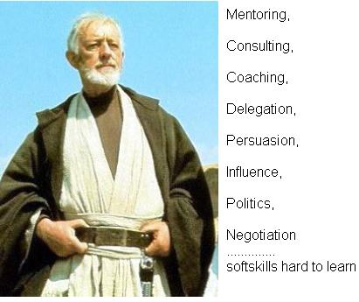
Project Management- Soft skills are Hard

Slide 6
Project Human Resource Management
  Processes that organize, manage and lead the project team.
  Project team is comprised of the people with assigned roles and responsibilities for completing the project.

Slide 7
Project HR Management
  Develop Human Resource Management Plan [PLANNING]
  Acquire Project Team [EXECUTING]
  Develop Project Team [EXECUTING]
  Manage Project Team [EXECUTING]

Slide 8
24. Develop Human Resource Plan
Identifying and documenting project roles, responsibilities and required skills, reporting relationships and creating a staffing management plan.

Slide 9
Develop Human Resource Plan
Project Human Resource Management
Planning Process Group
Activity resource requirements
Enterprise environmental factors
Organizational process assets
Organization charts and position descriptions
Networking
Organizational theory
Human resource plan

Slide 10
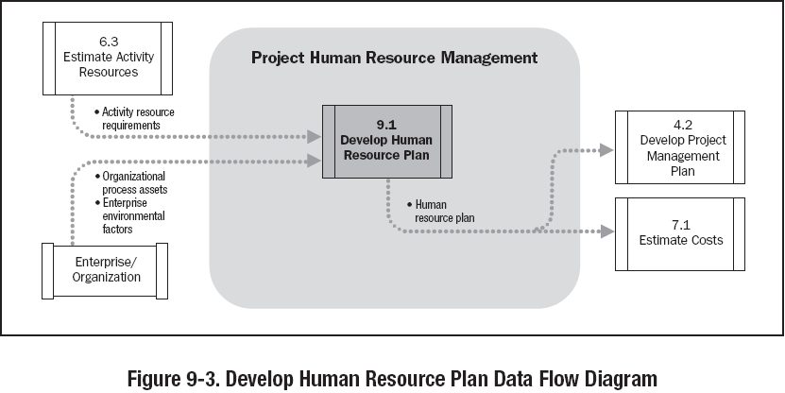

Slide 11
Responsibility Assignment Matrix - RAM
PERSON
Alex Bob Claire Danny Earl Fanny …
PHASE
Requirements
S R A P P
Functional
S A P P
Design
S R A l P
Development
R S A P P
Testing
S P l A P
P = Participant A = Accountable R = Review required
I = input required S = Sign-off required

Slide 12
Resource Histogram
Staff hours
300
275
Senior Designers
250
225
200
175
Resource Usage
150
125
100
75
50
25
0
9
16
23
30
6
13
20
27
6
13
20
27
3
10
17
24
1
8
15
22
Jan
Feb
Mar
Apr
May
Weekly Resource Usage Staff Hours

Slide 13
25. Acquire Project Team
Confirming human resource availability and obtaining the team necessary to complete project assignments

Slide 14
Acquire Project Team
Project Human Resource Management
Execution Process Group
Project management plan
Enterprise environmental factors
Organizational process assets
Pre-Assignment
Negotiation
Acquisition
Virtual teams
Project staff assignments
Resource calendars
Project management plan updates

Slide 15
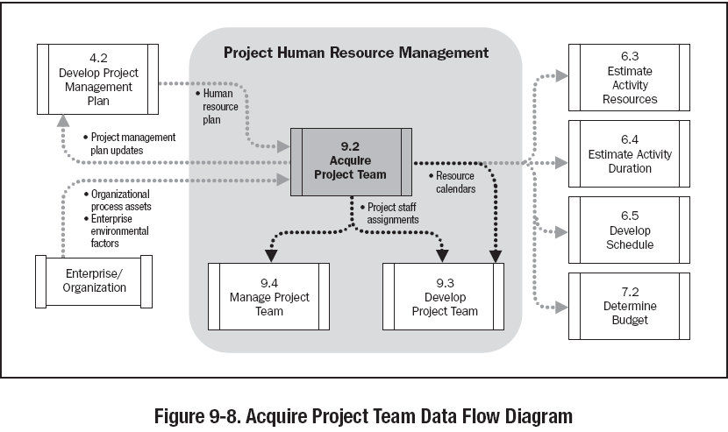

Slide 16
26. Develop Project Team
Process of improving competencies, team interaction, and the overall team environment to enhance project performance.

Slide 17
Develop Project Team
Project Human Resource Management
Execution Process Group
Project staff assignments
Project management plan
Resource calendars
Interpersonal skills
Training
Team building activities
Ground rules
Co-location
Recognition and rewards
Team performance assessments
Enterprise environmental factors updates

Slide 18
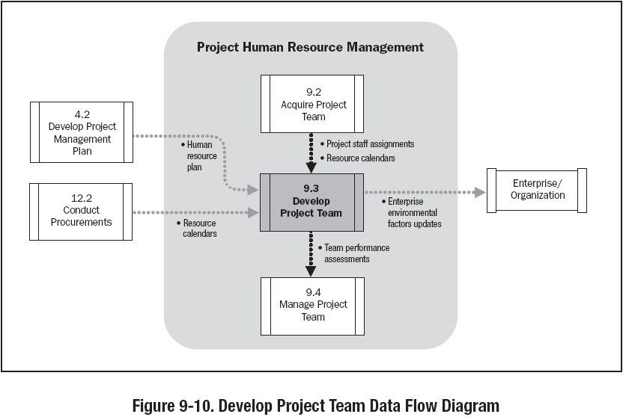

Slide 19
27. Manage Project Team
Tracking team member performance, providing feedback, resolving issues and managing changes to optimize project performance.

Slide 20
Manage Project Team
Project Human Resource Management
Execution Process Group
Project staff assignments
Project management plan
Team performance assessments
Performance reports
Organizational process assets
Observation and conversation
Project performance appraisals
Conflict management
Issue log
Interpersonal skills
Enterprise environmental factors updates
Organizational process assets updates
Change requests
Project management plan updates

Slide 21
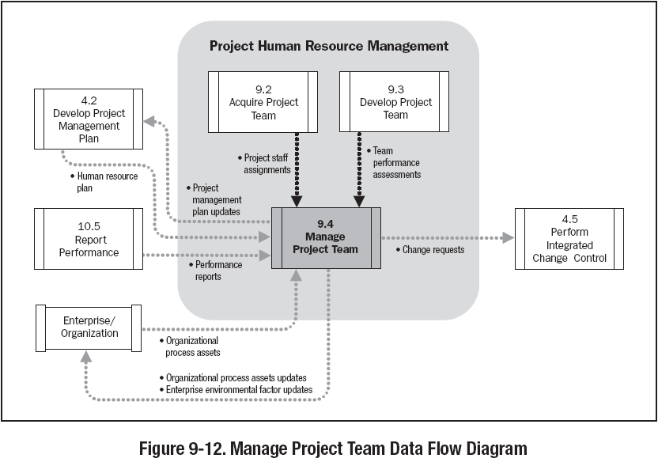

Slide 22
Conflict Management
  Conflicts - good or bad ???

Slide 23

Conflict Management
  Traditional view – Conflicts are bad, created by people and to be avoided
  Current view – Conflicts are good and need to be confronted in order to bring out real issues and resolve them
Hot Topics

Slide 24
Conflict Management
  Sources of conflict
  Schedules
  Project Priorities
  Technical Issues
  Personality Conflict
  Cost
  Scarce resources
  Personal work styles
  Administrative Procedures

Slide 25
Conflict Management
  Characteristics of conflict
  Conflict is natural and forces a search for alternatives
  Conflict is team issue
  Openness resolves conflict
  Conflict resolution should focus on issues, not personalities
  Conflict resolution should focus on the present not on the past

Slide 26
Conflict Resolution
  Withdrawal – avoiding, giving up, stop gap, passive reaction, buying time, appropriate for “cooling off” time, no solution, lose outcome
  Smoothing – grudging agreement, avoids conflict, appeasing, friendly atmosphere, no lasting solution, lose outcome
  Compromising – bargaining, acceptable agreement, some satisfaction to each party, not ideal solution, trade off, a form of definitive solution
  Confronting/Problem Solving – approached as an issue to be solved by examining alternatives.
  Give and take attitude, open dialog – direct approach, pinpoints problem, develops alternatives, objectively resolves issues, time consuming, ultimate solution, Win-Win outcome
  Collaborating – leading to consensus and commitment by incorporating multiple viewpoints and insights from differing perspectives.
  Forcing – Uses power, used as a last resort, ill feeling may result, Win-lose outcome

Slide 27
Conflict Resolution
HIGH
SMOOTHING
(ACCOMMODATING)
PROBLEM-SOLVING
(COLLABORATING)
RELATIONSHIP
ORIENTATION
COMPROMISE
WITHDRAWAL
(AVOIDING)
FORCING
(COMPETING)
LOW
        LOW OBJECTIVE ORIENTATION HIGH

Slide 28
Types of Power
  Formal – positional, granted by organizational/upper mgmt
  Expert – power earned through a recognized level of knowledge or skill in a specific area
  Reward – the power to give a positive consequences, like promotions, salary rise etc.
  Penalty – the power to provide negative consequences, like suspension, termination, reprimands
  Referent – power gained when team members admire, and willingly follow an individual as a role model

Slide 29
Management Style
  Refers to the way managers interact with organizational members
  Autocratic – traditional figure of a boss who makes binding decisions regardless of what subordinates think or desire
  Laissez-Fare – Other extreme of autocratic, the staff can pursue anything they wish, enhances free thinking
  Democratic – participative, decisions made jointly by management and staff

Slide 30
Key to Successful Team Management
  Understanding that team is an Integral Unit of Organization
  A team mission, objective, goals, strategy and role definition
  A leader and an organizational support system
  Managers responsive to needs of team members
  Encourage participation and effective communication
  Foster an atmosphere of trust among team members
  Provide feedback effectively
  A collective culture and style
  Motivate team members with challenges & rewards
Hot Topics

Slide 31
Team Development
  Five Stages of Team development
  Forming – Members of the group get to know each other and try to set up some ground rules about behavior
  Storming – Conflicts arise as various members of the group try to exert leadership and the methods of operation are being established
  Norming – Conflicts are largely settled and a feeling of group identity emerges
  Performing – Emphasis now is the task at hand
  Adjourning – The group disbands
  Sequence is followed for each individual/group

Slide 32

Motivational Theories

Slide 33
Motivational Theories
  Frederick Herzberg
  Hygiene Factors and Motivating Agents (1954)
Hygiene factors
    Supervision
    Company policy and administrator
    Positive working Condition
    Interpersonal relations
    Job Security
    Status
    Compensation
    Personal life
      Presence will not guarantee higher productivity
      Absence will result in poor productivity

Slide 34
Motivational Theories
  Frederick Herzberg
  Hygiene Factors and Motivating Agents (1954)
  Motivating factors
      Achievements
      Recognitions
      Work Itself
      Responsibility
      Advancement
      Possibility for growth
      Motivation will not work without Hygiene.

Slide 35
Motivational Theories
  Abraham Maslow’s Hierarchy of Needs (1954)
  (In order of priority)
Self Actualization
Self fulfillment, growth, learning
Accomplishment, Respect, Attention, Appreciation
Esteem
Love, affection, approval, friends, association
Social
Security, stability, freedom from threat and physical harm
Safety
Physiological
Air, water, food, house, clothing

Slide 36
Motivational Theories
Listens to subordinates to diagnose or solve problems
Sets goals and develops short- and long- range action plans
Gives directions about who is to do which tasks to what standards
Provides feedback on task performance
Rewards or disciplines task performance and personal characteristics
Develops subordinates

Slide 37
Motivational Theories
  Expectancy Theorem of Motivation by Victor Vroom
  The extent to which an individual is motivated…
  The level of expectation of their efforts will result in a desired outcome (effort performance linkage)
  (Is the work important?)
  The expectation that good work will be rewarded (Performance-reward linkage)
  (Will I be rewarded?)
  Attractiveness of the reward
  (What is the value of the reward?)
  Motivation will be high when all three factors are high

Slide 38
Leadership/Management Theories
  McGregor’s Theory X
  The average worker is inherently lazy and needs supervisions
  The average worker dislikes work and avoids work whenever possible
  To induce adequate effort, the supervisor must threaten punishment and exercise careful supervision
  The average worker avoids increased responsibility and seeks to be directed
  Theory X relies on Strict Rules, Performance incentives, Rewards, Threats to job security

Slide 39
Leadership/Management Theories
  McGregor’s Theory Y
  Workers are willing to do the job without continuous supervision
  The average worker wants to be active and finds the physical and mental effort on the job satisfying
  Greatest results come from willing participation which will tend to produce self-direction towards goals without coercion and control
  The average worker seeks opportunity for personal improvement and self respect
  Theory Y relies on worker participation in decisions, cordial manager-worker relationships, worker designed job methodology, worker individualism

Slide 40
Leadership/Management Theories
    William Ouchi’s Theory Z
    According to Theory Z, people who don’t fit either Theory X or Theory Y are really a combination of the two.
    People who develop a leadership style based on
    Theory Z, use different styles of leadership
    with different people, depending on the situation.

Slide 41
Leadership/Management Theories
Contingency Theory
  Built on a combination of Theory Y behaviors and the Hygiene Theory
  People are motivated to achieve level competency and will continue to be motivated by this need even after competency is reached

Slide 42
Job Satisfaction
  The Oldham-Hackman job characteristics model
  Skill Variety – the number of job skills that the job holder has the opportunity to exercise
  Task Identity – the degree to which your work and its result are identifiable as belonging to you
  Task Significance – the degree to which your job has an influence on others
  Autonomy – the discretion you have about the way that you do the job
  Feedback – the information that you get back about the result of your work

