Slide 1
Project Communication Management

Slide 2


Project Communications Management

Slide 3
Project Communication Management
  Processes required to ensure timely and appropriate generation, collection, distribution, storage, retrieval and ultimate disposition of project information.

Slide 4
Project Communications Management
  Identify Stakeholders [INITIATING]
  Plan Communications [PLANNING]
  Distribute Information [EXECUTING]
  Manage Stakeholder Expectations [EXECUTING]
  Report Performance [M&C]

Slide 5
28. Identify Stakeholders
Identifying all people or organizations impacted by the project and documenting relevant information regarding their interests, involvement and impact on project success.

Slide 6
Identify Stakeholders
Project Communication Management
Initiating Process Group
Project charter
Procurement documentation
Organizational process assets
Stakeholder analysis
Expert judgment
Stakeholder register
Stakeholder management strategy

Slide 7
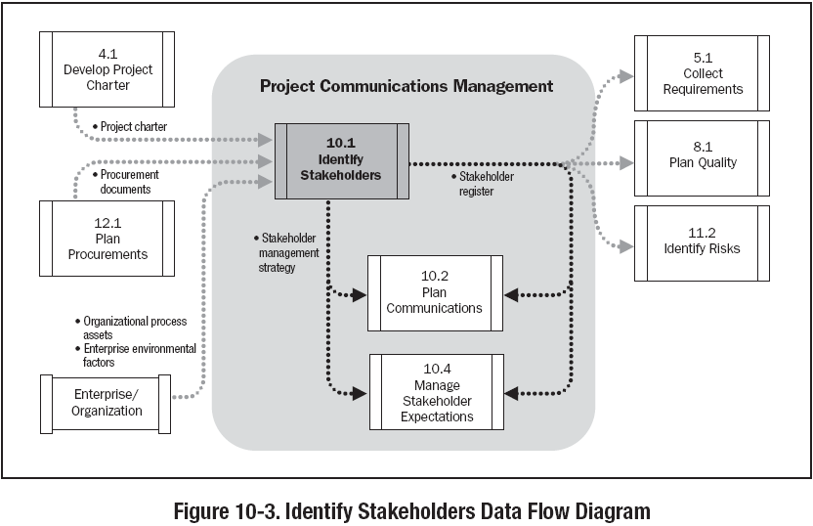

Slide 8
Sample Stakeholder Analysis Matrix
 | Stakeholders
 | Ahmed | Susan | Erik | Mark | David
Organization | Internal Senior Management | Project team | Project Team | Hardware Vendor | Project manager for other internal project
Role on project | Sponsor of project and one of the compnay's founder | DBA sequencing expert | Lead Programmer | Supplies some istrument hardware | Competing for company resources
Unique Facts | Demanding, likes details, business focus, stanford MBA | Very smart, Ph.D. in biology, easy to work with, has a toddler | Best Programmer I know, weird sense of humor | Start-up company, he knows we can make him rich if this works | Nice guy, one of oldest people at company, has 3 kids in college
Level of interest | Very high | Very high | High | Very high | Low to medium
Level of Influence | Very high, can call the shots | SME, critical to success | High; hard to replace | Low; other vendors available | Low to medium
Suggestions on managing relationship | Keep informed, let him lead conversations, do as he says and quickly | Make sure she reviews specifications and leads testing; can do some work from home | Keep him happy so he stays; emphasize stock options; likes mexican food | Give him enough leads time to deliver hardware | He knows his project takes a back seat to this one, but can learn from him

Slide 9
Sample Stakeholder Analysis Matrix
Stakeholder | Stakeholder Interest(s) in the Project | Assessment of Impact | Potential Strategies for Gaining Support or Reducing Obstacles

Slide 10
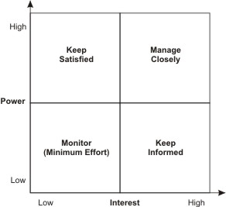
Power/Interest Grid with stakeholders
Regulatory Authorities
Sponsor, Team
Individual Citizens
Vendor

Slide 11
29. Plan Communications
Determining the project stakeholder information needs and defining a communication approach.

Slide 12
Plan Communications
Project Communication Management
Planning Process Group
Stakeholder register
Stakeholder Management strategy
Enterprise environmental factors
Organizational process assets
Communications requirements analysis
Communications technology
Communication models
Communication methods
Communications management plan
Project document updates

Slide 13
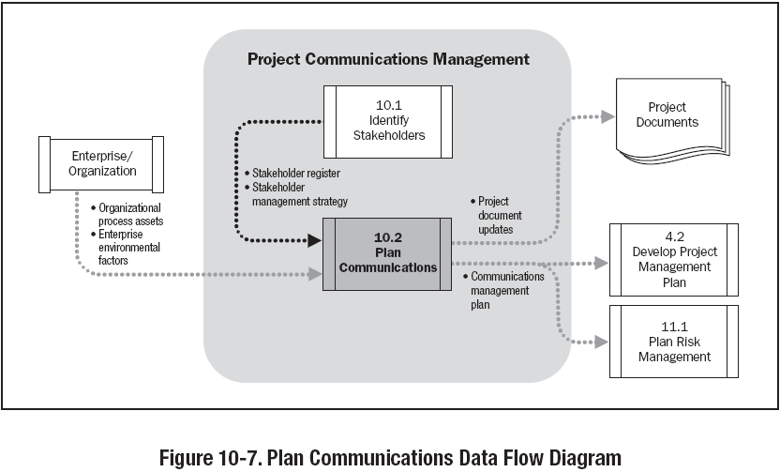

Slide 14
Communication Requirements
  Information requirements of the project stakeholders
  Project resources should be expended only on communicating information that contributes to success or where a lack of communication can lead to failure.
  Project organization and stakeholder responsibility relationships.
  Disciplines, departments, and specialties involved in the project.
  Logistics of how many individuals will be involved with the project and at which locations.
  Internal and External communication needs

Slide 15
Number of Communication Channels
  N(N-1)/2
Two People, One Channel
Three People, Three Channel
Four People, Six Channel
Six People, Fifteen Channel

Slide 16
Communication Model
Source
Encoding
Message
channel
Decoding
Receiver
Noise
Feedback

Slide 17
30. Distribute Information
Process of making relevant information available to project stakeholders as planned

Slide 18
Distribute Information
Project Communication Management
Executing Process Group
Project management plan
Performance reports
Organizational process assets
Communications methods
Information distribution tools
Organizational process assets updates

Slide 19
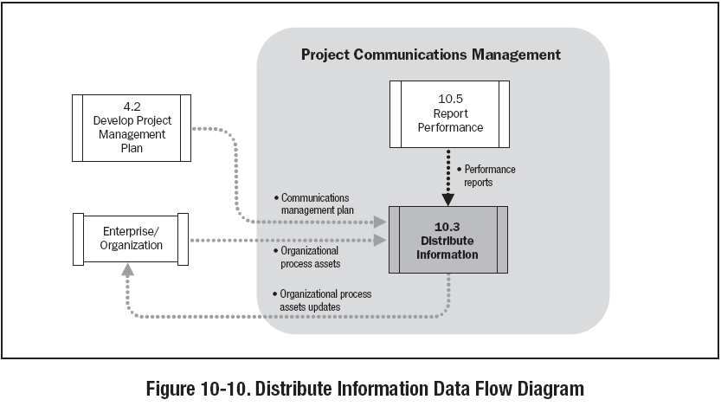

Slide 20
Distribute Information
Top Mgmt /Client/Sponsor
Up
Horizontal
Horizontal
Ext.Stk.Holder/
Reg.Agencies/
Press
Funct. Mgr/
Other.Mgrs.
Proj.Mgr.
Down
Team Members/ Contr./Sub-Contr.

Slide 21

31. Manage Stakeholder Expectations
Process of communicating and working with stakeholders to meet their needs and addressing issues as they occur.

Slide 22
Manage Stakeholder Expectations
Project Communication Management
Executing Process Group
Stakeholder register
Stakeholder management strategy
Project management plan
Issue log
Change log
Organizational process assets
Communications methods
Interpersonal skills
Management skills
Organizational process assets updates
Change requests
Project management plan updates
Project document updates

Slide 23
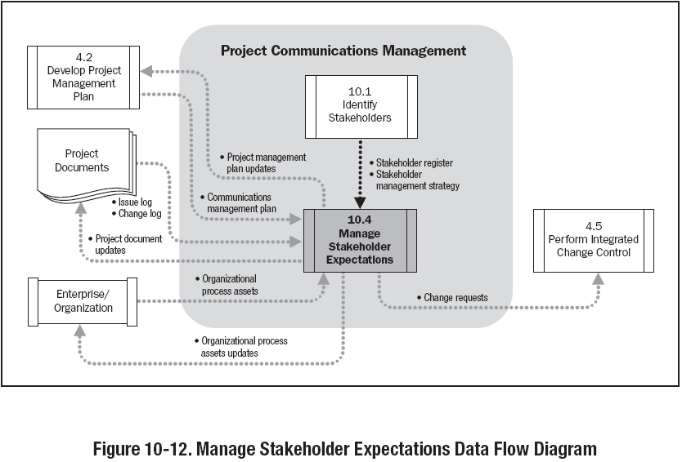

Slide 24
32. Report Performance
Process of collecting and distributing performance information, including status reports, progress measurements, and forecasts.

Slide 25
Report Performance
Project Communication Management
Monitoring & Controlling Process Group
Project management plan
Work performance information
Work performance measurements
Budget forecasts
Organizational process assets
Variance analysis
Forecasting methods
Communication methods
Reporting systems
Performance reports
Organizational process assets updates
Change requests

Slide 26
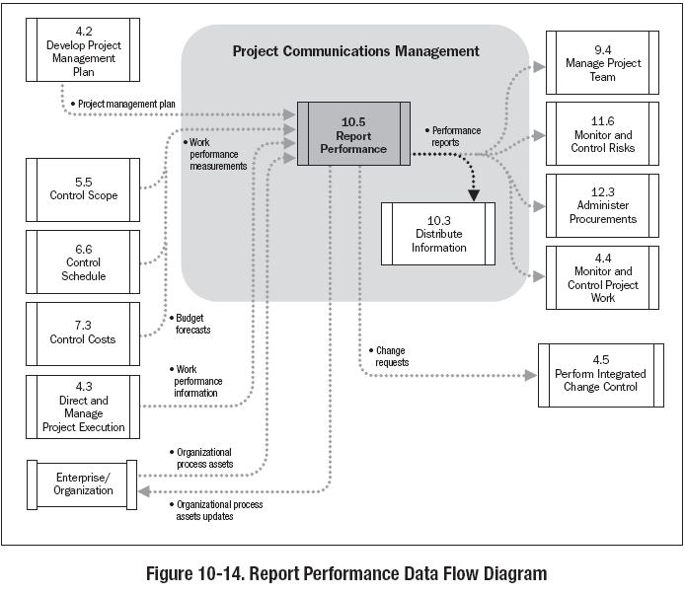

Slide 27
Communication Management
  Filtering – A phenomenon that occurs when a large portion of the message is lost in vertical/horizontal communication

Slide 28
Communication Management
  Probable Factors
  Senders reputation
  Status within the organization
  Environmental Background
  Dysfunctional emotional behaviors
  Situational Consideration – Predefined Mindset
  Historical Consideration in message interpretation
  Other Factors
  Ambiguity in language
  Culture
  Semantics
  Knowledge Base
  Message Content – hidden agendas

Slide 29
Cross Cultural Problems
  Project may require inputs from individual and groups from different countries
  Relevant concerns are -
  Differences in culture
  Differences in project environments.
  Attitude – perceiving others using one’s own standards rather than other’s.
  Stereotypes – sticking to a particular culture to apply in any situation
  Thought patterns – differing culture across geographical distances/organizations
  Time sense – differing sense of urgency

