Slide 1
Project Risk Management

Slide 2
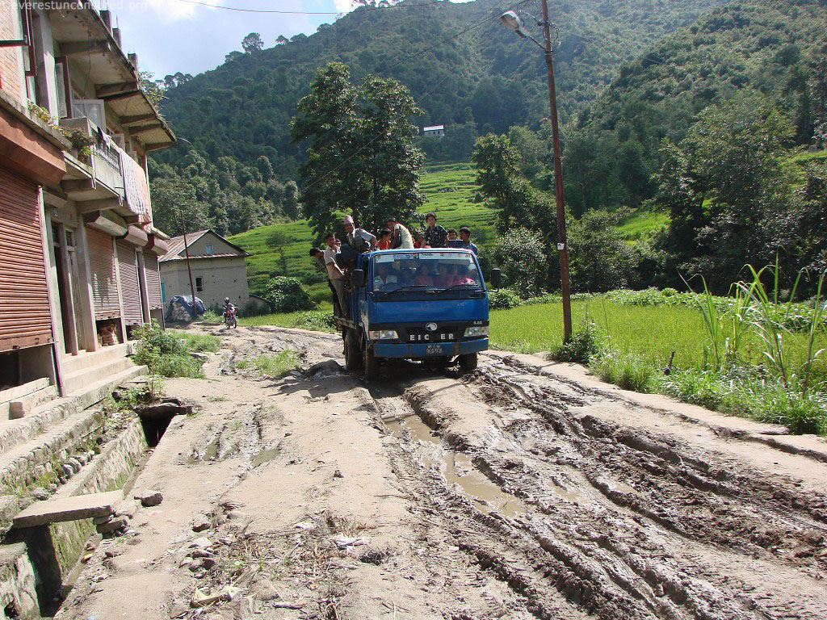


Slide 3
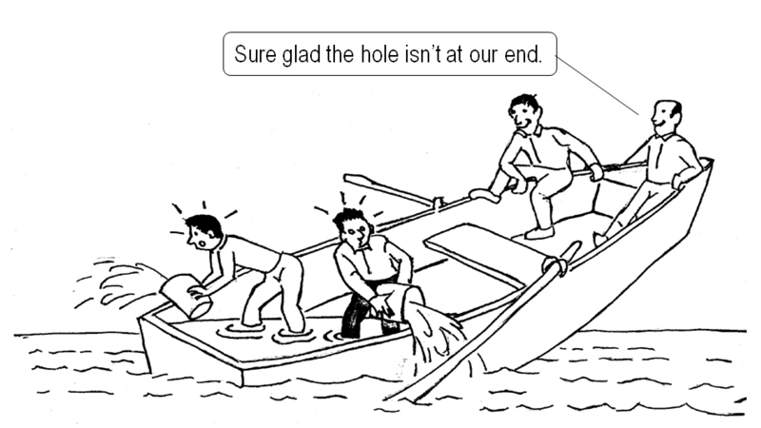

Slide 4


Slide 5
Plan Risk Management
  Processes for conducting risk management planning, identification, analysis, response planning and monitoring and control on a project.

Slide 6
Project Risk Management
  Plan Risk Management [PLANNING]
  Identify Risks [PLANNING]
  Perform Qualitative Risk Analysis [PLANNING]
  Perform Quantitative Risk Analysis [PLANNING]
  Plan Risk Responses [PLANNING]
  Monitor and Control Risks [M&C]

Slide 7
Personal Attitude to Risk
  Individuals fall into one of the three categories
  Risks Averse
  Risk Seeking
  Risk Neutral

Slide 8
33. Plan Risk Management
Defining how to conduct risk management activities for a project .

Slide 9
Plan Risk Management
Project Risk Management
Planning Process Group
Project scope statement
Cost management plan
Schedule management plan
Communications management plan
Enterprise environmental factors
Organizational process assets
Planning meetings and analysis
Risk management plan

Slide 10
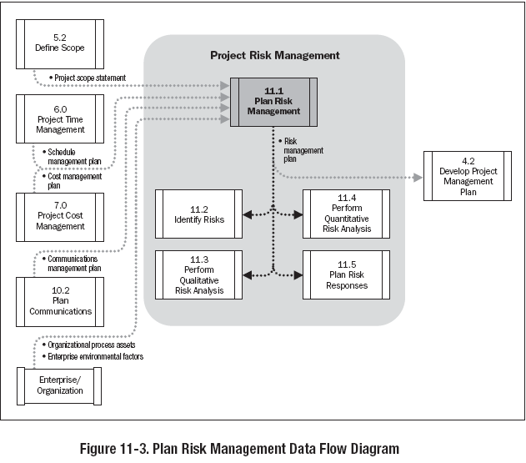

Slide 11
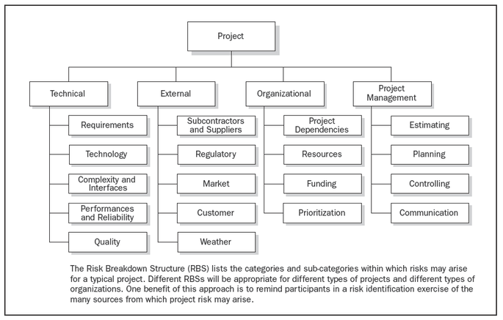
Risk Breakdown Structure
Source : PMI PMBOK® Fourth Edition

Slide 12
Project Risk Management
IMPACT
KNOWN
UNKNOWN
UNKNOWN
UNKNOWN EVENTS
KNOWN IMPACT
(Needs Cause Analysis)
UNKNOWN
UNKNOWN
(Ignorant Bliss)
UNKNOWN
EVENTS
EVENTS
KNOWN
KNOWN
(Certainty)
KNOWN EVENTS
UNKNOWN IMPACT
(Needs Risk Management)
KNOWN
KNOWN
KNOWN
UNKNOWN
IMPACT

Slide 13
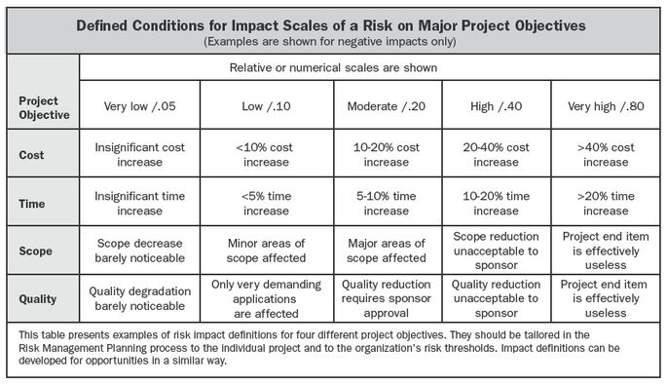
Definition of Impact
Source : PMI PMBOK® Fourth Edition

Slide 14
34. Identify Risks
Determining which risks may affect the project and documenting their characteristics

Slide 15
Identify Risks
Project Risk Management
Planning Process Group
Risk management Plan
Activity cost estimates
Activity duration estimates
Scope baseline
Stakeholder register
Cost management plan
Schedule management plan
Quality management plan
Project documents
Enterprise environmental factors
Organizational process assets
Documentation reviews
Information gathering techniques
Checklist analysis
Assumptions analysis
Diagramming techniques
SWOT analysis
Expert judgment
Risk register

Slide 16
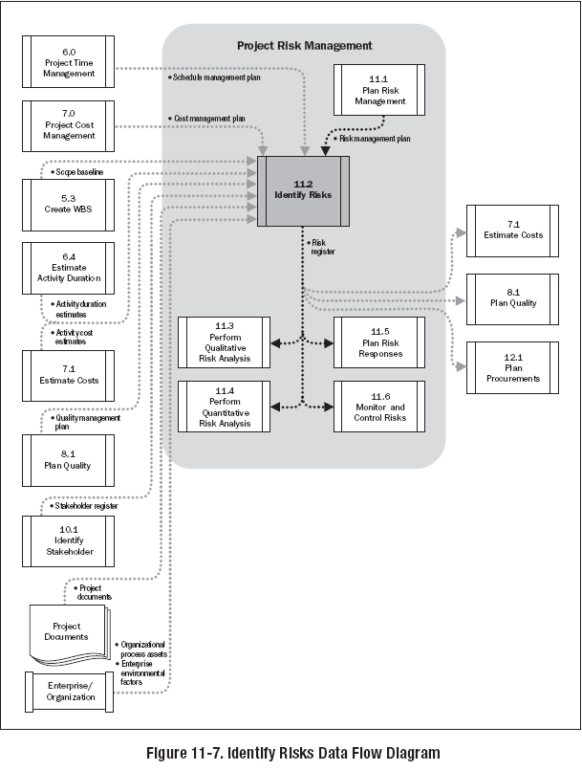

Slide 17
35. Perform Qualitative Risk Analysis
Prioritizing risks for further analysis or action by assessing and combining their probability of occurrence and impact.

Slide 18
Perform Qualitative Risk Analysis
Project Risk Management
Planning Process Group
Risk register
Risk management plan
Project scope statement
Organizational process assets
Risk probability and Impact assessment
Probability and impact matrix
Risk data quality assessment
Risk categorization
Risk urgency assessment
Expert judgment
Risk register updates

Slide 19
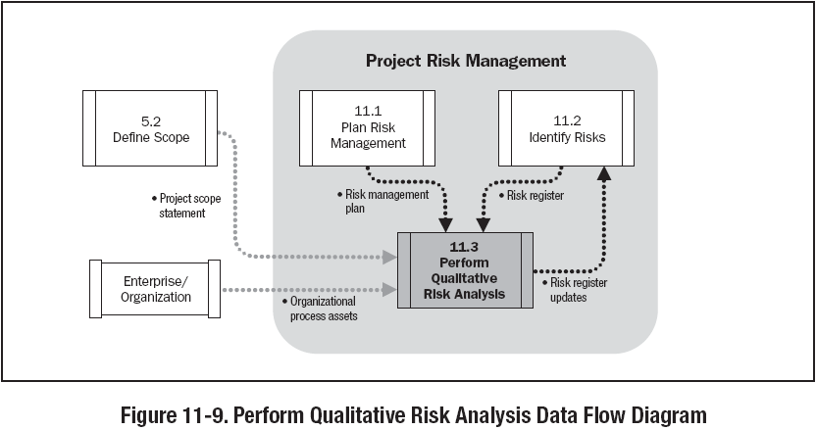

Slide 20
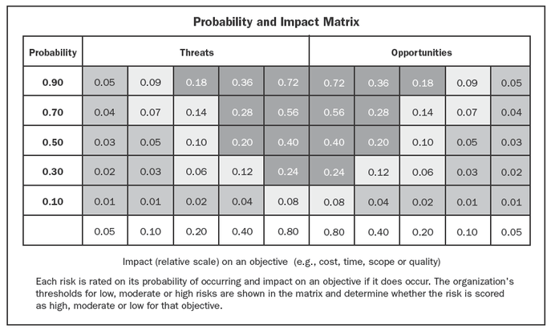
Probability Impact Matrix
    Define Threshold
    High risk (“red condition”)
    Medium risk (“yellow condition”)
    Low risk (“green condition”)
Source : PMI PMBOK® Fourth Edition

Slide 21
36. Perform Quantitative Risk Analysis
Numerically analyzing the effect of identified risks on overall project objectives.

Slide 22
Perform Quantitative Risk Analysis
Project Risk Management
Planning Process Group
Risk register
Risk management Plan
Cost management Plan
Schedule management Plan
Organizational process assets
Data gathering and representation techniques
Quantitative risk analysis and modeling techniques
Expert judgment
Risk register
updates

Slide 23
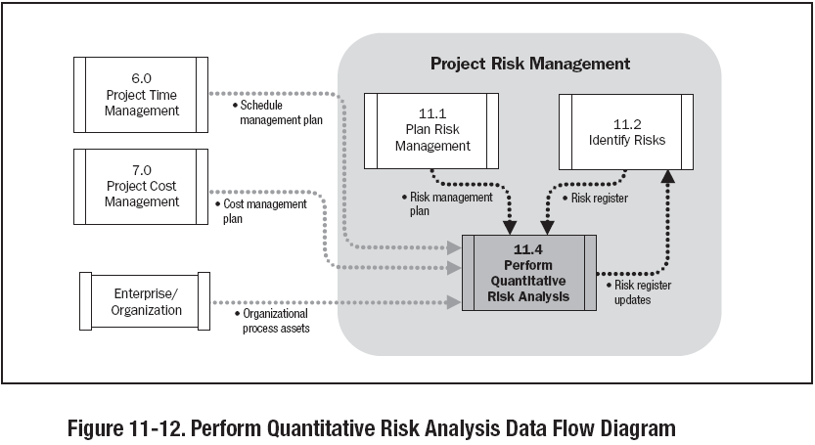

Slide 24
Formulae
Probability = Number of Occurrences / Total Number occurrences
= Frequency of Related Events / Total Number of Events
Probability = Frequency of Related Events /
Total Number of Possible Events
Expected Monetary Value (EMV) = Risk Event Probability X Risk Event Value
The sum of their probabilities of occurrence is 1.0

Slide 25
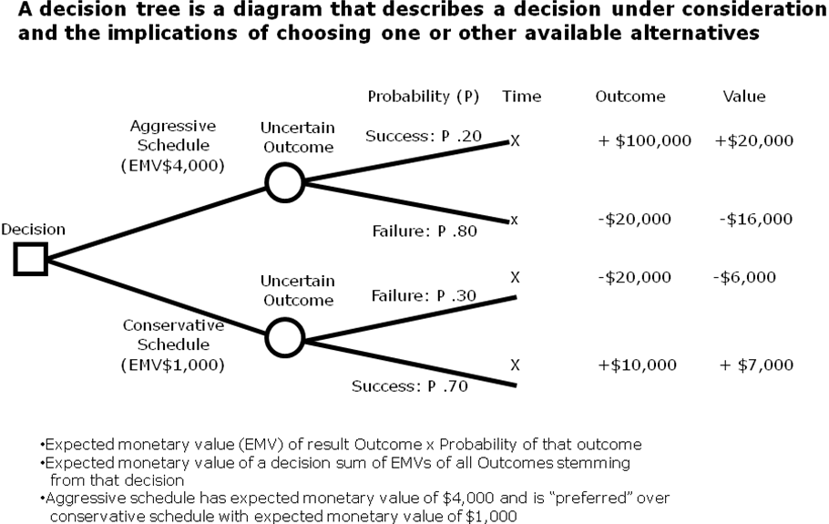
Decision Tree

Slide 26
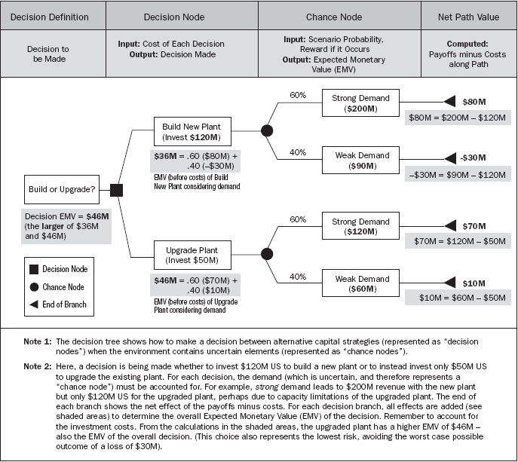
EVM- Decision Tree

Slide 27
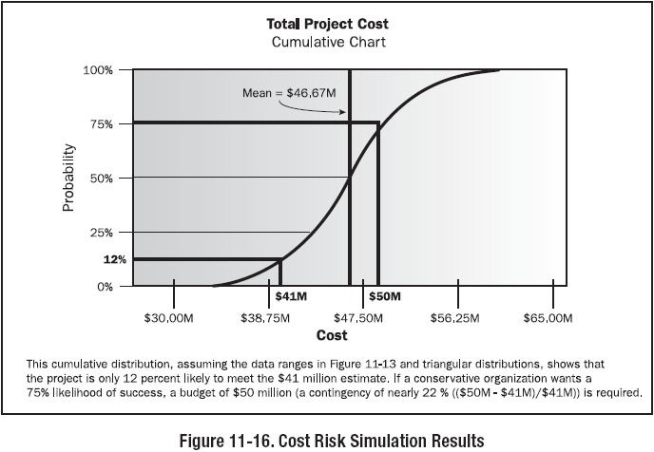
Modeling & Simulation

Slide 28
37. Plan Risk Response
Developing options and actions to enhance opportunities and reduce threats to project objectives.

Slide 29
Plan Risk Response
Project Risk Management
Planning Process Group
Risk register
Risk management plan
Strategies for negative risks or threats
Strategies for positive risks or opportunities
Contingent response strategy
Expert judgment
Risk register updates
Risk-related contract decisions
Project management plan updates
Project document updates

Slide 30
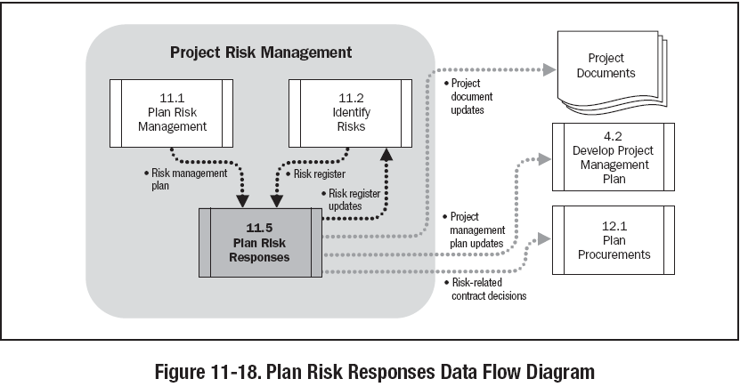

Slide 31
Plan Risk Responses
A risk may be:
  Unrecognized, unmanaged or ignored (by default)
  Recognized, but no action taken (absorbed as a matter of policy)
  Avoided (by taking appropriate steps)
  Reduced (by an alternative approach) reduction is dealing with the probability of the event occurring and / or actions to change specifications to reduce the consequences
  Shared (with others through contract or insurance)
  Transferred (to others through contract or insurance)
  Retained and absorbed (by prudent allowances)
  Managed through a combination of the above
But you can never eliminate the risk
  Can only be responded to

Slide 32
38. Monitor & Control Risks
Implementing risk response plans, tracking identified risks, monitoring residual risks, identifying new risks, and evaluating risk process effectiveness throughout the project.

Slide 33
Monitor & Control Risk
Project Risk Management
Monitoring & Controlling Process Group
Risk register
Project management plan
Work performance information
Performance reports
Risk reassessment
Risk audits
Variance and trend analysis
Technical performance measurement
Reserve analysis
Status meetings
Risk register updates
Organizational process assets updates
Change requests
Project management plan updates
Project document updates

Slide 34
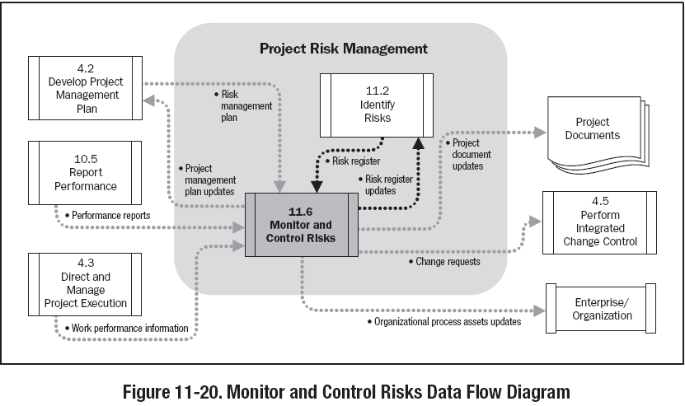

Slide 35
Project Risk Management
Contingency Reserve
  A separately planned quantity used to allow for future situations which may be planned for only in part (sometimes called “Known-unknowns”)
  Intended to reduce the impact of missing cost or schedule objectives
  Normally included in the project costs
Management Reserves
  “A separately planned quantity used to allow for future situations which are impossible to predict (sometimes called “Unknown- unknowns”)
  Intended to reduce the risk of missing cost or schedule objectives
  Use of Management reserves requires a change to the project’s cost baseline
Residual Risks
  Residual risks are those that remain after response measures have been taken.
  Include minor risks that have been accepted and addressed. E.g., By adding contingency amounts to the cost or by allowing time
Secondary risks
  Risks that arise as a result of implementing risk response
  Should be identified and responses planned

Slide 36
Project Risk Management Summary
There will always be risk in your project, so
Identify RISK EVENTS
Identify RISK CONSEQUENCES
Identify RISK PROBABILITY
Identify QUALITY AND QUANTITY
Identify RISK CONTAINMENT
Identify RISK CONTINGENCY
Then go and ...
SELL IT TO THE SPONSORS

Slide 37
RM Documents
Risk Register
Risk Database

