Slide 1
Project Procurement Management

Slide 2


Slide 3
Project Procurement Management
  Processes necessary to purchase or acquire products, services or results needed from outside the project team.

Slide 4
Another look @ Procurement Management
PROJECT
MANAGEMENT
INTEGRATION
SCOPE
TIME
Life Cycle
Environment Variations
Project
Definitions
Time Objectives
HUMAN
RESOURCES
Availability
Productivity
PROCUREMENT
MANAGEMENT
Cost
Objectives
COST
Directives
Data Exchange
Specification
Assurance
Risk Contracting
Performance, Service, Materials
COMMUNICATION
QUALITY
RISK

Slide 5
Project Procurement Management
  Plan Procurements [PLANNING]
  Conduct Procurements [EXECUTING]
  Administer Procurements [M&C]
  Close Procurements [CLOSING]

Slide 6
Project Manager’s Role
  Identifying project procurement needs
  Determine contract types and potential providers
  Identify/select procurement source
  Assessing quality and completeness of contract
  Verify product/service acceptance
  Structured review of the procurement process

Slide 7
39. Plan Procurement
Documenting project purchasing decisions, specifying the approach and identifying potential sellers.

Slide 8
Plan Procurement
Project Procurement Management
Planning Process Group
Scope baseline
Requirements documentation
Teaming agreements
Risk register
Risk-related contract decisions
Activity resource requirements
Project schedule
Activity cost estimates
Cost performance baseline
Enterprise environmental factors
Organizational process assets
Make-or-buy analysis
Expert judgment
Contract types
Procurement management plan
Procurement statements of work
Make-or-buy decisions
Procurement documents
Source selection criteria
Change requests

Slide 9
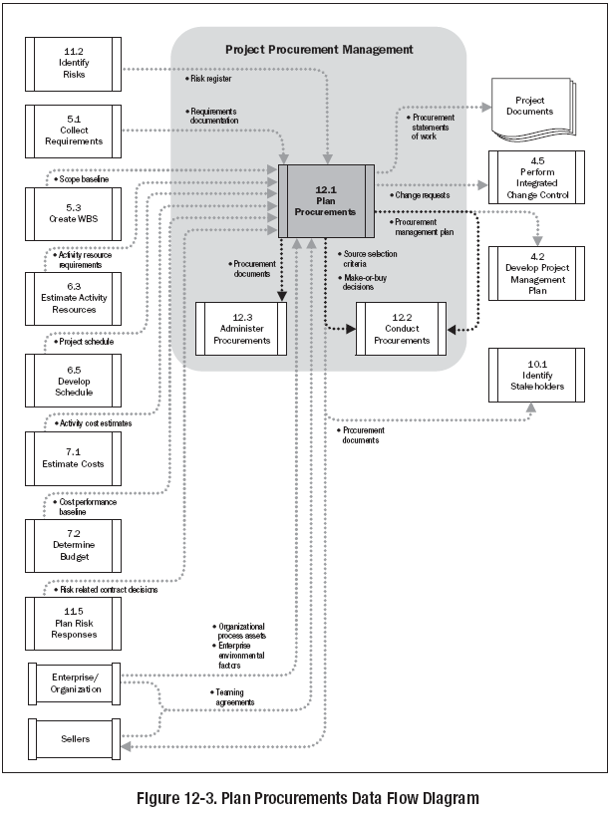

Slide 10
Procurement Management Plan
Describes how the procurement processes (from Plan Procurements through Close Procurements) will be managed
  Types of Contracts to be used
  Managing Multiple Providers
  Coordination with other project aspects

Slide 11
Sections of Contract
  SOW or Deliverables
  Schedule Baseline
  Performance Reporting
  Period of Performance
  Roles & Responsibilities
  Seller's Place of Performance
  Pricing
  Payment Terms
  Place of delivery
  Inspection and acceptance criteria

Slide 12
Sections of Contract
  Warranty
  Product Support
  Limitation of liability
  Fees and retainage
  Penalties
  Incentives
  Insurance and performance bonds
  Subordinate subcontractors approvals
  Change request handling
  Termination and alternative dispute resolution Mechanism

Slide 13
Procurement Contract Types
Different types of contracts are more or less appropriate for different types of purchases.
  Fixed Price or lump sum contracts
  Cost reimbursable contracts
  Time and material contracts

Slide 14
Types of Contracts
  T & M – Time & Materials
  The seller is paid for the amount of time it takes to accomplish the work & also reimbursed for the materials to complete the work
  Unit Price – Fixed Price
  The seller is paid a fixed price for an agreed upon Unit of Supply
Continued …

Slide 15
Types of Contracts- Fix Price Plus
  FFP – Firm Fixed Price
  Lump sum/firm Fixed Price. Seller at most risk
FPIF – Fixed Price Incentive Fee
  Most difficult to administer. It contains a number of cost/profit schemes like, cost, target profit, target price, ceiling price and share ratio. If seller maximizes profits, an incentive is offered to reduce costs and improve efficiency price, seller effort, but no profit
FP-EPA – Fixed Price with Economic Price Adjustment
  The seller is paid a fixed price. The contract is reviewed at pre-defined intervals in the project for adjustments to the contract price based on certain parameters

Slide 16
Types of Contracts- Cost Plus
  CPFF– Cost Plus Fixed Fee
Not desirable from buyer’s point of view.
The contractor is reimbursed its cost + a fixed fee.
  CPAF– Cost Plus Award Fee
Not desirable from buyer’s point of view. The contractor is influenced to increase costs.
  CPIF– Cost Plus Incentive Fee
  Seller is reimbursed for an agreed upon performance cost along with a pre established fee plus an incentive bonus. The buyer and seller share the uncertainty to a certain degree

Slide 17
Contract type & Risk
100%
Buyer
Risk
Seller
0%
CPPC
CPFF
CPAF
CPIF
T&M
FPEPA
FPIF
FP

Slide 18
Contract type Example: Fixed Price
Fixed Price (FP)
  Contract = $1,100,000
  It is fixed regardless of any other information
Fixed Price Incentive Fee (FPIF)
  Contract = $1,100,000. For every month early the project is completed, an additional $10,000 is paid to the seller. For every month late the project is completed a penalty of $20,000 is levied on the seller
  If project is completed 2 months early, Contract = $1,120,000
  If project is completed 2 months late, Contract = $1,060,000
Fixed Price Economic Price Adjustment (FPEPA)
  Contract = $1,100,000 but a price increase will be allowed in year two based on the U.S. Consumer Price Increase report for year one; or
  Contract = $1,100,000 but a price increase will be allowed in year two to account for increases in specific material costs

Slide 19
Contract type Example: Cost Reimbursable
Cost-Plus-Percentage of Cost (CPPC)
  Contract = Cost plus 12% of costs as fee
  If seller cost = 1,000,000, Contract = $1,120,000
Cost-Plus-Fixed-Fee (CPFF)
  Contract = Cost plus a fee of $100,000
  If seller cost = 1,000,000, Contract = $1,100,000
Cost-Plus-Incentive-Fee (CPIF)
Final payout = Target cost + Fixed fee + Buyer share ratio * (Actual Cost - Target Cost)
  Fixed fee (Target Profit) $100,000. Target cost of $1,000,000, the buyer to seller benefit/cost share ratio is 60/40. Minimum fee is $75,000, Maximum fee is $150,000.
  If project is completed at a cost of $900,000, Contract = $1,040,000.
  If project is completed at a cost of $1,100,000, Contract = $1,175,000.

Slide 20
CPIF Example
Final payout = Target cost + Fixed fee + Buyer share ratio * (Actual Cost - Target Cost)
Final payout = Target cost + Fixed fee + Buyer share ratio * (Ceiling Price - Target Cost)
Minimum Fee: nnn, Maxmum Fee: mmm
Min Fee | NA | NA | 50 | NA
Max Fee | NA | NA | 90 | NA
Ceiling Price | Na | 1100 | NA | NA
Target Cost | 1000 | 1000 | 1000 | 1000000
Fixed Feed (Target Profit) | 100 | 100 | 100 | 100000
Buyer/Seller Benefit/cost sharing | 80% /20% | 80% /20% | 80% /20% | 60% / 40%
Actual Cost | 900 | 900 |  | 900000
Contract Value | 1020 | 1020 |  | 1040000
Profit | 120 | 120 |  | 140000
Actual Cost | 1200 | 1200 | 1200 | 1100000
Contract Value | 1260 | 1100 | 1190 | 1160000
Profit/Loss | 60 | -160 | -70 | 60000

Slide 21
Contract type Example: Time & Material
Contract = Material $1000/CuM of concrete, Labour $200/CuM of concrete
  If actual quantity 100 CuM then
  Contract = $120,000
  If actual quantity 75 CuM then
  Contract = $90,000

Slide 22
Legal Requirements on Contracts
  Performing the promises in the contract between seller and buyer
  Essential elements of a contract
    Offer – clearly stated in a manner that can be understood by a reasonable person
    Contract must be between competent persons (mental state, age)
    Contract must have lawful objectives

Slide 23
Legal Requirements on Contracts
  Acceptance by the buyer, based on genuine assent of both parties
  Consideration – Most important part of the contract
  Something of value is received by the seller in exchange for meeting the promise
  Follows all laws where the contract execution occurs

Slide 24
40. Conduct Procurements
Process involves obtaining seller responses, selecting a seller and awarding a contract

Slide 25
Conduct Procurement
Project Procurement Management
Executing Process Group
Project management plan
Procurement documents
Source selection criteria
Qualified seller list
Seller proposals
Project documents
Make-or-buy decisions
Teaming agreements
Organizational process assets
Bidder conferences
Proposal evaluation techniques
Independent estimates
Expert judgment
Advertising
Internet search
Procurement negotiations
Selected sellers
Procurement contract award
Resource calendars
Change requests
Project management plan updates
Project document updates

Slide 26
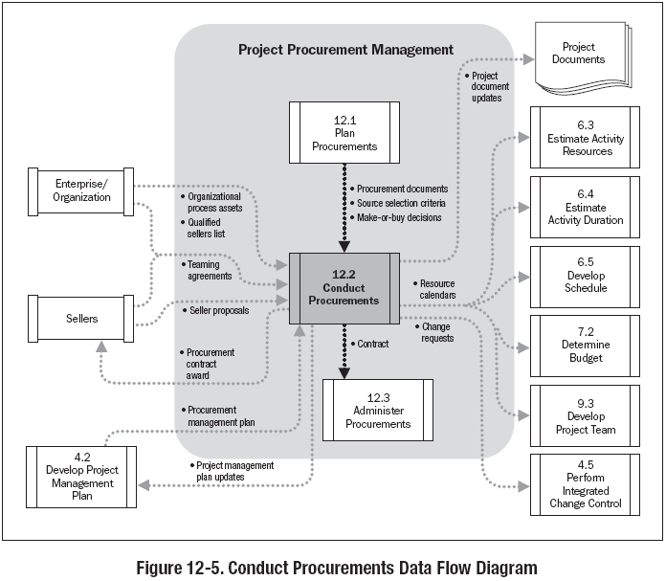

Slide 27
41. Administer Contract
Managing procurement relationships, monitoring contract performance and making changes and corrections as needed.

Slide 28
Administer Contract
Project Procurement Management
Monitoring & Controlling Process Group
Procurement documents
Project management plan
Contract
Performance reports
Approved change requests
Work performance information
Contract change control System
Procurement performance reviews
Inspections and audits
Performance reporting
Payment system
Claims administration
Records management system
Procurement documentation
Organizational process assets updates
Change requests
Project management plan updates

Slide 29
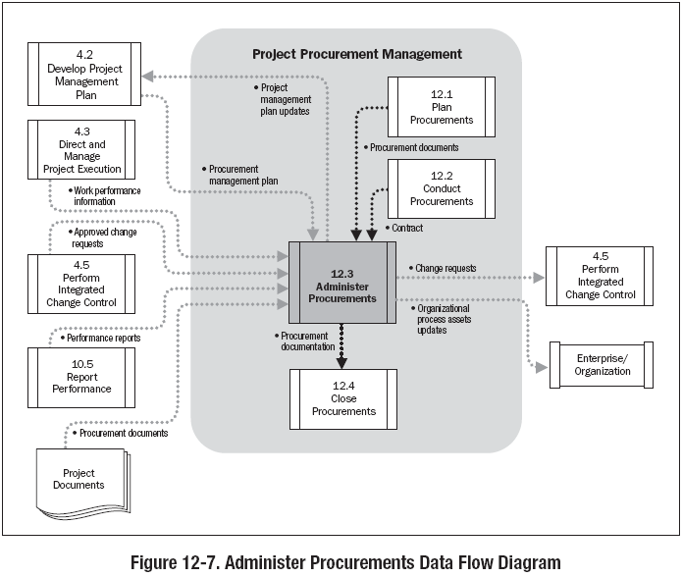

Slide 30
Change Control System
Process for modifying the contract.
Stress on Buyer Seller relationship
Greater reliance on reports to determine problems Includes:
  Paperwork
  Tracking
  Processes
  Approval Levels

Slide 31
42. Close Procurement
Process of completing each project procurement .

Slide 32
Close Procurement
Project Procurement Management
Closing Process Group
Project management plan
Procurement documentation
Procurement audits
Negotiated settlements
Records management system
Closed procurements
Organizational process assets updates

Slide 33
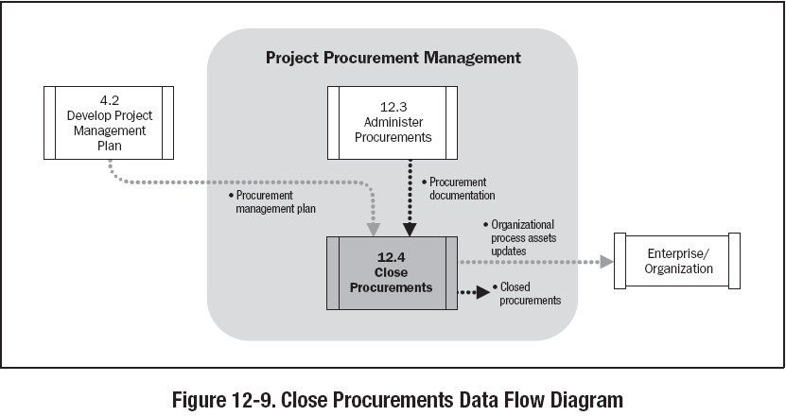

Slide 34

Procurement: Tips for PMP® Exam
Questions are written from buyer’s perspective
Seller is not supplying people to adjunct the buyer’s team (seller remains external to the project team)
Contracts require formality
All product and project management requirements should be specifically stated in the contract
If it is not in a contract, it can be done if a change is issued
If it is in the contract, it must be done or a change order, signed by both parties issued
Changes must be in writing

Slide 35
Procurement: Tips for PMP® Exam
Contracts are legally binding
Contracts should help diminish project risk
Most governments back all contracts by providing a court system for dispute resolution
Exam has very few references to International contracts
Questions are written by government contracting specialists of USA
In many parts of the world (including India), contracts are informal and relationships between parties is more important than the contract
It is important to take a more formal approach to the procurement process when answering questions

