Slide 1
Project Management, PMI & Credentials
Presented by
  Hari Prasad Thapliyal
  PMO & EPM Evangelist & Consultant
  Vedavit Project Solutions
In general interest of the public, aspiring PMP, project managers
Notes:
Click to add notes

Slide 2
Top 5 Tech Skills for 2010
Project Management
Security
Network Administration
Cloud Virtualization
Business Analysis
Source: 2010 IT Skills and salary report, Global knowledge and TechRepublic: Nov’2009 Survey

Slide 3
Project Manager is not Designation but a Profession. To adopt any profession we need to have education, skills & experience of that profession!
Most of the life we live like unconscious project manager!
Anybody who is working to bring change in… is part of project team. Scope of that project may vary. Ask yourself who is the project manager of that change?

Slide 4
So be proud that you are on right track
By choosing
“Project Management” Profession

Slide 5
What is a project?
A project is temporary endeavor undertaken to create unique product, service or result
  Temporary: Beginning and end
  End is reached when objectives have been achieved or project terminated or objective cannot be met
  Temporary: Does not apply to Product, service or result but to endeavour
  Unique: Either product is unique, customer is new or location is new or input to project is new
  A project can involve a single person, a single org unit or multiple org units

Slide 6
Project Produces :- Product, Service or Result
Product
  Residential Apartment
  Setup a factory
  Application enhancement of a banking software application
  Develop a new software application
Service
  Establish a training department which can take care of organizational training need
  Establish a presale department which can take care of all new business initiatives
  Setup a call centre
  Enabling a feature so that you start getting msg for every deposit or withdrawal from your account
  Define a new product release process
Result
  Passed in PMP exam, GMAT exam etc
  Health cured
  Illiteracy removed
  AIDS or Hepatitis B removed from the surface of earth
  Sanitary and hygiene education for all
  Hair cutting at saloon
  Conduct annual appraisals
  Conduct training programs
  Take food at a restaurant

Slide 7
Define Product, Service or Result
From previous slide can you state non overlapping definition of product, service or result

Slide 8
Projects and Operations
Develop one application and use it
Enhance certain feature in application and use those
Elect politicians, form government and run government
Setup airport and operanionalize
Setup school and operanionalize
Setup factory and operanionalize
Address the AIDS problems and make sure that no new case comes up
Find a job and do the job
Get married and maintain the marriage
Launch satellite in space and get the benefits
Get the peace and maintain it
Start a new branch office and run it
Open business new account and provide services
Built a national monuments and maintain it for public use
Spent money and use the product/ start the service/ get the result (realize benefits)

Slide 9
Top Management & Projects
Organization
Market place/ community
Any Portfolio
Need
Top Management
Validate the need, potential business opportunity, assign the need to portfolio/experts for creating a business case, business proposal is made
Org. Leadership
Unknown source
Particular Portfolio
Strategic Decision
Enterprise Level Decision
Fairly good amount $ @ stake
Long term commitment
Corporate image
Org Leadership
Prioritize the business proposal based on org vision/mission/value system of organization/ value the project’s product adds to stakeholders. Create portfolio/assign the business proposal to portfolio
Portfolio Manager is concern about the actual returns of the outcome of project but not in control after project/program has achieve its goal and outcome of project (service/product) in being used for giving services. Operation manager in control now
Portfolio Management
Create the programs, projects proposals from the selected business proposal. Outflow of values/ ROI

Slide 10
How project/program starts?
Need
Consideration
Strategic Mgmt
Evaluation
Prioritization
Assignment
Portfolio
Delivery
Program/ Project Management
Operationalization
Operation Mgmt

Slide 11
How project/program starts?
There is a need
Consideration: Should we address this need or ignore it- If not aligned to org goal/mission/objective/value systems then ignore it otherwise pick up for evaluation
Evaluation: What value it adds to organization/ stakeholders correspond to price need to be paid by stakeholders. ROI/ BCR
Prioritization: How much important this need is compare to other needs; because of resource constraints we cannot do all pickup few most important
Assignment: Assign the opportunity to portfolio and allocate the funds. Creates programs, projects.
Delivery: Programs, projects planned and delivered by program/project team
Operationalization: Benefits of Product/Result/Service of project are realized by user/community/stakeholders

Slide 12

Who owns the project/program
Program/Project Identified in Sponsor Org
Project in Performing Organization
Make of By Decision
Plan the phase/release
Identify Project/Program Manager
Define the overall scope
Execute release plan
Project Execution
Develop Overall Project plan & estimates
Stakeholder verify the results
Product, Service or Result realized
Project Execution
& Communication
Document lessons learned
Project Closure
Project Closure
Close release/phase

Slide 13
Buy Decision
Make of By Decision
RFP Floated by
Sponsor
Bidder Conference
Proposal Submitted by Vendor
Contract awarded
Identify Project/Program Manager
Project Executed
Project Closure

Slide 14
Why Project Fails?
Poor Alignment
Bad Planning
Lack of executive support
Incomplete requirements
Unclear expectations
Scope creep
Lack of resources
Choice of technology
Inexperience

Slide 15
For successful projects
Tips for requirement management
Surrender the pipe dream of complete requirements. They will keep coming…
Always assume the initial requirements are wrong. They will keep changing…
Accept that all requirements change
Simplify your change-management approach. Learn to manage requirement and changes to those.

Slide 16
Population, Megacities & Project Management Need
2004 There were only 2 megacities (10 mn population)
In 2010 there are 21 megacities
  11 in Asia, 4 in Latin America, 2 each in Africa, Europe and North America
  Today’s 21 megacities account for 9% of the world’s urban population
By 2025 there will be 29 megacities
Three are expected to emerge from China & similarly from India
By 2050, 70% of the worlds anticipated population (10 bn) will be urban dwellers
Source PMNetwork Aug’10

Slide 17
India’s Infrastructure Blitz
INR 46.4 Tn: The amount India plans to spend on infra between 2014 and 2017
22%: The rate India’s infrastructure industry grew between 2008 – 2009
41%: The portion of infrastructure project completed in India between Apr’1992-Mar’2009 that faced cost overruns
82%: The portion of projects in that time period that missed their deadlines
74%: Believe that the shortage of PM is the main factor influencing infra project delivery
Source: Study on drivers of success in infra projects 2010, PMI & KPMG : PMNetwork: Jul’2010

Slide 18
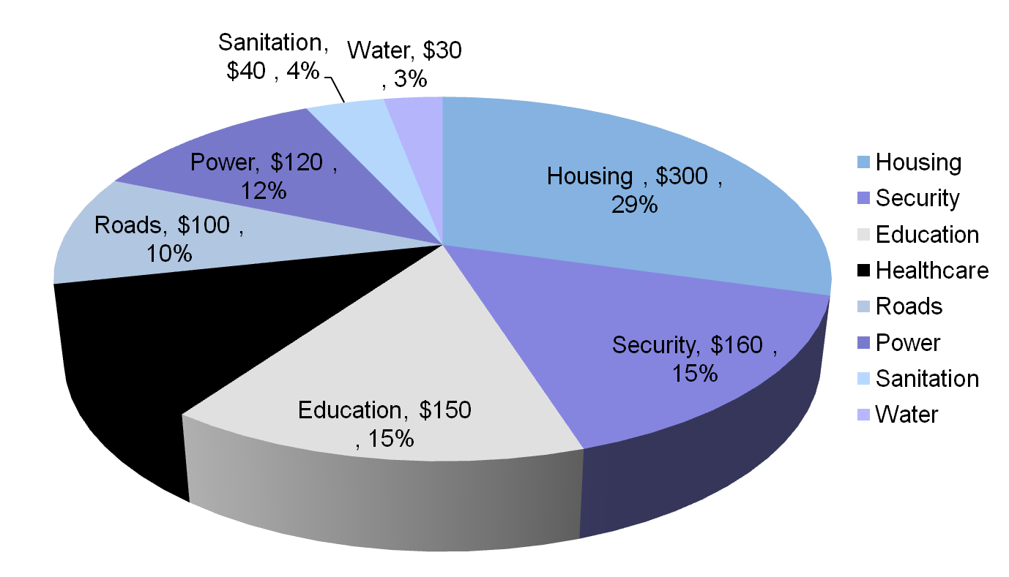
India Infrastructure Investment 2014-2017
Source: From the Report, prepared by Booz & Company in association with Cisco Systems for CII

Slide 19
Demand vs Supply of PMs
How we are going to meet this huge demand of project managers who should manage INR 47 Tn projects?
How many rightly experienced people are available today?
How many rightly educated people are available today?
Many projects (especially education, health) are managed by NGOs
Do Indian NGOs have required project management skills?
Do Indian government department have project management skills
Efforts in PM education, certification & experience can fill the gap.

Slide 20
Project Management Myth Vs Realty
It is inaccurate to think that only people designated as Project Managers have project management skills or use project management methodologies
Any person who needs to manage multiple task, involving multiple people and has deadline can use project management skills and knowledge

Slide 21
Ubiquitous nature of Project Management

Slide 22
Sales & Marketing
Campaign Management
Brand Management
Event Management
Product Lifecycle Management
Market Research
Public Relation

Slide 23
Human Resource
Training & Development
Recruitment Planning & Exec
Appraisal Execution
Organization development planning
Growth Planning

Slide 24
Finance
Budgeting
Variance Monitoring
Investment Planning
Merger & Acquisition Planning
IPO Planning & Execution
Following complains and disclosure procedures

Slide 25
Top Management
Strategic Planning
Monitoring initiative across department
Cash flow monitoring
Resource Planning
Expansion Planning
Managing Value Lifecycles
Crisis Management

Slide 26
Manufacturing
Process improvement
Capacity Expansion Planning
Building New factories
Quality Management
Defect Management
Kaizen

Slide 27
Home Users
Planning Parties or wedding
Building repair or house
Managing Proposals Finance
Tracking investments
Buying/selling property
Managing Cash flow
Moving residence from one place to other

Slide 28
Any Role
Manage complex interdependent task efficiently

Slide 29
Basic minimum you learn from workshop
Basics of Project Management
Explore specifics of project management to apply to your projects
Share and create common project management languages across
Create a baseline(s) to perform against & monitor the progress
Roles & Responsibilities of Project Manager
Understand the component of project planning and their purpose
Role of risk of risk management in Project Management
How to differentiate projects from operations
How projects, programs, portfolio and operations coordinate with each other
Understand stakeholders, expectation management & communication
Understand Project Lifecycle

Slide 30
PMI® & PMP®
An Overview
Notes:
Project Management Concepts
Version 3.1, 4/01 © 2003 by AstroWix

Slide 31
PMI® - Overview
Largest, not-for-profit global professional association for project
management practitioners
Established in 1969
Governed by a Board of Directors; elected “volunteer” members
PMI Offices is in Newtown Square, Pennsylvania in the USA.
Truly global membership with representation in over 130 countries.
Chapters act as “franchises”, providing education and networking
opportunities
Specific Interest Groups (SIGs), for similar industries or similar
interests.
Notes:
Project Management Concepts
Version 3.1, 4/01 © 2003 by AstroWix

Slide 32
PMI® – Membership Benefits
Member’s only services and discounts on many of PMI’s valuable products
Free Copy of the latest edition of the PMBOK® Guide CD ROM
Subscriptions to PM Network®, Project Management Journal® and PMI Today™
Join PMI’s Chapters, Specific Interest Groups (SIGs) and Colleges
Access the Members Area of the Web site
Access the PMI Member Community online
http://www.pmi.org/Membership/Pages/Types-of-Memberships.aspx
Notes:
Project Management Concepts
Version 3.1, 4/01 © 2003 by AstroWix

Slide 33
PMP® – Certification Benefits
Provides professional and personal recognition
Expedites professional advancement
Creates job growth and opportunities within an organization
Provides a framework for standardized project management requirements
Increases an employee’s value to the organization
A major benefit that organizations - a truly global
certification.
PMI Certified Project Managers are a preferred lot by any organization worldwide
High Demand due to short supply of Certified Project Managers
Increase in compensation within the organization
Notes:
Project Management Concepts
Version 3.1, 4/01 © 2003 by AstroWix

Slide 34
Project Management Standards
Projects
  PMBOK 4th Edition, 2008
  Schedule Management
  Risk Management
  Configuration Management
  Practice Standard for Work Break Down Structure
  Practice Standard for Earn Value Management
  Construction Extension
  Government Extensions

Slide 35
Project Management Standards
  Portfolio
  Portfolio Management
  Program
  Program Management
  Organization
  OPM3
  People
  Project Manager Competency Development Framework Profession

Slide 36
PMP Prerequisite
Secondary Diploma + 5 Years Experience in Projects+ 7500 Hours + 35 PDU
Or
4 years degree + 3 Years Experience in Projects+ 4500 Hours + 35 PDU

Slide 37
Costs of Certification
Registration fees for 35 Contact Hours program through a R.E.P
PMP Examination Fees
  Non-Members USD $555
  PMI Members USD $405
Re-Examination Fees
  Non-Members USD $375
  PMI Members USD $275

Slide 38
Contact Details
Hari P Thapliyal, PMP, MCITP, MBA, MCA, PGDFM
PMP, PMO , EPM Evangelist, Consultant & Trainer
hari.p@pmi-chennai.org; hariprasad.pmp@gmail.com
Ph: 9566002948
https://sites.google.com/site/lifeisprojectplus
Skype: hari.thapliyal
YM: hari_thapliyal
Twitter: harithapliyal

Slide 39


