Slide 1
Project Framework
Vedavit Project Solutions

Slide 2
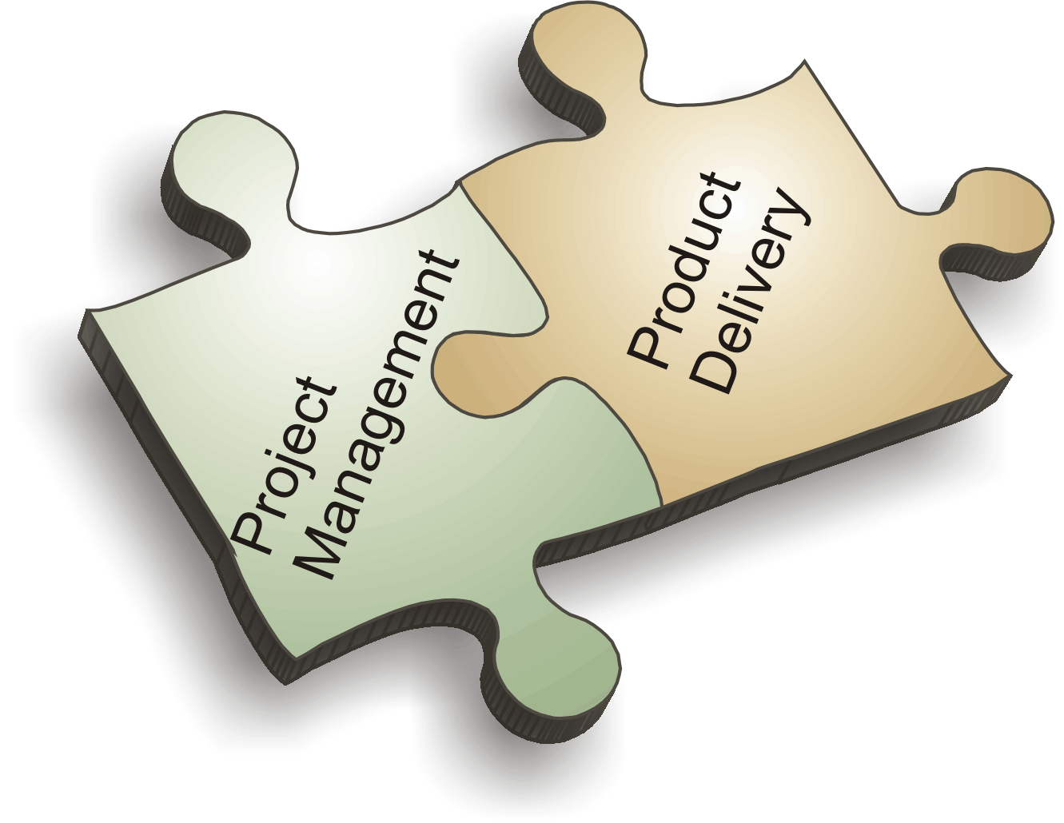
Vedavit Project Solutions

Slide 3

  Project
  Project Management
  Program Management
  Portfolio Management
  Program Management Office
  Stakeholder
  Organization Types
Hot Topics
Vedavit Project Solutions

Slide 4
  What is project???
Vedavit Project Solutions

Slide 5
  Project – A temporary endeavor undertaken to create a unique product, service or result
How Temporary?
  Has a definite beginning and end, not an on-going effort
  Ceases when objectives have been attained
  Team is disbanded upon project completion
Unique?
  The product or service is different in some way from other product or services
  Product characteristics are progressively elaborated
Vedavit Project Solutions

Slide 6
Project Characteristics
  Goal (measurable/verifiable) Oriented
  Finite duration with a beginning and end
  Uniqueness to a great extent and related uncertainties
  Coordinated undertaking of interrelated activities
  Performing the activities involve resources
  Resources cost money
Vedavit Project Solutions

Slide 7
Contrast Projects and Operations (Discussion)
How are “projects” different from “operations”?
Vedavit Project Solutions

Slide 8
Contrast Projects & Operations
  Projects
  Create own charter, organization, and goals
  Catalyst for change
  Unique product or service
  Heterogeneous teams
  Start and end date
  Operations
  Semi-permanent charter, organization, and goals
  Maintains status quo
  Standard product or service
  Homogeneous teams
  Ongoing
Vedavit Project Solutions

Slide 9






Project Constraints
Risk
Scope
Project and Product Quality
Schedule
Cost
Resource
Vedavit Project Solutions

Slide 10
Project Management
  The application of knowledge, skills, tools and
  techniques to project activities in order to meet
  the project requirements
Vedavit Project Solutions

Slide 11
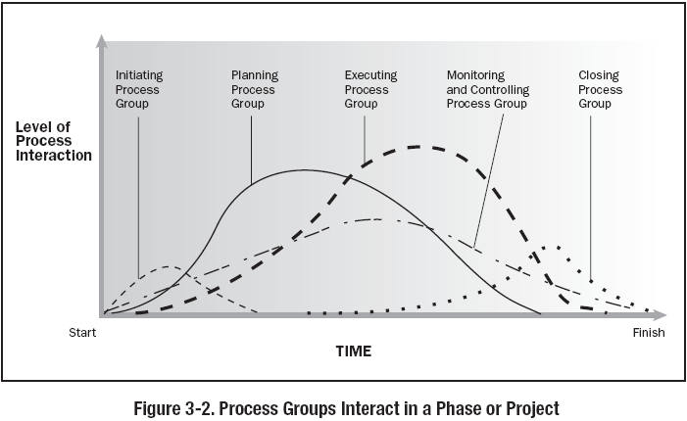
Typical PLC & Level of Activities
Vedavit Project Solutions

Slide 12
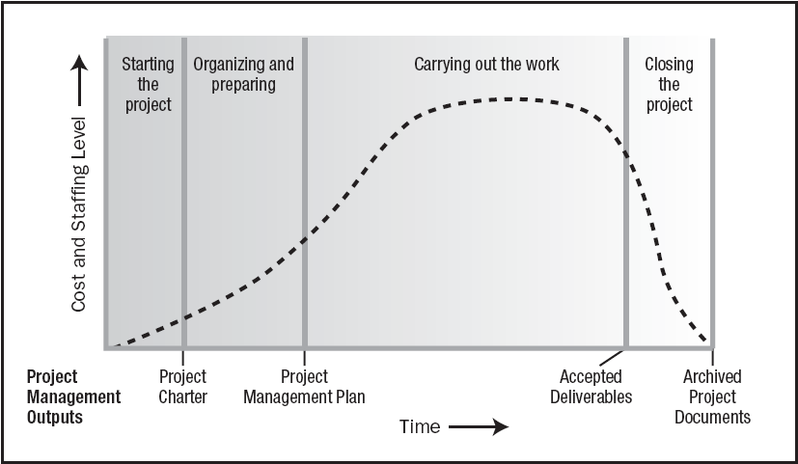
Typical Costing & Staffing across PLC
Vedavit Project Solutions

Slide 13
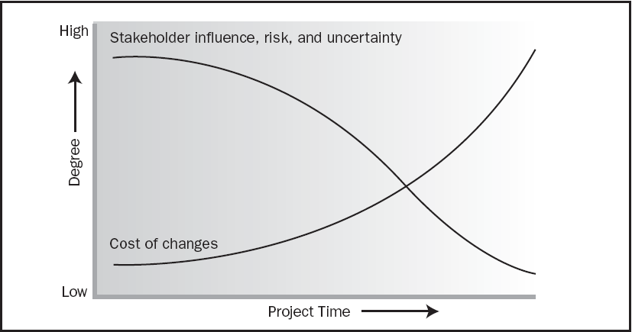
Impact of Variables based on Time
Vedavit Project Solutions

Slide 14
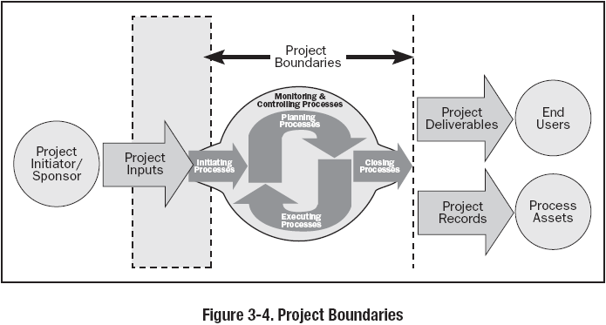
Vedavit Project Solutions

Slide 15
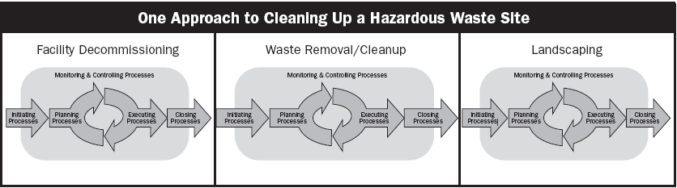
Relationship between Process Group & Phases
Vedavit Project Solutions

Slide 16
Project Management Context
  Project Portfolio Management
  Collection of projects or programs and other work that are grouped together to facilitate effective management of that work to meet strategic business objectives
Vedavit Project Solutions

Slide 17
Project Management Context
  Program
  Group of related projects managed in a coordinated way to obtain benefits and control not available from managing them individually
Vedavit Project Solutions

Slide 18
Project Management Office
  Managing shared resources across all project administered by PMO
  Identifying and developing project management methodology, best practices and standards
  Coaching, mentoring, training and oversight
  Monitoring compliance with project management standards, policies, procedures and templates via project audits
  Developing and managing project policies, procedures, templates and other shared documentation (organizational process assets), and
  Coordinating communication across projects
Vedavit Project Solutions

Slide 19
The Power of PMO
31% : Decrease in project failure
83% : Says that value added by PMO goes unquestioned by their executive sponsors
US$ .57 mn: The average amount companies with PMO saved per project
Source: PMI Magazine PMNetwork
Vedavit Project Solutions

Slide 20
Stakeholders
  Persons or organizations who are actively involved in the project or whose interests maybe positively or negatively affected by the performance or completion of the project
Vedavit Project Solutions

Slide 21
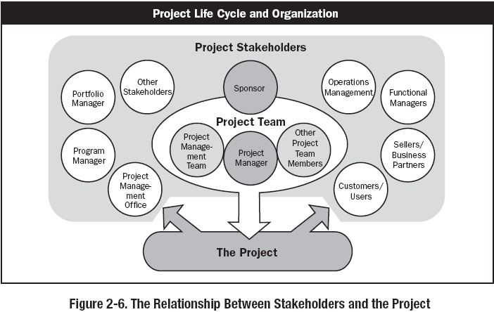
Stakeholders
Vedavit Project Solutions

Slide 22
Project Phases
  Projects are divided into phases where extra control is required to effectively manage the completion of the major deliverables
  Collectively, the project phases put together is known as Project life cycle
  Each phase is marked by one or more tangible verification work product
  The conclusion of a project phase is generally marked by a review
  The phase end points are referred to as phase exits, milestones, phase gates, decision gates, stage gates or kill points
  Starting a phase before approval of deliverables of a previous phase is called Fast Tracking
Vedavit Project Solutions

Slide 23
Organizational Types
  Functional
  Matrix
    Weak Matrix
    Balanced Matrix
    Strong matrix
  Projectized
Vedavit Project Solutions

Slide 24
Functional
Chief
Executive
Project Coordination
Functional
Manager
Functional
Manager
Functional
Manager
Staff
Staff
Staff
Staff
Staff
Staff
Staff
Staff
Staff
Vedavit Project Solutions

Slide 25
Weak Matrix
Chief
Executive
Functional
Manager
Functional
Manager
Functional
Manager
Staff
Staff
Staff
Staff
Staff
Staff
Staff
Staff
Staff
Project Coordination
Vedavit Project Solutions

Slide 26
Balance Matrix
Chief
Executive
Functional
Manager
Functional
Manager
Functional
Manager
Staff
Staff
Staff
Staff
Staff
Staff
Project Manager
Staff
Staff
Project Coordination
Vedavit Project Solutions

Slide 27
Strong Matrix
Chief
Executive
Functional
Manager
Functional
Manager
Functional
Manager
Manager of
Project Managers
Staff
Staff
Staff
Project Manager
Staff
Staff
Staff
Project Manager
Staff
Staff
Staff
Project Manager
Project Coordination
Vedavit Project Solutions

Slide 28
Projectized Matrix
Project Coordination
Chief
Executive
Project
Manager
Project
Manager
Project
Manager
Staff
Staff
Staff
Staff
Staff
Staff
Staff
Staff
Staff
Vedavit Project Solutions

Slide 29
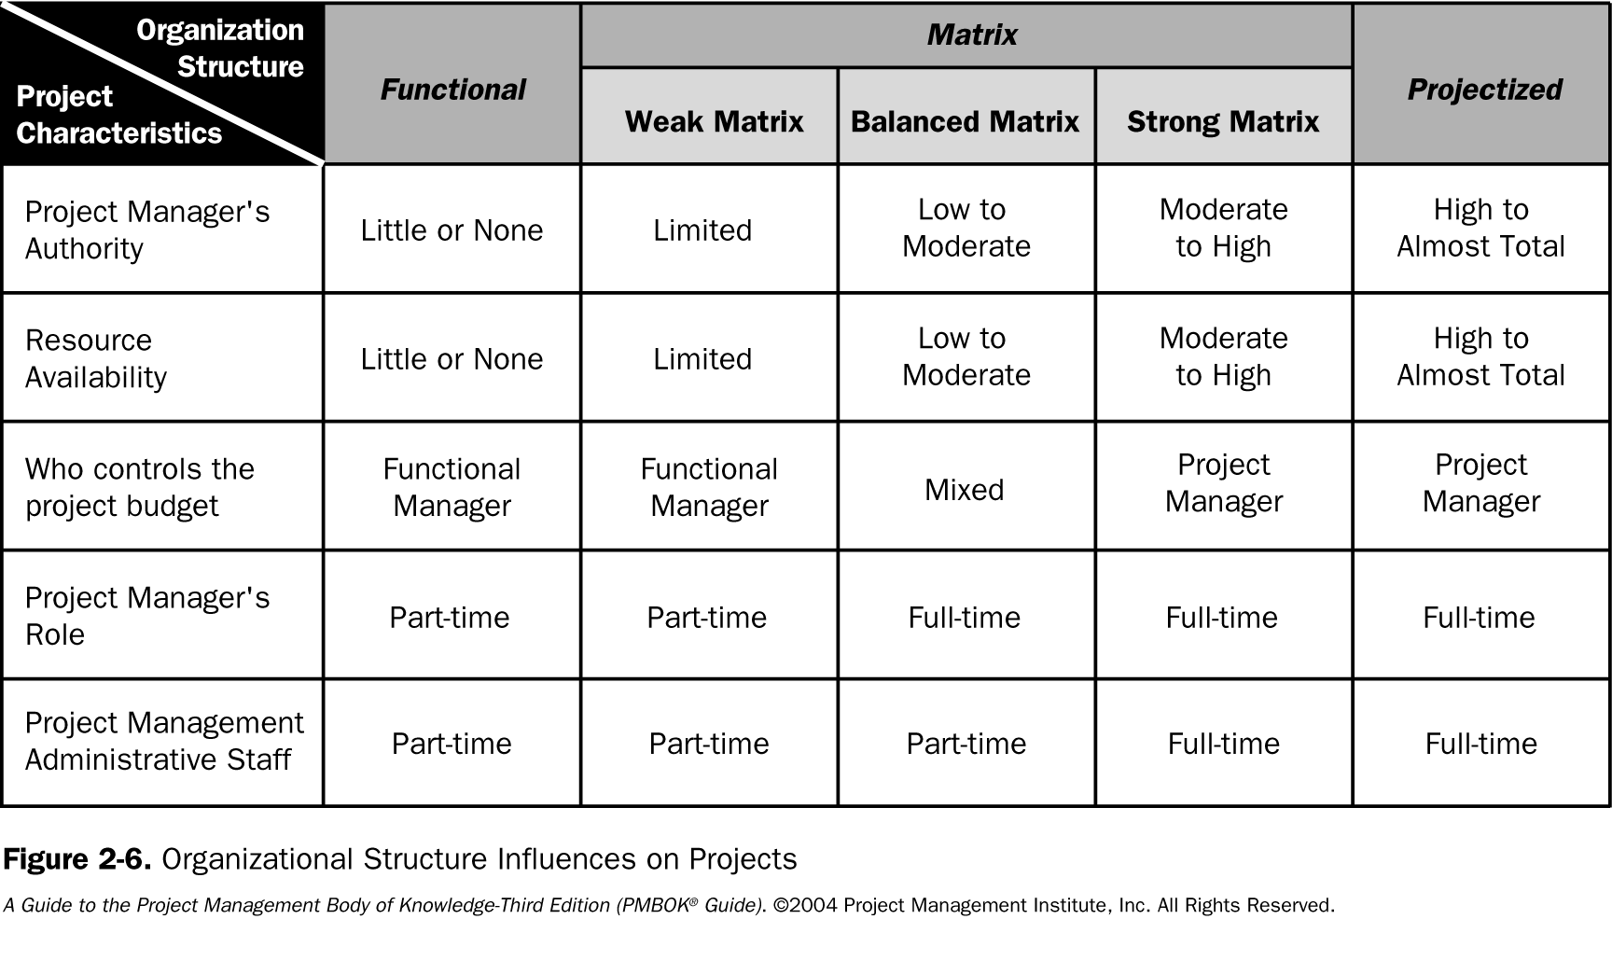
Organizational Influence
Vedavit Project Solutions

Slide 30
PM Competencies
Project Manager Competency Development Framework- 2nd Edition, 2007
Vedavit Project Solutions

Slide 31

Project Manager’s Role
Estimates of size, efforts & schedule
Risk identification, analysis, prioritization, monitoring & control
Resource allocation, resource backup and utilization
Scope management
Communication- reviews, steering committee meetings, stakeholder identification and expectation management
Defect free product delivery on time within budget
Team motivation, team management, training & development, appreciation, career planning, interview
Deliver as per contract & proposal
Procure as per contract & proposal
Configuration management, data backup
Quality planning
Cost optimization
Presales & proposals
Technical guidance to team – if team members are not available do their work (after project manager has completed his work & he has spare time)
Vedavit Project Solutions

Slide 32
Project Manager’s Responsibilities in Project Lifecycle
Initiating a Project
  Project aligned with org objectives & customer needs
  High-level risks, assumptions and constraints are understood
  Stakeholders identified and their need are understood
  Project Charter approved
Planning a Project
  Project scope agreed
  Project schedule approved
  Cost budget approved
  Project team identified with roles and responsibilities agreed
  Communication activities agreed
  Quality management process established
  Risk response plan approved
  Integrated change control processes defined
  Procurement plan approved
  Project Plan approved
Vedavit Project Solutions

Slide 33
Project Manager’s Responsibilities in Project Lifecycle
Executing a Project
  Project scope achieved
  Project stakeholders expectations managed
  Human resource managed
  Quality managed against plan
  Material resources managed
Monitoring & Controlling a Project
  Project tracked and status communicated to stakeholders
  Project change is managed
  Quality is monitored and controlled
  Risk is monitored and controlled
  Project team managed
  Contract administered
Closing a Project
  Project outcomes accepted
  Project resources released
  Stakeholder perceptions measured and analyzed
  Project formally closed
Vedavit Project Solutions

Slide 34
Personal Competence
Communication
Leading
Managing
Cognitive Ability
Effectiveness
Professionalism
Vedavit Project Solutions

Slide 35
Competence as PM
Assess Performance
Prepare Competence Development Plan
Implement PM Competence Development Plan
Vedavit Project Solutions

Slide 36
Vedavit Project Solutions

