Slide 1
Project Time Management
Vedavit Project Solutions

Slide 2

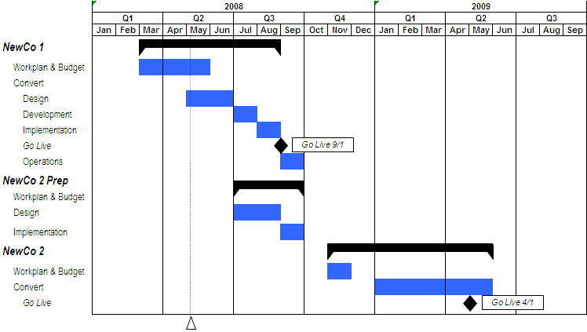
Project Time Management
Vedavit Project Solutions

Slide 3
Project Time Management
  “Doing your project without a plan is like watching television with someone else holding the remote control”- Peter Turla
  "The bad news is time flies. The good news is you're the pilot." - Michael Altshuler
  "I made this letter longer than usual because I lack the time to make it shorter." – Pascal
  “Time is a great teacher, but unfortunately it kills all its pupils." - Hector Louis Berlioz
Vedavit Project Solutions

Slide 4
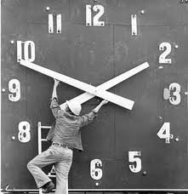
Project Time Management
  Processes required to manage timely completion of the project.
Vedavit Project Solutions

Slide 5
Project Time Management
  Define Activities [PLANNING]
  Sequence Activities [PLANNING]
  Estimate Activity Resources [PLANNING]
  Estimate Activity Durations [PLANNING]
  Develop Schedule [PLANNING]
  Control Schedule [M&C]
Vedavit Project Solutions

Slide 6

12. Define Activities
Identifying the specific actions to be performed to produce the project deliverables
Vedavit Project Solutions

Slide 7
Define Activities
Project Time Management
Planning Process Group
Scope baseline
Enterprise environmental factors
Organizational process assets
Decomposition
Rolling wave planning
Templates
Expert judgment
Activity list
Activity attributes
Milestone list
Vedavit Project Solutions

Slide 8
Activity Attributes
Dependency
Type of dependency
Efforts required
Related Deadline
Related WBS account
Critical activity
Type of task (fixed duration, resources, work)
Resource & skills required
Duration
Lead & Lag
Vedavit Project Solutions

Slide 9
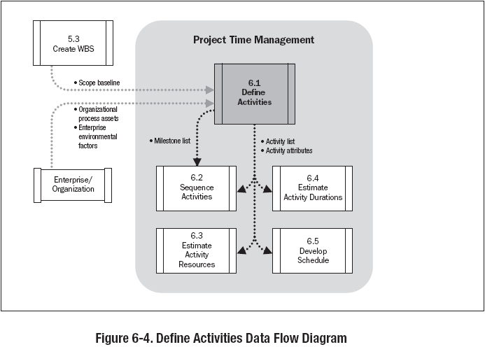
Vedavit Project Solutions

Slide 10
Discussion/Exercise 12
5 Minutes
Write activities & their attributes for previously created 2 level WBS for your project
Vedavit Project Solutions

Slide 11
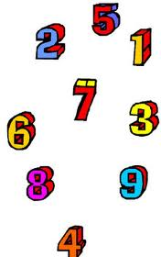
13. Sequence Activities
Identifying and documenting relationships among the project activities.
Vedavit Project Solutions

Slide 12
Sequence Activities
Project Time Management
Planning Process Group
Activity list
Activity attributes
Milestone list
Project scope statement
Organizational process assets
Precedence diagramming Method (PDM)
Dependency determination
Applying leads and lags
Schedule network templates
Project schedule network diagrams
Project document updates
Vedavit Project Solutions

Slide 13
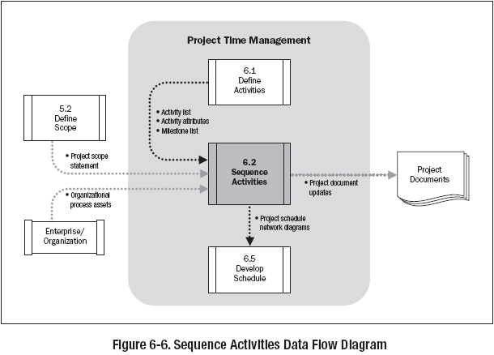
Vedavit Project Solutions

Slide 14
Discussion/Exercise 13
2 Minutes
Sequence Previously activities of your project write FS, SF, FF, SS after the activities
Vedavit Project Solutions

Slide 15
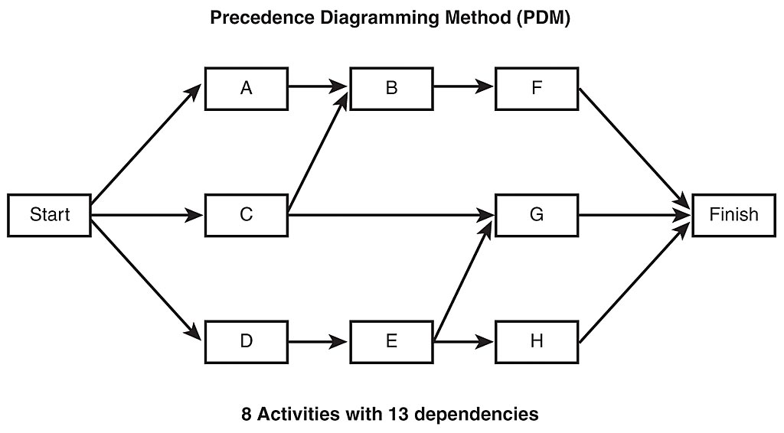
Precedence Diagramming Method (PDM)
Also known as Activity on Nodes (AON)
Vedavit Project Solutions

Slide 16
Network Development
Precedence Diagramming Method (AON)
A
B
C
Start
Finish
D
E
F
Vedavit Project Solutions

Slide 17
Network Development
Precedence Diagramming Method (AOA)
A
B
C
Start
Finish
F
D
E
Vedavit Project Solutions

Slide 18
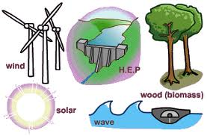
14. Estimate Activity Resources
Estimating the type and quantities of material, people, equipment or supplies required to perform each activity.
Vedavit Project Solutions

Slide 19
Estimate Activity Resources
Project Time Management
Planning Process Group
Activity list
Activity attributes
Resource calendars
Enterprise environmental factors
Organizational process assets
Expert judgment
Alternatives analysis
Published estimating data
Bottom-up estimating
Project management software
Activity resource requirements
Resource breakdown structure
Project management updates
Vedavit Project Solutions

Slide 20
Resource Breakdown Structure
Project ABC RBS
Labor |  |  |  |  |  |  |  |  |  |  | Material | Expenses
PM (1) | Config Mgmt |  | Technical Leaderhsip |  |  | Dev Team |  |  | Test Team
 | Config Mgr | Release Mgr | Arch (1) | UIExpert (1) | DBA (1) | Sr.Dev (4) | Jr.Dev (3) | TL (1) | Test Mgr | Tester (4) | Laptop (10 Units) | Procurement_Team
 |  |  |  |  |  |  |  |  |  |  | Desktop (Units) | Systems _eam
 |  |  |  |  |  |  |  |  |  |  | Leaseline (2 Mpbs) | Travel_Cost (3 People)
 |  |  |  |  |  |  |  |  |  |  | Servers (2 Units | Boarding_Loding_Cost (60 Days)
 |  |  |  |  |  |  |  |  |  |  |  | HR
Vedavit Project Solutions

Slide 21
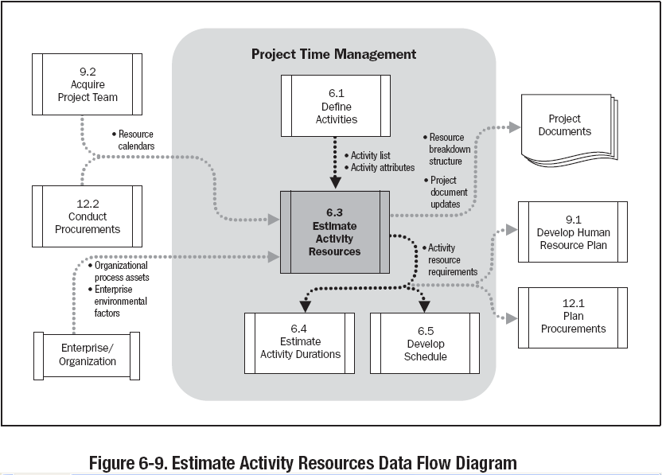
Vedavit Project Solutions

Slide 22
Discussion/Exercise 14
2 Minutes
Estimate Activity Resources for previously sequenced activities of your project
Vedavit Project Solutions

Slide 23

15. Estimate Activity Durations
Approximating the number of work periods needed to complete individual activities with estimated resources.
Vedavit Project Solutions

Slide 24
Estimate Activity Durations
Project Time Management
Planning Process Group
Activity list
Activity attributes
Activity resource requirements
Resource calendars
Project scope statement
Enterprise environmental factors
Organizational process assets
Expert judgment
Analogous estimating
Parametric estimating
Three-point estimates
Reserve analysis
Activity duration estimates
Project document updates
Vedavit Project Solutions

Slide 25
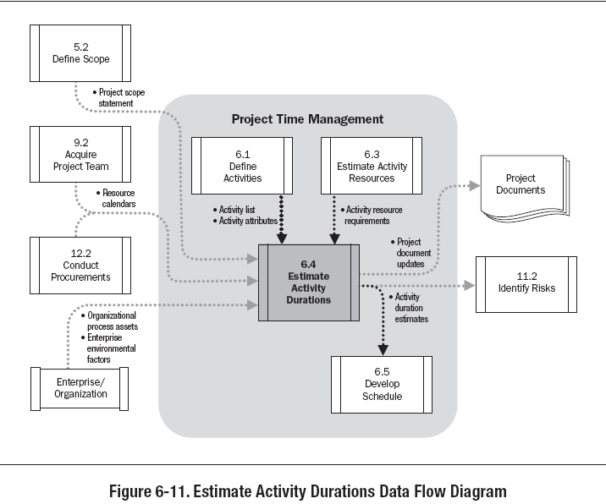
Vedavit Project Solutions

Slide 26
PERT – Program Evaluation and Review Technique
PERT Estimate = (Optimistic + 4 Most Likely + Pessimistic)/6
Standard Deviation (using PERT) = (Pessimistic-Optimistic)/6
Variance (using PERT) = ( (Pessimistic - Optimistic)/6)²
Vedavit Project Solutions

Slide 27
Discussion/Exercise 15
5 Minutes
Estimate Activity Duration for activities where resources are identified
Vedavit Project Solutions

Slide 28
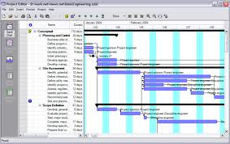
16. Develop Schedule
Analyzing activity sequences, durations, resource requirements and schedule constraints to create the project schedule.
Vedavit Project Solutions

Slide 29
Develop Schedule
Project Time Management
Planning Process Group
Activity list
Activity attributes
Project schedule network diagrams
Activity resource requirements
Resource calendars
Activity duration estimates
Project scope statement
Enterprise environmental factors
Organizational process assets
Schedule network analysis
Critical path method
Critical chain method
Resource leveling
What-if scenario analysis
Applying leads and lags
Schedule compression
Scheduling tool
Project schedule
Schedule baseline
Schedule data
Project document updates
Vedavit Project Solutions

Slide 30
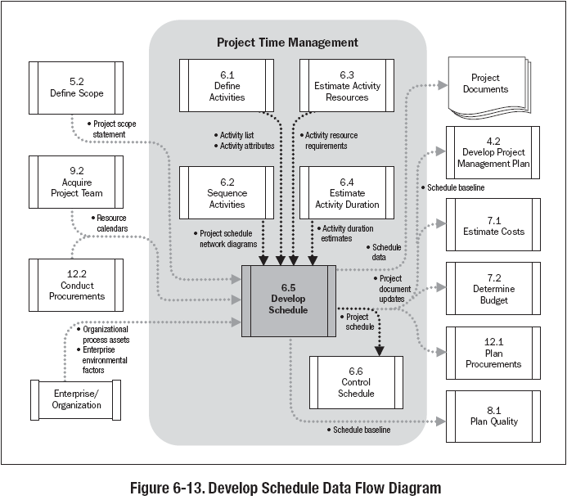
Vedavit Project Solutions

Slide 31
Critical Path Method
Critical Path method is a planning technique that is used to demonstrate and view the chronological activities of a program or project, and identifies any possible timing risks and can be used to establish the least amount of time to complete a project.
Vedavit Project Solutions

Slide 32
Critical Path
ES EF
ES EF
ES EF
ES EF
ES EF
ES EF
Duration 7
Task A
Duration 6
Task C
Duration 3
Task G
LS LF
LS LF
ES EF
LS LF
Duration 2
Task H
Start
Finish
ES EF
ES EF
ES EF
LS LF
Duration 3
Task B
Duration 3
Task D
Duration 3
Task E
LS LF
LS LF
LS LF
ES EF
Duration 2
Task F
Vedavit Project Solutions
LS LF

Slide 33
Forward Pass – Early Start, Early Finish
ES EF
ES EF
ES EF
Duration 7
Task A
0
7
Duration 3
Task G
Duration 6
Task C
13
16
7
13
LS LF
LS LF
ES EF
LS LF
Duration 2
Task H
16
18
Start
Finish
ES EF
ES EF
ES EF
LS LF
Duration 3
Task B
0
3
Duration 3
Task D
3
6
Duration 3
Task E
6
9
LS LF
LS LF
LS LF
ES EF
Duration 2
Task F
3
5
Vedavit Project Solutions
LS LF

Slide 34
Backward Pass – Late Start, Late Finish
ES EF
ES EF
ES EF
Duration 7
Task A
0
7
Duration 3
Task G
Duration 6
Task C
13
16
7
13
0
7
7
13
13
16
0
LS LF
LS LF
ES EF
LS LF
Duration 2
Task H
16
18
Start
Finish
7
7
7
16
18
ES EF
ES EF
ES EF
LS LF
Duration 3
Task B
0
3
Duration 3
Task D
3
6
Duration 3
Task E
6
9
7
10
10
13
13
16
LS LF
LS LF
LS LF
8
ES EF
Duration 2
Task F
3
5
11
13
Vedavit Project Solutions
LS LF

Slide 35
Critical Path – Longest Path, Zero Float
0
0
0
ES EF
ES EF
ES EF
Duration 7
Task A
0
7
Duration 3
Task G
Duration 6
Task C
13
16
7
13
0
7
7
13
13
16
0
LS LF
LS LF
ES EF
LS LF
Duration 2
Task H
16
18
Start
Finish
7
7
7
16
18
ES EF
ES EF
ES EF
LS LF
Duration 3
Task B
0
3
Duration 3
Task D
3
6
Duration 3
Task E
6
9
7
10
10
13
13
16
LS LF
LS LF
LS LF
8
ES EF
Duration 2
Task F
3
5
11
13
LS LF
Vedavit Project Solutions

Slide 36
Discussion/Excertise-16
5 Minutes
ES EF
ES EF
ES EF
Duration 4
Task A
Duration 4
Task B
Duration 3
Task C
LS LF
LS LF
LS LF
ES EF
ES EF
Duration 10
Task G
Start
Duration 7
Task D
Finish
LS LF
ES EF
LS LF
ES EF
Duration 5
Task E
Duration 5
Task F
LS LF
LS LF
Vedavit Project Solutions

Slide 37
Network Exercise - solution
Critical Path : ADCG
ES EF
ES EF
ES EF
Duration 4
Task A
0
4
Duration 3
Task C
Duration 4
Task B
11
14
4
8
0
4
7
11
11
14
LS LF
LS LF
LS LF
ES EF
ES EF
Duration 10
Task G
14
24
Duration 7
Task D
Start
4
11
Finish
14
24
4
11
LS LF
ES EF
LS LF
ES EF
Duration 5
Task E
0
5
Duration 5
Task F
5
10
4
9
9
14
LS LF
LS LF
Vedavit Project Solutions
Notes:
Free float: An activity can be delayed without impacting the start of next activity
Total float: As many alternative path that many total float. Total float is available on non critical path. Activities can be delayed without delaying project
Free float on critical path activities is Zero

Slide 38
Facts/Tips for Critical Path
Total Float is the amount of time the task can delayed without delaying the project finish date.
Free float is the amount of time a task can slip without delaying the early start of any task that immediately follows it
It is possible that a zero float activity may not be on critical path
Longest path & shortest time possible to complete the project
A project can multiple critical paths
Difference between late and early is float
Positive float (the activity can wait to start even after previous activity finishes)
Negative float (the activity must start before previous finishes)
Zero float (the activity must immediately start after the finish of previous one)
Crashing activities to short the overall duration of project
Fast-tracking activities to short the overall duration of project
Be cautious that non-critical activity is not being delayed than the allowed free float
Take care of sub-critical path or non-critical path
Manage critical path resources very closely
Do not overload critical path activity resources
Avoid multitasking for resources working on critical path activities
Vedavit Project Solutions

Slide 39
Benefits of PERT/CPM
It Provides following information
Expected Project completion time
Probability of completion before a specified date
The critical path activities that directly impact the completion time
The activities that have slack time and that can lend resources to critical path activities
Activity start and end dates
Vedavit Project Solutions

Slide 40
Limitation of PERT/CPM
The activity time estimates are somewhat subjective and depend on judgement. It can be biased.
Even if the activity times are well-estimated PERT assumes a beta distribution for these time estimates, but the actual distribution may be different
Even if the beta distribution assumption holds, PERT assumes that probability distribution of the project completion time is the same as the that of critical path. Because other paths can become the critical path, PERT underestimates the expected project completion time.
Vedavit Project Solutions

Slide 41
Type of Distribution
http://en.wikipedia.org/wiki/Probability_distribution
Beta (For a single probability)
  Bermoulli, Binomial
Gamma (For non-negative scaling parameter)
  Poisson or Exponential, Precision of Normal Distribution
Dirichlet (For a vector of probabilities that must sum to 1)
  Categorical, Multinominal, Generalization of Beta
Wishart (for a symmetric non-negative definite matrix)
  Multivariate normal, Generalization of Gamma
Vedavit Project Solutions

Slide 42

17. Control Schedule
Monitoring the status of the project to update project progress and manage changes to the schedule baseline
Vedavit Project Solutions

Slide 43
Control Schedule
Project Time Management
Monitoring & Controlling Process Group
Project management plan
Project schedule
Work performance information
Organizational process assets
Performance reviews
Variance analysis
Project management software
Resource leveling
What-if scenario analysis
Adjusting leads and lags
Schedule compression
Scheduling tool
Work performance measurements
Organizational process assets updates
Change requests
Project management plan updates
Project document updates
Vedavit Project Solutions

Slide 44
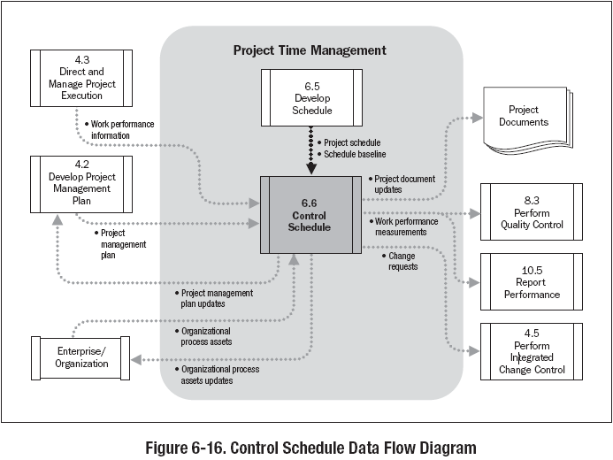
Vedavit Project Solutions

Slide 45
Discussion/Exercise 17
5 Minutes
Write work performance measures and their values of your project with respect to Schedule Management
Vedavit Project Solutions

Slide 46
Vedavit Project Solutions

