Slide 1




Fundamentals of
Project Management
Trainer : Hari Prasad Thapliyal
(PMP, PMI-ACP, CSM, MBA, MCA, PGDOM, PGDFM, CIC, PRINCE2-Practitioner)
[PMI-ACP : #318050]
[PMP : #1563385]
Colossal Technologies
queries@colossaltechnologies.com
http://www.colossaltechnologies.com
+91 80 25272499
This presentation copy is authorized only for Hibu India Pvt Ltd employees.
'PMI-ACP', 'PMI', and 'ACP' are a registered marks of the Project Management Institute, Inc.
Copyright 2013 Vedavit Project Solutions

Slide 2
Training Agenda
Overview | What is project?
 | Project vs Operation
 | Project Management
 | Project Constraints
 | Ten aspects of Project Management
 | Five process groups
 | Project Lifecycle
Project Initiation | What work is done before project kickoff?
 | Project Kickoff
 | Project Charter
 | Stakeholder Identification
Planning | Scope
 | Estimation
 | Quality
 | Communication
Risk Management | Plan Risk Management
 | Identify Risk
 | Risk Analysis
 | Plan Risk Reponse
 | Control Risk
Copyright 2013 Vedavit Project Solutions

Slide 3
Training Agenda
Monitoring & Controlling | Variances
 | Root Cause Analysis
 | Changes Management
 | Reporting
 | Issue management
Team Management | Team Development Stages
 | Setting Ground Rules
 | Mission & Vision of the Project
 | Conflict Management
 | Powers
 | Understand your team
Project Closure | Project Closure Reports
 | Lessons Learned & Archival
 | Project Handover
PM : Roles & Responsbilities
PM : Skills
Copyright 2013 Vedavit Project Solutions

Slide 4
Overview of Project Management
Copyright 2013 Vedavit Project Solutions

Slide 5
What is a Project?
‘A Project is a temporary endeavor undertaken to create a unique product or service’
Temporary : ‘every project has a definite beginning and a definite end’
Unique: ‘the product or service delivered is different from others’
  Organizations resort to Projects to achieve their strategic needs, which cannot otherwise be attained through normal operational means.
Copyright 2013 Vedavit Project Solutions
Notes:
Seven wonders of the world
Pyramids
Product or service or capability to create the product/service(building, business function, org restructuring), research project)
Temporary- end- when proj objectives are met or not met or cannot be met-; need no longer exists-aborted.
Uniqueness- contactor, budget, configuration, location..etc; repititive elements could be there---similar projects or degree of similarity.
Portfolio, Program, Project
Portfolio- L&T Infra dvision—has projects in oil, power, gas, water, airport…(portfolio)-objective to maximize returns; program –within power (projects in power or in airport)
I may have a portfolio of stocks across Banking, Infra, commodities, IT….Banking stocks are from banking program (inter dependencies--)

Slide 6
Project vs Operations
Attribute | Projects | Operations
Charter | Permanent Project Charter | Semi-permanent charter
Change | Catalyst for change | Maintains status quo
Product | Unique product or service | Standard product or service
Team | Heterogeneous teams | Homogeneous teams
Time | Start and end date | Ongoing
Requirments | Progressive elaboration | Predefined product
Copyright 2013 Vedavit Project Solutions

Slide 7






Project Constraints
Evaluate the competing demands and their impact on
project outcomes.
Risk
Scope
Project and Product Quality
Schedule
Cost
Resource
Copyright 2013 Vedavit Project Solutions

Slide 8
What is Project Management?
‘Application of knowledge, skills, tools and techniques to project activities to meet the Project requirements’
People with skills, knowledge and motivation
PEOPLE
Procedures and methods defining the relationship amongst tasks
Tools and Techniques to perform Processes
PROJECT
MANAGEMENT
PROCESSES
TOOLS
Copyright 2013 Vedavit Project Solutions
Notes:
Processes – Communication
Tools – Knowledge, Skills
Resource comes from the organization.

Slide 9
Project Management Process Groups
Monitoring and Controlling
Planning
Initiating
Closing
Executing
Copyright 2013 Vedavit Project Solutions

Slide 10
Project Phases
Project Phases
Projects are divided into phases where extra control is required to effectively manage the completion of the major deliverables
Collectively, the project phases put together is known as Project life cycle
Each phase is marked by one or more tangible verification work product
The conclusion of a project phase is generally marked by a review
The phase end points are referred to as phase exits, milestones, phase gates, decision gates, stage gates or kill points
Starting a phase before approval of deliverables of a previous phase is called Fast Tracking
Your Project Must have Phases
Copyright 2013 Vedavit Project Solutions

Slide 11
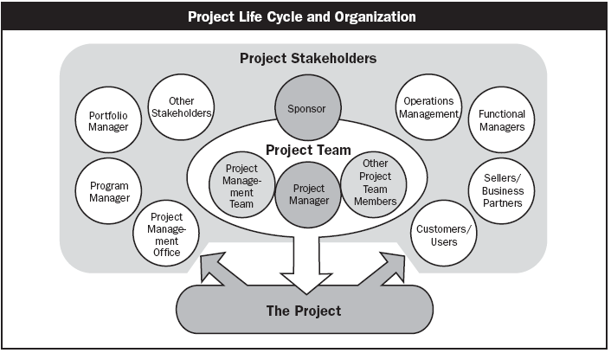
Who are Stakeholders?
Stakeholders
  Persons or organizations who are actively involved in the project or whose interests maybe positively or negatively affected by the performance or completion of the project
Source PMBOK Guide Version 5.0
Copyright 2013 Vedavit Project Solutions

Slide 12
Understanding Project Lifecycle
Performing Organization/ Stakeholders
Phase
I
Phase
II
Phase
III
Phase
IV
Closure
Initiation
Exits
Exits
Exits
a
b
c
d
Deliverables
Copyright 2013 Vedavit Project Solutions
Notes:
What is a lifecycle? Delivery strategy
Conceived, born, childhood, teenage, adult, working adult, married adult, parent, retired, obsolete
(transition from one state to the other needs to be clearly defined--tollgates)
Phase- logical grouping of related tasks, deliverables
Hybrid models
SAP-LIFECYCLE- Proj preparn, Bus blueprint,realizn, Final preparn, Go live and support

Slide 13
Project Lifecycle (Waterfall)
Waterfall Lifecycle
Requirements
Engineering
Design
Construct
(CUT)
Integration Testing
System Testing
Release
Acceptance Testing
Copyright 2013 Vedavit Project Solutions

Slide 14
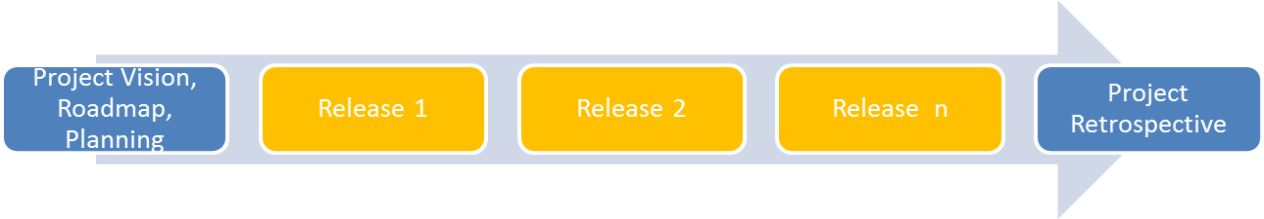
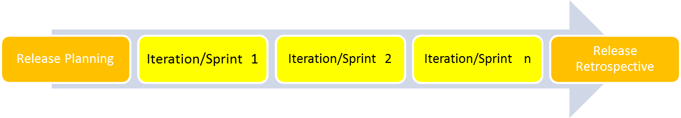
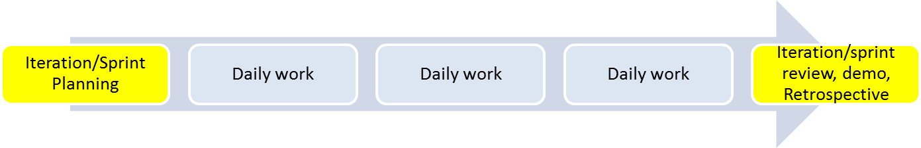
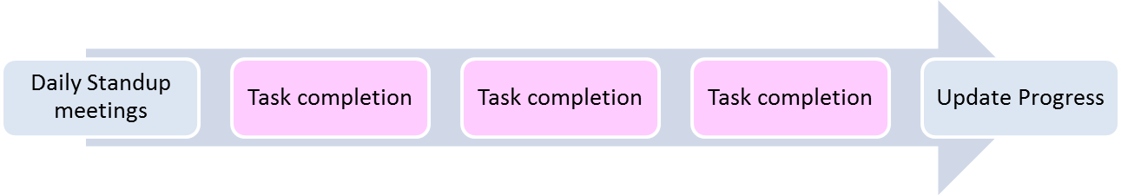
The Agile Methodology
Copyright 2013 Vedavit Project Solutions

Slide 15
10 Aspects of Project
Scope
Time
Cost
Quality
Human Resource
Communication
Risk
Procurement
Stakeholder
Integration
Copyright 2013 Vedavit Project Solutions

Slide 16
Initiating Process Group
SOW/Contract/MOU………
The Project and the Project Manager come into existence.
Project Charter – heralds the launch of the Project.
Project Kickoff.
Copyright 2013 Vedavit Project Solutions
Notes:
Herald – to announce something important – existence of project

Slide 17
Planning Process Group
Planning processes are important – as the project involves ‘doing something that has not been done before’
Amount of planning should be commensurate with
  Project Scope.
  Product Scope.
PLAN WHAT YOU WILL DO
Copyright 2013 Vedavit Project Solutions

Slide 18
Executing Process Group
Putting the Project Plan to work.
Actually performing project work to generate project results.
Coordinating project team members, support staff and other resources to carry out the project plan.
DO AS YOU PLANNED
Copyright 2013 Vedavit Project Solutions

Slide 19
Controlling Process Group
Monitoring Project progress regularly to identify variances from the plan.
Taking of corrective actions.
Taking of preventive action in anticipation of possible problems.
CHECK WHETHER YOU HAVE DONE AS YOU PLANNED, ACT ON THE DIFFERENCE
Copyright 2013 Vedavit Project Solutions

Slide 20
Closing Process Group
Bringing the project or phase to an orderly end and formalizing acceptance.
Administrative Closure
    Generating, gathering, disseminating information to formalize project completion.
Take the Learnings from your Planning, Doing and Acting , forward…..
Copyright 2013 Vedavit Project Solutions
Notes:
Within each group the process groups repeat.

Slide 21
Project Initiation
Copyright 2013 Vedavit Project Solutions

Slide 22
How do Projects Arise?
Organizations identify a business need that can be satisfied by executing a Project.
Projects can be ‘Internal’ or ‘External’.
Projects may arise out of many factors including:
  Market/ customer demands.
  Need to improve internal processes.
  Technology upgradation and Legal requirements.
  Social needs.
Copyright 2013 Vedavit Project Solutions

Slide 23
Why do Projects fail?
Lack of User Input/involvement.
Lack of Executive support.
Unrealistic Expectations.
Unclear/changing Goals.
Incomplete Requirements & Specifications.
Changing Requirements and Specifications.
Lack of appropriate methodologies.
Lack of experienced Project Manager.
Lack of skilled staff.
Poor estimation and planning.
Failure to communicate and act as a team.
Poor Risk Management.
Lack of Vendor control.
Abstracted from Standish group report
Copyright 2013 Vedavit Project Solutions

Slide 24


Develop the Project Charter
Objectives
Scope
Constraints
Project Charter
Assumptions
Risks
Sign off by Management
The Project Manager
The Stakeholders
Copyright 2013 Vedavit Project Solutions
Notes:
Constraints- resources, budgets, timelines

Slide 25
Understand Project Scope
In the Frame / Out of the Frame Flip Charts
Copyright 2013 Vedavit Project Solutions
Notes:
Areas IN GREY—tbd….TICKING bomb …by when…tbd till end of project;sitting on the fence
Functional, Non functional- user manual, training, installation, user support,

Slide 26
Project Kickoff
Forum for :
Communication and engagement of Stakeholders.
Arrive at shared understanding of Project scope, objectives, key success factors, dependencies, risks.
Decide Preventive actions based on understanding of lessons learnt in the past.
Copyright 2013 Vedavit Project Solutions
Notes:
Yr forum to speak…do yr ground work……share all the context from proposal stage till now…; contractual obligations

Slide 27
Identify Stakeholders
Maintain a stakeholder register in project
Keep all possible details of every stakeholder
Name, Designation, Location, Interest, Preferences etc.
Copyright 2013 Vedavit Project Solutions

Slide 28
Engaging Stakeholders
Engaging the Stakeholders- The RACI Matrix
Responsible, Accountable, Consulted, Informed
Project Phase & Deliverables/Activities | Stakeholders & RACI
 | Role 1 | Role 2 | Role 3 | Role 4 | Role 5 | Role 6
Phase 1
Deliverable 1 | R | I | C | A | C | I
Deliverable 2 | A | R | I | I | I | C
Phase 2
Deliverable 1 | R | A |  | I | C | I
Deliverable 2 | A | R | C |  | C | C
Deliverable 3 | I | A | I |  | R | I
Phase 3 | A | R | I | I | I | C
Deliverable 1 | A | R | C |  | C | C
Deliverable 2 | I | A | I |  | R | I
Copyright 2013 Vedavit Project Solutions
Notes:
In the making of an egg, the hen is involved; in the making of a bacon, the pig is committed; the buck finally stops here;head on the scalp.
Only 1 time in a row..Accountable

Slide 29

Project Planning
Copyright 2013 Vedavit Project Solutions

Slide 30
Planning
Planning includes
Estimation of size, complexity, duration, cost
Developing schedule
Determine funding requirements
Baselining Scope, Schedule, Cost & Quality Requirements
Determining project management methodology & approach
Identifying processes required to manage project
Identifying vendor dependency and considering lead or lag of external dependency while scheduling
Knowing alternative approaches of solution, resources, vendors to deliver the project
Copyright 2013 Vedavit Project Solutions

Slide 31
Overall Estimation Process flow
Requirements or SOW
Identify Estimation team
Estimate Size
Historical Database
Estimate Effort
Determine Resource Need
Classify the project and identify the method
Estimate Schedule
Cost Data
Draw up the schedule
Estimate Size, Effort, Schedule and Cost
Estimate Cost
Apply constraints (resources, deadlines)
Review and approve effort estimates
Adjust Schedule
Revisit estimates at the end of every phase.
Copyright 2013 Vedavit Project Solutions

Slide 32
Estimation Techniques
Following techniques can be used to estimate resources and duration
Wideband Delphi
Analogous Estimation
Parametric Estimation
Bottom-up Estimation
Three point Estimation
Copyright 2013 Vedavit Project Solutions

Slide 33
Planning : Scope
Copyright 2013 Vedavit Project Solutions

Slide 34
Scope of Work
While planning consider both
Project Scope "The work that needs to be accomplished to deliver a product, service, or result with the specified features and functions."
Product Scope "The features and functions that characterize a product, service, or result."
Copyright 2013 Vedavit Project Solutions

Slide 35
Analyse the work and Develop Solution
Product Analysis
  Product breakdown
  System analysis
  Requirement analysis
  System engineering: Deals with multiple complex systems
  Value engineering: Functions, value, cost
    Retain the function & value and reduce the cost
  Value analysis: Debate the function and its cost
    Discuss the value of function vs the cost
Alternative Identification
  Alternative way of doing work
Copyright 2013 Vedavit Project Solutions

Slide 36
The Work Breakdown Structure
The Work Breakdown Structure is a hierarchical chart used to organize the work of a project into related areas
It shows the breakdown of a project depending on the visibility and control needed
Each of these major components are then subdivided into the tasks necessary to reach successful project completion
Each of these major components are then subdivided into the work necessary to reach successful project completion.
Copyright 2013 Vedavit Project Solutions
Notes:
Decomposing till what level of granularity…till duration of the task is not more than 5 working days. Based on project duration/milestone…..if project is 15 days..then daily/agile.
Verbs, specific outputs that are measurable
More the granularity , more the visibility, more is the possibility of control; greater is the PM overhead. But for long durn, weekly may be too much; tied to tracking and reporting needs.
Breakdown to atleast 2 levels
Should be assignable, trackeable, estimatable
But for a new team member, greater; or only at TL level…they will in turn breakdown

Slide 37
WBS Types
Phase Driven
Department Driven
Milestone Driven
Component Driven
Location Driven
…….
Copyright 2013 Vedavit Project Solutions

Slide 38
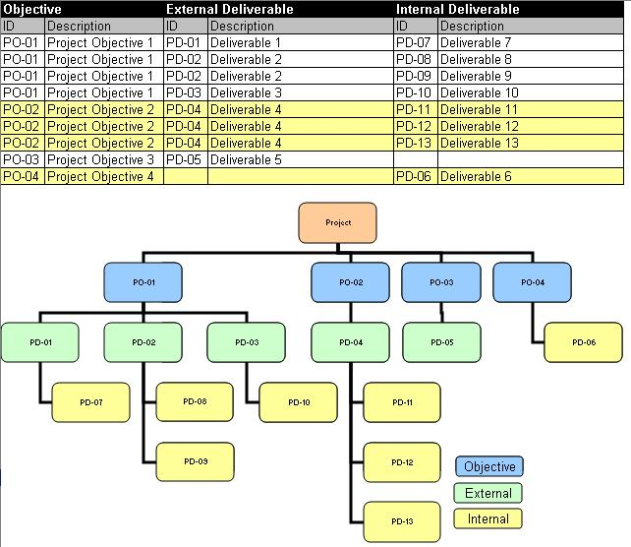
Definition of Deliverables
A Deliverable is a measurable, tangible, verifiable outcome, result, or item
that must be produced to complete a project or part of a project.
Deliverables may be External or Internal.
Copyright 2013 Vedavit Project Solutions

Slide 39
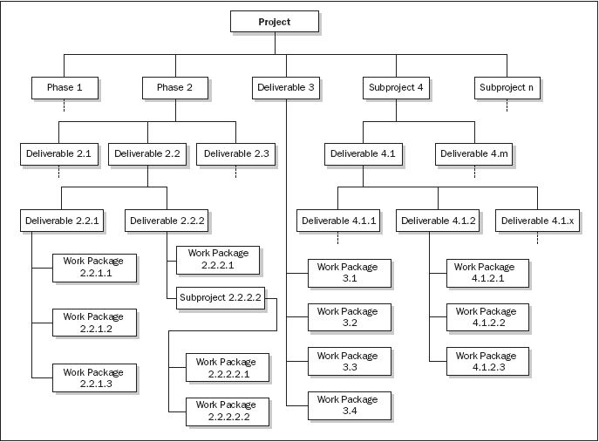
Phase oriented WBS
Copyright 2013 Vedavit Project Solutions

Slide 40
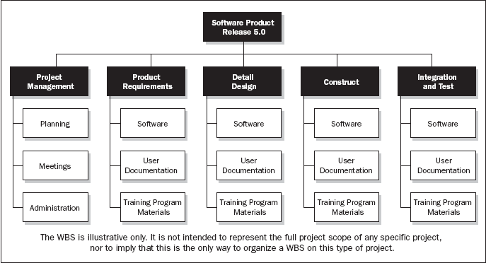
Department oriented WBS
Copyright 2013 Vedavit Project Solutions

Slide 41
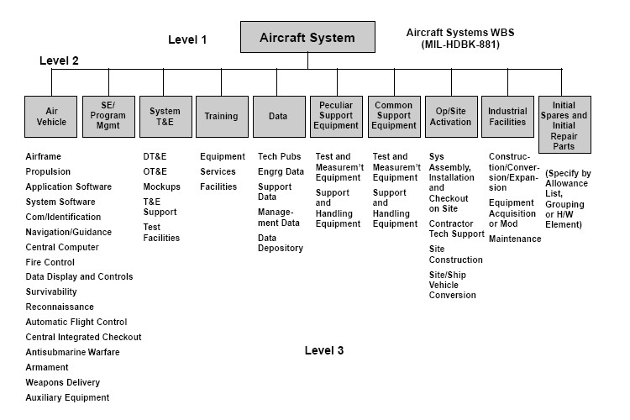
Subproject Oriented WBS
Copyright 2013 Vedavit Project Solutions

Slide 42
Planning : Schedule
Copyright 2013 Vedavit Project Solutions

Slide 43
Steps of Schedule Development
Define Activities
Sequence Activities
Estimate Resources
Estimate Duration
Develop Schedule
Copyright 2013 Vedavit Project Solutions

Slide 44
Define Activities
Know every product and project scope activities
Know the every possible attribute of these activities
List all the internal and external milestones
Copyright 2013 Vedavit Project Solutions

Slide 45
Sequence Activities
Sequence activities based on the activity attributes, lead, lag and dependencies between them
Mandatory dependencies – Logical relationships inherent in the set of
activities
Discretionary dependencies – Dependencies which are defined by the
Project team or the Performing organization
External dependencies – relationships between Project and outside
Organization
Lag : The amount of time delay between the completion of one task and the start of its successor task.
Lead: The successor activity starts before the predecessor activity has finished.
Dependency Types : Finish to Start, Start to Start, Finish to Finish, Start to Finish
Copyright 2013 Vedavit Project Solutions
Notes:
Discretionary dependencies– cannot process ahead without milestone review/ qa audit/ baselining/ signoff etc.

Slide 46
Estimate Resources
Resources required to complete activities may be material, human, equipment, expense
You need to identify every kind of resources and number of resource required to complete every activity
When you are identify human resources that time avoid assigning “named resources”
Copyright 2013 Vedavit Project Solutions

Slide 47
Estimate Duration
Techniques of duration estimation already discussed. Therefore use those techniques to estimate duration of each activity
Copyright 2013 Vedavit Project Solutions

Slide 48
Develop Schedule
Using following inputs for making schedule
Resource Pool Description - Knowledge of what resources will be available, at what time and in what patterns.
Calendars – When work is allowed. Working and Non-working times. Availability of resources.
Constraints- Imposed Dates. Key Events or Major Milestones.
Copyright 2013 Vedavit Project Solutions
Notes:
Factors considered: convert 5 working day effort to schedule(start Mon…; 1 person working)
-working days(weekends, holidays), part time/full time, dependency /wait time on another activity/resource, time zone-diff, personal leave, effective work hours/per day-org activities, early going, productivity(factored in estimate of 40 working hrs)…
Can finish early..if more hrs/per day/no dependencies, more productive than assumed,….
-

Slide 49
Develop Schedule : Critical Path
A Critical path for a project is the series of activities that determines the earliest time by which the project can be completed.
The Critical path is the longest path through the network diagram.
Copyright 2013 Vedavit Project Solutions

Slide 50
Critical Path
ES EF
ES EF
ES EF
ES EF
ES EF
ES EF
Duration 7
Task A
Duration 6
Task C
Duration 3
Task G
LS LF
LS LF
ES EF
LS LF
Duration 2
Task H
Start
Finish
ES EF
ES EF
ES EF
LS LF
Duration 3
Task B
Duration 3
Task D
Duration 3
Task E
LS LF
LS LF
LS LF
ES EF
Duration 2
Task F
Copyright 2013 Vedavit Project Solutions
LS LF

Slide 51
Critical Path – Longest Path, Zero Float
0
0
0
ES EF
ES EF
ES EF
Duration 7
Task A
0
7
Duration 3
Task G
Duration 6
Task C
13
16
7
13
0
7
7
13
13
16
0
LS LF
LS LF
ES EF
LS LF
Duration 2
Task H
16
18
Start
Finish
7
7
7
16
18
ES EF
ES EF
ES EF
LS LF
Duration 3
Task B
0
3
Duration 3
Task D
3
6
Duration 3
Task E
6
9
7
10
10
13
13
16
LS LF
LS LF
LS LF
8
ES EF
Duration 2
Task F
3
5
11
13
LS LF
Copyright 2013 Vedavit Project Solutions

Slide 52
Discussion/Excertise-16
5 Minutes
ES EF
ES EF
ES EF
Duration 4
Task A
Duration 4
Task B
Duration 3
Task C
LS LF
LS LF
LS LF
ES EF
ES EF
Duration 10
Task G
Start
Duration 7
Task D
Finish
LS LF
ES EF
LS LF
ES EF
Duration 5
Task E
Duration 5
Task F
LS LF
LS LF
Copyright 2013 Vedavit Project Solutions

Slide 53
Network Exercise - solution
Critical Path : ADCG
ES EF
ES EF
ES EF
Duration 4
Task A
0
4
Duration 3
Task C
Duration 4
Task B
11
14
4
8
0
4
7
11
11
14
LS LF
LS LF
LS LF
ES EF
ES EF
Duration 10
Task G
14
24
Duration 7
Task D
Start
4
11
Finish
14
24
4
11
LS LF
ES EF
LS LF
ES EF
Duration 5
Task E
0
5
Duration 5
Task F
5
10
4
9
9
14
LS LF
LS LF
Copyright 2013 Vedavit Project Solutions
Notes:
Free float: An activity can be delayed without impacting the start of next activity
Total float: As many alternative path that many total float. Total float is available on non critical path. Activities can be delayed without delaying project
Free float on critical path activities is Zero

Slide 54
Facts/Tips for Critical Path
Total Float is the amount of time the task can delayed without delaying the project finish date.
Free float is the amount of time a task can slip without delaying the early start of any task that immediately follows it
It is possible that a zero float activity may not be on critical path
Longest path & shortest time possible to complete the project
A project can multiple critical paths
Difference between late and early is float
Positive float (the activity can wait to start even after previous activity finishes)
Negative float (the activity must start before previous finishes)
Zero float (the activity must immediately start after the finish of previous one)
Crashing activities to short the overall duration of project
Fast-tracking activities to short the overall duration of project
Be cautious that non-critical activity is not being delayed than the allowed free float
Take care of sub-critical path or non-critical path
Manage critical path resources very closely
Do not overload critical path activity resources
Avoid multitasking for resources working on critical path activities
Copyright 2013 Vedavit Project Solutions

Slide 55
Planning : Cost
Copyright 2013 Vedavit Project Solutions

Slide 56
Components of Contract Price
Contract Price includes Material, Labor, Expenses, Overheads, Risk Management Budget, Profit Margins
Cost baseline includes contingency reserves
Project budget includes management reserves
Do you know?
Who estimates Material cost for your project?
Who estimates Human Resource cost for your project?
Who estimates Expenses cost for your project?
Who estimates Overhead cost for your project?
How much is contingency reserve for your project?
What are indirect costs to your project?
When can you use contingency funds and who approves that?
How much is profit margin on your project?
What is the price?
Copyright 2013 Vedavit Project Solutions

Slide 57
Estimate Cost
Before you start estimating cost, know what all different types of costs you should be included in the estimation
Know the rate of every resources you are going to use
Copyright 2013 Vedavit Project Solutions

Slide 58
Project Cost Estimation Ranges
Never ever commit one absolute number to your project sponsor. Always range.
Cost estimation may include only Direct Cost or in combination of with Indirect Costs
Class Name | % | Range
Definitive | - 5 -> +5% | 10%
Capital Cost | -15 -> +10% | 25%
Appropriation | -25 -> +15% | 40%
Budget Estimates | -10 -> +25% | 35%
Feasibility | -35 -> +25% | 60%
Order of Magnitude | -50 -> +50% | 100%
Copyright 2013 Vedavit Project Solutions

Slide 59
Determine Budget
Aggregate costs based on the duration
While aggregating also include the money which you pay to vendors for services & contingency reserves
Before you baseline the cost validate the funding requirements with availability of funds.
Copyright 2013 Vedavit Project Solutions

Slide 60
Planning : Quality
Copyright 2013 Vedavit Project Solutions

Slide 61
Plan Quality
Know your metrics, their calculation, data collection method and source
Determine product testing processes, tools
Determine defect fixing or feedback incorporation processes
Develop checklist wherever possible to test the product
Automate testing and review process as much as possible
Do not compromise on quality. Quantity can be sacrificed over quality.
Use 7 basic quality tools for managing project and product quality
Copyright 2013 Vedavit Project Solutions

Slide 62
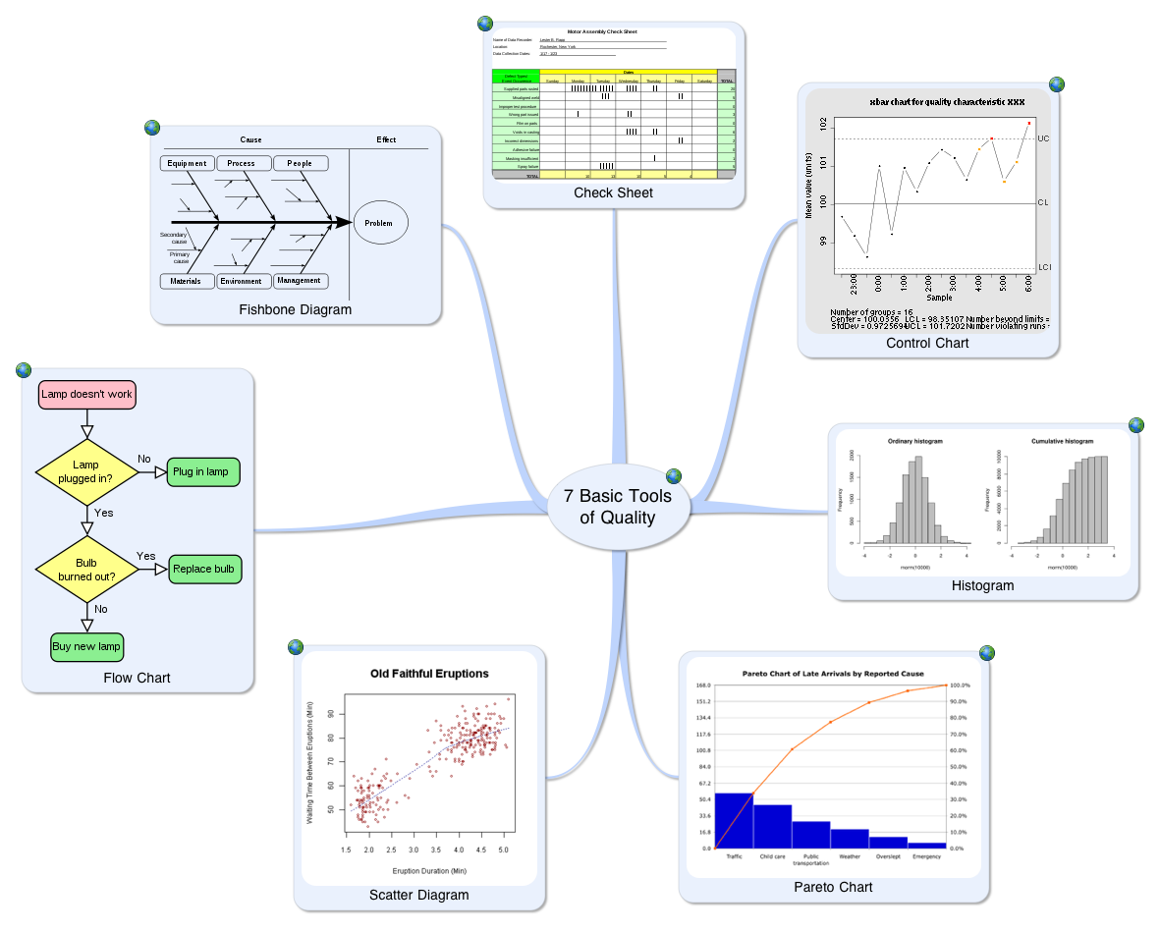
7 Basic Tools of Quality
Copyright 2013 Vedavit Project Solutions

Slide 63
Process Audit
Review your processes with auditors
Show your implementation with proof
Take best practices from auditors
Share your best practices with auditors
Copyright 2013 Vedavit Project Solutions

Slide 64
Planning : Communications
Copyright 2013 Vedavit Project Solutions

Slide 65
Plan Communication
Know who need to be communicated, when, how, what frequency, using what format
Copyright 2013 Vedavit Project Solutions

Slide 66
Elements of Communication Planning
Who do you need to talk to
Why are we talking to them
What do they need to know
When to tell them - timing
How do you communicate with them. Who does the telling
Where to tell them – the medium ~
Copyright 2013 Vedavit Project Solutions

Slide 67
Communications Plan- Example
Audience | Senior Management Team
Reason | Financial responsibility for project
Event | Monthly project expenditure report
Responsible | Project Manager
Medium | Presented at exec meeting
Timing | Monthly
Content | Expenditure to date v budget, estimate to finish, updated cash flow, anything that should be brought to the attention of the team
Copyright 2013 Vedavit Project Solutions

Slide 68
Communication Model
TRANSMITTER /
COMMUNICATOR
FEEDBACK
ENCODING
NOISE
MEDIUM
PERCEIVING,
DECODING,
INTERPRETING
RECEIVER
Copyright 2013 Vedavit Project Solutions
Notes:
Uhde- fax to Germany; virtual, barriers
Communican costs, blocking meeting rooms, ABC costing

Slide 69
Improving Communications
Make the message relevant to the receiver.
Reduce the message to it’s simplest form..
Organize the message into a series of stages
Repeat key points and obtain the reverse feedback.
Copyright 2013 Vedavit Project Solutions

Slide 70
Project Risk Management
Copyright 2013 Vedavit Project Solutions

Slide 71
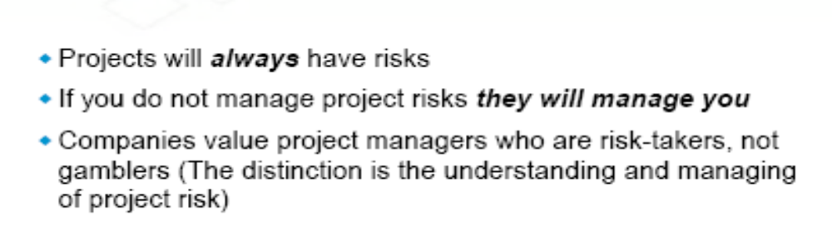
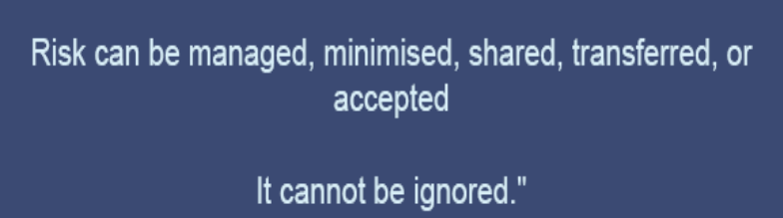

Introducing you to the World of Risks
Un-predictable Risks
Known Risks
Management of Uncertainties
Copyright 2013 Vedavit Project Solutions

Slide 72
Every Project has risks associated with it!
Commercial viability.
Technical feasibility.
Competitors move ‘faster’.
Customers’ preferences may change.
‘VC’ resources may ‘dry up’.
Project Sponsor changes or may not give continued support.
Attrition.
Project scope, time or cost related issues.
Government regulations.
Copyright 2013 Vedavit Project Solutions
Notes:
Technical risks- lifecycle, product/technology obsolescence
Management risks- Planning, estimation, budgeting, resources
Commercial- exchange rate , payment default
Legal- obligns failure

Slide 73
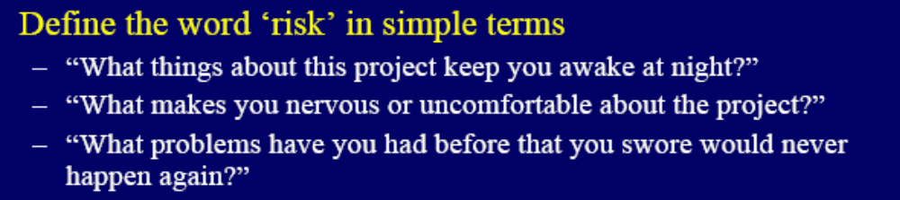
What is Risk?
A dictionary definition of risk is “the possibility of loss or injury”.
Project risk involves understanding potential problems that might occur on the project and how they might impede project success.
“Risk is the potential for realization of unwanted negative consequences of an event.”
Project Risk is an uncertain event or condition, that if it occurs, has a positive or negative impact on project objectives. (PMBOK)
Copyright 2013 Vedavit Project Solutions

Slide 74


Risk Identification – Information gathering Techniques
  Brainstorming Sessions.
  Interviewing.
  Checklists.
  Assumptions analysis.
  Review of Artifacts (WBS etc).
  SWOT Analysis
  Organization Risk Database.
Copyright 2013 Vedavit Project Solutions

Slide 75


Risk Management Process
Risk Assessment
Risk Control
Risk Database
Risk identification
Risk analysis
Risk prioritization
Risk response planning
Risk resolution
Risk monitoring
SDLC
Copyright 2013 Vedavit Project Solutions
Notes:
Self Explanatory slide !

Slide 76
Risk Event / Impact matrix
Contingency
Reserve
Management
‘kept’ Reserve
Unknown
Impact
Planning
N.A.
Known
Known
Unknown
Event
Copyright 2013 Vedavit Project Solutions
Notes:
Unknown unknown- Recession, customer demand/appetite changes, technology changes, new product-game changer has hit the market, farmer agitn –singur—recovery/continuity at Gujarat..
Known-known--- cust may not signoff; team member may leave, resource may not be available..
Known- unknown-----I know customer changes his mind, but don’t know impact;
Unknown-unknown--- don’t know if cycle will change; don’t know if recession might happen; don’t know if suddenly regulations change; don’t know whether customer may delay payment; don’t know if competition announces new changes.

Slide 77
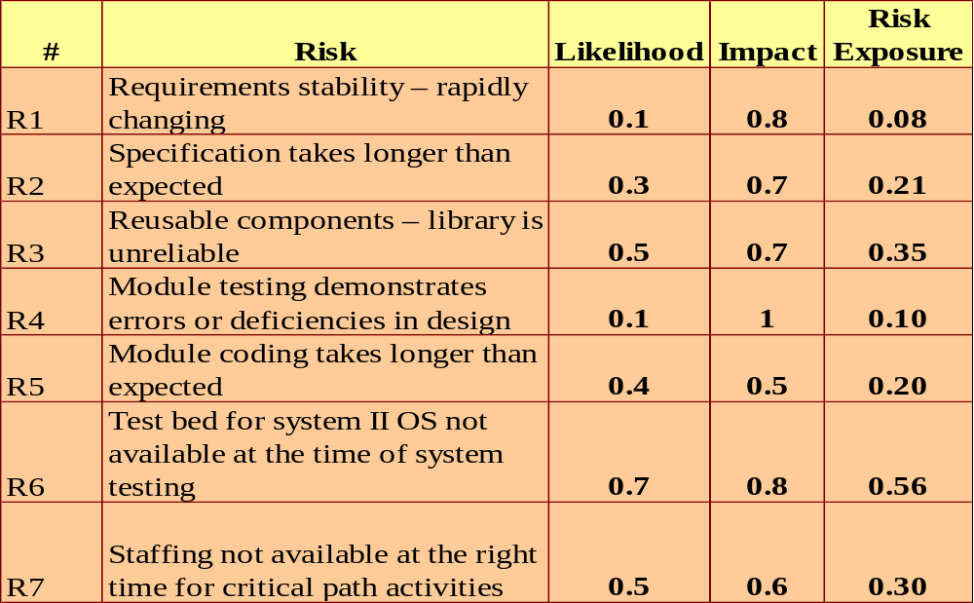
Risk Estimation
Copyright 2013 Vedavit Project Solutions

Slide 78
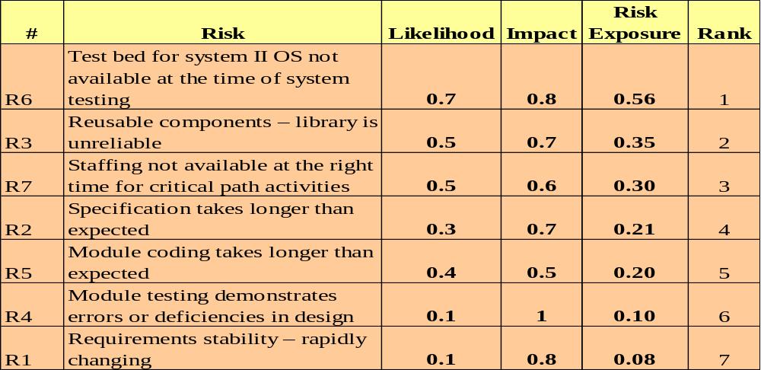
Risk Prioritization
Rank each Risk based on the exposure
Copyright 2013 Vedavit Project Solutions

Slide 79
Risk Response Strategies
Risk Avoidance
Risk Transference
Risk Mitigation
Risk Acceptance
Copyright 2013 Vedavit Project Solutions

Slide 80
Risk Monitoring & Control
Keeping track of identified risks
Monitoring of residual risks
Identifying new risks
Ensuring execution of the Risk Plan
Evaluating the effectiveness of the Risk Plan
Will be an ongoing process for the life of the project
Will reassess the priority of the risks periodically.
Copyright 2013 Vedavit Project Solutions

Slide 81
Good Risk Management Practices
Acknowledge that risks are inevitable.
Communicate risks openly.
Reward people who prevent crisis, not just those who create crises and then manage them.
Use organization’s risk database for cross project learning.
Take the Expert help whenever needed.
Remember all risks are important .
Copyright 2013 Vedavit Project Solutions
Notes:
Self Explanatory slide !

Slide 82
Bad excuses in Risk Management
We have no risk.
We deal with problems as they arise.
How can you predict what will happen 6 months from now?
Our job is to develop software, not to fill out bureaucratic forms.
That external interface is not in our risk management program because the interface is not our responsibility.
We deal with problems as they arise.
That method is proven and therefore not a risk. The speaker at the conference said so.
My tech people will rebel if we identify as a risk a lack of skills needed to do development.
We have to bid the lowest cost to win; we'll worry about doing the job when we get it.
(source-The Little book of bad excuses- SPMN)
Copyright 2013 Vedavit Project Solutions

Slide 83
Monitoring & Controlling
Copyright 2013 Vedavit Project Solutions

Slide 84
Overall Monitoring & Controlling
Know your metrics
Know the allowed threshold limit of each metrics
Get actual data
Compare the data against plan
Calculate your metrics and know your variances
Determine whether variance is without tolerance limit
Corrective and Preventive actions
Defect repair
Validate whether CAPA and Defect repairs recommended are implemented
Prepare reports
Share reports
Copyright 2013 Vedavit Project Solutions

Slide 85
Managing Variations
Variation:
The difference between the planned and the actual results. Variation could be with respect to Time, Cost or Quality.
Threshold:
The maximum permissible variation beyond which appropriate corrective action must be taken.
Copyright 2013 Vedavit Project Solutions
Notes:
Talk about:
Explain the definitions of variation and threshold and say that more will be discussed in the subsequent slides

Slide 86
Earned Value Management
BAC= Variance at completion
PV = Planned Value
AC = Actual Cost
EV = Earned Value
ETC = Estimate to Complete
EAC = Estimate at Completion
SPI = Schedule Performance Index
CPI = Cost Performance Index
Copyright 2013 Vedavit Project Solutions

Slide 87
Earned Value Rules
0% - 100%
50% - 50%
20% - 80%
25% - 75%
Copyright 2013 Vedavit Project Solutions

Slide 88
Types of Reviews/reports
Weekly reviews
Status/Progress reviews
Management reviews
Milestone/phase end reviews
Customer reviews
Vendor reviews
Copyright 2013 Vedavit Project Solutions

Slide 89
Project Review outcomes
All reviews must culminate with
  List of Issues Identified.
  List of Action Items decided.
Action items must be tracked to closure.
Issues must be monitored to determine if they are resolved.
Issues need to be escalated as per the defined Escalation procedures.
Copyright 2013 Vedavit Project Solutions

Slide 90

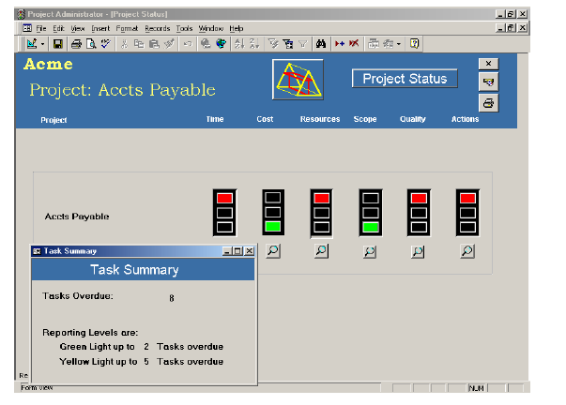
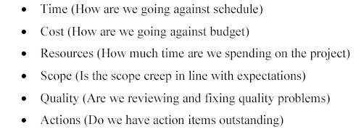
Project Dashboard (RAG)
Copyright 2013 Vedavit Project Solutions

Slide 91
Issue Management
Log issues and Issue source.
Determine action for resolution.
Establish responsibilities and timeline for action.
Track issue for resolution.
Escalate issue as per escalation procedure.
Copyright 2013 Vedavit Project Solutions

Slide 92

Team Management
Together Everyone Achieves More
Copyright 2013 Vedavit Project Solutions

Slide 93
Stages of Team Development
Forming
Storming
Norming
Performing
Adjourning
Copyright 2013 Vedavit Project Solutions
Notes:
Three chits- blame the predecessor; re-organize the team; make 3 more chits

Slide 94
Stages of Team Performance
Forming :
  Team members getting to know each other
  Heavy dependence on Leader’s directions
Storming:
  Team members vie for positions of authority/ Power struggles
Norming:
  Team members get to know each others’ strengths and weaknesses
  Agreement and Consensus/ Goal clarity
  Leader – facilitating role
Performing:
  Team has a shared vision
  Conflicts are resolved productively
  Leader – delegating and overseeing role
Copyright 2013 Vedavit Project Solutions
Notes:
Cliques – A group of people or associates

Slide 95
Motivation
The internally generated state (feeling) that stimulates us to act.
Internal process which creates and maintains the desire to move toward goals.
The driving force within that causes an individual to act in order to achieve a specific goal.
Copyright 2013 Vedavit Project Solutions

Slide 96
Maslow’s Need Pyramid
Self Actualization
& fulfillment
Esteem
& Status
Belonging &
Social needs
Safety & Security
Physiological needs
Copyright 2013 Vedavit Project Solutions

Slide 97
Project Closure
Copyright 2013 Vedavit Project Solutions

Slide 98
What is a Post Project Review?
A summary of project development, start to finish.
A brief description and analysis of
  Project activities
  Results
  Lessons learned
  Recommendations
An improvement tool
  NOT a record of failures
Copyright 2013 Vedavit Project Solutions

Slide 99


Why do a Post Project Review?
Learn from project experiences.
Retain knowledge for future projects.
Identify areas to improve.
Understand successes.
Provide team/individual feedback.
Split into two parts
  Looking backwards
  Looking ahead
Copyright 2013 Vedavit Project Solutions

Slide 100

What’s Involved?
Collect the information
  Technical
  Managerial
  Metrics
  Schedules
Anything kept during the project
  Manager or project logs
  Emails
  ...
  Identify three things you would continue to do ?
  Identify three things you would stop doing ?
  Identify three things you would start doing ?
Copyright 2013 Vedavit Project Solutions

Slide 101
What’s the Deliverable?
Reuse possibilities
Best Practices
Lessons Learnt
Risks That hit / hurt
Customer / Project / Process / Product measurements
Customer report defect data analysis
  Input for preventing defects in subsequent phases / projects
Customer Satisfaction Survey Analysis
Contributed to organizational repository for further processing
Copyright 2013 Vedavit Project Solutions

Slide 102
Retrospective : Ground Rules
Be polite and gracious.
Focus on problems and process.
No finger pointing.
No assigning blame.
No “You’s”
Let each person have a turn.
Avoid defensiveness.
Respect everyone’s perspective.
Copyright 2013 Vedavit Project Solutions

Slide 103
Project Archival
Ensure that all information is archived in line with the contractual agreements/internal procedures.
Plan for transitioning to warranty / maintenance.
Copyright 2013 Vedavit Project Solutions

Slide 104
Project Manager
Roles & Responsibilities
&
Knowledge and Skills required
Copyright 2013 Vedavit Project Solutions

Slide 105
General Management Knowledge & Skills
Financial Management & accounting
Procurement
Sales & Marketing
Contracts & Commercial law
Manufacturing & Distribution
Logistics & Supply chain
Strategic and Tactical planning
Org structures, org behavior,compensation, benefits
Health & Safety practices
Information Technology
Copyright 2013 Vedavit Project Solutions

Slide 106
Interpersonal Skills
Effective communication
Influencing the organization
Leadership
Motivation
Negotiation & Conflict Management
Problem solving
Copyright 2013 Vedavit Project Solutions

Slide 107
Project Manager Responsibilities
Project Manager’s Responsibilities in Project Lifecycle
Initiating a Project
  Project aligned with org objectives & customer needs
  High-level risks, assumptions and constraints are understood
  Stakeholders identified and their need are understood
  Project Charter approved
Planning a Project
  Project scope agreed
  Project schedule approved
  Cost budget approved
  Project team identified with roles and responsibilities agreed
  Communication activities agreed
  Quality management process established
  Risk response plan approved
  Integrated change control processes defined
  Procurement plan approved
  Project Plan approved
Copyright 2013 Vedavit Project Solutions

Slide 108
Project Manager Responsibilities
Project Manager’s Responsibilities in Project Lifecycle
Executing a Project
  Project scope achieved
  Project stakeholders expectations managed
  Human resource managed
  Ensure processes are being followed as agreed
  Material and equipment resources managed
  Risk management strategies are implemented
Monitoring & Controlling a Project
  Project tracked and status communicated to stakeholders
  Project change is managed
  Quality is monitored and controlled
  Risk is monitored and controlled
  Project team managed
  Contract administered
Closing a Project
  Project outcomes accepted
  Project resources released
  Stakeholder perceptions measured and analyzed
  Project formally closed
Copyright 2013 Vedavit Project Solutions

Slide 109
Project Manager in Nutshell
Project Manager’s Role
Should
Be a resourceful person who can get things done and keep all relevant stakeholders informed.
Ensure work is estimates in terms of size, efforts & schedule
Ensure risk identification, analysis, prioritization, monitoring & control is done periodically
Ensure right resource allocated for the work, resource backup and utilization
Ensure team is motivated, career planning, training and development activities are being done
Ensure scope and requirements are management
Ensure stakeholders are sufficiently engaged, their expectations are managed they are being communicated proactively
Ensure project objectives are met in terms of time, cost, scope and defect free product.
Ensure all contractual obligations are fulfilled
Ensure procurements are as per contract & proposal
Ensure Configuration management, data backup
Ensure lessons learned are documented and implemented
Ensure cost is optimized
Participate in presales & proposals
Copyright 2013 Vedavit Project Solutions

Slide 110

Hari P Thapliyal,
PMP, PMI-ACP, MCITP, Princ2 Practitioner, CSM, MBA, MCA, CIC, PGDFM
PMO Architect & Project Management Evangelist
Profile: http://in.linkedin.com/in/harithapliyal
For content related queries please contact me via
hari.Prasad@vedavit-ps.com
This document is proprietary and confidential. It remains the property of Vedavit Project Solutions at all times. No part of this document may be used, reproduced, or transmitted in any form or by any means electronic, including photocopying and recording, for any purpose without express consent of Vedavit Project Solutions.

