Slide 1




Project Estimation Techniques
2 day workshop
#Company
Trainer : Hari Prasad Thapliyal
(PMP, PMI-ACP, CSM, MBA, MCA, PGDOM, PGDFM, CIC, PRINCE2-Practitioner)
[PMI-ACP : #318050]
[PMP : #1563385]
SageTechnologies
thara@sagetech.co.in
http://www.sagetech.co.in/
(080) – 41750777
Koramangala, Bangalore – 560047, India
'PMI-ACP', 'PMI', and 'ACP' are a registered marks of the Project Management Institute, Inc.
This presentation copy is authorized only for BirlaSoft, Bangalore, SJR Tech Park employees.
'PMI-ACP', 'PMI', and 'ACP' are a registered marks of the Project Management Institute, Inc.

Slide 2
Faculty & Participants
An Introduction
Name, Company, Current Designation, Why Certification, Hobby

Slide 3
Workshop Ground Rules
Please keep your mobile on the silent mode. Always take your calls outside the training room.
No corner talk! Discussions only when group discussion is allowed
Keep your focus on the ongoing topic. Await your turn during the questionnaire round.
Strictly follow the workshop schedule for management of time.
There is parking lot. Write you questions and post with your name on parking lot.
Breaks only on agreed time
  Tea
  Lunch
  Tea
Everybody need to contribute
Use your experience only for relating the processes and best practices. To avoid confusion keep it outside of the class. Unlearning is first and biggest learning to learn something new.
Notes:
Project Management Concepts
06/28/13
Version 3.1, 4/01 © 2003 by AstroWix

Slide 4
Topics
Day 1
Concept of Estimation
What to Estimate
Software Estimation Challenge
Day 2

Slide 5
When do we estimate?
How will you know these numbers?
Number hairs you have on your head
Number of shoes you wore in your life till today
Population of India after one year of census
Amount of rice required for party of 500 people
Number of bricks required for a building construction work

Slide 6
When do we estimate?
How will you know these numbers?
Number of brother and sister you have
Your age
Number of uncles and aunts you have
Total of your marks in secondary school exam

Slide 7
What & When Do We Estimate
Known is counted with 100% confidence
Unknown
When time is constraint

Slide 8
General Methods of Estimation
Analogous Estimation
Parametric Estimation
Bottom-up Estimation
Three point Estimation
Published Data Source
Delphi Estimation

Slide 9
Analogous Estimation
Two years ago your brother got married and he spent INR 5 lacs. Now your close friend is planning to get married and he is asking how much it will take to get married if arrangement of similar type

Slide 10
Parametric Estimating
To make 500 SF flat you need 10000 bricks. How many bricks required to make a bungalow of 2500 SF
To travel 30 km it takes one hour how much time is required to travel 250 km

Slide 11
Bottom Up Estimating
 |  | Duration | Cost ('000) | Size
Implementation |  | 64 | 440 | 210
 | HR Operations | 20 | 100 | 80
 | Payroll | 18 | 120 | 60
 | Benefits Administration | 12 | 90 | 40
 | Employee Self Service | 14 | 130 | 30
Interfaces
 | HR
 | Payroll
 | Benefits Administration
Reporting
 | HR
 | Payroll
 | Benefits Administration
Testing
 | HR
 | Payroll
 | Benefits Administration
 | Employee Self Service
Launch
 | Training
 | Change Management

Slide 12
Three Point Estimation
Optimistic
Pessimistic
Most likely
Expected Value = (O + 4xM + P) /6
Standard Deviation = (P-O)/6

Slide 13
Published Estimating Data
If you do not have experts and experience around then from where you will get data to know
How much food is required to feed all the poor of your state?
How much paint is required to paint your complete duplex home?
How much time required to get business visa of Germany?

Slide 14
Delphi Estimates
Only experts participates in estimation processes
Estimates are anonymous
Extreme estimates are discussed

Slide 15
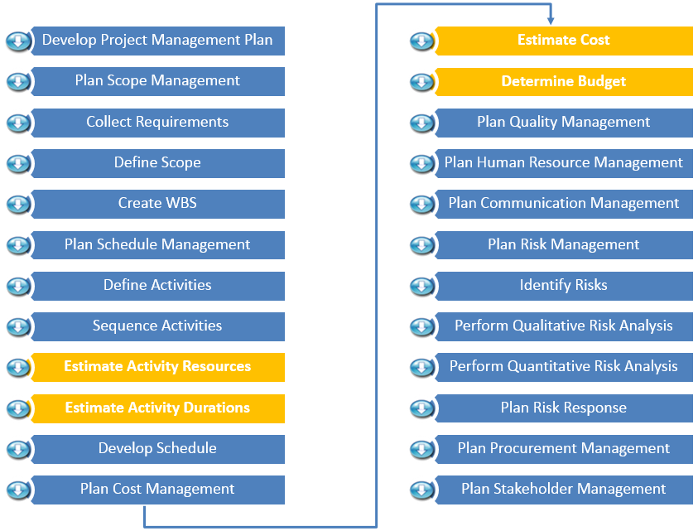
Planning Processes

Slide 16
Planning Processes
Develop Project Management Plan
Plan Scope Management
Collect Requirements
Define Scope
Create WBS
Plan Schedule Management
Define Activities
Sequence Activities
Estimate Activity Resources
Estimate Activity Durations
Develop Schedule
Plan Cost Management
Estimate Cost
Determine Budget
Plan Quality Management
Plan Human Resource Management
Plan Communication Management
Plan Risk Management
Identify Risks
Perform Qualitative Risk Analysis
Perform Quantitative Risk Analysis
Plan Risk Response
Plan Procurement Management
Plan Stakeholder Management

Slide 19
How do you Estimate?
Take your best guess and multiply by two
Take the best guess, multiple by two and raise it to the next higher unit of time
Add 54%”(An algorithmically determined fudge factor)
Ask the boss which number they want
Take the remaining time until the deadline and multiply it by the number of people on the team
Look Up
What are advantages?

Slide 20
Good Estimation Guidelines
Use ranges to know a confidence factor
Include basis of estimation (documented)
Perform at the appropriate level of detail
Should be performed by the person doing the work (experiential estimating)
Identify constraints and risks
Do not confuse between estimates of work and duration
Do not confuse between duration and project schedule
Considers experience and availability
Uses lessons learned at organization level
Never negotiates numbers without basis
Project Management Body of Knowledge 5th Edition

Slide 21
Estimation Types
Estimation at Initiation Stage
  Rough order of Magnitude (ROM) – [-25% - +75%]
  Budget Estimate [-10% - 25%]
Estimation when Project Work or Solution Approach is known
  Bottom up or Definitive Estimates. When WBS & details are available [-5% - +10%]

Slide 22
Estimation Definition
Effort Estimation: The number of labor units required to complete an activity or WBS component. Work-Hours
Duration Estimation: The number of work periods required to complete an activity or WBS component. Business-Days

Slide 23
How can you estimate efforts and duration required to reach a place without knowing the amount of work?

Slide 24
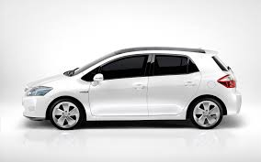
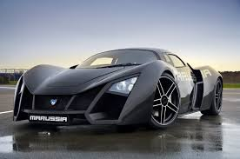
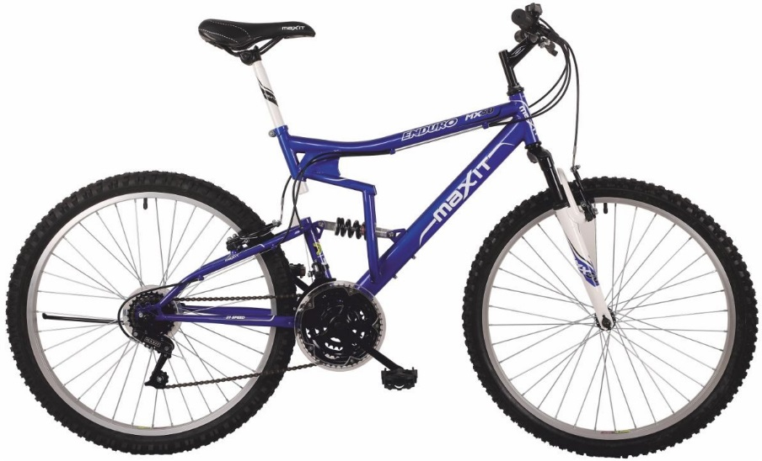

Duration Depends Upon - Mode

Slide 25


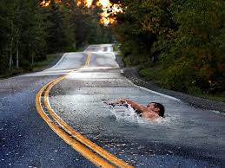
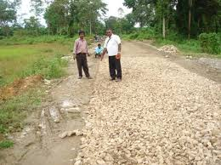
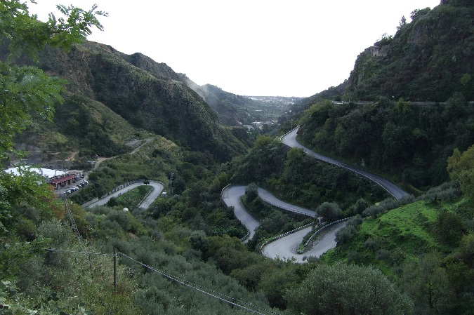
Duration Depends Upon- Roads

Slide 26
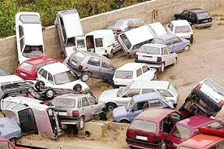
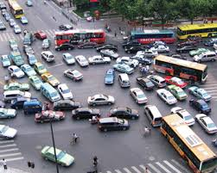
Duration Depends Upon- Traffic and Other People on Road

Slide 27

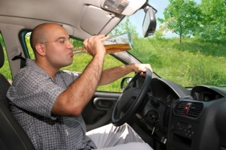

Duration Depends Upon- Driver

Slide 28
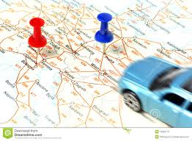
Duration Depends Upon- Distance

Slide 29
Project Duration Depends Upon
Environmental Factors (climate, politics, regulator, policies, willingness, project working time, resource availability, technology maturity)

Slide 30

How Many Candies in Jar?
What will you do to know the candies in jar without opening and physically counting them?
Factors affecting number are
Size of unseen candies
Distribution is equal in whole jar?
Is there anything else in jar
??

Slide 31
Realities of Estimation
Why we tend to underestimate?
Optimistic individuals and have a desire to please
Incomplete recall of previous experiences
Not generally familiar with the entire job to be required.
Murphy, of Murphy’s Law fame, will not work on this project.
Key estimating factors dramatically change estimates

Slide 32
Determine Schedule
Historical Data
Intuition
PERT
Delphi
Experience
Effectiveness (what could be theoretically produced and what is actually produced)
  In 20 hours we can write 4 FP but we have written 5 FP (Ratio) => 5/4 => 1.25
Efficiency (usage of resources against delivery)
  Using INR 100,000 Resources and delivering 10 FP vs using INR 90,000 Resources to deliver 10 FP =>
Productivity (produce more in less)
Time of the year
Availability
Waiting
Team Configuration
Vacations
Holidays
Work Schedule
Elapsed Time

Slide 33
 | Theoritical | Actual
20 Hours | 4 | 5 | 125% | Effectiveness | 25% More Effective
 | Cost of 20 hours
 | Earlier | Now
5 FP | 100000 | 80000 | 125% | Efficiency | 25% More Efficient
Efficiency/Effective | 100% |  |  | Productivity | 100% Productive

Slide 35

Hari P Thapliyal,
PMP, PMI-ACP, MCITP, PRINCE2 Practitioner, CSM, MBA, MCA, CIC, PGDFM
PMO Architect & Project Management Evangelist
Profile: http://in.linkedin.com/in/harithapliyal
For content related queries please contact me via
hari.Prasad@vedavit-ps.com
This document is proprietary and confidential. It remains the property of Vedavit Project Solutions at all times. No part of this document may be used, reproduced, or transmitted in any form or by any means electronic, including photocopying and recording, for any purpose without express consent of Vedavit Project Solutions.

