Slide 1
The Basic Seven (B7) Tools of Quality
A PowerPoint Training Presentation
By Keith H. Cooper
"As much as 95% of quality related problems in the factory can be solved with seven fundamental quantitative tools." - Kaoru Ishikawa
Notes:
Quote taken from http://wit.ksc.nasa.gov/spc/7_tools.cfm

Slide 2
What are the Basic Seven Tools of Quality?
Fishbone Diagrams
Histograms
Pareto Analysis
Flowcharts
Scatter Plots
Run Charts
Control Charts

Slide 3
Where did the Basic Seven come from?
Kaoru Ishikawa
Known for “Democratizing Statistics”
The Basic Seven Tools made statistical analysis less complicated for the average person
Good Visual Aids make statistical and quality control more comprehendible.
Notes:
“Democratizing Statistics” refers to the will of Ishikawa to spread Quality control throughout the workplace. The desire to make Quality control comprehendible for all of the workers.

Slide 4
The Basic Seven (B7) Tools of Quality
Fishbone Diagrams
No statistics involved
Maps out a process/problem
Makes improvement easier
Looks like a “Fish Skeleton”
Notes:
Also known as Ishikawa Diagrams and Cause and Effect Diagrams. By mapping out a company’s problem, new thoughts and ideas can arise to better the situation. Sheds light on situations.
Diagrams begin with the problem to be solved in a rectangle.

Slide 5
Constructing a Fishbone Diagram
Step 1 - Identify the Problem
Step 2 - Draw “spine” and “bones”
Example: High Inventory Shrinkage at local Drug Store
Shrinkage
Notes:
For the example Diagram, inventory shrinkage was used. This is a measure of the shoplifted, stolen, or broken goods at a store.
This is placed in a rectangle at the “head” of the fish.

Slide 6
Constructing a Fishbone Diagram
Step 3 - Identify different areas where problems may arise from
Ex. : High Inventory Shrinkage at local Drug Store
employees
Shrinkage
shoplifters
Notes:
Here “employees” and “shoplifters” were used as categories that problems may have come from. In other examples, it is acceptable to use Machines, Materials, Methods, and People as general categories(These are from Foster, see bibliography). These should encompass all aspects of the business.

Slide 7
Constructing a Fishbone Diagram
Step 4 - Identify what these specific causes could be
Ex. : High Inventory Shrinkage at local Drug Store
Shrinkage
Anti-theft tags poorly designed
Expensive merchandise out in the open
No security/ surveillance
shoplifters
Notes:
The brainstorming process should continue until every angle is covered. Keeping asking for examples until no more exist. According to Foster, 5 causes should be enough for most categories.

Slide 8
Constructing a Fishbone Diagram
Ex. : High Inventory Shrinkage at local Drug Store
employees
attitude
training
new trainee
benefits
practices
Shrinkage
Anti-theft tags poorly designed
Expensive merchandise out in the open
No security/ surveillance
shoplifters
Notes:
With the completion of the diagram, several points have been made about inventory shrinkage’s possible sources. These may or may not have been obvious to management before this brainstorming process occurred.

Slide 9
Constructing a Fishbone Diagram
Step 5 – Use the finished diagram to brainstorm solutions to the main problems.
Notes:
At this time, you can go back to the previous slide and brainstorm with the class about solutions to these problems, or other causes. This is the utility of the Cause-and-Effect Diagram.
Moving expensive merchandise behind the counters and educating employees to their perks may be some solutions to this problem.

Slide 10
The Basic Seven (B7) Tools of Quality
Histograms
Bar chart
Used to graphically represent groups of data
Notes:
Histograms are used to show the different frequencies in a process. It is useful for identifying trends and relationships that can lead to quality improvements.

Slide 11
Constructing a Histogram
From a set of data compute
sum
mean (x)
Max
Min
Range (max-min)

Slide 12
Constructing a Histogram
Use range to estimate beginning and end
Calculate the width of each column by dividing the range by the number of columns
Range
= Width
# of Columns

Slide 13
Acme Pizza Example
Let’s say the owner wants a distribution of Acme’s Thursday Night Sales
Data Set from last Thursday(slices)
0 2 1 2 2 4 1 3 1 2 1 2 2 4 3 4 1 4 3 2 2 3 2 1 2 2 1 2 2 1 4 2 2 1 2 1 2 2 1 2 1 2 1 2 1 2 1 2 1 2 2 2 1 2 1 2 1 1 2 2 2 3 1 4 2 2 3 2 2 2 1 2 3 2 2 4 2 2 4 4 1 2 2 2 3 2 2 1 2 2 4 2 1 2 4 2 1 7 2 1 2 2 3 1 2 1 1 2 1 2 2 2 1 2 2 1 2 1 2 2 2 4 2 4
Notes:
These numbers represent the customers order at the order window at the pizza store. For example, the first customer didn’t order any pizza, the second ordered 2 slices, the third ordered 1 and so on. It should be noticed that the highest order was 7 slices and the lowest was 0. This is used to find the range which is used to find the column width for the histogram.

Slide 14
Acme Pizza Example
Mean = 2.032258
Max = 7
Min = 0
Range = 7
Question
For 7 columns what would the width be?
Range/Columns=7/7=1 slice
Notes:
With this information computed, all that is left to do is chart the histogram.

Slide 15
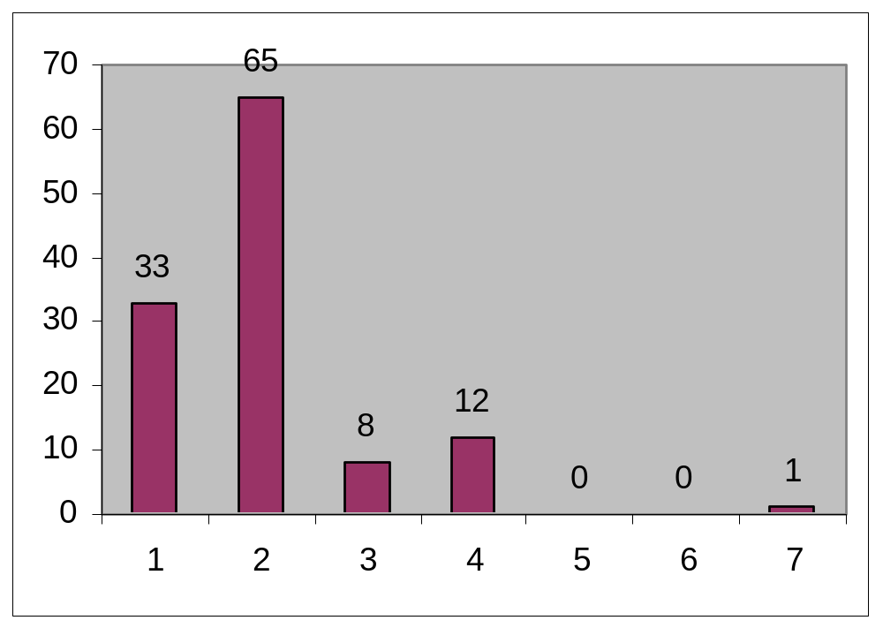
Acme Pizza Example
Histogram
# times ordered
Slices of Pizza
Notes:
Helpful in showing orders frequencies and variation.

Slide 16
Constructing a Histogram
How is this helpful to Acme?
2 slices of pizza most common order placed
Distribution of sales useful for forecasting next Thursday’s late night demand
If you were an Acme manager how could you apply this information?
Notes:
Most common types of orders placed is valuable information. Knowing that the average customer will order 2 slices of pizza can be implemented into Acme’s strategic plan. By taking at least 2 slices up to the window at peak hours, this can improve Acme’s customer service and speed. It makes the line move much faster making the perceived quality higher for the customer.

Slide 17
The Basic Seven (B7) Tools of Quality
Pareto Analysis
Very similar to Histograms
Use of the 80/20 rule
Use of percentages to show importance
Notes:
Vilfredo Pareto (1848-1923) originated the 80/20 Rule, which states that 80% of the problems comes from only 20% of the causes. Pareto Analysis is very similar to Histograms but it incorporates this theory into it. Pareto Analysis adds weight to the most frequently occurring things.

Slide 18
Acme Pizza (part 2)
Slices Frequency %
0 1 .3
1 33 13.09
2 65 25.79
3 8 3.17
4 12 4.76
5 0 0
6 0 0
7 1 .3
Notes:
The % column represents the slices percentage of total frequency. This dictates the order of the Pareto diagram which is always scaled according to size.

Slide 19
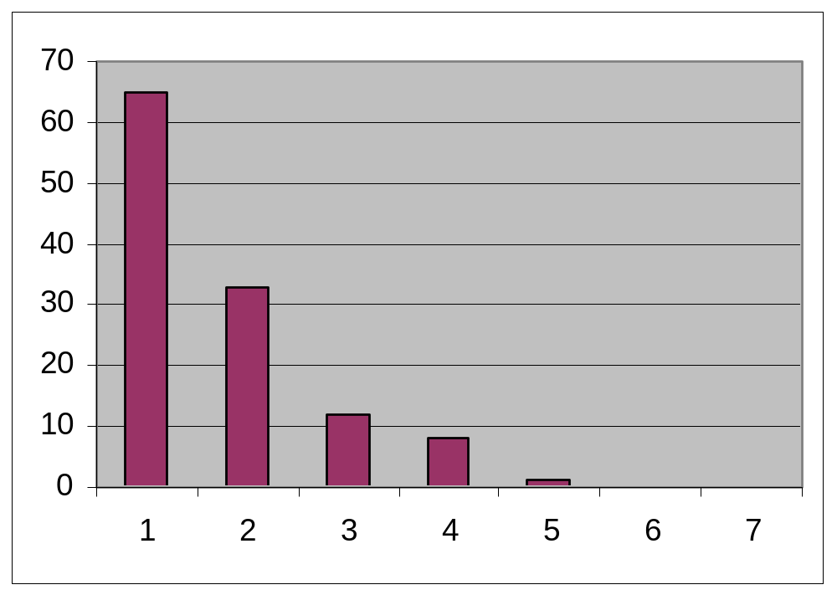
Acme Pizza (part 2)
The completed Pareto Analysis results in the following graph:
# times ordered
2
1
4
3
7
5
6
Slices of Pizza
Notes:
This sheds light on the most frequently ordered quantities. It is also common to plot percentages on the same graph.

Slide 20
Acme Pizza (part 2)
Critical Thinking
How does the Pareto Analysis differ from the Histogram?
How can this be a useful tool to the Acme boss?
Notes:
Answer #1: The Pareto Analysis Shows percentages. Is ordered to reflect frequency of occurrences.
Answer #2: Helps identify trends. Useful for quality improvements and planning processes.

Slide 21
The Basic Seven (B7) Tools of Quality
Flowcharts
A graphical picture of a PROCESS
Process
Decision
The process flow
Notes:
The rectangle, diamond and line are the standard symbols for flowcharts. There can be extra/different symbols depending on the process/business. The important thing is that it is consistent and maps out the process efficiently. Once flowcharts are effectively drawn they can shed light on possible problems or improvements.

Slide 22
Flowcharts
Don’t Forget to:
Define symbols before beginning
Stay consistent
Check that process is accurate

Slide 23
Acme Pizza Example (Flowchart)
Window Take Customer Money?
(start) Order
Get Pizza
Lockup
Put More in
Oven 2 Pies
Available?
Time
to close?
Take to Customer
yes
no
no
yes
no
yes
Notes:
Acme’s flowchart

Slide 24
How can we use the flowchart to analyze improvement ideas from the Histogram?
Window Take Customer Money?
(start) Order
Get Pizza
Lockup
Put More in
Oven 2 Pies
Available?
Time
to close?
Take to Customer
yes
no
no
yes
no
yes
Notes:
Answer: Since we know that 2 slices is the most common order we could possibly add a step between Time to close and take customer order. If we brought two slices up to the window during peak hours this would quicken service. There are multiple improvements that can be made on the process. The class can brainstorm on ways of improving this flowchart.
Note that a decision must be made at each triangle before the next step can begin.

Slide 25
Want some practice?
Make a flowchart for:
Taking a shower
Cooking dinner
Driving a car
Having a party
Creating a Flowchart
Any other processes you can think of?

Slide 26
The Basic Seven (B7) Tools of Quality
Scatter Plots
2 Dimensional X/Y plots
Used to show relationship between independent(x) and dependent(y) variables
Notes:
Scatter plots take place on an X and Y graph. Whichever variable is on the bottom should be the dependent variable. This means that the Y variable changes according to changes in X. In the upcoming example, Minutes cooking the pizza’s will directly affect the number of defective pies that are produced.
Scatter plots are useful for finding direct or indirect relationships which can then be used to analyze/improve quality.

Slide 27
Acme Pizza (Scatter Diagram)
Minutes Cooking Defective Pies
10 1
45 8
30 5
75 20
60 14
20 4
25 6
In this simple example, you can find the existing relationship without much difficulty but…
Notes:
This is meant to show the data. It isn’t too difficult for students to see that there is a direct relationship between Minutes cooking and defects. But the Scatter Plot will make this easier to see.

Slide 28
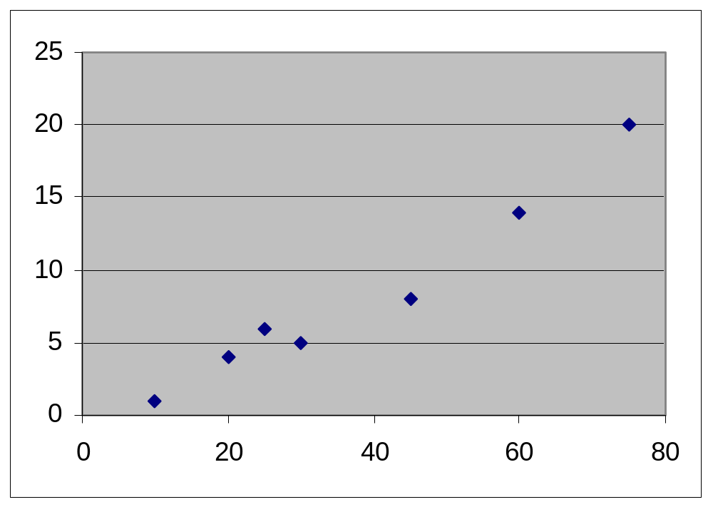
Scatter Diagrams
Easier to see direct relationship
Defective Pizzas
Time Cooking (minutes)
Notes:
There is a direct relationship between time spent cooking by employees and defects. As Time cooking increases, so does the amount of defects.

Slide 29
Scatter Diagrams
As a quality tool
What does this tell Acme management about their processes?
Improvements?
Defective Pizzas
Time Cooking (minutes)
Notes:
Answer: There is obviously some kind of process problem with the number of defective pies being produced. Maybe the cooks are getting sloppy from working too fast. Or maybe morale is low and there is just apathetic work being done. Whatever the case, if this was actually happening, quality improvements would have to be studied and implemented.

Slide 30
The Basic Seven (B7) Tools of Quality
Run charts
Time-based (x-axis)
Cyclical
Look for patterns
Notes:
Run Charts are used to plot data based on time. It’s very useful for identifying trends and cycles. The X-axis is usually the time element and the y axis is the process to be tracked. The following slide shows another Acme example that should make this easy to understand.

Slide 31
Run Charts
Slices/hour
5 10 15 20 25 30 35 40 45 50 55 60 65 70 75 80 85 90 95 100
8 9 10 11 12 1 2 3 4
8 9 10 11 12 1 2 3 4
8 9 10 11 12 1 2 3 4
Time
PM- AM
PM- AM
PM- AM
Thursday
Week 1
Thursday
Week 2
Thursday
Week 3
Notes:
Ask the class what trends they can identify. Week 2’s Thursday was a rainy day. Business Peaks between 1 and 3 each night so this is very valuable information to the management. Also with the exception of the rainy day, business seems to increase with warmer weather. Have the class come up with any other trends they can see or ideas to help improve quality based on this information. Such as higher staffing between 1 and 3 or higher inventory levels/preparation etc.

Slide 32
The Basic Seven (B7) Tools of Quality
Control Charts
Deviation from Mean
Upper and Lower Spec’s
Range
Notes:
Control charts are a means of regulating a process. It tracks the output of a process and its conformance to the company’s standards. As long as the process stays within the upper and lower limits then the process is “safe” and normal. Any observations made outside of the limits are irregular and problematic. They need to be immediately researched to improve quality. A process that consistently stays “safe” is a good quality process.

Slide 33
Control Charts
Upper Limit
Lower Limit
X
Unacceptable deviation
Notes:
X= mean
The majority of observations have fallen close the average. The one that’s under the lower limit is irregular, it needs to be examined and fixed.

Slide 34
Control Charts
Acme Pizza Management wants to get in on the control chart action
Average Diameter = 16 inches
Upper Limit = 17 inches
Lower Limit = 15 inches
Notes:
The average Diameter can be calculated by taking the average of a sample number of pizzas. As long as the sample’s average is close enough to 16 inches to satisfy management (ex. Within +/- .01 inches) then the average can be said to be 16 inches. Then from that management can decide what is the biggest/smallest allowable pies that are acceptable.

Slide 35
Acme example Control Charts
Upper Limit
17 inches
Lower Limit
15 Inches
16 inches=
X
Small Pie
Notes:
Monitoring the pizza process, this example shows how almost every pie is within specifications. The process should be analyzed to discover why the one small pie was produced and corrected to improve quality.

Slide 36
Acme example #50
Control Charts
Pies within specifications were acceptable
One abnormally small pie is “uncommon”
Should be examined for quality control
Notes:
Once the process is fixed the Control Chart continues to flow, any further abnormalities also need to be studied and fixed.

Slide 37
Summary
Basic Seven Tools of Quality
Measuring data
Quality Analysis
“Democratized statistics”
Notes:
All of these tools together can provide great process tracking and analysis that can be very helpful for quality improvements. These tools make quality improvements easier to see, implement and track.

Slide 38
Bibliography
Foster, Thomas. Managing Quality. An Integrative Approach. Upper Saddle River : Prentice Hall, 2001.
Stevenson, William. “Supercharging Your Pareto Analysis.” Quality Progress October 2000: 51-55.
“Dr Kaoru Ishikawa.” Internet “http://www.dti.gov.uk/mbp/bpgt/m9ja00001/m9j a0000110.html.” 16 February 2001.
“Chemical and Process Engineering.” Internet. “http://lorien.ncl.ac.uk/ming/spc/spc8.htm.” 17 February 2001.

