Slide 1
Project Leadership
For growth and transformation
PMI Annual Conference
Mumbai 20th Nov 2010
Pradeep Pendse
Dean IT/Business Design
Welingkar Institute of Management

Slide 2
The Evolution of the IT Industry
    Craft – Novelty - Development
    Mass Production – Commodity-Linking
    Process Enhancement – Quality-Modularisation
    Mass Customisation-Precision-Networking
    Co-Creation-Customer Intelligence

Slide 3
Key Challenges
The Growth Challenge
Protectionism
Increasing Costs – Dollar /Rs Parity – reducing Competitiveness
Over dependence on US as a market
Issue of Employability of available Educated Manpower
Growth without increasing Hierarchical levels
In-Organic Growth by Taking over Companies on Foreign Shores
Transformation Challenge
Future growth from Adding Value rather than mere numbers
Serving New Geographies
Providing New Services
Driving Change and Innovation
New Business Models and New Models of Engagement

Slide 4
The Project Leadership Challenge
    Project Leader as a CEO of his Project
    Managing in a Multi-Cultural Setting
    Scalability of the Project Leader – Increasing Span of Control
    Ability to Develop Others
    Vision for Project, Product , Technology
    Solution Orientation
    Adaptability
    Wider Range of Influencing Behaviours
    Design Thinking and Innovation

Slide 5
Research Objectives
Is there is something beyond project management ?
Project Leader Competencies required at present ?
Leadership in the context of Software Projects
State of IT project managers w.r.t. these competencies ?
How do project managers acquire these competencies

Slide 6
Defining Leadership
Leadership is both a process and a property.
The process of leadership is the use of non-coercive influence to direct and coordinate the activities of the members of an organized group toward the accomplishment of group objectives.
As a property, leadership is the set of qualities or characteristics attributed to those who are perceived to successfully employ such influence”

Slide 7
Approach to research
Focus Group Discussions – Dictionary of Competencies/Behaviours
Case Narrations - 40 Detailed Project Narrations
Survey of Ranking of Competencies (Local, Onsite and Foreign PMs)
Triangulation and Identification of Draft List of Competencies
Correlating Competencies to Success (Project Rating and PM success rating)
Final List of Competencies
Self rating by project managers on these competencies
Developing Competencies - a Survey

Slide 8
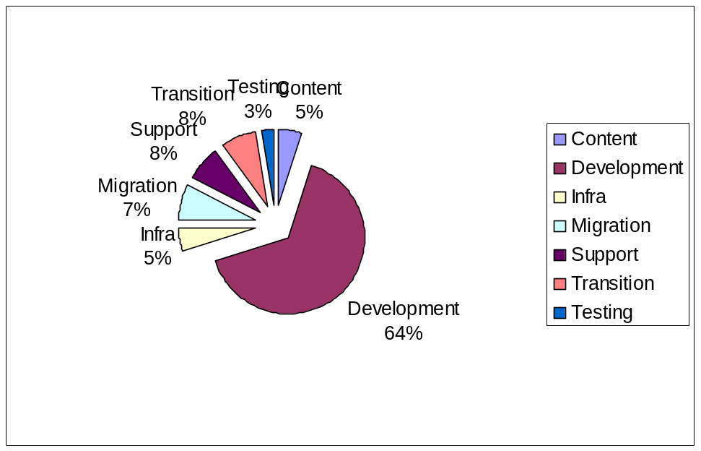
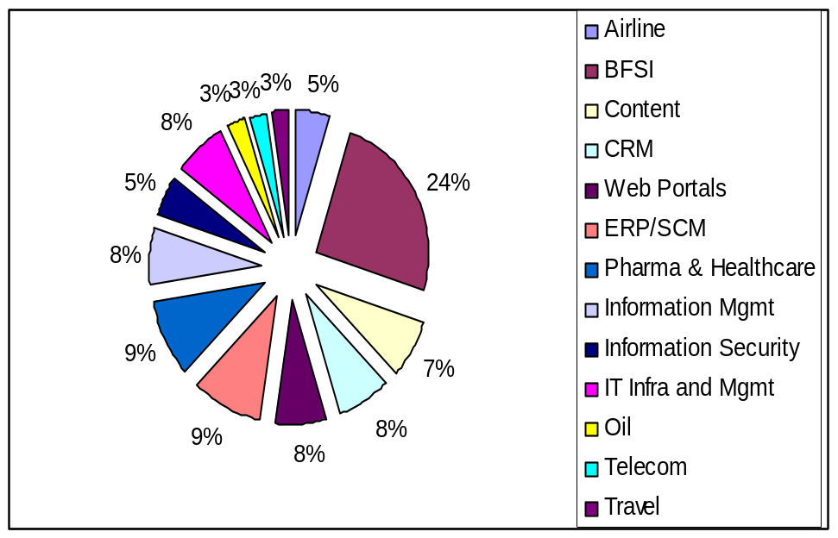
Demographics – Project Cases Studied
Breakup by Nature of Projects
Breakup by Application Domain

Slide 9
 | Competency | Self Rating
C1 | Team Management | Low
C2 | Influence/Negotiation | Low
C3 | Planning and Foresight | Low
C4 | Customer Orientation | Medium
C5 | Domain Knowledge | Medium
C6 | Openness/Transperancy | High
C7 | Change | Medium
C8 | Solution Orientation | Low
C9 | Monitor/Review | Medium
C10 | Goal Focus | Medium
C11 | Problem Solving – Conflict | Medium
C12 | Decisiveness | Medium
C13 | Process Rigour | Medium
C14 | Vision | Low
C15 | Innovativeness | Medium
C16 | Business Sense | Low
List of Project Leader
Competencies

Slide 10
List of Project Leadership Traits & Attitudes
Sr No |  | Category | Avg Self Rating Score | Remarks
T1 | Emotional Quotient | Trait | 6.0 | Low
T2 | Ownership | Trait | 7.8 | High
T3 | Proactiveness | Trait | 7.2 | High
T4 | Disposition to Leadership | Trait | Not Rated
T5 | Sense of Values | Trait | Not Rated
A1 | Positive Attitude | Attitude | Not Rated

Slide 11
General Observations
The top 8 Competencies appeared across all research samples and methods
Team Leadership, Influence and Planning appeared at the Top of all the lists
Process Rigour – found mention only in Case Narrations
Review Skills – was one of the most important skills identified
Sensitivity to Cultural Differences was not mentioned in most research methods
Innovation : Despite the hype – it does not feature in the top 10
Solution Orientation & Vision - fast emerging as desired Competencies

Slide 12
General Observations
High Self Rating by Indian PLs on :
  Openness,
  Ownership
  Proactive-ness / Initiative
Low Self Rating by Indian PLs on :
  Team Leadership,
  Influence,
  Planning,
  Solution Orientation,
  Vision
  Emotional Quotient

Slide 13
Characteristics of Successful Projects
Frequency of occurrence of the top 10 Competencies was significantly higher (1.5 times to 3 times) in successful projects than not so successful projects
The difference was particularly glaring (2 times and above) in
  Solution orientation,
  Process Rigour, Monitor and Review, G
  Goal Focus, Vision
  Innovation
  Multi-Culural Seisitivity,
  Decisiveness, Initiative/Proactiveness ,Positive Attitude
All successful Projects reported Innovation Behaviours
Resilience was called for more in Not so successful projects
Domain Knowledge mentioned more frequently in failed projects more in the sense of lack of adequate domain knowledge.

Slide 14
Characteristics of Successful PLs
Successful PLs seemed to demonstrate the following Competencies to a greater extent than the Not so successful ones
  Planning, Customer Service, Solution Orientation, Monitor & Review, Vision, Positive Attitude and Time Management
  Of these Review, Vision, Positive Attitude and Time Management were 4 to 10 times more frequently reported in successful PLs
  All Projects involving successful PLs seemed to demonstrate Vision
Cases involving Not So successful PLs seemed to report higher reference to Inspire/Develop Others, Goal Focus, Multi Culture Sensitivity, Domain Knowledge and Initiative more in the sense of inadequacy
Problem Solving, Change/Adaptability, Resilience was called for in projects involving not so successful PLs

Slide 15
Comparative Analysis across Geographies
First 7-8 Competencies were rated in the top 10 consistently
Foreign and Indian Onsite PLs expected greater
  Openness/Transperancy
  Goal Focus
  Stronger and disciplined Review (internal and with client)
  Resolving internal conflicts /coordination issues within the team
US respondents seemed to :
  Be comfortable with value adds and suggestions
  Expected greater flexibility and adaptability
  Expected PLs to develop and inspire others and called for Tenacity
Non-US (largely EMEA)
  Rated Openness and Transperancy at the top of the ranking
  Ranked Influence/Negotiation skills higher
  Expected greater degree of Decisiveness & conflict Management
None of the Groups Gave much importance to Cultural Sensitivity

Slide 16
Exemplary Project Leadership Behaviours
General Behaviours
Evolves and Shares Project Vision
Is Solution Oriented
Involve , Excite , Engage
Openness and Transperancy and Guard Values
Propogate Quality and Process Rigour
Bring Positive Energy & Attitude
A servant Leader – Helps others Succeed
Can Influence team, Client and Management
Can Develop others and Views New Comers as Reverse Mentors
Shares Success and Recognizes Achievements
Can Demand Work
Takes Tough Calls
Is Compassionate and empathetic
Is Resilient , Works Along side and steers team thru Difficulities

Slide 17
Exemplary Project Leadership Behaviours
Monitoring and Tracking
Encourages self monitoring – Visual Planning and Monitoring
Has his ears to the ground
Believes that Info Systems should focus on helping people to succeed
Uses Tracking Meetings to
  Assess real status measured in Objective terms (and clients view point)
  Encourages team to share issues and identify risk
  Listen and not Dominate or place blame
  Help team to Resolve Issues
  Highlight and recognize Achievements
  Work out Action plan and take decisions to help team stay on course
  Assesses Business Impacts
  Take a balanced and holistic view & Refocus on project goals
  Provide the daily/weekly dose of positive energy
Negative feedback to individuals given in separate one on one meetings.

Slide 18
Exemplary Project Leadership Behaviours
Requirements Management
Knowledge – As Checklist and not being Presumptious
Empathy – ‘this consultant understands my issues’
Understands Context, Needs/Outcomes, Impacts, Personas, Orientation
Engages Stakeholders in creating a shared vision and thru the lifecycle
Uses Product and Project Vision/Goals/Purpose as the basis for Influence & Action
Shapes Expectations -‘how their lives will change after the implementation’
Uses Modelling Tools to Understand and generate more questions
A Balanced Stool - Client – User – Consultant
The King Maker, the Queen of Hearts, Joker and The Ace
Adding Value – Innovation and PL as a Design Thinker
Openness and Transperancy
Professional Conduct at all times and at all levels
Treats Requirements Management as a Project in itself

Slide 19
Exemplary Project Leadership Behaviours
Project Leader as a Design thinker
  About Creation
  co-Creation
  Multidisciplinary
  Idealise
  Comfort in ambiguity
  Empathy
  Focus on Needs
  Multisense
  Be Creative
  Observe Deeply
  Think Critically
  Think Holistically
  Think Visually
  Think Abstract
  Abductive Thinking
  Experiment
  Be Hands-On
  Communicate

Slide 20
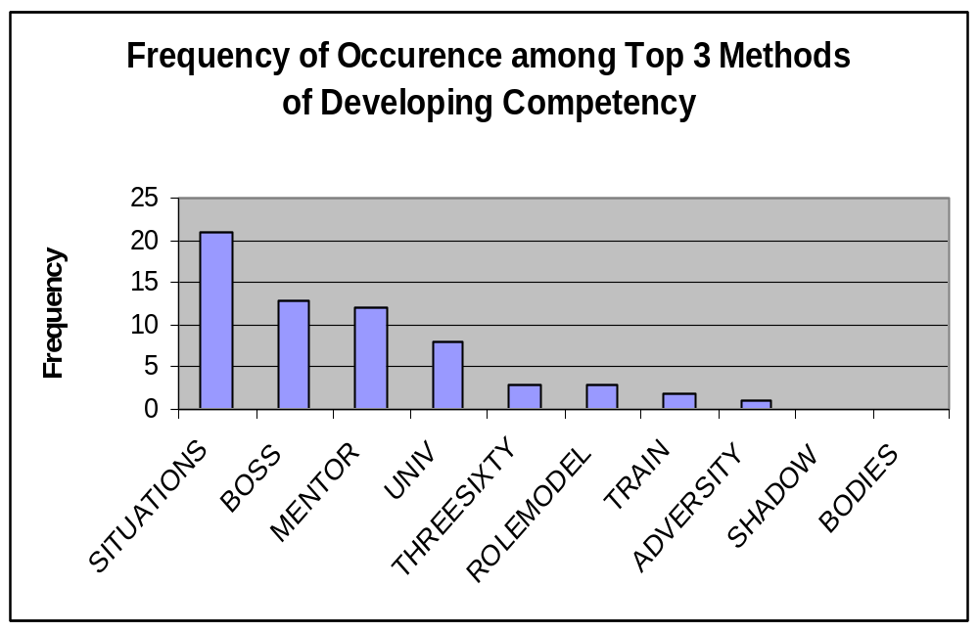
Techniques for Developing Skills and
Competencies

Slide 21
Thank You
and
Q&A
pradeep.pendse@welingkar.org
pendse_pradeep@yahoo.com

