Slide 1
Software Risk Management in
- Projects
- Organizations
Presented by : Sanjay Sahani
Founder & Director
Copyright © 2008-09 Optimizory

Slide 2

Copyright © 2008-09 Optimizory

Slide 3

A small company and 1 product.
Dependent on 1 major customer.
Subcontracted to India in T&M mode.
Constantly pursuing functional enhancement.
Repeated requests for performance consideration ignored.
End user rejects the product due to performance.
Liability put onto offshore vendor. Impact
  Lost customer.
  Order of 1 Mn US$ legal suit.
  Multiples of 100,000 US$ in legal costs.
Copyright © 2008-09 Optimizory

Slide 4

Young startup subcontracts engineering to India.
Poorly specified product.
VC funds dry up as they fail to meet sales targets.
Blame on Indian company claiming refund of all payments.
Likely Impact
  Loss of reputation
  Financial liability of more than 500,000 US$.
Copyright © 2008-09 Optimizory

Slide 5

A utilities company.
Subcontracts simulator development.
5 years and 150 Man Years later; subcontractor delivers a perfect (functionally) tested solution.
However !
  The output expected in 30 secs takes 30 minutes.
  System not designed for multiprocessor. Project is scrapped.
Impact
  Lost 150 MY of effort.
  Loss of credibility and customer.
  Customer’s plans significantly affected.
Copyright © 2008-09 Optimizory

Slide 6

A perfect relationship with all praises from your best customers.
One day the customer closes the relationship.
Reason
  Delivery below expectation.
  Today we decided to speak up.
  RCA reveals poor project management and politics inside team.
Impact
  Lost a major account with highly predictable revenue.
Copyright © 2008-09 Optimizory

Slide 7

Inadequate drafting of contract.
Poor / Incomplete specifications.
Missing acceptance criteria.
Non functional aspects
  Usability
  Performance
  Scalability
  Fault tolerance
Customer communication
Project Management
These are apart from the Global Financial Meltdown we saw recently.
Copyright © 2008-09 Optimizory

Slide 8

How Risk Management is different from other processes ?
  The flutter of butterfly wings in US can create a tornado in Calcutta [The Black Swan – Nassem Talib]
  Seemingly insignificant things become burning issues.
  Unpredictability is at the core of this process.
So what is the solution ?
  Only way to bring predictability in risk is to continuously scan extensive and continuously expanding Knowledge Base.
  Keep your eyes and ears open OR let a system be your eyes and ears !
  Act in time before the minor issues start gaining momentum.
Copyright © 2008-09 Optimizory

Slide 9

Present Scenario at a Macro Level
Context for Risk Management
Problem Domain
Solution Domain
Copyright © 2008-09 Optimizory

Slide 10

Copyright © 2008-09 Optimizory

Slide 11
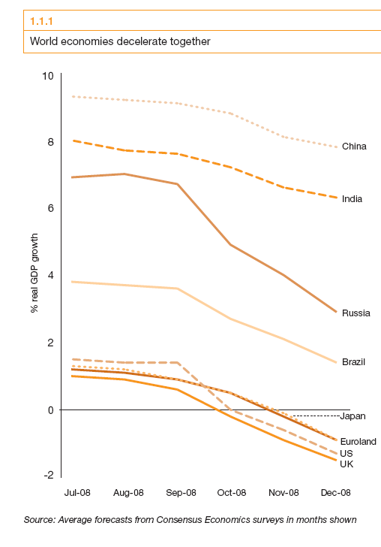
Copyright © 2008-09 Optimizory

Slide 12

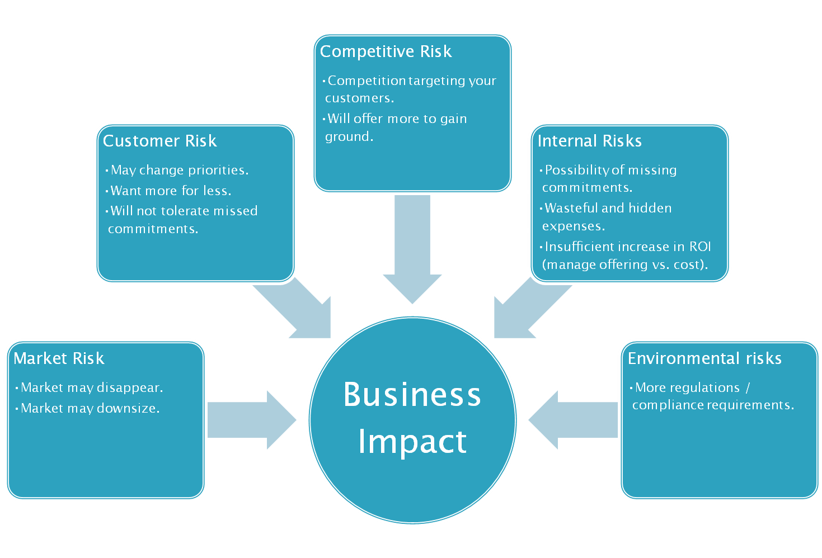
Copyright © 2008-09 Optimizory

Slide 13
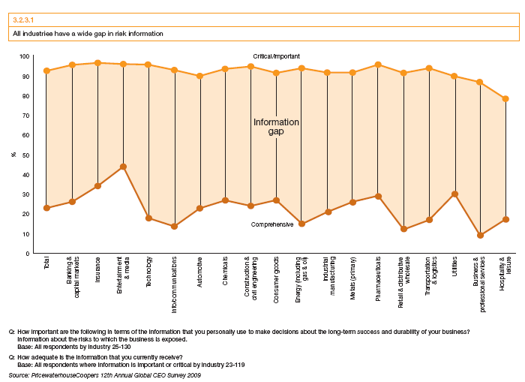
Copyright © 2008-09 Optimizory

Slide 14
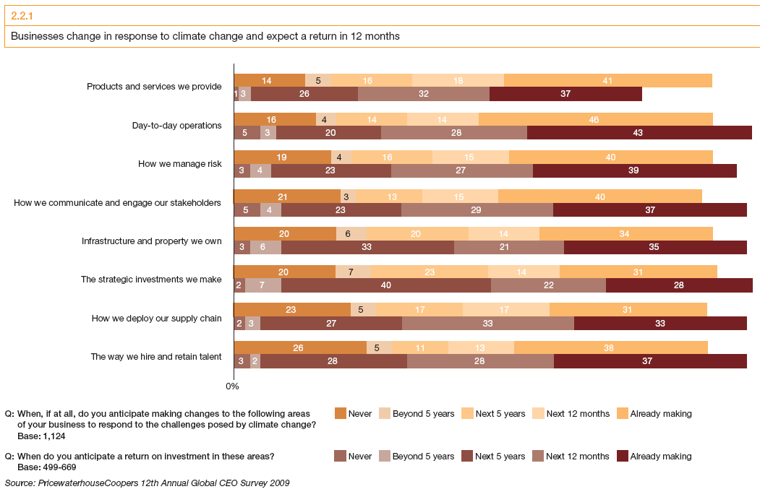
Copyright © 2008-09 Optimizory

Slide 15

Copyright © 2008-09 Optimizory

Slide 16

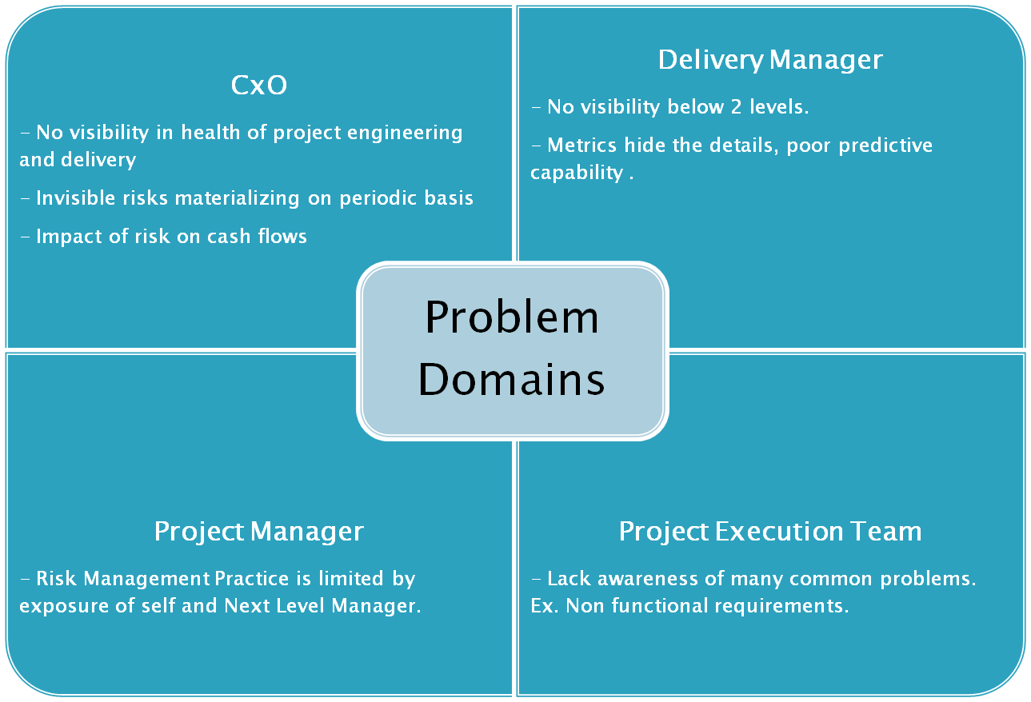
Copyright © 2008-09 Optimizory

Slide 17

Common occurrence & overlooked reasons
  Customers exploiting holes in contract
  Lack of personal capability / experience
  Unstable / incomplete requirements
  Unspecified acceptance criteria
  Poor architecture
  Non functional attributes not addressed
  Inadequate reviews in early stages of project
  Inadequate testing
  Poor team and project management
  Communication and reporting issues
Discovery and tracking can make a lot of difference to profitability.
With these problems, many T&M mode projects end with litigation / project closure.
Copyright © 2008-09 Optimizory

Slide 18
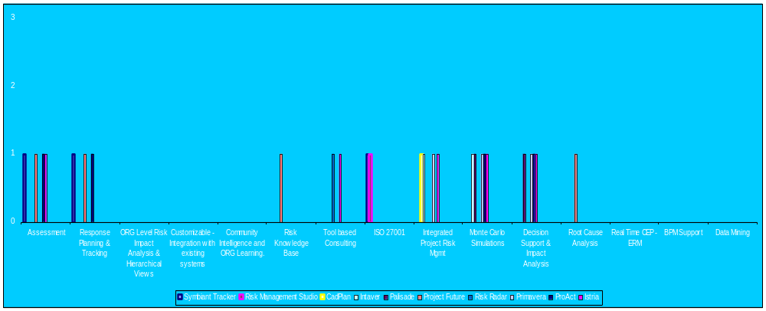
Copyright © 2008-09 Optimizory

Slide 19
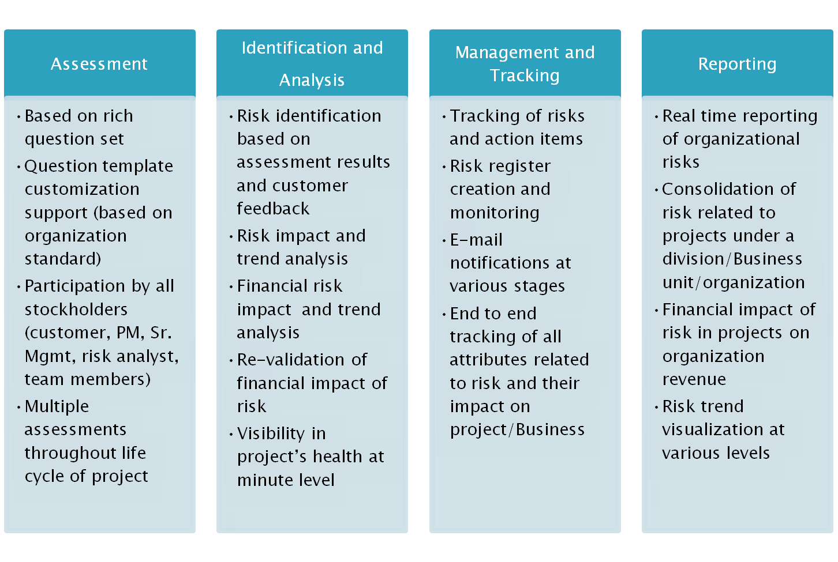
Copyright © 2008-09 Optimizory

Slide 20

Background of founders
  We are a first generation enterprise started by technopreneurs, who believes that present business/processes needs significant optimization.
  Circumstances forced us to look at product opportunities.
  Expensive prototypes.
Vision
  Our vision is to optimize our customer's businesses through a suite of products, which are small & efficient and seamlessly integrate within your organization.
The Road Ahead
  Take a 360 degree view of organization
  Identify the impact of every event (of significance)
Copyright © 2008-09 Optimizory

Slide 21
“Innovate for exponential impact on business performance”
Copyright © 2008-09 Optimizory

Slide 22

Demonstration of
Risk Management Platform
Copyright © 2008-09 Optimizory

