Slide 1
Project Integration Management

Slide 2
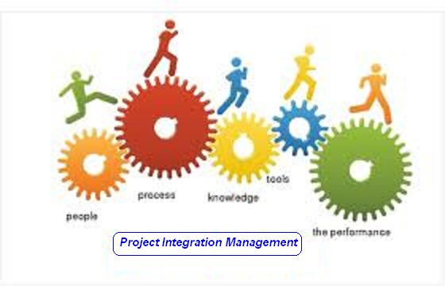

Slide 3
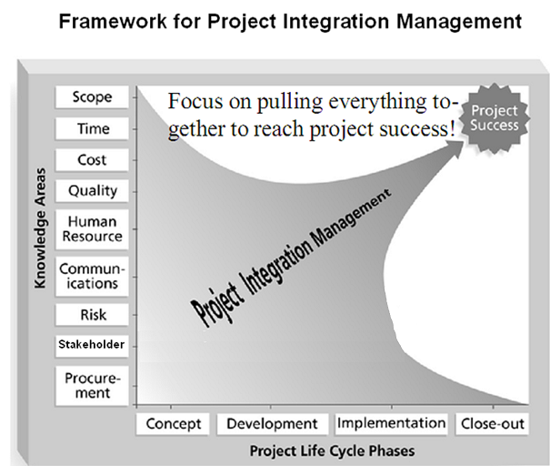

Slide 4
Project Integration Management
Processes and activities needed to identify, define, combine, unify, and coordinate the various processes and project management activities within the Project Management Process Groups

Slide 5
Project Integration Management
Develop Project Charter [INITIATING]
Develop Project Management Plan [PLANNING]
Direct and Manage Project Execution [EXECUTING]
Monitor and Control Project Work [M&C]
Perform Integrated Change Control [M&C]
Close Project or Phase [CLOSING]

Slide 6
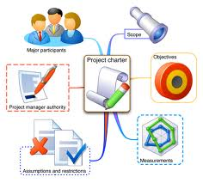
1. Develop Project Charter
Developing the project charter that formally authorizes a project or a project phase.

Slide 7
Develop Project Charter
Project Integration Management
Project Initiating
Project Statement of work
Business case
Agreements
Enterprise Environmental Factors
Organization Process Assets
Expert Judgement
Facilitation Techniques
Project Charter

Slide 8
Project Charter Template
Project purpose or justification
Measurable project objectives and related success criteria
High – Level Requirements
High – Level Project description
High – Level Risks
Summary milestone schedule
Summary Budget
Project approval requirements
Assigned project manager, responsibility, and authority level
Name and authority of the sponsor or other person(s) authorizing the project charter

Slide 9
Exercise-1
15 Minutes
Prepare Project Charter for your Project

Slide 10

2. Develop Project Management Plan
Documenting the actions necessary to define, prepare, integrate, and coordinate all subsidiary plans into a project management plan.

Slide 11
Develop Project Management Plan
Project Integration Management
Project Planning
Project Charter
Output from Other Processes
Enterprise Environmental Factors
Organization Process Assets
Expert Judgement
Facilitation Techniques
Project Management Plan

Slide 12
Exercise-2
5 Minutes
Write name of all type of subsidiary plans for your Project

Slide 13

3. Direct & Manage Project Work
Performing the work defined in the project Management plan to achieve the project’s objectives.

Slide 14
Direct and Manage Project Work
Project Integration Management
Project Executive
Project Management Plan
Approved Change Requests
Enterprise Environmental Factors
Organization Process Assets
Expert Judgement
Project Management Information System
Meetings
Deliverables
Work Performance Data
Change Requests
Project Management Plan Updates
Project Documents Updates

Slide 15
Exercise-3
5 Minutes
Write name of Deliverables & Name of work performance information for your Project

Slide 16
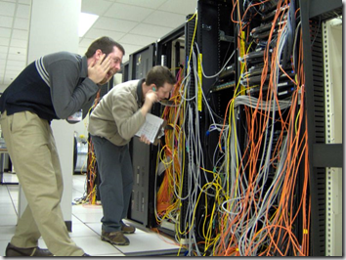
4. Monitor & Control Project Work
Tracking, reviewing and regulating the progress to meet the performance objectives defined in the project management plan.

Slide 17
Monitor and Control Project Work
Project Integration Management
Project Monitoring & Controlling
Project Management Plan
Schedule forecasts
Cost forecasts
Validated Changes
Work Performance Information
Enterprise Environmental Factors
Organization Process Assets
Expert Judgement
Analytical techniques
Project Management Information Systems
Meetings
Change Requests
Work performance reports
Project Management Plan Updates
Project Documents Updates

Slide 18
Exercise-4
5 Minutes
Write type & name of a few change requests for your Project

Slide 19

5. Perform Integrated Change Control
Reviewing all change requests, approving changes and managing changes to the deliverables, organizational process assets, project documents and the project management plan.

Slide 20
Perform Integrated Change Control
Project Integration Management
Project Monitoring & Controlling
Project Management Plan
Work Performance Report
Change Requests
Enterprise Environmental Factors
Organization Process Assets
Expert Judgement
Meetings
Change Control Meetings
Approved Change Requests
Change log
Project Management Plan Updates
Project Documents Updates

Slide 21
Exercise-5
5 Minutes
Write change management process for your Project OR
Prepare a format of change request report for your project

Slide 22

6. Close Project or Phase
Finalizing all activities across all of the project Management Process Groups to formally close the project or a project phase

Slide 23
Close Project or Phase
Project Integration Management
Project Closing
Project Management Plan
Accepted Deliverables
Organization Process Assets
Expert Judgement
Analytical techniques
Meetings
Final product, service or result transition
Organization Process Assets Updates

Slide 24
Exercise-6
5 Minutes
Write name of documents submitted to organization deliveries made to customer for your Project at the end of your project or project phase.

Slide 26
Project Scope Management

Slide 27


Slide 28
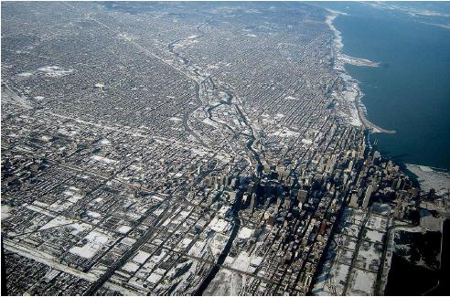





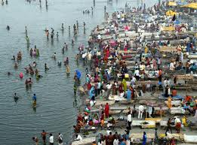
Level of Detailing in Scope

Slide 29
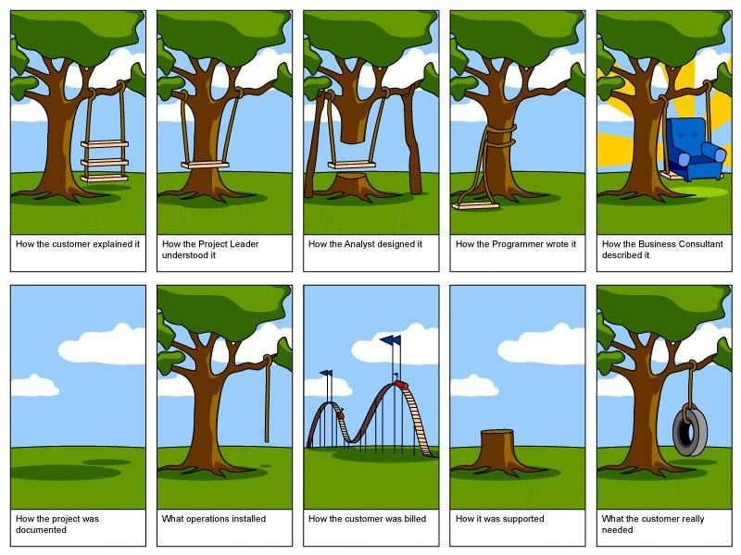
How the customer explained it
How the Project Leader understood it
How the Architect Designed it
How the Programmer wrote it
How the Business Consultant described it
How the project was documented
How operations installed it
What the customer really needed
How the customer was billed
How it was supported

Slide 30
Scope
Project Scope "The work that needs to be accomplished to deliver a product, service, or result with the specified features and functions."
Product Scope "The features and functions that characterize a product, service, or result."

Slide 31
Project Scope Management
Processes required to ensure that the project includes all the work required, and ONLY the work required to complete the project successfully

Slide 32
Project Scope Management
Plan Scope Management [PLANNING]
Collect Requirements [PLANNING]
Define Scope [PLANNING]
Create WBS [PLANNING]
Validate Scope [M&C]
Control Scope [M&C]

Slide 33
7. Plan Scope Management
Documenting how the project scope will be defined, validated and controlled

Slide 34
Plan Scope Management
Project Scope Management
Project Planning
Project Management Plan
Project Charter
Enterprise Environmental Factors
Organization Process Assets
Expert Judgement
Meetings
Scope Management Plan
Requirement Management Plan

Slide 35
Plan Scope Management IO
Scope Management Plan includes
Process for preparing project scope statement (PSS)
Process that enable creation of WBS from PSS
Process that specifies how formal acceptance be obtained
Process to control changes to details PSS
Requirement Management Plan includes
Process of analyzing, documenting and managing requirements
Process of requirement prioritization
Product measurement metrics and their rationale
RTM structure
Configuration management activities related to product

Slide 36

8. Collect Requirements
Defining and documenting stakeholders’ needs to meet the project objectives.

Slide 37
Collect Requirements
Project Scope Management
Project Planning
Scope Management Plan
Requirement Management Plan
Stakeholder Management Plan
Project Charter
Stakeholder Register
Interviews
Focus Groups
Facilitated Workshops
Group Creativity Technique
Group Decision Making Techniques
Questionnaires and Surveys
Observations
Prototypes
Benchmarking
Context diagrams
Document Analysis
Requirements Documentation
Requirement Traceability Matrix

Slide 38



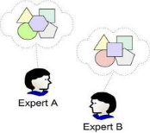

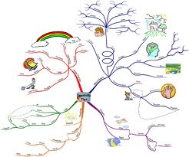
Collect Requirements
Focus groups
Guided by moderator, group’s final opinion is taken
Facilitated workshops
Cross functional stakeholders. Settle their differences like JAD with developers
Group creativity techniques
Brain storming
Nominal group techniques: Brainstorming only on most voted
Delphi Techniques: Only selected experts answers. Who answered what is not shared
Idea Mapping techniques: Individuals ideas mapped on single map
Affinity diagrams: Grouping and sorting of ideas for discussion
Group decision making techniques
Majority, Unanimity, Plurality, Dictatorship

Slide 39
Requirement Traceability Matrix
Tracing Requirements to
Business needs, opportunities, goals & objectives
Project objectives
Project scope/WBS deliverables
Product design
product development
Test strategy and test scenarios
Traces high-level requirements to more detailed requirements.
Attributes in RTM can be
Unique identified
Textual description of requirement
Rationale for inclusion
Owner
Source
Priority
Version
Current Status (active, cancelled, differed, added, approved)
Date completed
Stability
Complexity
Acceptance Criteria

Slide 40
Requirement vs Scope
Scope and requirement are two different things.
Requirements are only those, which are in scope!
Requirements are driven from scope
Boundaries are defined first (using SOW), requirements are collected next
Requirement must be measurable, testable, traceable, complete, consistent and acceptable to key stakeholders.

Slide 41
Requirement Documentation includes
Business need or opportunity to be seized, describing the limitation of the current situation and why the project has been undertaken
Business and project objectives for traceability
Functional requirements, describing business process, information, and interaction with the product, as appropriate which can be documented textually in a requirements list, in models, or both
Non-functional requirements like SLA, performance, safety, security, compliance, supportability, retention/purge
Quality requirements
Acceptance criteria
Business rules stating the guiding principles
Impacts to other organizational areas call centre, technology centre, sales force
Impacts to other entities inside or outside the performing organization
Support and training requirements
Requirements assumptions and constraints

Slide 42
Discussion/Exercise-7
5 Minutes
How to collect, analyze, document, prioritize, manage req; how change should be initiated and impact analysis done; Tracking changes, configuration management activities, RTM structure
Write Requirement Management Plan for your projects OR
Write Columns of RTM for your project

Slide 43

9. Define Scope
Developing a detailed description of the project and product.

Slide 44
Define Scope
Project Scope Management
Project Planning
Scope Management Plan
Project Charter
Requirements Documentation
Organization Process Assets
Expert Judgement
Product Analysis
Alternatives Identification
Facilitated Workshops
Project Scope Statement
Project Documents Updates

Slide 45
Define Scope
Product Analysis
Product breakdown
System analysis
Requirement analysis
System engineering: Deals with multiple complex systems
Value engineering: Functions, value, cost
Retain the function & value and reduce the cost
Value analysis: Debate the function and its cost
Discuss the value of function vs the cost
Alternative Identification
Alternative way of doing work

Slide 46
Scope Statement
Scope statement has following sections
Product Scope Description
Product Acceptance Criteria
Project Deliverables
Project Exclusions
Project Constraints (budget, imposed date, scheduled milestones, contractual provisions)
Project Assumptions
Organizational policies
Available skilled resources

Slide 47
Discussion/Exercise 8
5 Minutes
Product Scope Description, Product Acceptance Criteria, Project Deliverables
Project Exclusions, Project Constraints (budget, imposed date, scheduled milestones, contractual provisions), Project Assumptions, Organizational policies, Available skilled resources
Write Project Scope Statement for your project

Slide 48
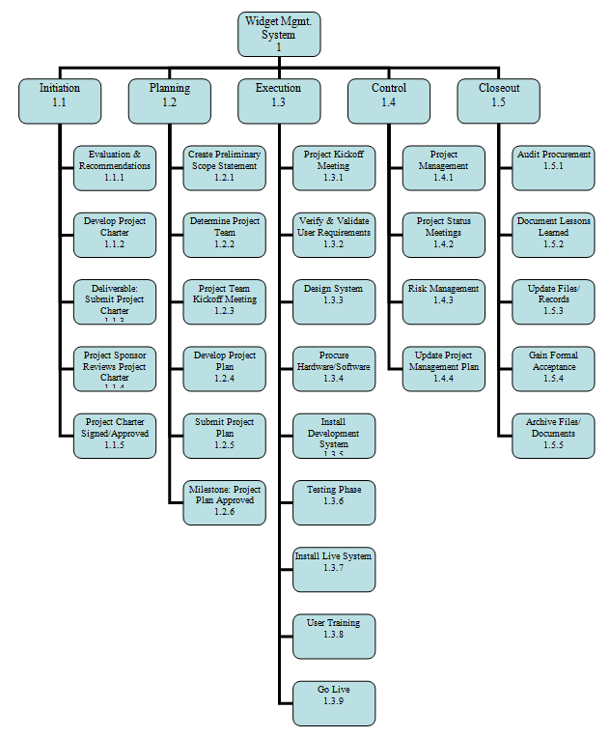
10. Create WBS
Subdividing project deliverables and project work into smaller, more manageable components.

Slide 49
Create WBS
Project Scope Management
Project Planning
Scope Management Plan
Project Scope Statement
Requirements Documentation
Enterprise Environmental Factors
Organization Process Assets
Expert Judgement
Decomposition
Scope Baseline
Project Documents Updates

Slide 50
Scope baseline
Scope baseline is part of PMP, Scope baseline includes
Project Scope Statements
WBS
WBS Dictionary

Slide 51
WBS Types
Phase Driven
Department Driven
Milestone Driven
Component Driven
Location Driven
…….

Slide 52
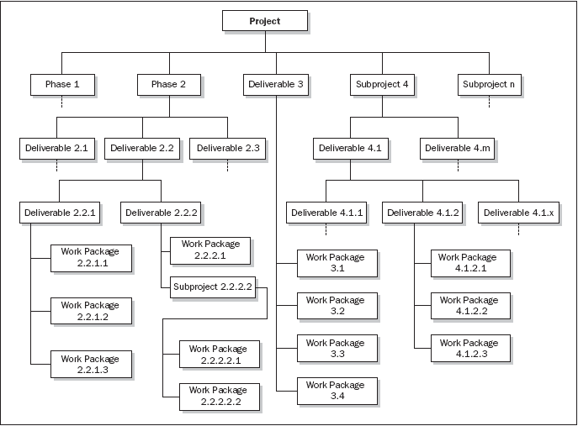
Phase oriented WBS

Slide 53
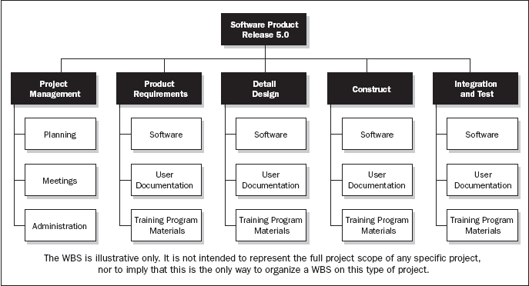
Department oriented WBS

Slide 54
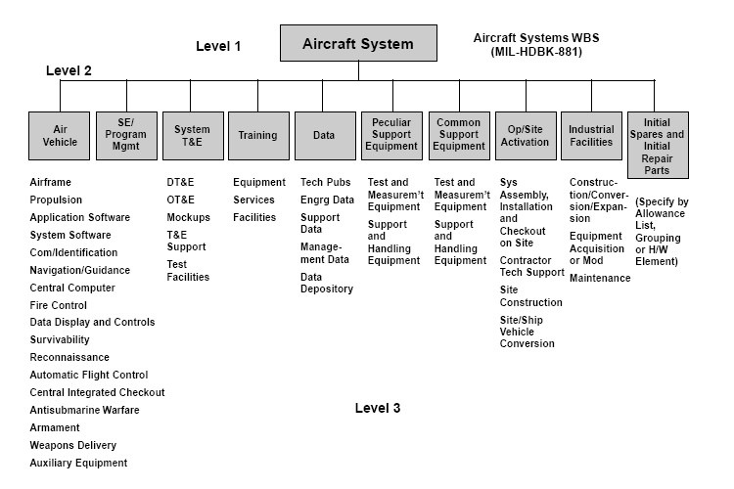
Subproject Oriented WBS

Slide 55
Discussion/Exercise 9
5 Minutes
Write 2 Level WBS & WBS Dictionary with min 5 deliverables for your project

Slide 56

11. Validate Scope
Formalizing acceptance of the completed project deliverables.

Slide 57
Validate Scope
Project Scope Management
Project Monitoring & Controlling
Project Management Plan
Requirements Documentation
Requirement Traceability Matrix
Validated deliverables
Work Performance Data
Inspection
Group Decision Making Techniques
Accepted Deliverables
Change Requests
Work Performance Information
Project Documents Updates

Slide 58
Discussion/Exercise 10
5 Minutes
Write verify scope activities for your project; also write the name of deliverables verified.

Slide 59

12. Control Scope
Monitoring the status of the project and product scope and managing changes to the scope baseline.

Slide 60
Control Scope
Project Scope Management
Project Monitoring & Controlling
Project Management Plan
Requirements Documentation
Requirement Traceability Matrix
Work Performance Data
Organization Process Assets
Variance Analysis
Work Performance Information
Change Requests
Project Management Plan Updates
Project Documents Updates
Organization Process Assets Updates

Slide 61
Discussion/Exercise-11
5 Minutes
Write work performance measurement metrics and their values for your project

