Slide 1


Fundamentals of Project Management
Trainer : Hari Prasad Thapliyal
(MBA, MCA, PGDOM, PGDFM, CIC, PMP, PMI-ACP, CSM, SCPO, SDC
PRINCE2-Trainer, Scrum Certified Trainer, Microsoft Certified Trainer)
[PMI-ACP : #318050]
[PMP : #1563385]
RPS Consulting
'PMI-ACP', 'PMI', and 'ACP' are a registered marks of the Project Management Institute, Inc.

Slide 2
What are your challenges in managing project?

Slide 3
What is your learning focus for 2 days?

Slide 4
Introduction
Max 1 min for one person
Name
Experience Total/PM
Role
Expectations

Slide 5
Hari Prasad Thapliyal
Education & Certification
B.Sc (Physics), MCA, MBA (Operations), PGDFM, MA (Eco)
13 Certifications in Project Management Domain (PMP, PMI-ACP, PRINCE2 Trainer, MCITP, Microsoft Trainer, Scrum Trainer
Experience
23+ years of cross-functional experience in IT Delivery organization, training, consulting.
Domain: BFSI, Recruitment, NGO, Cargo, LBS, EDMS
Conducted 250+ PMP, CAPM, MSP, Various Other Project Management Topics
Training 3000+ professionals globally
Project Management experience of managing 30+ IT projects
FPA counting experience of more than 30000 FP
Setting up and Managing PMO
Champion in Quality Initiatives like CMMI (1.1, 1.2), ISO9001:2000
Champion in ISO-20000, ISMS/ ISO-27001 rollout in organization
Starting and running software development centre
Product Development
Scrum/Agile/PMO Consulting/Coaching
Notes:
5

Slide 6
Hari Prasad Thapliyal
Trained People on project management from
IT, ITES, Banking, Pharma, Power, Defense, Management Consulting, Electronics & Electricity, Telecom, Construction
Trained People from 60+ Corporates
IBM, Bank of America, Uninor, Reliance Industries, WNS, Schneider Electrics, KPMG, Hewitt, ECCI, Manila Waters, Deutsche Bank, Mphasis, Ericsson, Accenture, Aurovision, Service India, TATA AIG, Pyramid IT, Birlasoft, United health group (UHG), Zamil Infrastructure, Amadeus, Multi media communication, Vikram Solar, Infosys, Wipro, Kale consultants, Sun Guard, Army and Navy, ANZ bank, L&T, HCL, EDS, TOYOTA, Sutherland, Nokia Seimens, Xansa, Verizon, Reliance communication, TCS, Standard Charted Bank, RBS, ITC, California software, Dell, Capgemini, Gujarat gas, Godrej, Punjab Infotech, NICT , Infineon, HP, CGI, Microsoft, Pace
Membership
PMI (USA),
PMI (Mumbai Chapter),
PMI (Chennai Chapter),
ScrumAlliance
Affiliation
Ex-Board Member of PMI Chennai Chapter & PMI Mumbai Chapter
Ex-Ethics Committee Chair of PMI Mumbai Chapter
Worked with Aurovision, Pyramid IT Consulting, Amsys Infotech
Hobbies
Languages, Reading Scriptures, Yoga, Traveling, Photography, Philosophy, Mythology, History, World Religions, Communication, Cultures
Notes:
6

Slide 7
Workshop Agenda
Day 1
Project Management Framework
Overview of Project Management
Project Success, failure and lessons learned
Project Management life cycle
Philosophy and Concepts
Project Planning and Control
Methodologies of effective leadership and motivation
Enterprise Environmental Factors
Organizational Process Assets
Project Scheduling - CPM & PERT
Cost-management
Day 2
Risk Management
Project Quality Management
Procurement Management
Project Manger’s Roles & Responsibilities
Essential project management tools and techniques

Slide 8
Ground Rules
Phone/Electronics-
Corner Talk
During QA wait for you turn
Write questions on note and handover to me
Participate in exercises with your full heart and mind
Free flow of coming and going
Respect time break durations
Tea break 10:30 (15 min)
Lunch break 12:30 (45 min)
Tea Break 15:00 (15 min)

Slide 9
Understanding this will help us……
Project Management is a huge subject with hundreds of techniques and processes
In 2 days we will try to dig the top surface of this field
Let us not get bog down into technical and business of any project but focus on project management aspects.
For the time being keep your technical hat off. Wear just leadership and management hat

Slide 10
Day 1

Slide 11
What is a Project?
‘A Project is a temporary endeavor undertaken to create a unique product or service’
Temporary : ‘every project has a definite beginning and a definite end’
Unique: ‘the product or service delivered is different from others’
Organizations resort to Projects to achieve their strategic needs, which cannot otherwise be attained through normal operational means.
Notes:
Seven wonders of the world
Pyramids
Product or service or capability to create the product/service(building, business function, org restructuring), research project)
Temporary- end- when proj objectives are met or not met or cannot be met-; need no longer exists-aborted.
Uniqueness- contactor, budget, configuration, location..etc; repititive elements could be there---similar projects or degree of similarity.
Portfolio, Program, Project
Portfolio- L&T Infra dvision—has projects in oil, power, gas, water, airport…(portfolio)-objective to maximize returns; program –within power (projects in power or in airport)
I may have a portfolio of stocks across Banking, Infra, commodities, IT….Banking stocks are from banking program (inter dependencies--)

Slide 12
Project vs Operations
Attribute | Projects | Operations
Charter | Permanent Project Charter | Semi-permanent charter
Change | Catalyst for change | Maintains status quo
Product | Unique product or service | Standard product or service
Team | Heterogeneous teams | Homogeneous teams
Time | Start and end date | Ongoing
Requirments | Progressive elaboration | Predefined product

Slide 13
How do Projects Arise?
Organizations identify a business need that can be satisfied by executing a Project.
Projects can be ‘Internal’ or ‘External’.
Projects may arise out of many factors including:
Market/ customer demands.
Need to improve internal processes.
Technology upgradation and Legal requirements.
Social needs.

Slide 14
Some Project Fail Statistics
Innotas (cloud portfolio management provider) : Fifty percent of businesses had an IT project fail during the 2012
IBM; Nearly 60 percent of projects aimed at achieving business change do not fully meet their objectives.
Harvard Business Review : The brutal fact is that about 70% of all change initiatives fail.
Over 1 in 3 (34%) projects have no baseline. (Source: Wellingtone)

Slide 15
Why Project Fails
Group Activity 1

Slide 16
Why Project fails?
Lack of User Input/involvement.
Lack of Executive support.
Unrealistic Expectations.
Unclear/changing Goals.
Incomplete Requirements & Specifications.
Changing Requirements and Specifications.
Lack of appropriate methodologies.
Lack of experienced Project Manager.
Lack of skilled staff.
Poor estimation and planning.
Failure to communicate and act as a team.
Poor Risk Management.
Lack of Vendor control.
Abstracted from Standish group report

Slide 17
Meaning of Project Success
Group Activity 2

Slide 18
Let’s Select a Project for us!
Shifting your house
Develop an app to sell music
Migrating all corporate desktops to windows 10

Slide 19
Project Management Framework

Slide 20






Project Constraints
Evaluate the competing demands and their impact on project outcomes.
Risk
Scope
Project and Product Quality
Schedule
Cost
Resource

Slide 21
Project Phases
Project Phases
Projects are divided into phases where extra control is required to effectively manage the completion of the major deliverables
Collectively, the project phases put together is known as Project life cycle
Each phase is marked by one or more tangible verification work product
The conclusion of a project phase is generally marked by a review
The phase end points are referred to as phase exits, milestones, phase gates, decision gates, stage gates or kill points
Starting a phase before approval of deliverables of a previous phase is called Fast Tracking
Your Project Must have Phases

Slide 22
Identify Project Phases
Group Activity 3

Slide 23
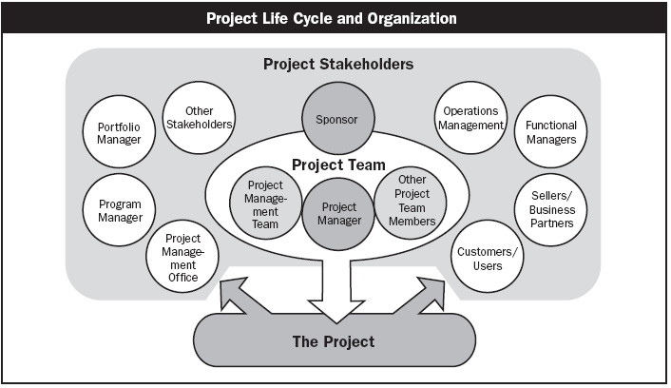
Who are Stakeholders?
Stakeholders
Persons or organizations who are actively involved in the project or whose interests maybe positively or negatively affected by the performance or completion of the project
Source PMBOK Guide Version 5.0

Slide 24
Identify Stakeholders
Maintain a stakeholder register in project
Keep all possible details of every stakeholder
Name, Designation, Location, Interest, Preferences etc.

Slide 25
Engaging Stakeholders
Engaging the Stakeholders- The RACI Matrix
Responsible, Accountable, Consulted, Informed
Project Phase & Deliverables/Activities | Stakeholders & RACI
 | Role 1 | Role 2 | Role 3 | Role 4 | Role 5 | Role 6
Phase 1
Deliverable 1 | R | I | C | A | C | I
Deliverable 2 | A | R | I | I | I | C
Phase 2
Deliverable 1 | R | A |  | I | C | I
Deliverable 2 | A | R | C |  | C | C
Deliverable 3 | I | A | I |  | R | I
Phase 3 | A | R | I | I | I | C
Deliverable 1 | A | R | C |  | C | C
Deliverable 2 | I | A | I |  | R | I
Notes:
In the making of an egg, the hen is involved; in the making of a bacon, the pig is committed; the buck finally stops here;head on the scalp.
Only 1 time in a row..Accountable

Slide 26
Identify Project Stakeholders
Group Activity 4

Slide 27
Understanding Project Lifecycle
Performing Organization/ Stakeholders
Phase I
Phase II
Phase III
Phase IV
Closure
Initiation
Exits
Exits
Exits
a
b
c
d
Deliverables
Notes:
What is a lifecycle? Delivery strategy
Conceived, born, childhood, teenage, adult, working adult, married adult, parent, retired, obsolete
(transition from one state to the other needs to be clearly defined--tollgates)
Phase- logical grouping of related tasks, deliverables
Hybrid models
SAP-LIFECYCLE- Proj preparn, Bus blueprint,realizn, Final preparn, Go live and support

Slide 28
Project Lifecycle (Waterfall)
Waterfall Lifecycle
Requirements
Engineering
Design
Construct
(CUT)
Integration Testing
System Testing
Release
Acceptance Testing

Slide 29
The Agile Methodology
Project Vision, Roadmap, Planning
Release 1
Release n
Project Retrospective
Release 2
Release Planning
Iteration/Sprint 1
Iteration/Sprint n
Release Retrospective
Iteration/Sprint 2
Iteration/Sprint Planning
Daily work
Iteration/sprint review, demo, Retrospective
Daily work
Daily work
Daily Standup meetings
Task completion
Update Progress
Task completion
Task completion

Slide 30
Which Methodology for Your Project?
Group Activity 5

Slide 31
Enterprise Environmental Factors (EEF)
Constraints from the environment which restricts options of project manager and s/he does not have control over it but they affects the project success.
Climate, Political stability, Organization Culture, organizational systems and processes, attitude of stakeholders, market price of product/services, legal approvals, monopoly, competition, competitor’s strategy

Slide 32
Organizational Process Assets (OPA)
Non-physical assets of organization which are available to project manager and project can get benefited by use of these. It is project manager’s responsibility to refine and further build OPA.
Examples: Estimation database, risk database, skill database, rate database, list of preferred vendors, processes, templates, specs/design from prev. projects, issue register from prev. projects, lessons learned copyrights, org template/checklist/guidelines/forms

Slide 33
Group Activity 6
For your project
Make a list of 10 EFF
Make a list of 10 OPA

Slide 34
10 Aspects of Project
Scope
Time
Cost
Quality
Human Resource
Communication
Risk
Procurement
Stakeholder
Integration

Slide 35
Process Groups

Slide 36
Project Management Process Groups
Monitoring and Controlling
Planning
Initiating
Closing
Executing

Slide 37
Initiating Process Group
Finalize document needed to be handed over to PM
Create project charter
Assign PM
Authorize PM
Form an initial project team
Identify Stakeholders & Prepare Stakeholder Register
Conduct a Kickoff Meeting
Notes:
Herald – to announce something important – existence of project

Slide 38
A Project Charter Contains…
Objective: What we want to achieve? Across the product line reduce defects by 90%. It will help improving organization’s brand image, more sales and lessen warranty support.
High level Requirements: What should be done? Perform a through study where improvement possible and can help significantly. Identify points wherever automation possible. Study Process. Automate Process. Training.
Deliverables: As is study document, Solution and Approach Document, Automated Processes, Training Manual, Training
Milestones: As is study completion: 01-May-??
Budget: $ 1,00,000 (+/- 10%). + $ 5,000 Contingency Reserve
Timeline: 6 Months +/- 2 weeks.
Approval Requirement
Risk: Known Project Risk. Inherent Risk of the Project.
Initial Team
Project Manager Name
Sponsor Name
Date of Sign

Slide 39
Project Kick-off
Present vision, goal to the team
Define ground rule
Understand key risk and dependencies
Understand milestone
?
??
Notes:
Yr forum to speak…do yr ground work……share all the context from proposal stage till now…; contractual obligations

Slide 40
Let’s write a Project Charter
Group Activity 7

Slide 41
Planning Process Group
Team identifies activities which need to be done for execution, monitoring, controlling and closing project
Amount of effort in planning depends upon
Project Scope.
Product Scope.
You plan for everything. How, who, when… of scope, time, cost, quality, hr, risk, communication, procurement.

Slide 42
Executing Process Group
Putting the Project Plan to work.
Actually performing project work to generate project results.
Coordinating project team members, support staff and other resources to carry out the project plan.

Slide 43
Monitoring & Controlling Process Group
Monitoring Project progress regularly to identify variances from the plan.
Taking of corrective actions.
Taking of preventive action in anticipation of possible problems.

Slide 44
Closing Process Group
Bringing the project or phase to an orderly end and formalizing acceptance.
Administrative Closure
Generating, gathering, disseminating information to formalize project completion.
Notes:
Within each group the process groups repeat.

Slide 45
Scope Management

Slide 46
Scope of Work
While planning consider both
Project Scope "The work that needs to be accomplished to deliver a product, service, or result with the specified features and functions."
Product Scope "The features and functions that characterize a product, service, or result."

Slide 47
Analyse the work and Develop Solution
Product Analysis
Product breakdown
System analysis
Requirement analysis
System engineering: Deals with multiple complex systems
Value engineering: Functions, value, cost
Retain the function & value and reduce the cost
Value analysis: Debate the function and its cost
Discuss the value of function vs the cost
Alternative Identification
Alternative way of doing work

Slide 48
The Work Breakdown Structure
The Work Breakdown Structure is a hierarchical chart used to organize the work of a project into related areas
It shows the breakdown of a project depending on the visibility and control needed
Each of these major components are then subdivided into the tasks necessary to reach successful project completion
Each of these major components are then subdivided into the work necessary to reach successful project completion.
Notes:
Decomposing till what level of granularity…till duration of the task is not more than 5 working days. Based on project duration/milestone…..if project is 15 days..then daily/agile.
Verbs, specific outputs that are measurable
More the granularity , more the visibility, more is the possibility of control; greater is the PM overhead. But for long durn, weekly may be too much; tied to tracking and reporting needs.
Breakdown to atleast 2 levels
Should be assignable, trackeable, estimatable
But for a new team member, greater; or only at TL level…they will in turn breakdown

Slide 49
WBS Types
Phase Driven
Department Driven
Milestone Driven
Component Driven
Location Driven
…….

Slide 50
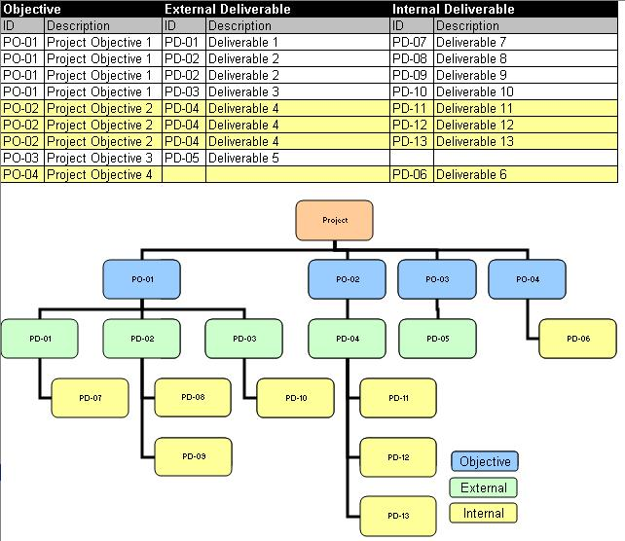
Definition of Deliverables
A Deliverable is a measurable, tangible, verifiable outcome, result, or item
that must be produced to complete a project or part of a project.
Deliverables may be External or Internal.

Slide 51
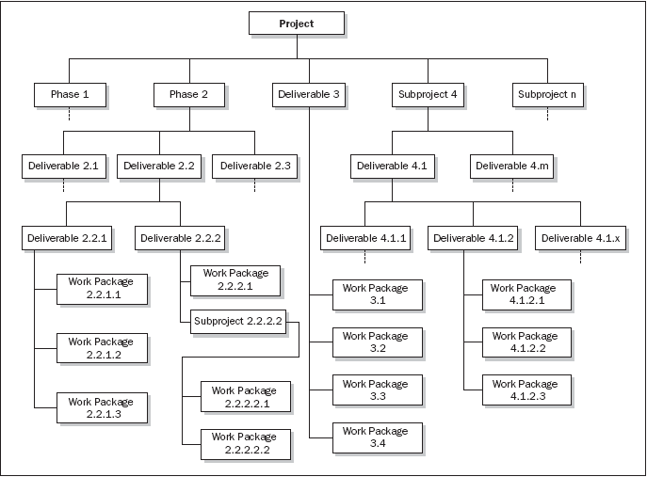
Phase oriented WBS

Slide 52
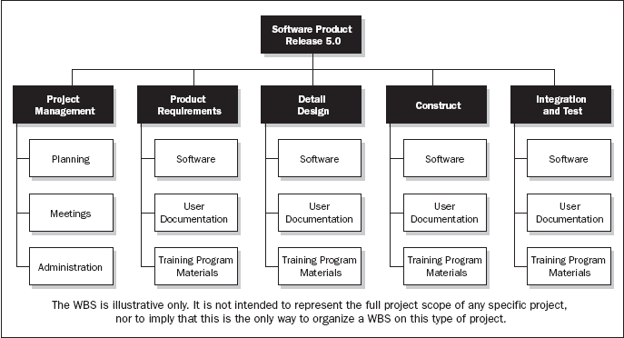
Department oriented WBS

Slide 53
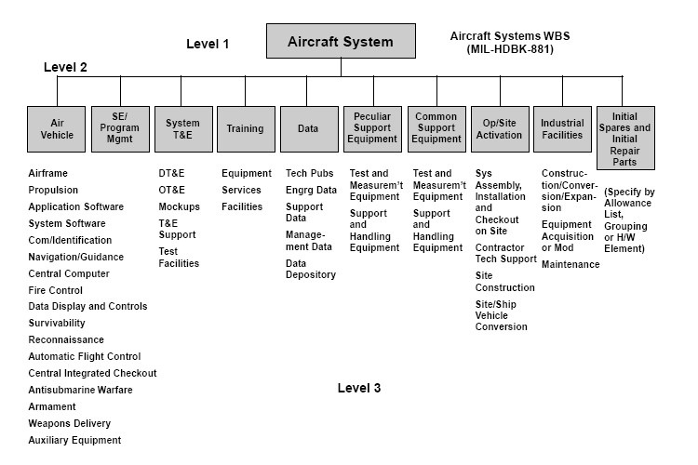
Subproject Oriented WBS

Slide 54
Let’s Identify Documents Required to Manage Scope and Requirements
Group Activity 8

Slide 55
Project Scheduling - CPM & PERT

Slide 56
Steps of Schedule Development
Define Activities
Sequence Activities
Estimate Resources
Estimate Duration
Develop Schedule

Slide 57
Define Activities
Know every product and project scope activities
Know the every possible attribute of these activities
List all the internal and external milestones

Slide 58
Sequence Activities
Sequence activities based on the activity attributes, lead, lag and dependencies between them
Mandatory dependencies – Logical relationships inherent in the set of
activities
Discretionary dependencies – Dependencies which are defined by the
Project team or the Performing organization
External dependencies – relationships between Project and outside
Organization
Lag : The amount of time delay between the completion of one task and the start of its successor task.
Lead: The successor activity starts before the predecessor activity has finished.
Dependency Types : Finish to Start, Start to Start, Finish to Finish, Start to Finish
Notes:
Discretionary dependencies– cannot process ahead without milestone review/ qa audit/ baselining/ signoff etc.

Slide 59
Estimate Resources
Resources required to complete activities may be material, human, equipment, expense
You need to identify every kind of resources and number of resource required to complete every activity
When you are identify human resources that time avoid assigning “named resources”

Slide 60
Estimate Duration
Techniques of duration estimation already discussed. Therefore use those techniques to estimate duration of each activity

Slide 61
Develop Schedule
Using following inputs for making schedule
Resource Pool Description - Knowledge of what resources will be available, at what time and in what patterns.
Calendars – When work is allowed. Working and Non-working times. Availability of resources.
Constraints- Imposed Dates. Key Events or Major Milestones.
Notes:
Factors considered: convert 5 working day effort to schedule(start Mon…; 1 person working)
-working days(weekends, holidays), part time/full time, dependency /wait time on another activity/resource, time zone-diff, personal leave, effective work hours/per day-org activities, early going, productivity(factored in estimate of 40 working hrs)…
Can finish early..if more hrs/per day/no dependencies, more productive than assumed,….
-

Slide 62
Develop Schedule : Critical Path
A Critical path for a project is the series of activities that determines the earliest time by which the project can be completed.
The Critical path is the longest path through the network diagram.

Slide 63
Critical Path
ES EF
ES EF
ES EF
ES EF
ES EF
ES EF
Duration 7 Task A
Duration 6 Task C
Duration 3 Task G
LS LF
LS LF
ES EF
LS LF
Duration 2 Task H
Start
Finish
ES EF
ES EF
ES EF
LS LF
Duration 3 Task B
Duration 3 Task D
Duration 3 Task E
LS LF
LS LF
LS LF
ES EF
Duration 2 Task F
LS LF

Slide 64
Critical Path – Longest Path, Zero Float
0
0
0
ES EF
ES EF
ES EF
Duration 7 Task A
0
7
Duration 3 Task G
Duration 6 Task C
13
16
7
13
0
7
7
13
13
16
0
LS LF
LS LF
ES EF
LS LF
Duration 2 Task H
16
18
Start
Finish
7
7
7
16
18
ES EF
ES EF
ES EF
LS LF
Duration 3 Task B
0
3
Duration 3 Task D
3
6
Duration 3 Task E
6
9
7
10
10
13
13
16
LS LF
LS LF
LS LF
8
ES EF
Duration 2 Task F
3
5
11
13
LS LF

Slide 65
Discussion/Excertise-16
5 Minutes
ES EF
ES EF
ES EF
Duration 4 Task A
Duration 4 Task B
Duration 3 Task C
LS LF
LS LF
LS LF
ES EF
ES EF
Duration 10 Task G
Start
Duration 7 Task D
Finish
LS LF
ES EF
LS LF
ES EF
Duration 5 Task E
Duration 5 Task F
LS LF
LS LF

Slide 66
Network Exercise - solution
Critical Path : ADCG
ES EF
ES EF
ES EF
Duration 4 Task A
0
4
Duration 3 Task C
Duration 4 Task B
11
14
4
8
0
4
7
11
11
14
LS LF
LS LF
LS LF
ES EF
ES EF
Duration 10 Task G
14
24
Duration 7 Task D
Start
4
11
Finish
14
24
4
11
LS LF
ES EF
LS LF
ES EF
Duration 5 Task E
0
5
Duration 5 Task F
5
10
4
9
9
14
LS LF
LS LF
Notes:
Free float: An activity can be delayed without impacting the start of next activity
Total float: As many alternative path that many total float. Total float is available on non critical path. Activities can be delayed without delaying project
Free float on critical path activities is Zero

Slide 67
Facts/Tips for Critical Path
Total Float is the amount of time the task can delayed without delaying the project finish date.
Free float is the amount of time a task can slip without delaying the early start of any task that immediately follows it
It is possible that a zero float activity may not be on critical path
Longest path & shortest time possible to complete the project
A project can multiple critical paths
Difference between late and early is float
Positive float (the activity can wait to start even after previous activity finishes)
Negative float (the activity must start before previous finishes)
Zero float (the activity must immediately start after the finish of previous one)
Crashing activities to short the overall duration of project
Fast-tracking activities to short the overall duration of project
Be cautious that non-critical activity is not being delayed than the allowed free float
Take care of sub-critical path or non-critical path
Manage critical path resources very closely
Do not overload critical path activity resources
Avoid multitasking for resources working on critical path activities

Slide 68
Let’s write the steps to prepare a project schedule and baseline schedule
Group Activity 9

Slide 69
Planning : Cost

Slide 70
Components of Contract Price
Contract Price includes Material, Labor, Expenses, Overheads, Risk Management Budget, Profit Margins
Cost baseline includes contingency reserves
Project budget includes management reserves
Do you know?
Who estimates Material cost for your project?
Who estimates Human Resource cost for your project?
Who estimates Expenses cost for your project?
Who estimates Overhead cost for your project?
How much is contingency reserve for your project?
What are indirect costs to your project?
When can you use contingency funds and who approves that?
How much is profit margin on your project?
What is the price?

Slide 71
Estimate Cost
Before you start estimating cost, know what all different types of costs you should be included in the estimation
Know the rate of every resources you are going to use

Slide 72
Project Cost Estimation Ranges
Never ever commit one absolute number to your project sponsor. Always range.
Cost estimation may include only Direct Cost or in combination of with Indirect Costs
Class Name | % | Range
Definitive | - 5 -> +5% | 10%
Capital Cost | -15 -> +10% | 25%
Appropriation | -25 -> +15% | 40%
Budget Estimates | -10 -> +25% | 35%
Feasibility | -35 -> +25% | 60%
Order of Magnitude | -50 -> +50% | 100%

Slide 73
Determine Budget
Aggregate costs based on the duration
While aggregating also include the money which you pay to vendors for services & contingency reserves
Before you baseline the cost validate the funding requirements with availability of funds.

Slide 74
Let’s write the steps to prepare a project budget and baseline cost
Group Activity 10

Slide 75
Revisit
Project Management Framework
Overview of Project Management
Project Success, failure and lessons learned
Project Management life cycle
Philosophy and Concepts
Project Planning and Control
Methodologies of effective leadership and motivation
Enterprise Environmental Factors
Organizational Process Assets
Project Scheduling - CPM & PERT
Cost-management

Slide 76
Day 2

Slide 77
Recap- Day 1

Slide 78
Planning : Quality

Slide 79
Plan Quality
Know your metrics, their calculation, data collection method and source
Determine product testing processes, tools
Determine defect fixing or feedback incorporation processes
Develop checklist wherever possible to test the product
Automate testing and review process as much as possible
Do not compromise on quality. Quantity can be sacrificed over quality.
Use 7 basic quality tools for managing project and product quality

Slide 80
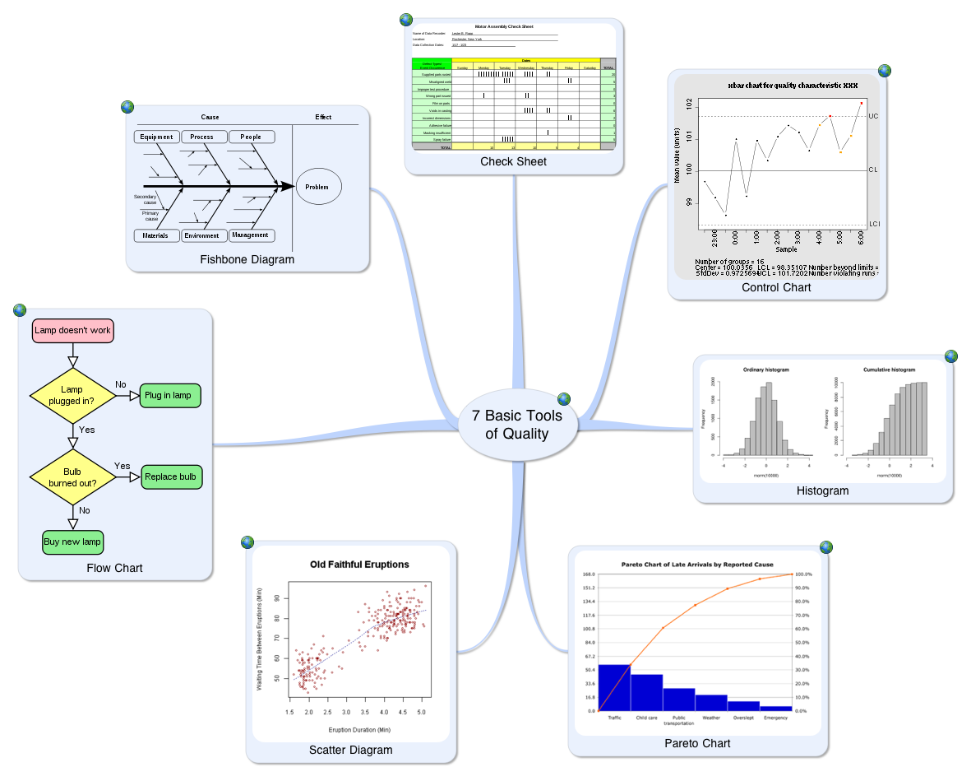
7 Basic Tools of Quality

Slide 81
Process Audit
Review your processes with auditors
Show your implementation with proof
Take best practices from auditors
Share your best practices with auditors

Slide 82
Let’s identify activities to be done to ensure quality of project and quality of product
Group Activity 11

Slide 83
Project Risk Management

Slide 84
Introducing you to the World of Risks
Un-predictable Risks
Known Risks
Management of Uncertainties

Slide 85
Every Project has risks associated with it!
Commercial viability.
Technical feasibility.
Competitors move ‘faster’.
Customers’ preferences may change.
‘VC’ resources may ‘dry up’.
Project Sponsor changes or may not give continued support.
Attrition.
Project scope, time or cost related issues.
Government regulations.
Notes:
Technical risks- lifecycle, product/technology obsolescence
Management risks- Planning, estimation, budgeting, resources
Commercial- exchange rate , payment default
Legal- obligns failure

Slide 86
What is Risk?
A dictionary definition of risk is “the possibility of loss or injury”.
Project risk involves understanding potential problems that might occur on the project and how they might impede project success.
“Risk is the potential for realization of unwanted negative consequences of an event.”
Project Risk is an uncertain event or condition, that if it occurs, has a positive or negative impact on project objectives. (PMBOK)

Slide 87

Risk Identification – Information gathering Techniques
Brainstorming Sessions.
Interviewing.
Checklists.
Assumptions analysis.
Review of Artifacts (WBS etc).
SWOT Analysis
Organization Risk Database.

Slide 88
Risk Management Process
Risk Assessment
Risk Control
Risk Database
Risk identification
Risk analysis
Risk prioritization
Risk response planning
Risk resolution
Risk monitoring
SDLC
Notes:
Self Explanatory slide !

Slide 89
Risk Event / Impact matrix
Contingency Reserve
Management ‘kept’ Reserve
Unknown
Impact
Planning
N.A.
Known
Known
Unknown
Event
Notes:
Unknown unknown- Recession, customer demand/appetite changes, technology changes, new product-game changer has hit the market, farmer agitn –singur—recovery/continuity at Gujarat..
Known-known--- cust may not signoff; team member may leave, resource may not be available..
Known- unknown-----I know customer changes his mind, but don’t know impact;
Unknown-unknown--- don’t know if cycle will change; don’t know if recession might happen; don’t know if suddenly regulations change; don’t know whether customer may delay payment; don’t know if competition announces new changes.

Slide 90
Risk Estimation

Slide 91
Risk Prioritization
Rank each Risk based on the exposure

Slide 92
Risk Response Strategies
Risk Avoidance
Risk Transference
Risk Mitigation
Risk Acceptance

Slide 93
Risk Monitoring & Control
Keeping track of identified risks
Monitoring of residual risks
Identifying new risks
Ensuring execution of the Risk Plan
Evaluating the effectiveness of the Risk Plan
Will be an ongoing process for the life of the project
Will reassess the priority of the risks periodically.

Slide 94
Good Risk Management Practices
Acknowledge that risks are inevitable.
Communicate risks openly.
Reward people who prevent crisis, not just those who create crises and then manage them.
Use organization’s risk database for cross project learning.
Take the Expert help whenever needed.
Remember all risks are important .
Notes:
Self Explanatory slide !

Slide 95
Bad excuses in Risk Management
We have no risk.
We deal with problems as they arise.
How can you predict what will happen 6 months from now?
Our job is to develop software, not to fill out bureaucratic forms.
That external interface is not in our risk management program because the interface is not our responsibility.
We deal with problems as they arise.
That method is proven and therefore not a risk. The speaker at the conference said so.
My tech people will rebel if we identify as a risk a lack of skills needed to do development.
We have to bid the lowest cost to win; we'll worry about doing the job when we get it.
(source-The Little book of bad excuses- SPMN)

Slide 96
Let’s identify activities to be done to manage risk proactively
Group Activity 12

Slide 97
Project Procurement Management

Slide 98
Basics of Procurement
Identify your procurement need: Know what is needed by you to complete the project work but your project team cannot produce it. (it may external testing, training, software, hardware, service, material etc)
Specification of each procurement need
Who, when, at what cost
How will you verify the objective is met
Change request

Slide 99
Monitoring & Controlling

Slide 100
Overall Monitoring & Controlling
Know your metrics
Know the allowed threshold limit of each metrics
Get actual data
Compare the data against plan
Calculate your metrics and know your variances
Determine whether variance is without tolerance limit
Corrective and Preventive actions
Defect repair
Validate whether CAPA and Defect repairs recommended are implemented
Prepare reports
Share reports

Slide 101
Managing Variations
Variation:
The difference between the planned and the actual results. Variation could be with respect to Time, Cost or Quality.
Threshold:
The maximum permissible variation beyond which appropriate corrective action must be taken.
Notes:
Talk about:
Explain the definitions of variation and threshold and say that more will be discussed in the subsequent slides

Slide 102
Earned Value Management
BAC= Variance at completion
PV = Planned Value
AC = Actual Cost
EV = Earned Value
ETC = Estimate to Complete
EAC = Estimate at Completion
SPI = Schedule Performance Index
CPI = Cost Performance Index

Slide 103
Earned Value Rules
0% - 100%
50% - 50%
20% - 80%
25% - 75%

Slide 104
Types of Reviews/reports
Weekly reviews
Status/Progress reviews
Management reviews
Milestone/phase end reviews
Customer reviews
Vendor reviews

Slide 105
Project Review outcomes
All reviews must culminate with
List of Issues Identified.
List of Action Items decided.
Action items must be tracked to closure.
Issues must be monitored to determine if they are resolved.
Issues need to be escalated as per the defined Escalation procedures.

Slide 106
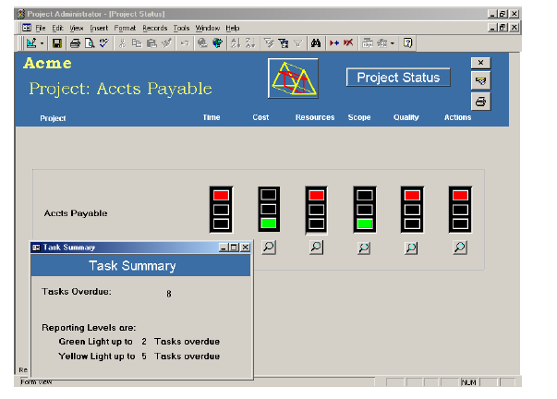
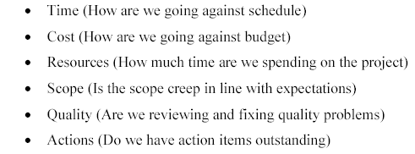
Project Dashboard (RAG)

Slide 107
Issue Management
Log issues and Issue source.
Determine action for resolution.
Establish responsibilities and timeline for action.
Track issue for resolution.
Escalate issue as per escalation procedure.

Slide 108

Team Management
Together Everyone Achieves More

Slide 109
Stages of Team Performance
Forming :
Team members getting to know each other
Heavy dependence on Leader’s directions
Storming:
Team members vie for positions of authority/ Power struggles
Norming:
Team members get to know each others’ strengths and weaknesses
Agreement and Consensus/ Goal clarity
Leader – facilitating role
Performing:
Team has a shared vision
Conflicts are resolved productively
Leader – delegating and overseeing role
Notes:
Cliques – A group of people or associates

Slide 110
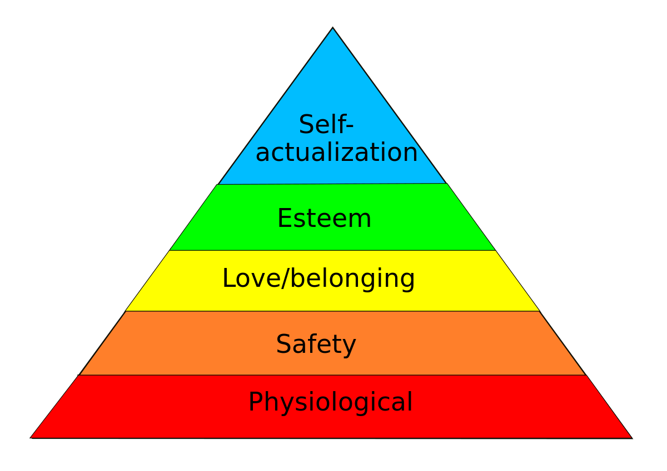
Maslow’s Need Pyramid

Slide 111
Motivation
Project is done by people but all people do not have same motivation. And same thing does not motivate them all the time
Remain in touch with team understand their permanent motivation factors and short term motivation factors and need of the project.
As a servant leader create an environment which is free from impediments, external to project.

Slide 112
Group Activity 12
Let’s identify short term motivation factors
Day to day impediments
How can you solve those impediments
Reasons of conflict between team members

Slide 113
Project or Phase Closure

Slide 114
What is a Post Project Review?
Looking backing to know how differently we could have done
Looking forward to plan what should we do
Not about the people and blaming their behavior. But about process and opportunities to learn from the interactions of the team members.
Should not wait to end project or phase. But any time when you feel need (like moral is down, productivity is down, team making more mistake etc), you can do project review.
Another purpose of this is to contribute learnings of the project with organization so that future projects can be done in better way

Slide 115
What’re the Deliverable?
Reuse possibilities
Best Practices
Lessons Learnt
Risks That hit / hurt
Customer / Project / Process / Product measurements
Customer report defect data analysis
Input for preventing defects in subsequent phases / projects
Customer Satisfaction Survey Analysis. Contributed to organizational repository for further processing

Slide 116
Ground Rules
Be polite and gracious.
What happens in you when somebody does not agree with you
What do you do when you do not agree with someone?
Focus on problems and process.
What do you do to ensure problem is understood correctly and in right context?
No finger pointing/ No assigning blame.
How, when and who do you do retrospective?
Do you think that there is something called perfect plan? What happens when things goes wrong in project?
Let each person have a turn.
Avoid defensiveness.
How many times and how long you should be humiliated over one mistake?
Respect everyone’s perspective.
Whose input matters?
How do you make any decision?

Slide 117
Project Archival
Ensure that all information is archived in line with the contractual agreements/internal procedures.
Plan for transitioning to warranty / maintenance.

Slide 118
Essential Project Management Tools and Techniques

Slide 119
Integration
Expert Judgement
Facilitation Techniques
Project Management Information System
Meetings
Change Control Meetings
Analytical techniques

Slide 120
Scope Management
Interviews
Focus Groups
Observations
Prototypes
Inspection
Facilitated Workshops
Group Creativity Technique
Group Decision Making Techniques
Questionnaires and Surveys
Benchmarking
Context diagrams
Document Analysis
Product Analysis
Alternatives Identification
Decomposition
Variance Analysis

Slide 121
Time Management
Rolling Wave Planning
Precedence Diagramming Method
Dependency Determination
Leads and Lags
Reserve Analysis
Schedule Network Analysis
Critical Path Method
Schedule Compression
Alternatives Analysis
Published Estimated Data
Critical Chain Method
Resource Optimization techniques
Modeling Techniques
Scheduling Tool

Slide 122
Cost Management
Bottom-up estimating
Analogous Estimating
Parametric Estimating
Three-point estimates
Vendor Bid Analysis
Cost Aggregation
Historical Relationships
Funding Limit Reconciliation
EVM
Forecasting
TCPI
Cost-benefit analysis
Performance Reviews

Slide 123
Quality Management
Seven basic quality tools
Cost of Quality
Design of experiments
Statistical sampling
Additional quality planning tools
Quality audits
Process analysis
Approved Change Request Review

Slide 124
HR Management
Training
Team-building activities
Ground Rules
Pre-assignment
Negotiation
Acquisition
Organization Charts and position descriptions
Networking
Organizational Theory
Virtual Teams
Multi-criteria decision analysis
Interpersonal Skills
Co-location
Recognition and Rewards
Personnel Assessment Tools
Observation & Conversation
Project Performance Appraisals
Conflict Management

Slide 125
Communication
Communication Requirement Analysis
Communication Technology
Communication Models
Communication Methods
Information Management Systems
Performance Reporting

Slide 126
Risk Management
Documentation Reviews
Information Gathering Techniques
Checklist Analysis
Assumptions Analysis
Diagramming Techniques
SWOT Analysis
Strategies for Negative risk or threats
Risk Probability and impact assessment
Probability and impact matrix
Risk Categorization
Risk urgency assessment
Risk data quality assessment
Strategies for Positive risks or opportunities
Contingent response strategies
Risk Reassessment
Variance and trend analysis
Data gathering and representation techniques
Quantitative Risk analysis and modelling techniques
Risk Audits
Technical performance measurement

Slide 127
Procurement Management
Make-or-buy analysis
Market Research
Contract Change Control System
Bidder conferences
Proposal evaluation techniques
Independent estimates
Advertising
Procurement Negotiation
Procurement Performance Reviews
Inspections and Audits
Payment Systems
Claim Administration
Records Management Systems
Procurement Audits

Slide 128
Project Manager
Roles & Responsibilities
&
Knowledge and Skills required

Slide 129
General Management Knowledge & Skills
Financial Management & accounting
Procurement
Sales & Marketing
Contracts & Commercial law
Manufacturing & Distribution
Logistics & Supply chain
Strategic and Tactical planning
Org structures, org behavior,compensation, benefits
Health & Safety practices
Information Technology

Slide 130
Interpersonal Skills
Effective communication
Influencing the organization
Leadership
Motivation
Negotiation & Conflict Management
Problem solving

Slide 131
Project Manager Responsibilities
Project Manager’s Responsibilities in Project Lifecycle
Initiating a Project
Project aligned with org objectives & customer needs
High-level risks, assumptions and constraints are understood
Stakeholders identified and their need are understood
Project Charter approved
Planning a Project
Project scope agreed
Project schedule approved
Cost budget approved
Project team identified with roles and responsibilities agreed
Communication activities agreed
Quality management process established
Risk response plan approved
Integrated change control processes defined
Procurement plan approved
Project Plan approved

Slide 132
Project Manager Responsibilities
Project Manager’s Responsibilities in Project Lifecycle
Executing a Project
Project scope achieved
Project stakeholders expectations managed
Human resource managed
Ensure processes are being followed as agreed
Material and equipment resources managed
Risk management strategies are implemented
Monitoring & Controlling a Project
Project tracked and status communicated to stakeholders
Project change is managed
Quality is monitored and controlled
Risk is monitored and controlled
Project team managed
Contract administered
Closing a Project
Project outcomes accepted
Project resources released
Stakeholder perceptions measured and analyzed
Project formally closed

Slide 133
Project Manager in Nutshell
Project Manager’s Role
Should
Be a resourceful person who can get things done and keep all relevant stakeholders informed.
Ensure work is estimates in terms of size, efforts & schedule
Ensure risk identification, analysis, prioritization, monitoring & control is done periodically
Ensure right resource allocated for the work, resource backup and utilization
Ensure team is motivated, career planning, training and development activities are being done
Ensure scope and requirements are management
Ensure stakeholders are sufficiently engaged, their expectations are managed they are being communicated proactively
Ensure project objectives are met in terms of time, cost, scope and defect free product.
Ensure all contractual obligations are fulfilled
Ensure procurements are as per contract & proposal
Ensure Configuration management, data backup
Ensure lessons learned are documented and implemented
Ensure cost is optimized
Participate in presales & proposals

Slide 134
Recap- Day 2

Slide 135

This document is proprietary and confidential. It remains the property of Vedavit Project Solutions at all times. No part of this document may be used, reproduced, or transmitted in any form or by any means electronic, including photocopying and recording, for any purpose without express consent of Vedavit Project Solutions.

Slide 136







hari.prasad@vedavit-ps.com
+91 9535999336
http://rarementors.com
https://in.linkedin.com/in/harithapliyal
http://twitter.com/harithapliyal
http://pmlogy.com/
http://facebook.com/harithapliyalpage

