Slide 1

Project Management 101
Session 1
Hari Thapliyaal
MSc (Data Science), MCA, MBA (Operations), PGDFM,
PMP, PMI-ACP, PRINCE2 Practitioner,
ZED Master Trainer, MCITP
SCT, CSM, MCT, SDC, SCM, SPOC, SAMC
Linkedin: https://www.linkedin.com/in/harithapliyal
'PMI-ACP', 'PMI', and 'ACP' are a registered marks of the Project Management Institute, Inc.

Slide 2
Objective
To sensitize technical people moving into project management role about the PM responsibilities.
To normalize the project management experience between senior and junior project management practitioners.
Understand the difference between practices and processes of Agile and Traditional project management.

Slide 3
Agenda of Session 1
Introduction, Ground Rules and Expectation Setting
Objective & Agenda of workshop
Summarizing Survey
Project Manager Responsibilities
Project Initiation
Process vs Practices
Project Characteristics & PMM
Project Charter
OPA
EEF
Project Monitoring & Controlling
Metrics
Based on participant’s interest, duration and topics of this session can be changed

Slide 4
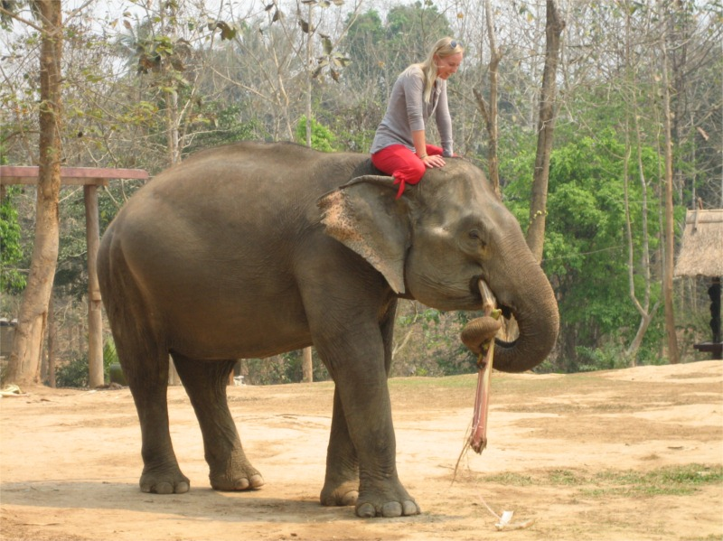

Project Management Main Topics
7- Communication
Project Manager
2- Scope
6- Human Resources
1- Integration
3-Time
9- Procurement
4- Cost
10- Stakeholders
5- Quality
8- Risk

Slide 5

Project Manager Responsibilities
Estimates of size, efforts & schedule
Risk identification, analysis, prioritization, monitoring & control
Resource allocation, resource backup and utilization
Scope management
Communication- reviews, steering committee meetings, stakeholder identification and expectation management
Stakeholder Expectation Management
Defect free product delivery on time within budget
Team motivation, team management, training & development, appreciation, career planning, interview
Deliver as per contract & proposal
Procure as per contract & proposal
Configuration management, data backup
Quality planning
Cost optimization
Presales & proposals
Technical guidance to team – if team members are not available do their work (after project manager has completed his work & he has spare time)

Slide 6
Project Manager Responsibilities Phasewise
Initiating a Project
Project aligned with org objectives & customer needs
High-level risks, assumptions and constraints are understood
Stakeholders identified and their need are understood
Project Charter approved
Planning a Project
Project scope agreed
Project schedule approved
Cost budget approved
Project team identified with roles and responsibilities agreed
Communication activities agreed
Quality management process established
Risk response plan approved
Integrated change control processes defined
Procurement plan approved
Project Plan approved

Slide 7
Project Manager Responsibilities Phasewise
Executing a Project
Project scope achieved
Project stakeholders expectations managed
Human resource managed
Quality managed against plan
Material resources managed
Monitoring & Controlling a Project
Project tracked and status communicated to stakeholders
Project change is managed
Quality is monitored and controlled
Risk is monitored and controlled
Project team managed
Contract administered
Closing a Project
Project outcomes accepted
Project resources released
Stakeholder perceptions measured and analyzed
Project formally closed

Slide 8
Key Responsibilities of Scrum Master
Servant Leaders
Removing impediments
Should be a person who can be heard by development team and client side product owner.
Master of scrum ceremonies
Ensure team is doing daily standup
Ensure team is doing sprint planning
Ensure PO is explaining requirements and prioritizing product backlog

Slide 9
Project Initiation
Developing Project Charter
Deciding Project Management Methodology Based on Project Characteristics
Identifying stakeholders
Identifying project inherent risk
Documenting project assumption
Identifying project manager and project sponsor
Defining R&R of initial project team

Slide 10
Processes vs Practices
Processes can be followed easy by machine and automation is easy.
Processes has clearly defined input, output and tasks to be done as a part of the processes
Practices has defined objective and goal.
Practices are part of human behavior.
Traditional project management is Process driven
Agile project management is practices driven.

Slide 11
Defined vs Empirical Processes
Defined Processes
Assumes that every piece of work is completely understood
Input is well-defined
A set of well-defined input produces same output every time within known variance limit
Has tightly coupled steps
No checkpoint and feedback steps

Slide 12
Defined vs Empirical Processes
Empirical Processes
Relies on frequent inspections and adaption
Applies to those process which are loosely defined because of their complexity
Understand that output of a process can be unpredictable and unrepeatable

Slide 13
Organizational Process Assets
Process Assets which created by the organization while doing the project in past
Processes, Standards, Guidelines, Checklist, Templates standardized by the Quality Department or PMO
Lessons learned report of the previous projects
Consider them for project Initiation, Planning, Executing, Monitoring & Controlling and Closing. Do not reinvent the wheel in project management.
e.g. Time/Cost/Resource Estimation database, Risk database, Issue Register, Skills Database

Slide 14
Enterprise Environmental Factors
Constraints which are not in control of a Project Manager and the project manager has to consider them to make project successful.
These constraints are imposed by environment of those enterprises which are involved in the project
Consider them for project Initiation, Planning, Executing, Monitoring & Controlling and Closing
e.g. Skill Availability, Market Condition, Attitude of People, Organization Culture, Climatic Condition, Political Condition, Bosses etc.

Slide 15
Benefits of Project Management
Meet business objectives;
Satisfy stakeholder expectations;
Be more predictable;
Increase chances of success;
Deliver the right products at the right time;
Resolve problems and issues;
Respond to risks in a timely manner;
Optimize the use of organizational resources;
Identify, recover, or terminate failing projects;
Manage constraints (e.g., scope, quality, schedule, costs, resources);
Balance the influence of constraints on the project (e.g., increased scope may increase cost or schedule); and
Manage change in a better manner.

Slide 16
Project Monitoring & Controlling
If we cannot measure we cannot manage
To monitor we need metrics
To control we need to know thresholds of those metrics.

Slide 17
Metrics
We need to establish key metrics for our project.
How to calculate those metrics, i.e. the formula.
From where the data will come
At what frequency data will be collected
At what frequency metrics will be compiled
Goal and threshold against each metrics
Owner of metrics.

Slide 18
Templates Shared in .doc format
1. Benefit Cost Analysis
2. Project Charter
3. Stakeholder Analysis
4. Scope Management Plan
5. Requirement Management Plan
6. Project Scope Statement
7. Milestone Report
8. Cost Estimates
9. Quality Management Plan
10. Staffing Management Plan
11. Human Resource Management Plan
12. Communication Management Plan
13. Risk Management Plan
14. Risk Register
15. Procurement Management Plan
16. Project Management Plan
17. Progress Report
18. Status Report

Slide 19


