Slide 1

Project Management 101
Session 2
Hari Thapliyaal
MSc (Data Science), MCA, MBA (Operations), PGDFM,
PMP, PMI-ACP, PRINCE2 Practitioner,
ZED Master Trainer, MCITP
SCT, CSM, MCT, SDC, SCM, SPOC, SAMC
Linkedin: https://www.linkedin.com/in/harithapliyal
'PMI-ACP', 'PMI', and 'ACP' are a registered marks of the Project Management Institute, Inc.

Slide 2
Workshop Ground Rules
Participation from Everyone is must.
Please keep your mobile & surrounding noises on the silent mode.
Strictly follow the workshop schedule for management of time.
Post your question in QA are only
Breaks only on agreed time. Do not leave the virtual training room intermittently.
Anything else you want to add?
Notes:
Project Management Concepts
06/28/13
Version 3.1, 4/01 © 2003 by AstroWix
2

Slide 3
Objective
To sensitize project team for Agile Project Management
Discuss Scrum an Agile method.

Slide 4
Agenda of Session 2
Revision from Last Session
Introduction to Agile & Scrum
Agile Project Management : Communication
Agile Project Management : Requirement Management
Agile Estimation & Planning
Agile Metrics
Agile Artifacts
Agile Architecture & Design
Agile Quality Management

Slide 5
Introduction to Agile & Scrum
What is Agile
Why Agile?
Is Agile for Me
Define Positive Values
Agile Values & Principle
Scrum Framework

Slide 6
Agile Characteristics
Adaptability not Predictability
Accepting that outcomes of a process are not predictable, and processes are not repeatable
Values and Principles of Collaboration
The conventions which we agree we define those. In the interest of project, if required we can change those
Processes are documented; practices are followed.

Slide 7
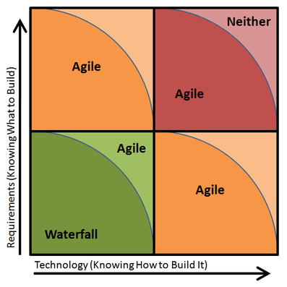
Why Agile?
Simple | Complicated | Complex | Chaotic
Well established requirement and technology to do the project | Some bit away from your regular projects. Technology and requirements explanation with SME | Completely new type of project. No expertise around. You need to research to understand the requirement and technology both. When able to identify protein signature. Then developing vaccine was complex. | Many things mixed up not able to identify the problem clearly. Not able to categories problem. Handling COVID19 was chaos in earlier stage.
Sense-Categorize-Respond | Sense-Analyse-Respond | Probe-Sense-Respond | Act-Sense-Respond

Slide 8
Agile Values for Stakeholders
Customer Values
Incremental Delivery
Client Driven
Client Focused
Adaption to Change
End user Values
Incremental Delivery
Waste Elimination
Prioritization
Quick Clarification
Team Values
Empowerment
Trust
Respect
Defining the work
Self-Organized
Future Leadership
Training
System Thinking
Organization Values
Least Escalations
Predictive Revenue
Simple Processes
Collaboration
New Business
No Extra Overhead
Sponsor Value
Predictive Demand
Predictive Revenue
Agile Accounting
Agile Contracting
Highest Return

Slide 9
Value in Agile Manifesto
“We are uncovering better ways of developing software by doing it and helping others do it. Through this work we have come to value”
Individuals and interactions over processes and tools
Working software over comprehensive documentation
Customer collaboration over contract negotiation
Responding to change over following a plan
That is, while there is value in the items on the right, we value the items on the left more.
www.agilemanifesto.org

Slide 10
Agile Principles
Satisfy customer by continuous delivery of valuable product | working software
2. Welcome Change even at late stage | responding change
3. Deliver working software Frequently | working software
4. Business and Developer work together | customer collaboration
5. Build around Motivated Individuals- Give team opportunity, trust them | Individual & Interactions
6. Face-to-face communication | Collaboration
7. Working software is the primary measure of progress. | Working Software
8. Sustainable Development | All
9. Continuous Technical Excellence | All
10. Simplicity (the art of maximizing the amount of unwanted work not done) is essential. | All
11. Self Organizing Team | All
12. Team reflection at regular intervals | All
www.agilemanifesto.org

Slide 11
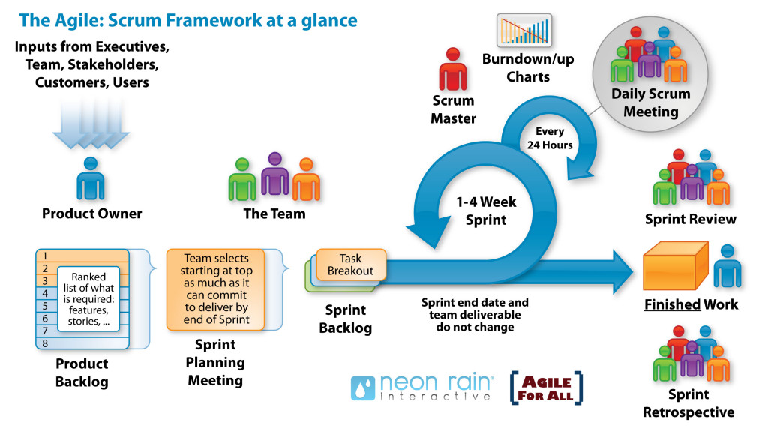
Scrum Framework
Product Vision
Product Backlog
Project Kickoff
Release Planning
Inside Story

Slide 12
Agile Methodologies
Scrum
Extreme Programming (XP)
Lean Software Development (LSD)
Feature Driven Development (FDD)
Dynamic System Development Methods (DSDM)
Kanban
Scrum-Ban
Crystal Methods

Slide 13
Value Delivery & Project Life Cycle
Lifecycles: Waterfall- Iterative- Agile
Define
Design
Develop
Test
Deploy
Iteration-1
$
Phase1
Phase2
Phase3
Phase4
Phase5
Define
Design
Develop
Test
Deploy
$
Agile
Waterfall
Define
Design
Develop
Test
Deploy
Iteration-2
$
Define
Design
Develop
Test
Deploy
Iteration-3
$
Iterative
Define
Design
Develop
Define
Define
Define
Design
Design
Design
Develop
Develop
Develop
Test
Test
Test
Test
Deploy
Deploy
Deploy
Deploy
Iteration
Iteration1
Iteration2
Iteration3
In iterative development initial iterations can have less value or no value.

Slide 14
Communication
Information Radiator
Osmotic Communication
Daily Standups
Communication Barrier
Communication Effectiveness
Agile Team Structure

Slide 15
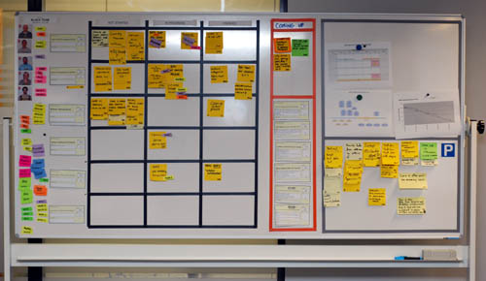
Information Radiator
Team Members
Work Progress
Impediments
Work Progress
Work Completed
Parking Lot

Slide 16
Osmotic Communication
Agile project relies on collocation, minimum documentation, least reporting, maximum constructive engagement. This can be achieved if frequently sought important information is available in published form in team space
Whoever need the information can go and get the information without wasting time in requesting, making, sending, receiving the information
Benefits
Least cost, effort and time waste in communication
Updated information is always available without making new reports
People can get whatever particular information they are looking for
Happens at the same time
Feedback loop is quick
Those people who are left in regular reporting also get benefitted
No junk, old, repetitive information, but fresh and useful.
Dis-benefits
Some people get extra information which they do not need
It is left to individual’s interpretation

Slide 17
Daily Stand-ups
Daily stand-up is heart beat of agile project management
Team meets daily (typically in working area, war room) at fixed time (time should not be changed) preferable first thing in morning
This is not reporting session but information sharing among team members
Only “Pigs” allowed to speak, “chicken” should listen (they are not allowed to interfere or ask while stand up meeting is in progress)
It is 15-20 min meeting, conducted while everybody is standing (showing the sense of urgency). A person should not take more than 2 min to update this work status.
Any one in the team can facilitate this meeting
Project manager notes the impediments and start working on those immediately after the meeting is over.

Slide 18
Communication Barriers
Physical Distance => Physical Proximity
Working in Different Shifts => Temporal Proximity
Human Language
Technical Knowledge
Detrimental Attitude
Difference in Culture
Difference in Project Environment
Attitude, willingness => Amicability
Communication Channels

Slide 19
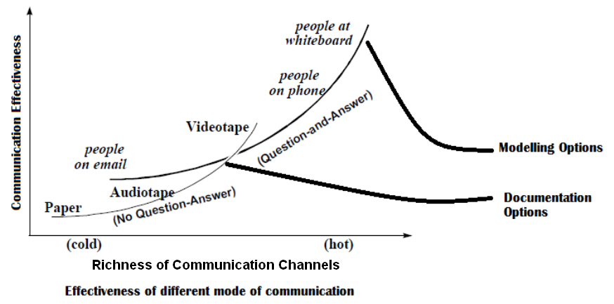
Communication Technologies & Effectiveness

Slide 20
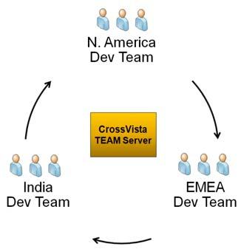
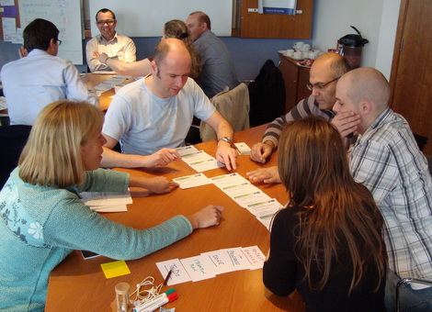
Collocated vs Distributed Team

Slide 21
Requirements Management
Value of Feature
Product Backlog Prioritization
3C User Story
INVEST Model of User Story
Epic, Feature, Story, Task
MMF (Minimum Marketable Features)

Slide 22
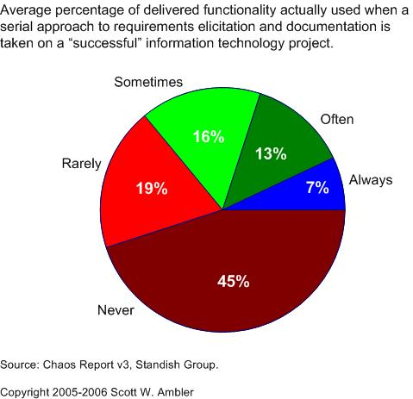
Value of Delivered and non-used Features

Slide 23
3Cs of User Story
Card
Conversation
Confirmation

Slide 24
INVEST Model of User Story
INVEST model defines following characteristics of a user story
Independent
Negotiable
Verifiable
Estimatable
Sized Appropriately
Testable

Slide 25
Epic, Feature, Story, Task
Epic is a collection of features. An epic is typically 1-3 months in duration
Feature is collection of stories. A feature is typically 2-4 weeks in duration
User-story is smallest unit of requirement created from features. A user-story is typically less than a week in duration
Task are smallest unit of executable items which team members assign to themselves to complete a user story. A task is typically of 8 hours in duration

Slide 26
Minimum Marketable Features (MMF)
MMF is basic minimum set feature of the product so that people can start using it
MMF can be made of a single or combined of multiple user stories
MMF has business value to the end user

Slide 27
Agile Estimation & Planning
Complexity and Efforts
Planning Poker
Sprint Planning
Time Boxing

Slide 28
Planning Poker
Planning poker is widely used estimation technique in agile projects. This is a variation of Wideband Delphi.
Logistic Required for Planning Poker Estimation
As many set of deck cards as many estimators in the room
All the team members with a deck of cards inside the room
A coordinator with laptop
A facilitator
Product owner
Planner Poker Process
Facilitator projects the product backlog on wall using a projector
He reads loudly a user story at a time so that everybody in the room understand what they need to estimate
Estimator estimates it silently and shows the card only to the coordinator
Coordinator documents all the estimates provided by all estimator
If there is difference between estimates then estimators who provided two extreme estimates need to talk the basis of estimates.
After a short discussion. Next round of estimation starts the same way as before and coordinator document the estimate provided by estimator
Keep repeating steps 3,4,5,6 till estimates provided by estimators are not converged
Read next user story
Notes:
28

Slide 29
Relative Size Estimation
You can take base either category like T-shirt size, fruits, animals etc.
Let us say our product back log has
8 x bananas (5 points each) = 40 story points
10 x pineapple (20 points each) = 200 story points
6 x oranges (8 points each) = 48 story points
30 x bunches of grapes (2 points each) = 60 story points
Total story points in product backlog is 40+200+48+60 = 348
Les us assume that based on guess or some previous release teams knows that their velocity is 30 story points
Total iterations required = 348 / 30 = 11 iterations
If iteration is of 2 weeks then 22 weeks required to finish the work in product backlog

Slide 30
Time-boxing
Iteration length is time-boxed.
Following sequence of activities takes place in any time-boxed iteration
Grooming product backlog (done by product owner, in parallel to iteration work)
Iteration Planning (1 hour for every week of iteration)
Daily stand-up (15 min, max 2 min for one person, typical team size of agile team is 7±2)
Regular iteration work
Iteration Review (1 hour for every week of iteration)
Iteration Retrospective (1 hours for every week of iteration)

Slide 31
Agile Metrics
Velocity
Burndown
Risk Burndown

Slide 32
Metrics
Velocity
Velocity is number of story points a team can do in an iteration.
When you are starting a new project that point of time best way to know the productivity is guess based on previous experience. But never benchmark velocity of team based on previous project
It takes 3-4 iteration to stabilize velocity of team
Team members should not be added or removed from development team otherwise it destabilized the velocity
Methods to improve velocity
Periodically pay down technical debt
Improve customer involvement
Support energized work environment
Provided needed resources (people, equipment, software etc)
Offload admin duties of programmer
Add experienced programmers
Notes:
32

Slide 33
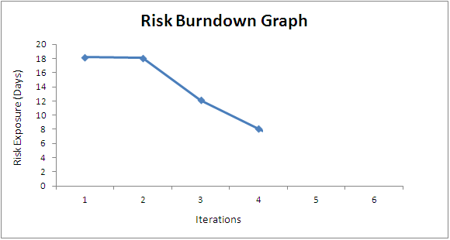
Risk Burn-down Graph
Risk Responses: Threats & Opportunities
Actual Risk Trend line
Ideal Risk Trend line
If actual risk trend line is above than ideal trend line then it means risks are not coming down at the appropriate rate

Slide 34
Agile Artifacts
Product Backlog
Release Backlog
Sprint Backlog
Agile Documentation
Agile Architecture

Slide 35
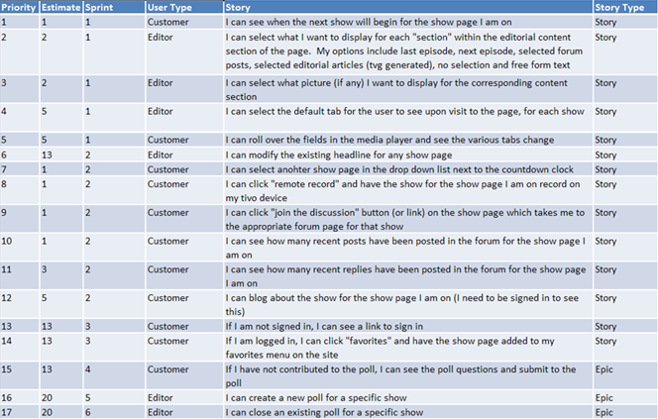
Backlog
Product Backlog
Product backlog grooming is continuous activity. PO is responsible for this.

Slide 36
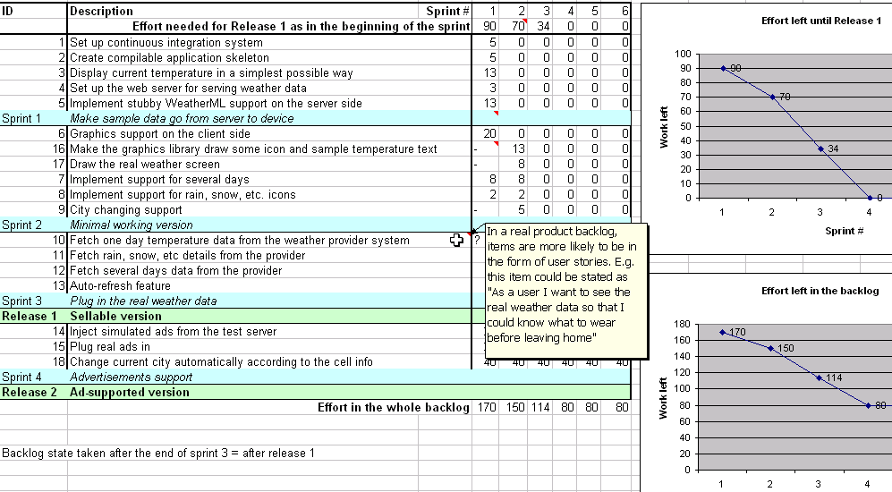
Backlog
Release Backlog
Release backlog is created during release planning meetings. PO is responsible for this

Slide 37
Backlog
Sprint Backlog
Unlike product backlog and release backlog which is comprised by user stories, sprint backlog is comprised of task
Sprint Backlog can have following types of tasks
Design Tasks
Coding Tasks
Testing Task
Documentation Tasks
No one is allowed to add user story or task in Sprint backlog but team can delete task if they feel out of time
Sprint backlog is developed at the time of sprint planning

Slide 38
Backlog
Sprint Backlog
Generally every task in sprint backlog should be related to some user story
To identify task for user story programmers need to do the detail discussion about user story with PO
Each task in sprint back log should have following information in the form of Task card
Task description
Estimated hours
Owner name (if taken by any team member)
Exit criteria
Verification method (test or inspection)
Who will perform verification

Slide 39
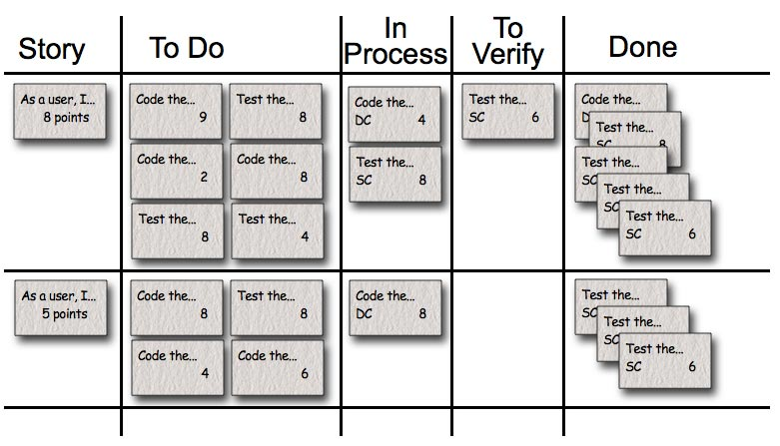
Backlog
Sprint Backlog

Slide 40
Agile Quality Management
User Story Definition of Done
Sprint Definition of Done
Release Definition of Done
Agile Health Checkup

Slide 41
Definition of Done (DoD)
The DoD changes over time. Organizational support and the team’s ability to remove impediments may enable the inclusion of additional activities into the DoD for features or sprints.
Continuous Integration (CI) helps you validating the “Doneness”
There are 3 level of DoD
Story DoD
Iteration DoD
Release DoD

Slide 42
Definition of Done (DoD)
Story “Done”
Unit test should provide 60-70% test coverage
Story is either written in pair or reviewed by peer
All code checked in
All unit code passed
All acceptance test case passed
Story accepted by owner

Slide 43
Definition of Done (DoD)
Iteration “Done”
Iteration should have defined Iteration Goal
All acceptance test cases should run for all user stories in Iteration
All stories completed must be accepted by the product owner
Defects identified are fixed or planned for future
Code performance is tested and accepted
If database is involved then database script should be available, automated and tested
Backup of iteration work product is taken

Slide 44
Definition of Done (DoD)
Release “Done”
Release should have defined Release Goal
Product has formal release date
Product is deployed on staging area
Stress testing done and results accepted
All non-functional requirements are tested and results accepted
Required documentation is available
Release should not have any known bug

Slide 45
Agile Health Checkup
To know the agile maturity in your project you can perform following Agile Health Checkup. Discuss in group and ask team to rate these parameters on the scale of 1-5
Frequent Delivery
Reflective Improvement
Close Communication (does it take less than 1 min to get you question answered by a person who know the answer?)
Focus (everybody understand the goal and desired outcome of the delivered software?)
Personal Safety (can you give bad news to your boss?)
Easy Access to Outside Experts
Strong Technical Environment (SVN used? Test Automation?)
Sunny Day Visibility (Does everyone on the team understand the rate of progress being made on the product?)
Regular Cadence or Rhythm (Is heartbeat of the system on?)

Slide 46
Agile Architecture & Design
Agile Architecture
Refracturing
Technical Debt
Agile Documentation
DRY (Don't Repeat Yourself)

Slide 47
Agile Architecture
Do the simplest thing possible which makes future changes/additions easier
No up-front high-level system architecture
No up-front high-level component architecture
No up-front high-level data model
Determine the details of technology when building functionality

Slide 48
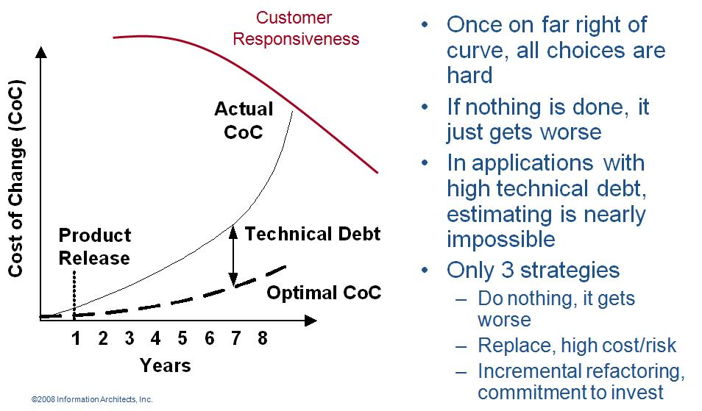
Refactoring
Agile programmer writes simple and bare minimum code they do not complicate the code
Down the line structure the code without changing its behavior. It helps in improving the quality (maintainability, readability) of code

Slide 49
Technical Debt
While writing code agile programmer do not pay attention to structure, duplication etc but to functionality and make sure that code is passing all unit test cases
In this process if they do not clean the code by structuring (refactoring) it will become unreadable and un-maintainable and over a period of time this cause increases response time to fix the problems, adding new feature and deteriorate the quality.
The concept of unclean code is called technical debt. Technical debt keep increasing over the period of time therefore Agile team need to pay this debt back by putting efforts in refactoring.

Slide 50
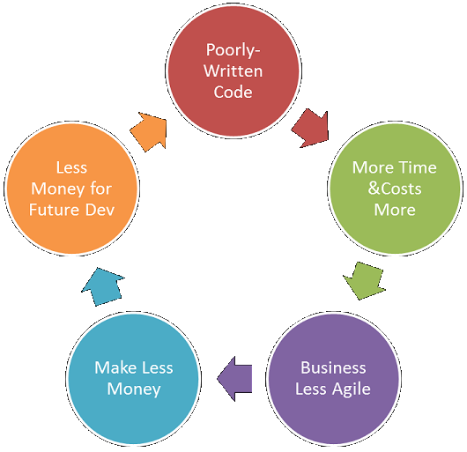
Technical Debt
Vicious Cycle of Technical Debt

Slide 51
Agile Documentation
Strategies for reducing documentation CRUFT
C- How correct is document?
R- Will document be read?
U- Will document be understood?
F- Will document be followed?
T- Will document be trusted?

Slide 52


