Slide 1

Survey Summary
'PMI-ACP', 'PMI', and 'ACP' are a registered marks of the Project Management Institute, Inc.

Slide 2
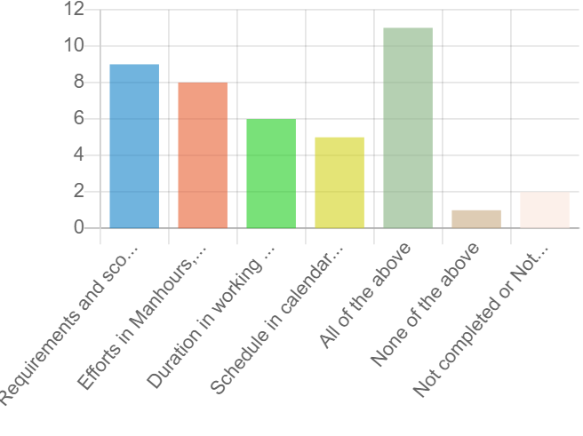
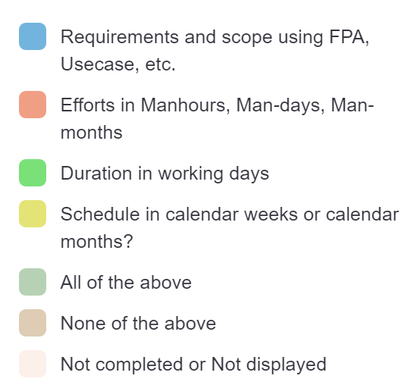
What do you estimate in your project?

Slide 3
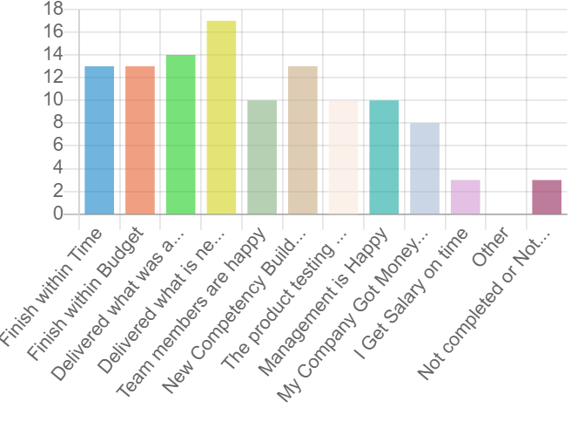
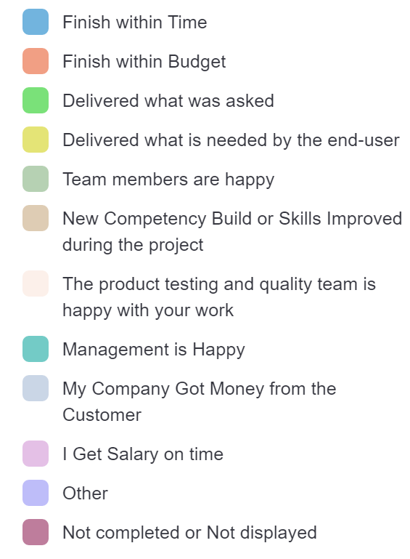
What is the meaning of "a project is a success" for you? (You can select multiple options)

Slide 4
Successful Projects
Total Projects | Successful | %
1 | 0 | 0%
2 | 2 | 100%
2 | 0 | 0%
3 | 3 | 100%
3 | 2 | 67%
4 | 4 | 100%
5 | 4 | 80%
7 | 4 | 57%
10 | 10 | 100%
12 | 10 | 83%
12 | 10 | 83%
15 | 10 | 67%
20 | 15 | 75%
30 | 20 | 67%
100 | 96 | 96%
200 | 20 | 10%

Slide 5
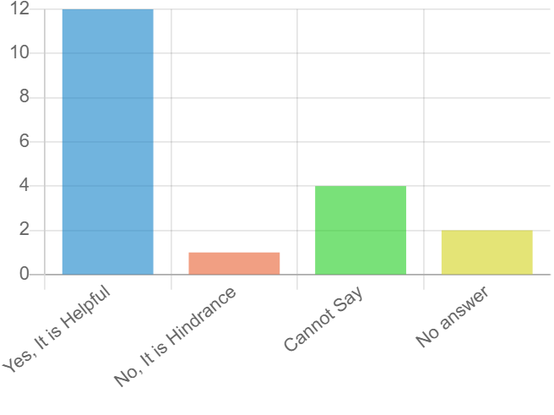
Your organizational processes like CMMI, ISO, ISMS, etc help you in managing your project in a better way or you find it a hindrance to your delivery process?

Slide 6
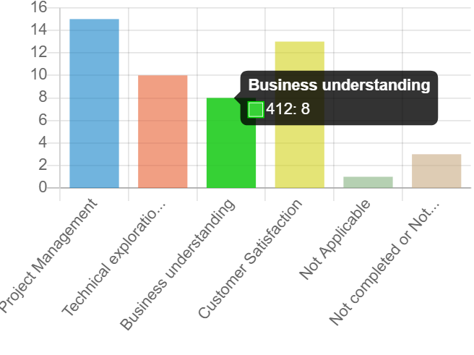
Organizational processes are helpful most in what aspects? (If you answer to question 3 is Yes)

Slide 7
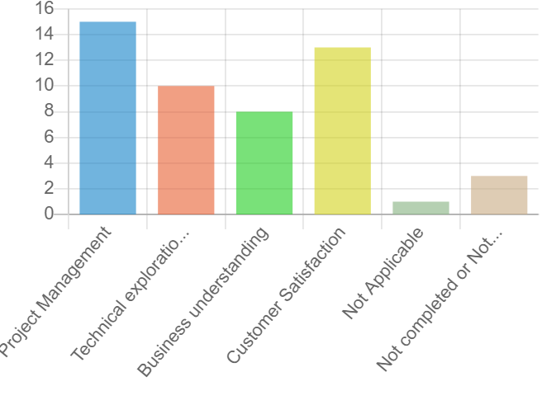
Organizational processes are helpful most in what aspects? (If you answer to question 3 is Yes)

Slide 8
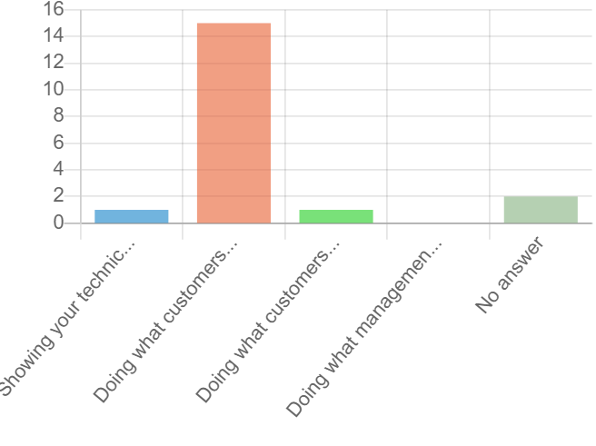
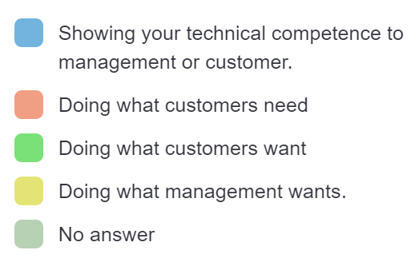
Among the items mentioned below, what is the most important for you?

Slide 9
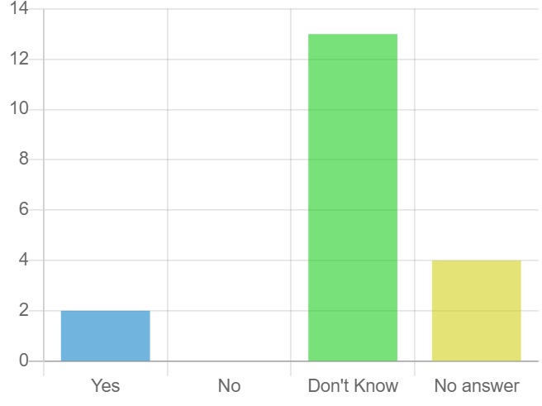
Do you/your organization use Earn Value Management in your project?

Slide 10
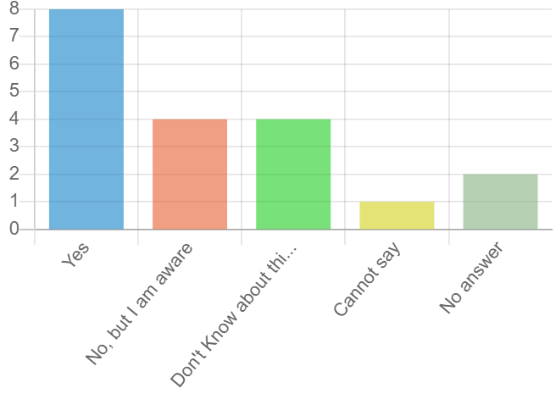
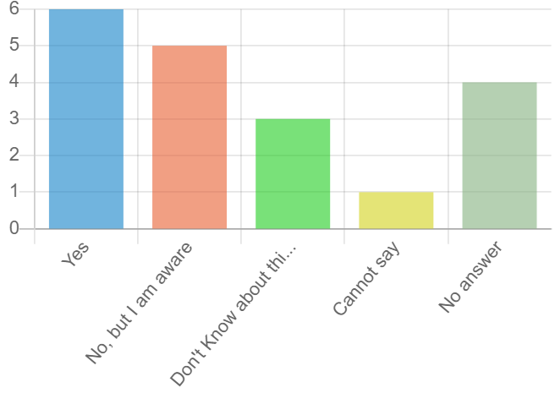
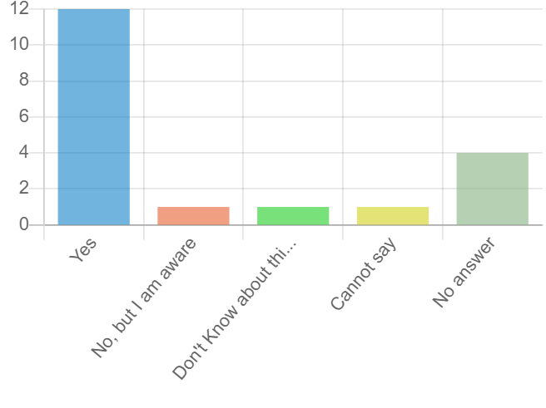
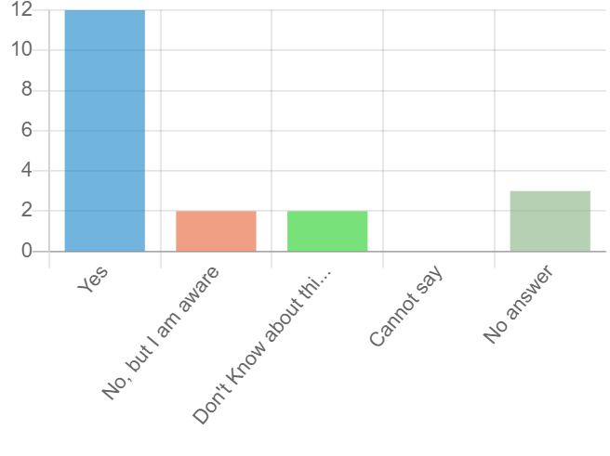
Change Management, Configuration, Built & Deployment, Demo Processes

Slide 11
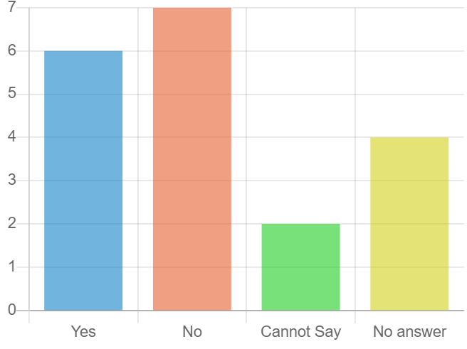
Does your project has a Project Charter?

Slide 12
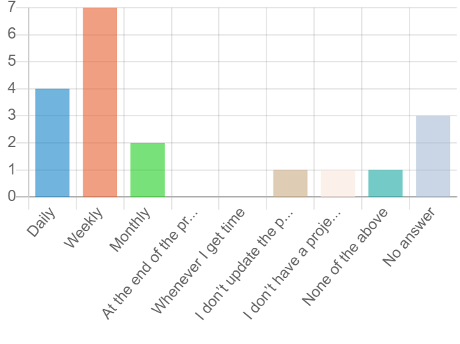
How frequently do you update your project plan?

Slide 13
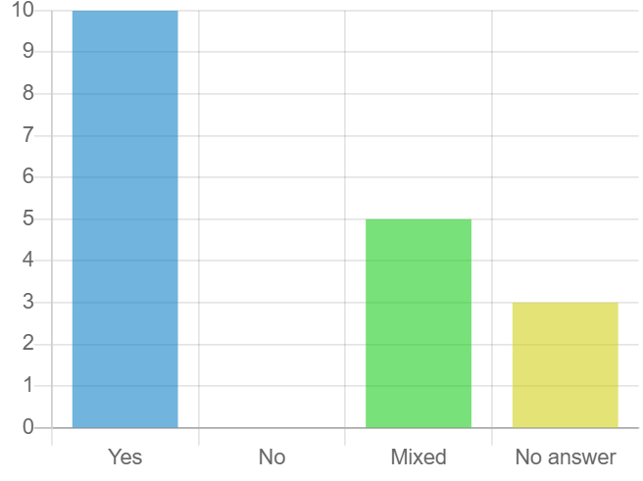
Do you manage your projects using agile methods?

Slide 14
Retrospective Meetings
Client and Onsite Coordinator steers meeting, Team members, Project Manager, Clients, Onsite co-ordinators, 1 hour, We have a checklist to ensure meeting points are met
In my project, it is happening from the client end and they will take care of that meeting. it is happening for nearly 30 minutes to 1 hour. in that our client and onsite team member will participate. They are tracking the meeting points in the Devops.
Project manager, Team members are participiants, based on team size
Team lead,PM, all team members participate duration of meeting depends upon the coverage of the project 1 hour may be multiple sessions. include the points in respective process, template."
Scrum Master, Entire team, 30 minutes to hour, Meeting notes
Not in the current project due to the nature of the project and client's expectations
Not regularly , these are ad hoc and usually done by me. We do a lessons learnt document and ensure we don's repeat the same mistakes again.
Only 5 Answers are Yes.

Slide 15
Product Demo
Product demo by TPM. Demo given to stake holders, demo approx 1 to 2 hours.
Respective team member will do an regular demo activity for an hour or two every week to the Client.
To Stakeholder, Team members on round robin, 30 minutes, Sprint end day"
Representative from team, Client, various stakeholders, 30 minutes to hour, After each sprint"
We are doing demo once in a sprint, onsite coordinator will do the demo to the client. it last long for 1 hour.
Team provides demo, to client, 1 hr, twice in a month (at the end of the sprint)
Team members based on the sprints
Team members in round robin fashion, Demo presented to client, 30mins to 1 hour, Every Sprint - we demo to Client
Only 8 Answers are Yes

Slide 16
If you use agile methods, then what agile Practices you use in your project?
Agile dashboard for work items
Agile Scrum
Backlogs
Boards
Burndown chart
Continuous integration
Daily Scrum
Daily Stand up
Devops - Board, Pipelines
Eliminate what end user not need
Epics/Feature/User Stories
Kick Off
Product Backlog Refinement meetings
Retrospective meeting,
Small release
Sprint Demo
Sprint Planning

Slide 17
What are the top 3 key challenges in your project?
Refer to google sheet

Slide 18
What are the top 3 key challenges in your project?
Adding work items in the middle of the sprint when there is no time for impact analysis.
frequent changes in the requirement and sprint
Lack of clear goals and success criteria
No Requirements document
Not clear user stories. Sometimes clarifications are cleared at the end of sprint. so facing lack of time.
Requirements given by the Client
Scope Definition
Scope management, resources, to get the sign off.
No Project /Task Scope document
Changing Requirements
frequent changes in the requirement and sprint
Applications/Software access issues with Clients.
Code Repository Management
Inadequate skills of team members
Interoperability
Its a Customer handled project so we cannot introduce our process.
Less On Site Technical Resource and Project Management in the initial Phase of Project
No Program Management before I stepped in.
Onsite Stakeholders.
People
Skills, Motivation to team, setting expectation, continious change in requirements. Gap in understanding
Some of processes taking time impacting schedule
Sprint Planning with Client
Team awareness on process and following it
team coordination, work dependency, technical blockers
Technical Skills
UAT Delay from Client
Under-performing Resources
Effort Estimation
Managing efforts and estimate.
Unrealistic deadlines
Wrong Estimation with Over Aggressive timeline
Aggressive Deadline

Slide 19
Based on your experience, why do you think a project fails or gets challenged?
Refer to google sheet

Slide 20
Based on your experience, why do you think a project fails or gets challenged?
Not clear on the requirement or requirement got changed frequently.
Lack of review and unit testing will affect the product quality.
Lack of estimation // Bad Estimation
Bad Quality
Budget & lack of understanding of requirements.
Improper Communication
Planning and Testing
Defining requirement
Defining the scope of work
Sprint planning
Frequent Change in requirements and without a proper project plan and quality resources
Inappropriate planning
Incorrect Scope Understanding
Incorrect Effort Estimation
Ever changing Requirements from Customer (Requirement Analysis is always Open)
Technical Skill Gaps
Resource Churning
Communication Issues
Process not followed
Non-Alignment for any deliverables for each SDLC phase
No Sign-off for each SDLC phase
No Process in place
Technical skills lagging
Not properly planned.
Over Commitment and Scope Under estimation
Poorly defined project scope.
Inadequate risk management.
Risk analysis not followed
Qualification of the project from delivery stand point not done, signoff on scope, clear milestone, success criteria
Unrealistic deadlines and Onsite Stakeholders attitude makes a project fails or gets challenged.

