Slide 1
Business Connectivity Services

Slide 2
Outline
Business Connectivity Services (BCS) Primer
Creating BCS Applications
Creating .NET Assembly Connectors in Visual Studio 2010 support
BCS Security

Slide 3
Business Connectivity Services (BCS) Primer

Slide 4


Microsoft SharePoint 2010 The business collaboration platform for the Enterprise and the Web
Sites
Connect and Empower People
Composites
Communities
Cut Costs with a Unified Infrastructure
Insights
Content
Rapidly Respond to Business Needs
Search
Notes:
Business Connectivity Services lives in the “Composites” section of the blue workloads circle
Composites =
Building robust business applications without any/much involvement from IT (IT Pros/developers)
Easily integrate and consume external data not resident within SharePoint
Also has a developer extensibility point to provide lots of customized options

Slide 5

BCS Architecture
Office Client
SharePoint Server 2010
External Business Parts
SharePoint Site
Custom Code
VSTO
Package
External
List
Office Integration
Search, Workflow, Web Parts
Business Connectivity Services
Secure Store Service (SSS)
Business Connectivity Services
BDC Client Runtime
Cache
External Content Types (ECT)
BDC Server Runtime
SQL
Web Service
Custom
.NET Assembly Connector
External Data
Notes:
Business Connectivity Services is composed of many pieces
Office Client – By connecting to SharePoint, Office clients can consume data from the external systems
SharePoint Server – SharePoint houses the external content types (ECTs) which is the backbone of the entire system
External Data – this is the source of where the data is coming from

Slide 6



External Content Types
Describes the schema and data access capabilities of an external data source and its behavior within Office and SharePoint
*formerly known as BDC Entity
Office Clients (Rich)
BCS
External Content Type
(ECT)
External Data Source
(Web Service, DB, .NET Assembly Connector, external systems, Web 2.0 service, etc.)
SharePoint (Thin)
BCS
BCS-enabled solutions rely on ECTs to integrate external data into SharePoint and the Office client applications
Notes:
Business objects such as customer, product, invoice, etc
Created in SharePoint Designer or Visual Studio 2010
May also be defined in a file and uploaded
Forms the basis of an external list
Cornerstone of enabling BCS

Slide 7
External Content Type Modeling
demo

Slide 8
Creating BCS Applications

Slide 9



Solution Types, Personas and Tools
Power User / No code
RAD Dev
OOB UX on thin and rich clients (Outlook and SharePoint Workspace) based on External Lists
Custom Forms in SharePoint and Groove
Connect to existing back-end integration services or simple databases
Simple BDC Runtime Object Models (few ECTs, simple associations)
Transparent packaging (managed by BCS)
Advanced
Advanced Dev Custom Code
Custom UX and data integration on thin and rich clients (apps that support VSTO add-ins)
Through Office, SharePoint and BCS Object Models
Custom back-end connectivity through .NET Assembly Connectors
Complex BDC Runtime Object Models (many ECTs, complex associations)
Explicit packaging (managed by dev)
Simple
SharePoint Designer
Notes:
This slide is designed to present the spectrum of possible solutions
“Simple” Solutions are the ones you create using SPD and the browser.
“Advanced” Solutions use Visual Studio. This can be from scratch or exporting from SPD and importing to VS
Once you have External Content Types, you can use them in many ways
External list
Read/write to external data defined by External Content Type
Views based on the “Finder” methods
Pre and post query filters
Actions appear on ECB
BDC Web Parts
BDC Columns
Supplementing User Profiles
SPD support is for the designer. VS for the developer..
Lecture 9: BCS - 9

Slide 10
Solution Scenarios
Client
Microsoft Word
Microsoft Outlook
VSTO 4 Solutions
SharePoint Workspace
Declarative Solutions
Basic
Advanced
SharePoint Designer
.NET Assembly Connector
Server
Notes:
This slide shows the different levels of solutions that you can build, as well as the different places they can reside (client/server)… including what options & tools are available for each solution.

Slide 11




Development Approaches
SharePoint Server
(Prod / Dev)
SharePoint Designer
IT Admin
“Live” connection
WSP/ ClickOnce Package
Import & Configure
WSP/BDC
SI/IT Devs
Produce WSP/ClickOnce
Package w/BDC Model
No code, discover and configure existing back-end integration end-points
Connect to (existing) WCF, ADO.NET and .NET Objects
Simultaneously author thin and rich client UX for External List and InfoPath Forms
Create custom back-end integration logic using .NET Assemblies
Author thin and rich client UX (independently) as SharePoint and VSTO customization projects
Pro Dev
Notes:
Build 1
Everything begins with a SharePoint Site. The “OBA Designer” feature must be enable for anything except simple External List. The OBA Designer feature (which will be renamed to fit with BCS) provide 8 Document Libraries that house all of the artifacts necessary for the solutions.
Build 2
The “Solution Designer” uses the SharePoint Designer to create some External Content Types against an the CRM system so that contact information can be surfaced in MS Outlook. The work involves creating some forms for Outlook and some actions that can be taken against the External Content Types.
Layouts: XML files that define form pages similar to web part pages in the client
Actions: Ribbon component definitions for Office clients
Contexts: Defines relationships and states
Build 3
The Client Extensions are what allows for the deployment of the External Content Types, Forms, Actions, and Outlook Add-In to the client. Client extensions are essentially a .VSTO package file.
Build 4
The Solution Designer uses SPD to Publish the solution to a SharePoint Site. Today the publishing process is a PowerShell script that creates the .VSTO file. This will go away in the future. There will also be APIs that expose the publishing process.
Build 5
The Process wraps up everything that the client will need to use the solution. Manifest and add-in are standard VSTO components. Office Integration Runtime (OIR) files are specific to BCS and used by the client-side BCS components.
Build 6
These are components that are common to all BCS solutions
OBA Client Application Manifest: Solution Manifest
Entity Model: External Content Types
Subscriptions: Define data to cache on the client
Pre/Post Deployment: Actions to take pre/post deployment (e.g., create a set of InfoPath forms for the client views)
Build 7
The “Solution Developer” wants to add a solution to the site based on data from the ERP system that should surface in Excel. He uses Visual Studio to create External Content Types and an Excel Add-In.
Build 8
The Solution Developer publishes the solution to the Client Extensions. The client will get both solutions with no additional effort.
He runs the Publishing script and his custom add-in is added to the .VSTO package.
Build 9
Now the Solution Designer wants to add the capability to use the CRM data in MS Word for creating invoices. He updates his solution and deploys it.
Build 10
User goes to site and can download the package through ClickOnce (a link to the .VSTO file) or it can be deployed directly to the client machine by Operations.

Slide 12
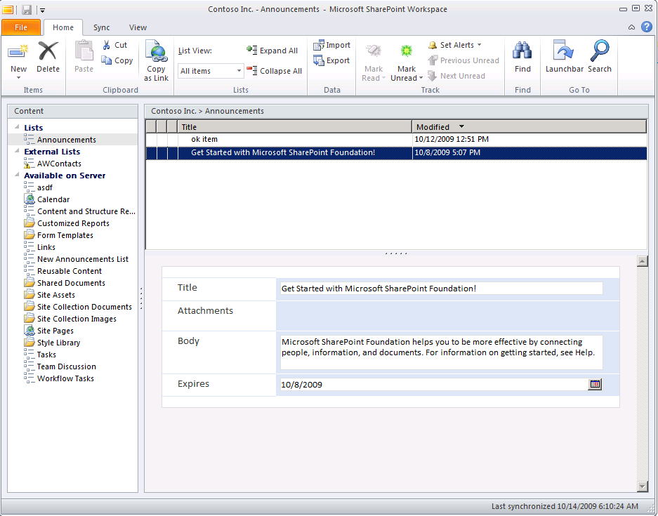

SharePoint Workspace The next generation of the product formerly known as Groove
Offline capable
InfoPath forms UI (customizable)
Respects SharePoint view settings (filter/sort/group)
Error/conflict resolution
Search across external data
Notes:
This slide introduces the SharePoint Workspace as the primary client for SharePoint.
Lecture 9: BCS - 12

Slide 13
Creating .NET Connector Assemblies in Visual Studio 2010

Slide 14
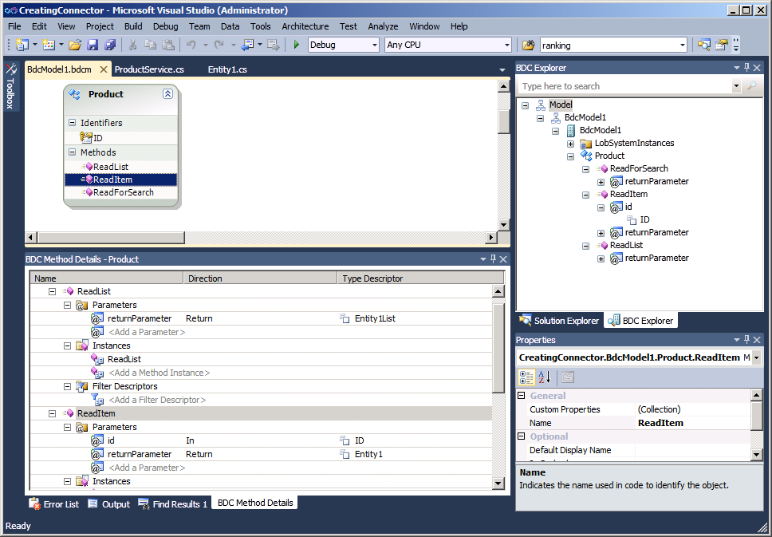
Visual Studio 2010 Support
The tool for creating .NET Assembly Connectors
Notes:
Visual Studio 2010 BDC Designer allows you to develop, debug and deploy Business Data Connectivity Models using the External System type “.NET Assembly Connector”. This type is used for:
Aggregation scenarios (across back-ends, across multiple calls to same backend, read from one back-end write to another)
Custom/Complex Data Transformations,
Custom Security (e.g. where SSO falls short)
Custom Business Logic/Rules needed outside the back-end (don’t have good example of this)
In addition Visual Studio 2010 BDC designer allows to import models created by SPD customize them, package them and deploy them through the Visual Studio

Slide 15
Creating a .NET Assembly Connector
demo

Slide 16
BCS Security Overview
Popular Auth types | WCF Connector | DB Connector | .NET Host Connector
SQL Auth | N/A | Yes | Code-Based
UserName & Password | Yes | Yes | Code Based
NTLM Pass through | Yes | Yes | Yes
Claims Token | Yes | No | Code Based
Oauth / LiveID | Code Based | No | Code Based
Notes:
This slide talks about the different security options available within BCS solutions

Slide 17











BDC Authentication (server)
SharePoint Server
Process Account
Modes:
PassThrough
(Uses logged-on user)
RevertToSelf
(Uses process account)
SSO Authentication
(Credentials, etc. from
Secure Store)
Application
Credentials Ticket
Delegation Token
Other
WebPart
Logged-on
user
VL
BDC Server
Runtime
Secure Store
Service
SAML
Token
Application
Delegated
Token
Credentials
Claims Aware
Service
Web 2.0
External System
Notes:
This slide explains the authentication story for BCS

Slide 18
Summary
Business Connectivity Services (BCS) Primer
Creating BCS Applications
Creating .NET Assembly Connectors in Visual Studio 2010 support
BCS Security

