Slide 1

Effectively and Securely Using the Cloud Computing Paradigm
Peter Mell, Tim Grance
NIST, Information Technology Laboratory
10-7-2009
Notes:
Cloud Computing Quotes from Vivek Kundra (Federal CIO):
"The cloud will do for government what the Internet did in the '90s," he said. "We're interested in consumer technology for the enterprise," Kundra added. "It's a fundamental change to the way our government operates by moving to the cloud. Rather than owning the infrastructure, we can save millions."
http://www.nextgov.com/nextgov/ng_20081126_1117.php
“I believe it's the future," he says. "It's moving technology leaders away from just owning assets, deploying assets and maintaining assets to fundamentally changing the way services are delivered.“
http://www.cio.de/news/cio_worldnews/867008
"It's definitely not hype," says Vivek Kundra, CTO for the District of Columbia government, which plans to blend IT services provided from its own data center with external cloud platforms like Google Apps. "Any technology leader who thinks it's hype is coming at it from the same place where technology leaders said the Internet is hype.“
http://www.cio.de/news/cio_worldnews/867008/

Slide 2
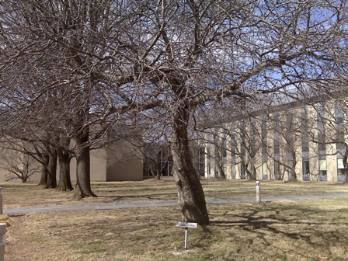
NIST Cloud Research Team
Peter Mell
Project Lead
Tim Grance
Program Manager
Lee Badger
Contact information is available from:
http://www.nist.gov/public_affairs/contact.htm
Notes:
The NIST tree pictured is a direct decendant of the tree that dropped an apple on Sir Isaac Newton in 1665 (see http://www.gazette.net/gazette_archive/1997/199714/gaithersburg/news/a55925-1.html).

Slide 3
NIST Cloud Computing Resources
NIST Draft Definition of Cloud Computing
Presentation on Effective and Secure Use of Cloud Computing
http://csrc.nist.gov/groups/SNS/cloud-computing/index.html

Slide 4
Caveats and Disclaimers
This presentation provides education on cloud technology and its benefits to set up a discussion of cloud security
It is NOT intended to provide official NIST guidance and NIST does not make policy
Any mention of a vendor or product is NOT an endorsement or recommendation
Citation Note: All sources for the material in this presentation are included within
the Powerpoint “notes” field on each slide

Slide 5

Agenda
Part 1: Effective and Secure Use
Understanding Cloud Computing
Cloud Computing Security
Secure Cloud Migration Paths
Cloud Publications
Cloud Computing and Standards
Part 2: Cloud Resources, Case Studies, and Security Models
Thoughts on Cloud Computing
Foundational Elements of Cloud Computing
Cloud Computing Case Studies and Security Models

Slide 6

Part I: Effective and Secure Use

Slide 7

Understanding Cloud Computing

Slide 8
Origin of the term “Cloud Computing”
“Comes from the early days of the Internet where we drew the network as a cloud… we didn’t care where the messages went… the cloud hid it from us” – Kevin Marks, Google
First cloud around networking (TCP/IP abstraction)
Second cloud around documents (WWW data abstraction)
The emerging cloud abstracts infrastructure complexities of servers, applications, data, and heterogeneous platforms
(“muck” as Amazon’s CEO Jeff Bezos calls it)
Notes:
Jeff Bezos’ quote: http://news.cnet.com/8301-13953_3-9977100-80.html?tag=mncol
Kevin Marks quote: http://news.cnet.com/8301-13953_3-9938949-80.html?tag=mncol video interview

Slide 9
A Working Definition of Cloud Computing
Cloud computing is a model for enabling convenient, on-demand network access to a shared pool of configurable computing resources (e.g., networks, servers, storage, applications, and services) that can be rapidly provisioned and released with minimal management effort or service provider interaction.
This cloud model promotes availability and is composed of five essential characteristics, three service models, and four deployment models.
Notes:
Note 1: Cloud computing is still an evolving paradigm. Its definitions, use cases, underlying technologies, issues, risks, and benefits will be refined in a spirited debate by the public and private sectors. These definitions, attributes, and characteristics will evolve and change over time.
Note 2: The cloud computing industry represents a large ecosystem of many models, vendors, and market niches. This definition attempts to encompass all of the various cloud approaches.

Slide 10
5 Essential Cloud Characteristics
On-demand self-service
Broad network access
Resource pooling
Location independence
Rapid elasticity
Measured service

Slide 11
3 Cloud Service Models
Cloud Software as a Service (SaaS)
Use provider’s applications over a network
Cloud Platform as a Service (PaaS)
Deploy customer-created applications to a cloud
Cloud Infrastructure as a Service (IaaS)
Rent processing, storage, network capacity, and other fundamental computing resources
To be considered “cloud” they must be deployed on top of cloud infrastructure that has the key characteristics
Notes:
Cloud Software as a Service (SaaS). The capability provided to the consumer is to use the provider’s applications running on a cloud infrastructure and accessible from various client devices through a thin client interface such as a Web browser (e.g., web-based email). The consumer does not manage or control the underlying cloud infrastructure, network, servers, operating systems, storage, or even individual application capabilities, with the possible exception of limited user-specific application configuration settings.
Cloud Platform as a Service (PaaS). The capability provided to the consumer is to deploy onto the cloud infrastructure consumer-created applications using programming languages and tools supported by the provider (e.g., java, python, .Net). The consumer does not manage or control the underlying cloud infrastructure, network, servers, operating systems, or storage, but the consumer has control over the deployed applications and possibly application hosting environment configurations.
Cloud Infrastructure as a Service (IaaS). The capability provided to the consumer is to provision processing, storage, networks, and other fundamental computing resources where the consumer is able to deploy and run arbitrary software, which can include operating systems and applications. The consumer does not manage or control the underlying cloud infrastructure but has control over operating systems, storage, deployed applications, and possibly select networking components (e.g., firewalls, load balancers).

Slide 12
Service Model Architectures

Slide 13
4 Cloud Deployment Models
Private cloud
enterprise owned or leased
Community cloud
shared infrastructure for specific community
Public cloud
Sold to the public, mega-scale infrastructure
Hybrid cloud
composition of two or more clouds
Notes:
Private cloud. The cloud infrastructure is operated solely for an organization. It may be managed by the organization or a third party and may exist on premise or off premise.
Community cloud. The cloud infrastructure is shared by several organizations and supports a specific community that has shared concerns (e.g., mission, security requirements, policy, and compliance considerations). It may be managed by the organizations or a third party and may exist on premise or off premise.
Public cloud. The cloud infrastructure is made available to the general public or a large industry group and is owned by an organization selling cloud services.
Hybrid cloud. The cloud infrastructure is a composition of two or more clouds (private, community, or public) that remain unique entities but are bound together by standardized or proprietary technology that enables data and application portability (e.g., cloud bursting).

Slide 14
Common Cloud Characteristics
Cloud computing often leverages:
Massive scale
Homogeneity
Virtualization
Resilient computing
Low cost software
Geographic distribution
Service orientation
Advanced security technologies

Slide 15
The NIST Cloud Definition Framework
Hybrid Clouds
Deployment
Models
Private Cloud
Community
Cloud
Public Cloud
Service
Models
Software as a Service (SaaS)
Platform as a Service (PaaS)
Infrastructure as a Service (IaaS)
On Demand Self-Service
Essential
Characteristics
Broad Network Access
Rapid Elasticity
Resource Pooling
Measured Service
Massive Scale
Resilient Computing
Common
Characteristics
Homogeneity
Geographic Distribution
Virtualization
Service Orientation
Low Cost Software
Advanced Security
Notes:
Cloud diagram idea inspired by Maria Spinola 8-31-09

Slide 16

Cloud Computing Security

Slide 17
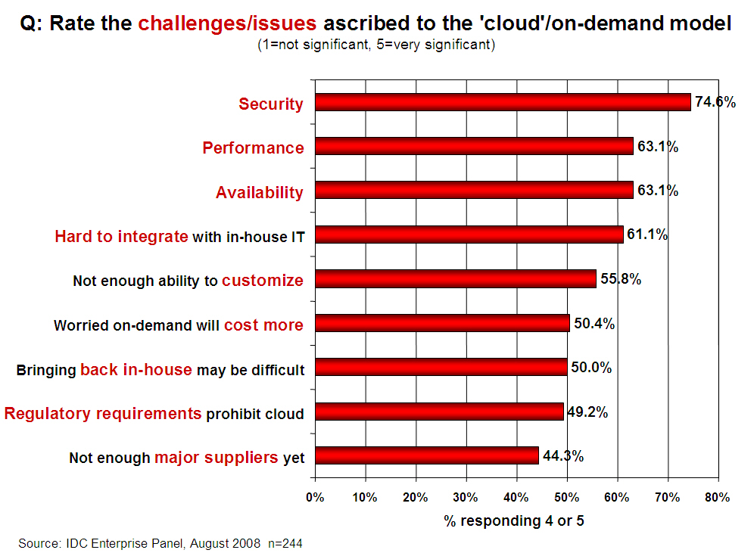
Security is the Major Issue

Slide 18
Analyzing Cloud Security
Some key issues:
trust, multi-tenancy, encryption, compliance
Clouds are massively complex systems can be reduced to simple primitives that are replicated thousands of times and common functional units
Cloud security is a tractable problem
There are both advantages and challenges
Former Intel CEO, Andy Grove: “only the paranoid survive”

Slide 19

General Security Advantages
Shifting public data to a external cloud reduces the exposure of the internal sensitive data
Cloud homogeneity makes security auditing/testing simpler
Clouds enable automated security management
Redundancy / Disaster Recovery

Slide 20

General Security Challenges
Trusting vendor’s security model
Customer inability to respond to audit findings
Obtaining support for investigations
Indirect administrator accountability
Proprietary implementations can’t be examined
Loss of physical control

Slide 21
Security Relevant Cloud Components
Cloud Provisioning Services
Cloud Data Storage Services
Cloud Processing Infrastructure
Cloud Support Services
Cloud Network and Perimeter Security
Elastic Elements: Storage, Processing, and Virtual Networks

Slide 22
Provisioning Service
Advantages
Rapid reconstitution of services
Enables availability
Provision in multiple data centers / multiple instances
Advanced honey net capabilities
Challenges
Impact of compromising the provisioning service

Slide 23
Data Storage Services
Advantages
Data fragmentation and dispersal
Automated replication
Provision of data zones (e.g., by country)
Encryption at rest and in transit
Automated data retention
Challenges
Isolation management / data multi-tenancy
Storage controller
Single point of failure / compromise?
Exposure of data to foreign governments

Slide 24
Cloud Processing Infrastructure
Advantages
Ability to secure masters and push out secure images
Challenges
Application multi-tenancy
Reliance on hypervisors
Process isolation / Application sandboxes

Slide 25
Cloud Support Services
Advantages
On demand security controls (e.g., authentication, logging, firewalls…)
Challenges
Additional risk when integrated with customer applications
Needs certification and accreditation as a separate application
Code updates

Slide 26
Cloud Network and Perimeter Security
Advantages
Distributed denial of service protection
VLAN capabilities
Perimeter security (IDS, firewall, authentication)
Challenges
Virtual zoning with application mobility

Slide 27
Cloud Security Advantages Part 1
Data Fragmentation and Dispersal
Dedicated Security Team
Greater Investment in Security Infrastructure
Fault Tolerance and Reliability
Greater Resiliency
Hypervisor Protection Against Network Attacks
Possible Reduction of C&A Activities (Access to Pre-Accredited Clouds)

Slide 28
Cloud Security Advantages Part 2
Simplification of Compliance Analysis
Data Held by Unbiased Party (cloud vendor assertion)
Low-Cost Disaster Recovery and Data Storage Solutions
On-Demand Security Controls
Real-Time Detection of System Tampering
Rapid Re-Constitution of Services
Advanced Honeynet Capabilities

Slide 29
Cloud Security Challenges Part 1
Data dispersal and international privacy laws
EU Data Protection Directive and U.S. Safe Harbor program
Exposure of data to foreign government and data subpoenas
Data retention issues
Need for isolation management
Multi-tenancy
Logging challenges
Data ownership issues
Quality of service guarantees

Slide 30
Cloud Security Challenges Part 2
Dependence on secure hypervisors
Attraction to hackers (high value target)
Security of virtual OSs in the cloud
Possibility for massive outages
Encryption needs for cloud computing
Encrypting access to the cloud resource control interface
Encrypting administrative access to OS instances
Encrypting access to applications
Encrypting application data at rest
Public cloud vs internal cloud security
Lack of public SaaS version control

Slide 31
Additional Issues
Issues with moving PII and sensitive data to the cloud
Privacy impact assessments
Using SLAs to obtain cloud security
Suggested requirements for cloud SLAs
Issues with cloud forensics
Contingency planning and disaster recovery for cloud implementations
Handling compliance
FISMA
HIPAA
SOX
PCI
SAS 70 Audits

Slide 32

Secure Migration Paths for Cloud Computing

Slide 33
The ‘Why’ and ‘How’ of Cloud Migration
There are many benefits that explain why to migrate to clouds
Cost savings, power savings, green savings, increased agility in software deployment
Cloud security issues may drive and define how we adopt and deploy cloud computing solutions

Slide 34
Balancing Threat Exposure and Cost Effectiveness
Private clouds may have less threat exposure than community clouds which have less threat exposure than public clouds.
Massive public clouds may be more cost effective than large community clouds which may be more cost effective than small private clouds.
Doesn’t strong security controls mean that I can adopt the most cost effective approach?

Slide 35
Cloud Migration and Cloud Security Architectures
Clouds typically have a single security architecture but have many customers with different demands
Clouds should attempt to provide configurable security mechanisms
Organizations have more control over the security architecture of private clouds followed by community and then public
This doesn’t say anything about actual security
Higher sensitivity data is likely to be processed on clouds where organizations have control over the security model

Slide 36
Putting it Together
Most clouds will require very strong security controls
All models of cloud may be used for differing tradeoffs between threat exposure and efficiency
There is no one “cloud”. There are many models and architectures.
How does one choose?

Slide 37
Migration Paths for Cloud Adoption
Use public clouds
Develop private clouds
Build a private cloud
Procure an outsourced private cloud
Migrate data centers to be private clouds (fully virtualized)
Build or procure community clouds
Organization wide SaaS
PaaS and IaaS
Disaster recovery for private clouds
Use hybrid-cloud technology
Workload portability between clouds

Slide 38
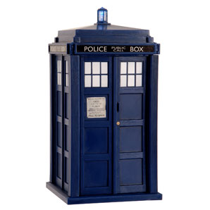
Possible Effects of Cloud Computing
Small enterprises use public SaaS and public clouds and minimize growth of data centers
Large enterprise data centers may evolve to act as private clouds
Large enterprises may use hybrid cloud infrastructure software to leverage both internal and public clouds
Public clouds may adopt standards in order to run workloads from competing hybrid cloud infrastructures

Slide 39
Cloud Computing and Standards

Slide 40
Cloud Standards Mission
Provide guidance to industry and government for the creation and management of relevant cloud computing standards allowing all parties to gain the maximum value from cloud computing

Slide 41

NIST and Standards
NIST wants to promote cloud standards:
We want to propose roadmaps for needed standards
We want to act as catalysts to help industry formulate their own standards
Opportunities for service, software, and hardware providers
We want to promote government and industry adoption of cloud standards
41

Slide 42
Goal of NIST Cloud Standards Effort
Fungible clouds
(mutual substitution of services)
Data and customer application portability
Common interfaces, semantics, programming models
Federated security services
Vendors compete on effective implementations
Enable and foster value add on services
Advanced technology
Vendors compete on innovative capabilities

Slide 43

A Model for Standardization and Proprietary Implementation
Advanced features
Core features
Proprietary Value
Add Functionality
Standardized Core
Cloud Capabilities

Slide 44

Proposed Result
Cloud customers knowingly choose the correct mix for their organization of
standard portable features
proprietary advanced capabilities

Slide 45

A proposal: A NIST Cloud Standards Roadmap
We need to define minimal standards
Enable secure cloud integration, application portability, and data portability
Avoid over specification that will inhibit innovation
Separately addresses different cloud models
45
Notes:
Credit: “Go Dog Go” is a children’s book by P.D. Eastman

Slide 46
Towards the Creation of a Roadmap (I)
Thoughts on standards:
Usually more service lock-in as you move up the SPI stack (IaaS->PaaS->SaaS)
IaaS is a natural transition point from traditional enterprise datacenters
Base service is typically computation, storage, and networking
The virtual machine is the best focal point for fungibility
Security and data privacy concerns are the two critical barriers to adopting cloud computing

Slide 47
Towards the Creation of a Roadmap (II)
Result:
Focus on an overall IaaS standards roadmap as a first major deliverable
Research PaaS and SaaS roadmaps as we move forward
Provide visibility, encourage collaboration in addressing these standards as soon as possible
Identify common needs for security and data privacy standards across IaaS, PaaS, SaaS

Slide 48
A Roadmap for IaaS
Needed standards
VM image distribution (e.g., DMTF OVF)
VM provisioning and control (e.g., EC2 API)
Inter-cloud VM exchange (e.g., ??)
Persistent storage (e.g., Azure Storage, S3, EBS, GFS, Atmos)
VM SLAs (e.g., ??) – machine readable
uptime, resource guarantees, storage redundancy
Secure VM configuration (e.g., SCAP)

Slide 49
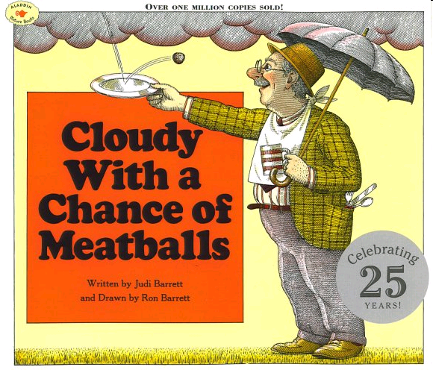
A Roadmap for PaaS and SaaS
More difficult due to proprietary nature
A future focus for NIST
Standards for PaaS could specify
Supported programming languages
APIs for cloud services
Standards for SaaS could specify
SaaS-specific authentication / authorization
Formats for data import and export (e.g., XML schemas)
Separate standards may be needed for each application space

Slide 50
Security and Data Privacy Across IaaS, PaaS, SaaS
Many existing standards
Identity and Access Management (IAM)
IdM federation (SAML, WS-Federation, Liberty ID-FF)
Strong authentication standards (HOTP, OCRA, TOTP)
Entitlement management (XACML)
Data Encryption (at-rest, in-flight), Key Management
PKI, PKCS, KEYPROV (CT-KIP, DSKPP), EKMI
Records and Information Management (ISO 15489)
E-discovery (EDRM)
Notes:
EDRM: Electronics Discovery Reference Model (http://www.edrm.net)
ISP 15489: http://www.iso.org/iso/catalogue_detail?csnumber=31908

Slide 51

Cloud Computing Publications

Slide 52

Planned NIST Cloud Computing Publication
NIST is planning a series of publications on cloud computing
NIST Special Publication to be created in FY09
What problems does cloud computing solve?
What are the technical characteristics of cloud computing?
How can we best leverage cloud computing and obtain security?

Slide 53

Part II: Cloud Resources, Case Studies, and Security Models

Slide 54
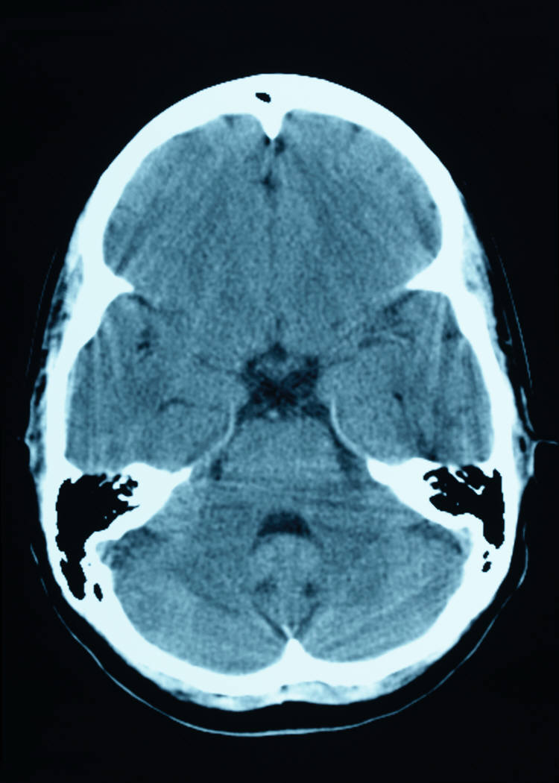
Thoughts on Cloud Computing

Slide 55
Thoughts on Cloud Computing
Galen Gruman, InfoWorld Executive Editor, and Eric Knorr, InfoWorld Editor in Chief
“A way to increase capacity or add capabilities on the fly without investing in new infrastructure, training new personnel, or licensing new software.”
“The idea of loosely coupled services running on an agile, scalable infrastructure should eventually make every enterprise a node in the cloud.”
Notes:
Source: InfoWorld Quote, http://www.infoworld.com/article/08/04/07/15FE-cloud-computing-reality_2.html

Slide 56
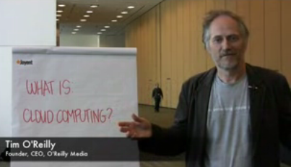
Thoughts on Cloud Computing
Tim O’Reilly, CEO O’Reilly Media
“I think it is one of the foundations of the next generation of computing”
“The network of networks is the platform for all computing”
“Everything we think of as a computer today is really just a device that connects to the big computer that we are all collectively building”
Notes:
Source: CNET video interview 5/7/08 http://news.cnet.com/8301-13953_3-9938949-80.html?tag=mncol

Slide 57
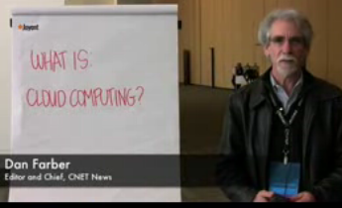
Thoughts on Cloud Computing
Dan Farber, Editor in Chief CNET News
“We are at the beginning of the age of planetary computing. Billions of people will be wirelessly interconnected, and the only way to achieve that kind of massive scale usage is by massive scale, brutally efficient cloud-based infrastructure.”
Notes:
CNET Article written by Dan Farber 6/26/08
http://news.cnet.com/8301-13953_3-9978153-80.html?tag=mncol

Slide 58
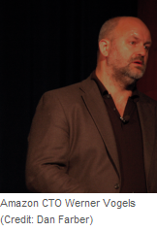
Core objectives of Cloud Computing
Amazon CTO Werner Vogels
Core objectives and principles that cloud computing must meet to be successful:
Security
Scalability
Availability
Performance
Cost-effective
Acquire resources on demand
Release resources when no longer needed
Pay for what you use
Leverage others’ core competencies
Turn fixed cost into variable cost
Notes:
Source: http://news.cnet.com/8301-13953_3-9977100-80.html?tag=mncol

Slide 59

A “sunny” vision of the future
Sun Microsystems CTO Greg Papadopoulos
Users will “trust” service providers with their data like they trust banks with their money
“Hosting providers [will] bring ‘brutal efficiency’ for utilization, power, security, service levels, and idea-to-deploy time” –CNET article
Becoming cost ineffective to build data centers
Organizations will rent computing resources
Envisions grid of 6 cloud infrastructure providers linked to 100 regional providers
Notes:
Data source: CNET article 6/25/08 http://news.cnet.com/8301-13953_3-9977517-80.html?tag=mncol

Slide 60
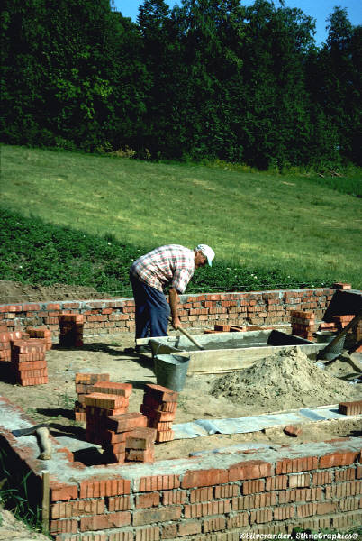
Foundational Elements of Cloud Computing

Slide 61
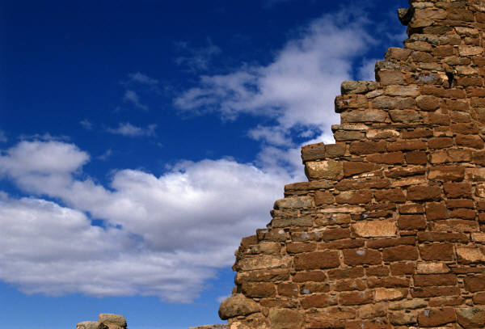
Foundational Elements of Cloud Computing
Primary Technologies
Other Technologies
Virtualization
Grid technology
Service Oriented Architectures
Distributed Computing
Broadband Networks
Browser as a platform
Free and Open Source Software
Autonomic Systems
Web 2.0
Web application frameworks
Service Level Agreements

Slide 62
Web 2.0
Consumer Software Revolution
Is not a standard but an evolution in using the WWW
“Don’t fight the Internet” – CEO Google, Eric Schmidt
Web 2.0 is the trend of using the full potential of the web
Viewing the Internet as a computing platform
Running interactive applications through a web browser
Leveraging interconnectivity and mobility of devices
The “long tail” (profits in selling specialized small market goods)
Enhanced effectiveness with greater human participation
Tim O'Reilly: “Web 2.0 is the business revolution in the computer industry caused by the move to the Internet as a platform, and an attempt to understand the rules for success on that new platform.”
Notes:
Source: Long tail, The Long Tail" by Chris Anderson, Wired, Oct. 2004
Source: O’Reilly quote, http://radar.oreilly.com/archives/2006/12/web-20-compact.html

Slide 63
Software as a Service (SaaS)
Enterprise Software Revolution
SaaS is hosting applications on the Internet as a service (both consumer and enterprise)
Jon Williams, CTO of Kaplan Test Prep on SaaS
“I love the fact that I don't need to deal with servers, staging, version maintenance, security, performance”
Eric Knorr with Computerworld says that “[there is an] increasing desperation on the part of IT to minimize application deployment and maintenance hassles”
Notes:
Source: Williams and computerworld quotes, Software as a service: The next big thing, Eric Knorr 23/03/06, http://www.computerworld.com.au/index.php/id;889026646;fp;4;fpid;1398720840
63

Slide 64
Three Features of Mature SaaS Applications
Scalable
Handle growing amounts of work in a graceful manner
Multi-tenancy
One application instance may be serving hundreds of companies
Opposite of multi-instance where each customer is provisioned their own server running one instance
Metadata driven configurability
Instead of customizing the application for a customer (requiring code changes), one allows the user to configure the application through metadata
64
Notes:
Source: Scalable definition, André B. Bondi, 'Characteristics of scalability and their impact on performance', Proceedings of the 2nd international workshop on Software and performance, Ottawa, Ontario, Canada, 2000, ISBN 1-58113-195-X, pages 195 - 203
Source: Three attributes for SaaS, Architecture Strategies for Catching the Long Tail, Frederick Chong and Gianpaolo Carraro Microsoft Corporation April 2006, http://msdn.microsoft.com/en-us/library/aa479069.aspx
64

Slide 65
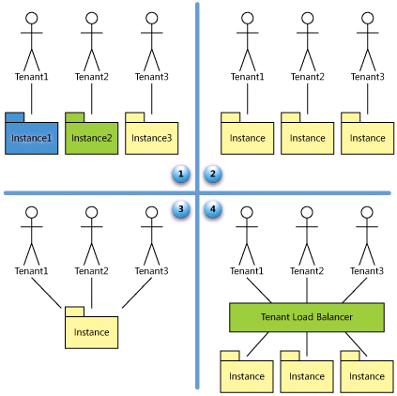
SaaS Maturity Levels
Level 1: Ad-Hoc/Custom
Level 2: Configurable
Level 3: Configurable, Multi-Tenant-Efficient
Level 4: Scalable, Configurable, Multi-Tenant-Efficient
65
Source: Microsoft MSDN Architecture Center
Notes:
Source: Architecture Strategies for Catching the Long Tail, Frederick Chong and Gianpaolo Carraro Microsoft Corporation April 2006, http://msdn.microsoft.com/en-us/library/aa479069.aspx
65

Slide 66
Utility Computing
“Computing may someday be organized as a public utility” - John McCarthy, MIT Centennial in 1961
Huge computational and storage capabilities available from utilities
Metered billing (pay for what you use)
Simple to use interface to access the capability (e.g., plugging into an outlet)

Slide 67
Service Level Agreements (SLAs)
Contract between customers and service providers of the level of service to be provided
Contains performance metrics (e.g., uptime, throughput, response time)
Problem management details
Documented security capabilities
Contains penalties for non-performance
Notes:
Source SLA Zone: http://www.sla-zone.co.uk/
Wikipedia definition of SLA: http://en.wikipedia.org/wiki/Service_level_agreement

Slide 68
Autonomic System Computing
Complex computing systems that manage themselves
Decreased need for human administrators to perform lower level tasks
Autonomic properties: Purposeful, Automatic, Adaptive, Aware
IBM’s 4 properties: self-healing, self-configuration, self-optimization, and self-protection
IT labor costs are 18 times that of equipment costs.
The number of computers is growing at 38% each year.
Notes:
Source: 38% statistic, Xiaolong Jin and Jiming Liu, "From Individual Based Modeling to Autonomy Oriented Computation", in Matthias Nickles, Michael Rovatsos, and Gerhard Weiss (editors), Agents and Computational Autonomy: Potential, Risks, and Solutions, pages 151–169, Lecture Notes in Computer Science, vol. 2969, Springer, Berlin, 2004. ISBN 978-3-540-22477-8.
Source: 18:1 statistics, Trends in technology’, survey, Berkeley University of California, USA, March 2002
Source: IBM 4 properties, http://www-01.ibm.com/software/tivoli/autonomic/
Source: Autonomic properties, Wikipedia entry on autonomic system computing (providing an alternate vision to IBM’s)

Slide 69
Grid Computing
Distributed parallel processing across a network
Key concept: “the ability to negotiate resource-sharing arrangements”
Characteristics of grid computing
Coordinates independent resources
Uses open standards and interfaces
Quality of service
Allows for heterogeneity of computers
Distribution across large geographical boundaries
Loose coupling of computers
Notes:
Source: “What is the Grid? A Three Point Checklist”, Ian Foster, http://www-fp.mcs.anl.gov/~foster/Articles/WhatIsTheGrid.pdf
Source: Wikipedia, http://en.wikipedia.org/wiki/Grid_computing

Slide 70
Platform Virtualization
“[Cloud computing] relies on separating your applications from the underlying infrastructure” - Steve Herrod, CTO at VMware
Host operating system provides an abstraction layer for running virtual guest OSs
Key is the “hypervisor” or “virtual machine monitor”
Enables guest OSs to run in isolation of other OSs
Run multiple types of OSs
Increases utilization of physical servers
Enables portability of virtual servers between physical servers
Increases security of physical host server

Slide 71
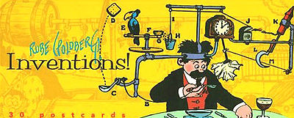
Web Services
Web Services
Self-describing and stateless modules that perform discrete units of work and are available over the network
“Web service providers offer APIs that enable developers to exploit functionality over the Internet, rather than delivering full-blown applications.” - Infoworld
Standards based interfaces (WS-I Basic Profile)
e.g., SOAP, WSDL, WS-Security
Enabling state: WS-Transaction, Choreography
Many loosely coupled interacting modules form a single logical system (e.g., legos)
71
Notes:
Source: ‘Web Services: Principles and Technology’ (Michael Papazoglou) Chapter 1
Source: Infoworld quote, http://www.infoworld.com/article/08/04/07/15FE-cloud-computing-reality_2.html
Source: Rube Goldberg picture, http://en.wikipedia.org/wiki/Rube_Goldberg

Slide 72
Service Oriented Architectures
Service Oriented Architectures
Model for using web services
service requestors, service registry, service providers
Use of web services to compose complex, customizable, distributed applications
Encapsulate legacy applications
Organize stovepiped applications into collective integrated services
Interoperability and extensibility
Notes:
Source: ‘Web Services: Principles and Technology’ (Michael Papazoglou) Chapter 1

Slide 73
Web application frameworks
Coding frameworks for enabling dynamic web sites
Streamline web and DB related programming operations (e.g., web services support)
Creation of Web 2.0 applications
Supported by most major software languages
Example capabilities
Separation of business logic from the user interface (e.g., Model-view-controller architecture)
Authentication, Authorization, and Role Based Access Control (RBAC)
Unified APIs for SQL DB interactions
Session management
URL mapping
Wikipedia maintains a list of web application frameworks
Notes:
Wikipedia list of frameworks: http://en.wikipedia.org/wiki/List_of_web_application_frameworks

Slide 74

Free and Open Source Software
External ‘mega-clouds’ must focus on using their massive scale to reduce costs
Usually use free software
Proven adequate for cloud deployments
Open source
Owned by provider
Need to keep per server cost low
Simple commodity hardware
Handle failures in software

Slide 75

Public Statistics on Cloud Economics

Slide 76

Cost of Traditional Data Centers
11.8 million servers in data centers
Servers are used at only 15% of their capacity
800 billion dollars spent yearly on purchasing and maintaining enterprise software
80% of enterprise software expenditure is on installation and maintenance of software
Data centers typically consume up to 100 times more per square foot than a typical office building
Average power consumption per server quadrupled from 2001 to 2006.
Number of servers doubled from 2001 to 2006
Notes:
Source: 11.8 and 15%, Martin MC Brown, Computerworld, http://blogs.computerworld.com/data_center_utilization_15_of_11_8_million_is_a_big_number
Source: $800, Ron Markezich, Vice President Microsoft Online, Microsoft talk at the Booz Allen Hamilton Cloud Computing Summit, 11/20/2008.
Source: IBM Report May 2008, Creating a green data center to help reduce energy costs and gain a competitive advantage.

Slide 77
Energy Conservation and Data Centers
Standard 9000 square foot costs $21.3 million to build with $1 million in electricity costs/year
Data centers consume 1.5% of our Nation’s electricity (EPA)
.6% worldwide in 2000 and 1% in 2005
Green technologies can reduce energy costs by 50%
IT produces 2% of global carbon dioxide emissions
Notes:
Source: http://www.cloudave.com/link/global-green-computing-fund
http://news.cnet.com/8301-11128_3-10140142-54.html?tag=newsEditorsPicksArea.0

Slide 78
Cloud Economics
Estimates vary widely on possible cost savings
“If you move your data centre to a cloud provider, it will cost a tenth of the cost.” – Brian Gammage, Gartner Fellow
Use of cloud applications can reduce costs from 50% to 90% - CTO of Washington D.C.
IT resource subscription pilot saw 28% cost savings - Alchemy Plus cloud (backing from Microsoft)
Preferred Hotel
Traditional: $210k server refresh and $10k/month
Cloud: $10k implementation and $16k/month
Notes:
Source: Gartner stat, ComputerWeekly, 4/11/2008, http://www.computerweekly.com/galleries/233192-8/Gartner-fellow-Brian-Gammage-Align-IT-with-business-and-look-for-cost-savings-in-the-cloud.htm
Source: Alchemy Plus, 12/3/08, http://www.infoworld.com/article/08/12/03/Scotland_hotbed_for_green_datacenters_1.html
Source: Preferred Hotel, 11/24/08, http://www.computerworld.com/action/article.do?command=viewArticleBasic&articleId=9121485
Source: CTO DC, Mike Bradshaw, Google talk at the Booz Allen Hamilton Cloud Computing Summit, 11/20/2008.
Patrick Marshall, The power of the cloud. Government Computer News, 9/29/08. http://www.gcn.com/print/27_24/47228-1.html

Slide 79
Cloud Economics
George Reese, founder Valtira and enStratus
Using cloud infrastructures saves 18% to 29% before considering that you no longer need to buy for peak capacity
Notes:
Source: Reese, http://broadcast.oreilly.com/2008/10/the-economics-of-cloud-c.html

Slide 80

Cloud Computing Case Studies and Security Models

Slide 81
Google Cloud User: City of Washington D.C.
Vivek Kundra, CTO for the District (now OMB e-gov administrator)
Migrating 38,000 employees to Google Apps
Replace office software
Gmail
Google Docs (word processing and spreadsheets)
Google video for business
Google sites (intranet sites and wikis)
“It's a fundamental change to the way our government operates by moving to the cloud. Rather than owning the infrastructure, we can save millions.”, Mr. Kundra
500,000+ organizations use Google Apps
GE moved 400,000 desktops from Microsoft Office to Google Apps and then migrated them to Zoho for privacy concerns
Notes:
http://arstechnica.com/software/news/2008/10/washington-dc-latest-to-drop-microsoft-for-web-apps.ars
Quote is from http://www.nextgov.com/nextgov/ng_20081126_1117.php

Slide 82
Are Hybrid Clouds in our Future?
OpenNebula
Zimory
IBM-Juniper Partnership
"demonstrate how a hybrid cloud could allow enterprises to seamlessly extend their private clouds to remote servers in a secure public cloud...“
VMWare VCloud
“Federate resources between internal IT and external clouds”
Notes:
Source: IBM hybrid cloud, http://news.cnet.com/8301-19413_3-10161245-240.html?tag=newsFeaturedBlogArea.0

Slide 83
vCloud Initiative
Goal:
“Federate resources between internal IT and external clouds”
Application portability
Elasticity and scalability, disaster recovery, service level management
vServices provide APIs and technologies
Notes:
Source: vCloud press release, 9/15/08, http://vmware.com/company/news/releases/vcloud_vmworld08.html

Slide 84










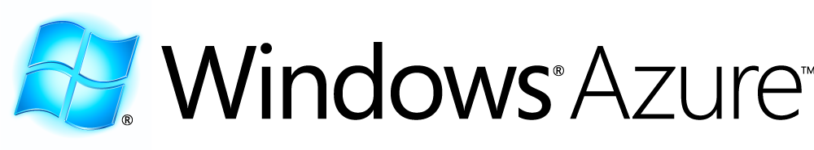
Microsoft Azure Services
Azure™ Services Platform
Source: Microsoft Presentation, A Lap Around Windows Azure, Manuvir Das

Slide 85
Windows Azure Applications, Storage, and Roles
n
m
Web Role
Worker Role
LB
Cloud Storage (blob, table, queue)
Source: Microsoft Presentation, A Lap Around Windows Azure, Manuvir Das

Slide 86
Case Study: Facebook’s Use of Open Source and Commodity Hardware (8/08)
Jonathan Heiliger, Facebook's vice president of technical operations
80 million users + 250,000 new users per day
50,000 transactions per second, 10,000+ servers
Built on open source software
Web and App tier: Apache, PHP, AJAX
Middleware tier: Memcached (Open source caching)
Data tier: MySQL (Open source DB)
Thousands of DB instances store data in distributed fashion (avoids collisions of many users accessing the same DB)
“We don't need fancy graphics chips and PCI cards," he said. “We need one USB port and optimized power and airflow. Give me one CPU, a little memory and one power supply. If it fails, I don't care. We are solving the redundancy problem in software.”
Notes:
Data taken from CNET news article and interview 8/18/08
http://news.cnet.com/8301-13953_3-10027064-80.html?tag=mncol

Slide 87
Case Study: IBM-Google Cloud (8/08)
“Google and IBM plan to roll out a worldwide network of servers for a cloud computing infrastructure” – Infoworld
Initiatives for universities
Architecture
Open source
Linux hosts
Xen virtualization (virtual machine monitor)
Apache Hadoop (file system)
“open-source software for reliable, scalable, distributed computing”
IBM Tivoli Provisioning Manager
Notes:
Source: Infoworld Article, http://www.infoworld.com/article/08/08/27/35NF-cloud-providers_2.html
Source: IBM cloud presentation at BAH cloud computing summit 10/29/08

Slide 88
Case Study: Amazon Cloud
Amazon cloud components
Elastic Compute Cloud (EC2)
Simple Storage Service (S3)
SimpleDB
New Features
Availability zones
Place applications in multiple locations for failovers
Elastic IP addresses
Static IP addresses that can be dynamically remapped to point to different instances (not a DNS change)
Notes:
Source: Infoworld article (availability zones and elastic IP), http://www.infoworld.com/article/08/03/27/Amazon-adds-resilience-to-cloud-computing_1.html

Slide 89
Amazon Cloud Users: New York Times and Nasdaq (4/08)
Both companies used Amazon’s cloud offering
New York Times
Didn’t coordinate with Amazon, used a credit card!
Used EC2 and S3 to convert 15 million scanned news articles to PDF (4TB data)
Took 100 Linux computers 24 hours (would have taken months on NYT computers
“It was cheap experimentation, and the learning curve isn't steep.” – Derrick Gottfrid, Nasdaq
Nasdaq
Uses S3 to deliver historic stock and fund information
Millions of files showing price changes of entities over 10 minute segments
“The expenses of keeping all that data online [in Nasdaq servers] was too high.” – Claude Courbois, Nasdaq VP
Created lightweight Adobe AIR application to let users view data
Notes:
Source: Infoworld, http://www.infoworld.com/article/08/04/07/15FE-cloud-computing-utility_1.html

Slide 90
Case Study: Salesforce.com in Government
5,000+ Public Sector and Nonprofit Customers use Salesforce Cloud Computing Solutions
President Obama’s Citizen’s Briefing Book Based on Salesforce.com Ideas application
Concept to Live in Three Weeks
134,077 Registered Users
1.4 M Votes
52,015 Ideas
Peak traffic of 149 hits per second
US Census Bureau Uses Salesforce.com Cloud Application
Project implemented in under 12 weeks
2,500+ partnership agents use Salesforce.com for 2010 decennial census
Allows projects to scale from 200 to 2,000 users overnight to meet peak periods with no capital expenditure
Notes:
http://arstechnica.com/software/news/2008/10/washington-dc-latest-to-drop-microsoft-for-web-apps.ars
Quote is from http://www.nextgov.com/nextgov/ng_20081126_1117.php

Slide 91
Case Study: Salesforce.com in Government
New Jersey Transit Wins InfoWorld 100 Award for its Cloud Computing Project
Use Salesforce.com to run their call center, incident management, complaint tracking, and service portal
600% More Inquiries Handled
0 New Agents Required
36% Improved Response Time
U.S. Army uses Salesforce CRM for Cloud-based Recruiting
U.S. Army needed a new tool to track potential recruits who visited its Army Experience Center.
Use Salesforce.com to track all core recruitment functions and allows the Army to save time and resources.
Notes:
http://arstechnica.com/software/news/2008/10/washington-dc-latest-to-drop-microsoft-for-web-apps.ars
Quote is from http://www.nextgov.com/nextgov/ng_20081126_1117.php

Slide 92

Questions?
Peter Mell
NIST, Information Technology Laboratory
Computer Security Division
Tim Grance
NIST, Information Technology Laboratory
Computer Security Division
Contact information is available from:
http://www.nist.gov/public_affairs/contact.htm

