Slide 1
Project Management Concepts
WELCOME
Project Management Training Series
Notes:
Project Management Concepts
Version 3.1, 4/01 © 2003 by AstroWix

Slide 2
Course Purpose
Learn and apply techniques, concepts, and approaches for accomplishing projects with less frustration.

Slide 3
Introduction
Your name
Your Job
Your Company
Any prior PM training on
concept/tool
What is your expectation
out of this class?

Slide 4
Project Failure vs. Success
Top Five Reasons
FOR FAILURE
FOR SUCCESS
Lack of executive support
Lack of user input
Incomplete requirements and specifications
Technological incompetence
Changing requirements and specifications
Executive management support
User involvement
Realistic expectations
Clear statement of requirements
Proper planning

Slide 5
Benefits of Planning
Plan
Do/Undo/Redo
Complete
Start
Plan
Execute
Benefit of Planning
Complete
Start
Notes:
Project Management Concepts
Version 3.1, 4/01 © 2003 by AstroWix

Slide 6
Project- PMBOK® Definition
  Project – A temporary endeavor undertaken to create a unique product or service
Definition
How Temporary?
  Has a definite beginning and end, not an on-going effort
  Ceases when objectives have been attained
  Team is disbanded upon project completion
Unique?
  Product characteristics are progressively elaborated
  The product or service is different in some way from other product or services
Notes:
Project Management Concepts
Version 3.1, 4/01 © 2003 by AstroWix

Slide 7
Project Characteristics
  Goal (measurable/verifiable) Oriented
  Finite duration with a beginning and end
  Uniqueness to a great extent and related uncertainties
  Coordinated undertaking of interrelated activities
  Performing the activities involve resources
  Resources cost money
Notes:
Project Management Concepts
Version 3.1, 4/01 © 2003 by AstroWix
What are some examples of projects?

Slide 8
Project – Evolution
Problems
Opportunities
Strategic Plan
Customer Requirements
New Ideas
  A project evolves in order to fulfill someone’s vision needs emergence
  Physical
  Social
  Cultural change
  Organizational
  Environmental
Project Prioritization
Notes:
Project Management Concepts
Version 3.1, 4/01 © 2003 by AstroWix
What are some examples of projects?

Slide 9
Triple Constraint Theorem
TIME
COST
QUALITY
SCOPE
  Harold Kerzner
Balancing SCOPE, COST and TIME within the frame work of QUALITY, meeting customer expectations
Notes:
Project Management Concepts
Version 3.1, 4/01 © 2003 by AstroWix
What are some examples of projects?

Slide 10
What is Project Management?
  The application of knowledge, skills, tools, and techniques to project activities in order to meet or exceed stakeholder needs and expectations
  Stakeholder
  Individuals and organizations involved in or affected by the project outcome
Definition
Definition
Notes:
Project Management Concepts
Version 3.1, 4/01 © 2003 by AstroWix

Slide 11


Project Manager’s Operating Environment
Government
Suppliers
The Organization
Organization Goals
Top Management
Sponsor
Boss
Project Manager
Project Staff
Colleagues
Managers Controlling Internal Resources
Internal Users
Sub Contractors
External Users
Notes:
Project Management Concepts
Version 3.1, 4/01 © 2003 by AstroWix

Slide 12
Project Phases
  Projects are divided into phases for better understanding and overcoming uncertainties
  Collectively, the project phases put together is known as Project life cycle
  Each phase is marked by one or more tangible verification work product
  The conclusion of a project phase is generally marked by a review
  The phase reviews are often called phase exits, stage gates, or kill points
  Starting a phase before approval of deliverables of a previous phase is called Fast Tracking
Notes:
Project Management Concepts
Version 3.1, 4/01 © 2003 by AstroWix
What are some examples of projects?

Slide 13
A Typical Project Stage
  Project Plan
Do work
Deliver Results
Take corrective
action
Measure progress
Reforecast
Change log
Issue log
Risk and
Opportunities log
Forward resource plan
Forward schedule plan
Forward benefits plan
Forward cost plan
Identify issues
And risks
Notes:
Project Management Concepts
Version 3.1, 4/01 © 2003 by AstroWix
What are some examples of projects?

Slide 14
Process Interaction
Initiating
Processes
Planning
Processes
Controlling
Processes
Executing
Processes
Closing
Processes
Notes:
Project Management Concepts
Version 3.1, 4/01 © 2003 by AstroWix

Slide 15
Typical Project Life Cycle
Executing Processes
Planning
Processes
Closing
Processes
Level
Of
Activity
Initiating
Processes
Controlling Processes
PhaseStart
Time
Phase
Finish
Notes:
Project Management Concepts
Version 3.1, 4/01 © 2003 by AstroWix
What are some examples of projects?

Slide 16
Characteristics of a Life Cycle
Opportunity to add Value
High
Low
Cost to make change
Life Cycle of Project (Time)
Notes:
Project Management Concepts
Version 3.1, 4/01 © 2003 by AstroWix
What are some examples of projects?

Slide 17
Related Endeavors
  Program – Consists of a group of projects supporting broad, general goals and managed in a coordinated way
  Project Portfolio Management – Collection of projects or programs and other work that are grouped together to facilitate effective management of that work to meet strategic business objectives
  Subprojects – Components of a project that are often contracted out
  Project Management Office (PMO) – A PMO sometimes also referred as Program Management Office is an organization to centralize and coordinate the management of projects under its domain
Notes:
Project Management Concepts
Version 3.1, 4/01 © 2003 by AstroWix
What are some examples of projects?

Slide 18

Project Phases
Planning and Executing Projects
Define & Organize the Project
(1.0)
Plan the Project
(2.0)
Execute & Control the Project
(3.0)
Close Out
(4.0)
1.1
Establish the Project
Organization
2.1
Develop WBS
3.1
Collect Status
4.1
Project Archive
1.2
Define the Project
Parameters
2.2
Develop the
Schedule
3.2
Analyze Variance
4.2
Formal Acceptance
2.3
Refine Est. &
Resource Req.
3.3
Plan & Take
Adaptive Action
4.3
Lessons Learned
1.3
Define the Project
Framework
2.4
Develop Risk
Management Plan
3.4
Report Project
Status
Notes:
Project Management Concepts
Version 3.1, 4/01 © 2003 by AstroWix
What are some examples of projects?

Slide 19
Define & Organize the Project
1.0
Planning and Executing Projects
Define & Organize the Project
(1.0)
Plan the Project
(2.0)
Execute & Control the Project
(3.0)
Close Out
(4.0)
1.1
Establish the Project
Organization
2.1
Develop WBS
3.1
Collect Status
4.1
Project Archive
1.2
Define the Project
Parameters
2.2
Develop the
Schedule
3.2
Analyze Variance
4.2
Formal Acceptance
2.3
Refine Est. &
Resource Req.
3.3
Plan & Take
Adaptive Action
4.3
Lessons Learned
1.3
Define the Project
Framework
2.4
Develop Risk
Management Plan
2.4
Report Project
Status

Slide 20
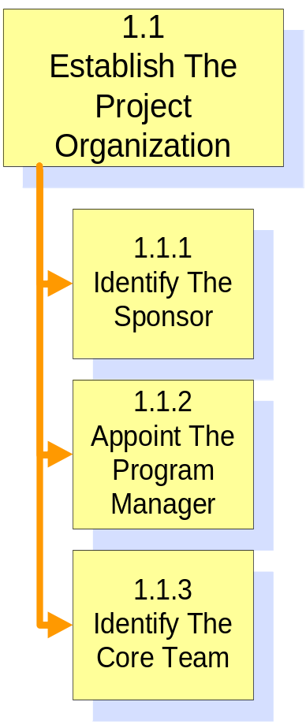
Establish the Project Organization
1.1

Slide 21
Expectations
Expectations
Stakeholder
Customer
When can I get the product?
What are the features that exists (that I want eliminated now)?
What are the additional feature desired?
How much I would have to pay?
Organization
When can I get the product out?
What is the quantum of work involved?
How many people would this project need (skill level)?
What would be their utilization/availability on this project?
How much would the cost/ investment for resources be?
Employee
What is my role and the job/task specifications in this project?
What learning opportunity/new skill will I get from this project?
Shareholder
What is the company doing to minimize overheads & maximize profits?
What are the efforts and direction for new avenues of business this year?
How does this company compare with and stay ahead of competition?
Notes:
Project Management Concepts
Version 3.1, 4/01 © 2003 by AstroWix
What are some examples of projects?

Slide 22
Identify the Sponsor
Responsibilities
  Establish Project Charter
  Serve as link to top management-to company & customer
  Point of escalation for resolution of critical issues
  Negotiate issues between functional areas & project manager
Sponsor
Schedule
Resources
Scope
PM & Team
Notes:
Project Management Concepts
Version 3.1, 4/01 © 2003 by AstroWix
What are some examples of projects?

Slide 23

How to Identify the Project Sponsor?
Difficult to find
But who answers the following questions:
  Who approves the plan
  Who approves the budget
  Who will the team go to for support

Slide 24

Identify-Project Manager
  Role of a Project Manager
Schedule
Resources
Scope
  Establish and Lead Team
  Meet Project Objectives
Planning and Executing Projects
Define & Organize the Project
Plan the Project
Track & Manage The Project
  Manage PM Process
Notes:
Project Management Concepts
Version 3.1, 4/01 © 2003 by AstroWix
What are some examples of projects?

Slide 25
Identify the Project Manager
  Role of a Project Manager
Characteristics of successful PM
  Problem oriented sees “big picture”
  Motivator , team leader
  Effective Communicator
  Good understanding of PM Practices
  Maintains team player attitude
  Good organizer
  Goal oriented
  Understanding of technical domain of the project
  Well respected by his peers
Focus Areas
  Planning
  Organizing
  Leading
  Controlling
Additional Responsibilities
  Integrator
  Communicator
  Team Builder
Notes:
Project Management Concepts
Version 3.1, 4/01 © 2003 by AstroWix
What are some examples of projects?

Slide 26
Exercise – Project Charter
Project Title & Description : (brief description of the project)
Goals & Objectives : (what the project is supposed to accomplish, provide numbers if possible).
Scope
  The scope of the project includes the activities listed below.
  The scope of the project does not include.
  The Following areas of scope are uncertain or have not been fully defined.
Major Deliverables
  The major deliverables from this project are:
Business Need or Opportunity
Financial Benefits of the Project
Project Charter Acceptance Signed & Approved by:
Notes:
Project Management Concepts
Version 3.1, 4/01 © 2003 by AstroWix
What are some examples of projects?

Slide 27
Plan the Project
2.0
Planning and Executing Projects
Define & Organize the Project
(1.0)
Plan the Project
(2.0)
Execute & Control the Project
(3.0)
Close Out
(4.0)
1.1
Establish the Project
Organization
2.1
Develop WBS
3.1
Collect Status
4.1
Project Archive
1.2
Define the Project
Parameters
2.2
Develop the
Schedule
3.2
Analyze Variance
4.2
Formal Acceptance
2.3
Refine Est. &
Resource Req.
3.3
Plan & Take
Adaptive Action
4.3
Lessons Learned
1.3
Define the Project
Framework
2.4
Develop Risk
Management Plan
2.4
Report Project
Status

Slide 28
Benefit of Planning
Lay foundation for:
  Improved communication
  Minimized rework
  Improved schedule predictability
  Quality products on time
  Visualizing the project

Slide 29
Project Scope
What is the WORK we are supposed to do to deliver the final service / product to the customer?

Slide 30
Product Scope
The features and functionalities that categorize a product or service

Slide 31
Project Scope : Scope Statement
Project Objectives
Product scope description
Project requirement
Project boundaries
Project deliverables
Project acceptance criteria
Project constraints
Project assumptions
Initial project organization
Initial defined risks
Schedule milestones
Fund limitation
Cost estimate
Project configuration management system
Project specifications
Approval requirement

Slide 32
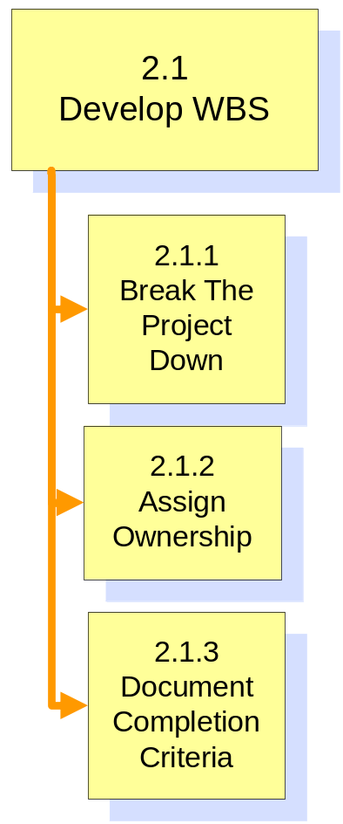
Develop the Work Breakdown Structure

Slide 33

Work Breakdown Structure (WBS)
WBS is a tool for identifying project work
Hierarchical, logical structuring of project work
It provides comprehensive Methodology

Slide 34
WBS Decomposition
Team should be involved to:
  Identify 4-7 major components of work (how you will manage work)
  Identify Level 2 tasks for each
  grouping
  Repeat the process until a task has:
    One owner (may be multiple doers)
    Clear deliverable
    2-20 days duration
    Credible estimate of duration
    Ability to be tracked

Slide 35

Remember in include!
  Task related with following:
  Planning activities for the project
  Approval cycle
  Key project meetings
  Management/customer interfaces
  Quality inspections/fixing defects
  Training
  Project management
  Test planning, development and execution
  Project reviews and project closing

Slide 36

WBS- Bottom-up
Team Effort:
  Brainstorm all tasks
  Organize tasks into 4-7 major groupings reflecting how the project will be managed

Slide 37

Level of Detail
  Project is broken down to the level of desired tracking
  Rule of thumb: lowest level task should have duration between 2-20 days and effort that does not exceed 1 person week

Slide 38
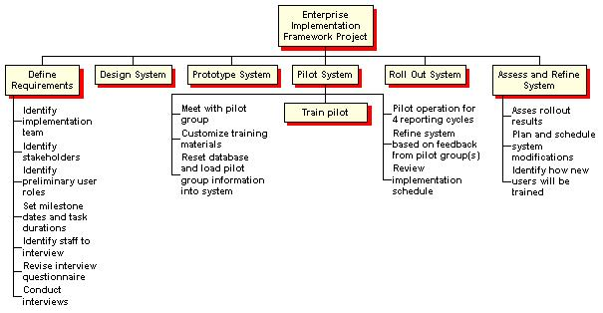
WBS Example

Slide 39


Exercise-3 WBS
Develop a WBS
Develop the first level of breakdown structure for your project
  Rule of Thumb: it should consists of 4-7 major components of work
  Use larger post it notes
Break each major component further level 2 and 3.
  Goal is to have 25-35 lowest level tasks at the completion of this lab

Slide 40
Assign Ownership
Task Ownership
Multiple Owners = 0 owners
  1 owner per task
  Owner responsible for planning and managing task
  Owner may or may not be a doer

Slide 41
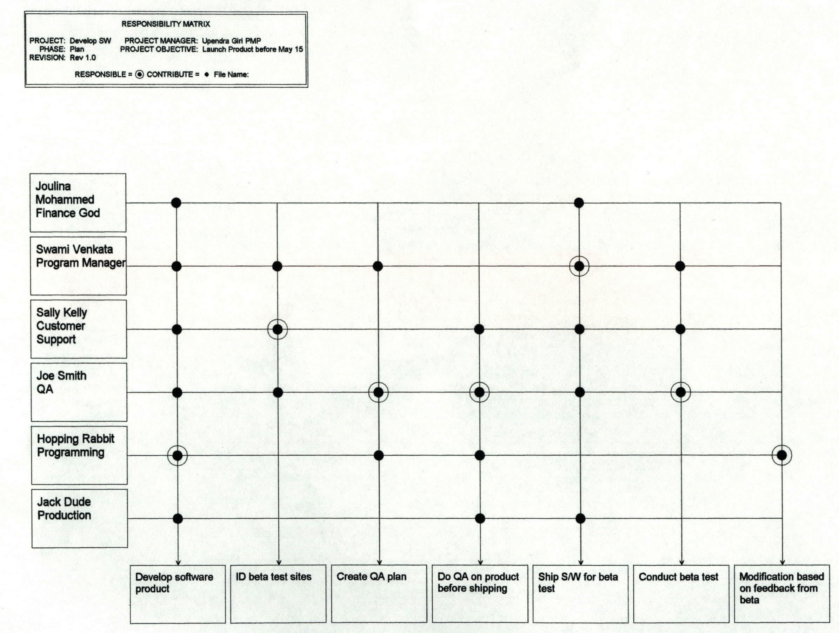
Responsibility Matrix

Slide 42
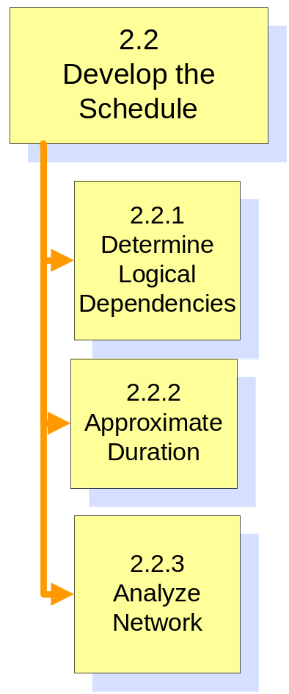
Develop The Preliminary Schedule

Slide 43
Network Development
Precedence Diagramming Method
A
B
C
Start
Finish
D
E
F
Activity on Node

Slide 44
Milestones
No Duration or Work
Start/Finish
Significant Events
(Example- Conference)
External dependencies/ deliverables
Major Accomplishments
Phase Signoffs
Intermediate Checkpoints
Status reporting periods
Notes:
Project Management Concepts
Version 3.1, 4/01 © 2003 by AstroWix
Do you want me to add the details on pg 90?

Slide 45
Network Development
Task Relationships
Predecessor
i
Finish to Start
Successor
j
i
Predecessor
Successor
j
i
j
i
j
Start to Finish
Predecessor
Successor
Finish to Finish
Predecessor
Start to Start
Successor
Notes:
Project Management Concepts
Version 3.1, 4/01 © 2003 by AstroWix
What are some examples of projects?

Slide 46
Network Development
Task Relationships – Lead & Lag
Predecessor
Finish to Start
i
lag
Successor
2d
j
Predecessor
i
lead
Finish to Start
2d
Successor
j
Notes:
Project Management Concepts
Version 3.1, 4/01 © 2003 by AstroWix

Slide 47
Precedence Diagram
ES EF
ES EF
ES EF
Duration 7
Task A
Duration 6
Task C
Duration 3
Task G
LS LF
LS LF
ES EF
LS LF
Duration 2
Task H
Start
Finish
ES EF
ES EF
ES EF
LS LF
Duration 3
Task B
Duration 3
Task D
Duration 3
Task E
LS LF
LS LF
LS LF
ES EF
Duration 2
Task F
LS LF
Notes:
Project Management Concepts
Version 3.1, 4/01 © 2003 by AstroWix

Slide 48
Forward Pass – Early Start, Early Finish
ES EF
ES EF
ES EF
Duration 7
Task A
0
7
Duration 3
Task G
Duration 6
Task C
13
16
7
13
LS LF
LS LF
ES EF
LS LF
Duration 2
Task H
16
18
Start
Finish
ES EF
ES EF
ES EF
LS LF
Duration 3
Task B
0
3
Duration 3
Task D
3
6
Duration 3
Task E
6
9
LS LF
LS LF
LS LF
ES EF
Duration 2
Task F
3
5
LS LF
Notes:
Project Management Concepts
Version 3.1, 4/01 © 2003 by AstroWix

Slide 49
Backward Pass – Late Start, Late Finish
0
0
0
ES EF
ES EF
ES EF
Duration 7
Task A
0
7
Duration 3
Task G
Duration 6
Task C
13
16
7
13
0
7
7
13
13
16
0
LS LF
LS LF
ES EF
LS LF
Duration 2
Task H
16
18
Start
Finish
7
7
7
16
18
ES EF
ES EF
ES EF
LS LF
Duration 3
Task B
0
3
Duration 3
Task D
3
6
Duration 3
Task E
6
9
7
10
10
13
13
16
LS LF
LS LF
LS LF
8
ES EF
Duration 2
Task F
3
5
11
13
LS LF
Notes:
Project Management Concepts
Version 3.1, 4/01 © 2003 by AstroWix

Slide 50
Critical Path – Longest Path, Zero Float
0
0
0
ES EF
ES EF
ES EF
Duration 7
Task A
0
7
Duration 3
Task G
Duration 6
Task C
13
16
7
13
0
7
7
13
13
16
0
LS LF
LS LF
ES EF
LS LF
Duration 2
Task H
16
18
Start
Finish
7
7
7
16
18
ES EF
ES EF
ES EF
LS LF
Duration 3
Task B
0
3
Duration 3
Task D
3
6
Duration 3
Task E
6
9
7
10
10
13
13
16
LS LF
LS LF
LS LF
8
ES EF
Duration 2
Task F
3
5
11
13
LS LF
Notes:
Project Management Concepts
Version 3.1, 4/01 © 2003 by AstroWix

Slide 51
Critical Path – Longest Path Zero Float
Forward Pass = Early Start/Finish
Backward Pass = Late Start/Finish
Positive Float/Negative Float
Critical Path has zero or negative float
Notes:
Project Management Concepts
Version 3.1, 4/01 © 2003 by AstroWix

Slide 52
Exercise 4- Critical Path
ES EF
ES EF
ES EF
Duration 4
Task A
Duration 4
Task B
Duration 3
Task C
LS LF
LS LF
LS LF
ES EF
ES EF
Duration 10
Task G
Start
Duration 7
Task D
Finish
LS LF
ES EF
LS LF
ES EF
Duration 5
Task E
Duration 5
Task F
LS LF
LS LF
Notes:
Project Management Concepts
Version 3.1, 4/01 © 2003 by AstroWix

Slide 53

Isolate Areas of High Risk
Overwhelming Risk
Miscommunications
Changing Requirements
Long Tasks
Vendor Deliverables
Interfaces
Loss of Key Resource
Technical Problems
Reorganization
Equipment failure

Slide 54
Isolate Areas of High Risk
Schedule Risks
Tasks with durations longer than 2 weeks
Tasks on Critical Path
Tasks which have several predecessors
Tasks that have minimal “float” or “slack”
Optimistically estimated tasks
Tasks reliant on external groups
Start-to-start dependencies
Dependencies with lag
Major Milestones
Schedules that don’t list the assumptions

Slide 55
Isolate Areas of High Risk (cont)
Resource Risks
Tasks with one key individual assigned
Tasks using scarce resources
Tasks which are mismatched with the people assigned
Tasks which require large amounts of resources
Availability of tools and/or techniques

Slide 56
Isolate Areas of High Risk (cont)
Scope Risks
Uncertainty of New Technologies
Dynamics of customer requirements
Tasks with significant business impacts
Extremely aggressive business requirements
Unforeseen issues

Slide 57
Isolate Areas of High Risk (cont)
Probability Impact Matrix
Risk Score for a Specified Risk
Probability (P) | Risk Score P x I
0.9 | 0.05 | 0.09 | 0.18 | 0.36 | 0.72
0.7 | 0.04 | 0.07 | 0.14 | 0.28 | 0.56
0.5 | 0.03 | 0.05 | 0.10 | 0.20 | 0.40
0.3 | 0.02 | 0.03 | 0.06 | 0.12 | 0.24
0.1 | 0.01 | 0.01 | 0.02 | 0.04 | 0.08
Impact (I) | 0.05 | 0.10 | 0.20 | 0.40 | 0.80
 | Impact on an Objective (e.g. Cost, time, or scope) (Ratio Scale)
Impact : 0.05 = Very Low , 0.10 = Low, 0.2 = Moderate
0.4= High, 0.8= Very High

Slide 58
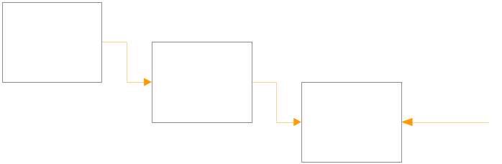
Approve and Set the Project Baseline Plan
Baseline
Snapshots of approved plan
Establishes a target
Provides something to measure progress against
Makes project goals visible

Slide 59
Approve and Set the Project Baseline Plan
Definition
The baseline is the plan against which all project progress will be measured
The baseline is set at the end of the planning phase

Slide 60
Approve and Set the Project Baseline Plan
Process
Communicate the setting of the baseline to all groups that are impacted
Distribute approved plans and supporting assumptions in accordance with project framework decisions
Archive a copy of the schedule and resource plans along with the assumptions
Ensure that any contracts with suppliers and customers are consistent with the baseline

Slide 61
Approve and Set the Project Baseline Plan
Changing the Baseline
Once set, it should not be easily changed
The baseline plan can only be changed after:
  Major events which cause change have been identified and communicated
  Impact of changes has been approved

Slide 62
Approve and Set the Project Baseline Plan
Completion
Criteria
Project baseline plan approved which includes:
  Priority matrix and POS
  Schedule
  Resources
  Assumptions

Slide 63

Set up Management Processes
Change Management
  Log all changes
  Review proposed changes
  Validate if outside POS
  Announce changes

Slide 64
Set up Management Processes
Change Management
Review and implement project change management process
A well defined process must be communicated to all people involved
The project manager is ultimately responsible for the process
The process should reflect the results of the framework discussions
The process should identify the source, describe the change, the impact, the consequences and reasons for approval /rejection

Slide 65
Execute & Control
3.0
Planning and Executing Projects
Define & Organize the Project
(1.0)
Plan the Project
(2.0)
Execute & Control the Project
(3.0)
Close Out
(4.0)
1.1
Establish the Project
Organization
2.1
Develop WBS
3.1
Collect Status
4.1
Project Archive
1.2
Define the Project
Parameters
2.2
Develop the
Schedule
3.2
Analyze Variance
4.2
Formal Acceptance
2.3
Refine Est. &
Resource Req.
3.3
Plan & Take
Adaptive Action
4.3
Lessons Learned
1.3
Define the Project
Framework
2.4
Develop Risk
Management Plan
3.4
Report Project
Status
Notes:
Project Management Concepts
Version 3.1, 4/01 © 2003 by AstroWix
What are some examples of projects?

Slide 66
Project Controlling
The Monitor and Control Project Work process is performed to monitor project processes associated with initiating, planning, executing, and closing.
Definition
Monitoring includes:
Collecting, measuring, and disseminating performance information
Assessing measurements and trends to effect process improvements.

Slide 67
Project Controlling
Data Collection & Status Reporting
Project Monitoring & Tracking
Earned Value Analysis
Variance Analysis

Slide 68
Data Collection
4 Key Questions
  Did the task start?
  If yes, on what date?
  What date will the task finish?
  If finishes on what date did it finish?

Slide 69

Track & Manage the Project
Benefits of Tracking
Provides clear indication of progress
Keeps everyone informed
Encourages the addressing of problems
Provides credible completion estimates

Slide 70
Identify Variances
New activities on the critical path
Changes in milestone dates or the end date of the project
Reductions or increases in float for upcoming activities
Slips in the schedule of particular groups of activities
Schedule
Variances

Slide 71
Identify Variances
Process
Compare actual data and estimates of remaining work to the baseline plan
Variance exist where this current data differs from the baseline
Positive variances are areas where the current data falls short of the baseline
Negative variances are areas where the current data exceeds the baseline

Slide 72
Identify Variances
Resource
Variance
Investments of more time than planned
Not investing enough time to get the task done on schedule
Conflicting requirements for common resources (now and in the future)

Slide 73
Identify Variances
Deliverables not meeting or exceeding specs
Deliverables not meeting or exceeding quality requirements
Scope
Variance

Slide 74
Determine the Causes
Detecting Variance and Cause
  Many standard reports show variance
  Backtrack slippage
  Variance tells “what” (hard data)
  More detective work for “why” (soft data)

Slide 75
Analyze the impact
+3
+2
+1
0
-!
-2
Trigger
Net CP
Change
(in days)
Status Periods
6/7 6/21 7/4 7/18
Trigger
Variance Trend Analysis
  Records cumulative schedule information
  “Triggers” re-planning
  Same as critical path variance
Notes:
Project Management Concepts
Version 3.1, 4/01 © 2003 by AstroWix

Slide 76

Identify Variances
Variances is the difference between plan and actual
Projects slip one day at a time

Slide 77
Earned Value Management
BAC = Budget at Completion
EAC = Estimate at Completion
VAC = Variance at Completion
CV = Cost Variance
SV = Schedule Variance
CPI = Cost Performance Index
CPI^{C} = Cumulative CPI
SPI = Schedule Performance Index

Slide 78
Earned Value Management
Earned Value Example
Activity | Budgeted Man Hours | % Complete | Actual Man Hours | Earned Value
A | 120 | 75 | 103
B | 200 | 80 | 190
C | 100 | 50 | 60
D | 300 | 90 | 260
Sum
CPI = Earned Value/Actual Value
EAC = BAC/CPI
Overall % Complete = (EV/PV)*100
BAC = Budget at Completion
EAC = Estimate at Completion
VAC = Variance at Completion
CV = Cost Variance
SV = Schedule Variance
Cost Performance Index CPI = EV/AC

Slide 79
Earned Value – Variance Analysis
Schedule Variance:
SV = EV – PV (or BCWP-BCWS)
Cost Variance:
CV = EV-AC (or BCWP-ACWP)
Schedule Performance Index:
SPI = EV/PV (or BCWP/BCWS)
Cost Performance Index:
CPI = EV/AC (or BCWP/ACWP)
Cumulative Cost Performance Index:
CPI^{C} = EVC/ACC

Slide 80
Earned Value – S Curve
PV
AC
CV
SV
Cost
Progress Review
T
EV
Time

Slide 81
Close Out
4.0
Planning and Executing Projects
Define & Organize the Project
(1.0)
Plan the Project
(2.0)
Execute & Control the Project
(3.0)
Close Out
(4.0)
1.1
Establish the Project
Organization
2.1
Develop WBS
3.1
Collect Status
4.1
Project Archive
1.2
Define the Project
Parameters
2.2
Develop the
Schedule
3.2
Analyze Variance
4.2
Formal Acceptance
2.3
Refine Est. &
Resource Req.
3.3
Plan & Take
Adaptive Action
4.3
Lessons Learned
1.3
Define the Project
Framework
2.4
Develop Risk
Management Plan
3.4
Report Project
Status

Slide 82
Conduct a Closeout Review
Purpose
A close out review should highlight both what went right and what went wrong
  Both are essential for continuous improvement
  Exploit the successes and identify the elements which contributed to the success
  Avoid the problems in the future and identify processes that need to be defined, redefined and improved
Key Learning's can be valuable for the next project

Slide 83
Close the Project File
Process
  Complete all final review documents
  Bundle similar reports, if possible (all status reports) and label the bundle
    Facilitates later research
    Helps ensure that individual; papers aren’t lost
  All files should be sent to Administration for storage
  Ensuring that the files are stored properly and is the project managers responsibility

Slide 84


