Slide 1
Demand Management and Workflow
Jan Kalis
http://blogs.msdn.com/jkalis
Product Marketing Manager
Microsoft Corporation

Slide 2
Agenda
Introduction to Demand Management
What’s new in Workflow
Implementing a Workflow

Slide 3
Introduction to Demand Management
Guiding process for Project lifecycle – from initiation, selection to planning and managing
Typically follows the customer business process or methodology requirements
Consists of Phases, Stages, Project Detail Pages (SharePoint page with Web Parts), Specific Custom Fields and Workflow
The Project Online and Project Server 2013 workflow builds on SharePoint 2013 Workflow Infrastructure
Includes Project Server 2013 specific workflow actions
(NEW) Project Online and Project Server 2013 now supports declarative workflows and using Microsoft Visio 2013 and SharePoint Designer 2013
(NEW) Projects can origin from SharePoint items (a.k.a. Ideation)

Slide 4
What’s new

Slide 5
What’s new
Project Server 2013 Workflow
Support for Declarative workflow
With no code (customization)
Use Visio 2013 and SharePoint Designer 2013
With Visual Studio (extensibility)
SharePoint/Project 2010 Workflows
SharePoint 2013 Workflows

Slide 6
Workflow in SharePoint 2013
Workflow now treated as a service in SharePoint 2013
Moved to Workflow Manager (formerly Windows Azure Workflow Server (WAWS))
No longer runs in the content farm
No longer runs on SharePoint WFE / App servers
Harnesses the latest workflow technology from Microsoft
SharePoint deployment drives where workflow runs
On-Premises and Hosted – Workflow Manager
Improves stability, scalability & transparency

Slide 7
SharePoint Workflow Improvements
Introducing “Stages”
Mitigates SharePoint Designer’s lack of loop support
Provides functionality of “state machine” workflows in WF 3.5
Declarative workflows have loops
Loop # times / with condition / with expression
Declarative workflows can call REST/SOAP services

Slide 8
High-Level Workflow Infrastructure
Azure ACS
Project 2013
Workflow Manager
Visual Studio
Project Web UI for Workflows
OAuth2
Workflow Definitions & Activities
Visio 2013
Workflow Packaging
Workflow OM
Workflow Engine
SharePoint Designer
REST Calls
Project Objects
Events

Slide 9
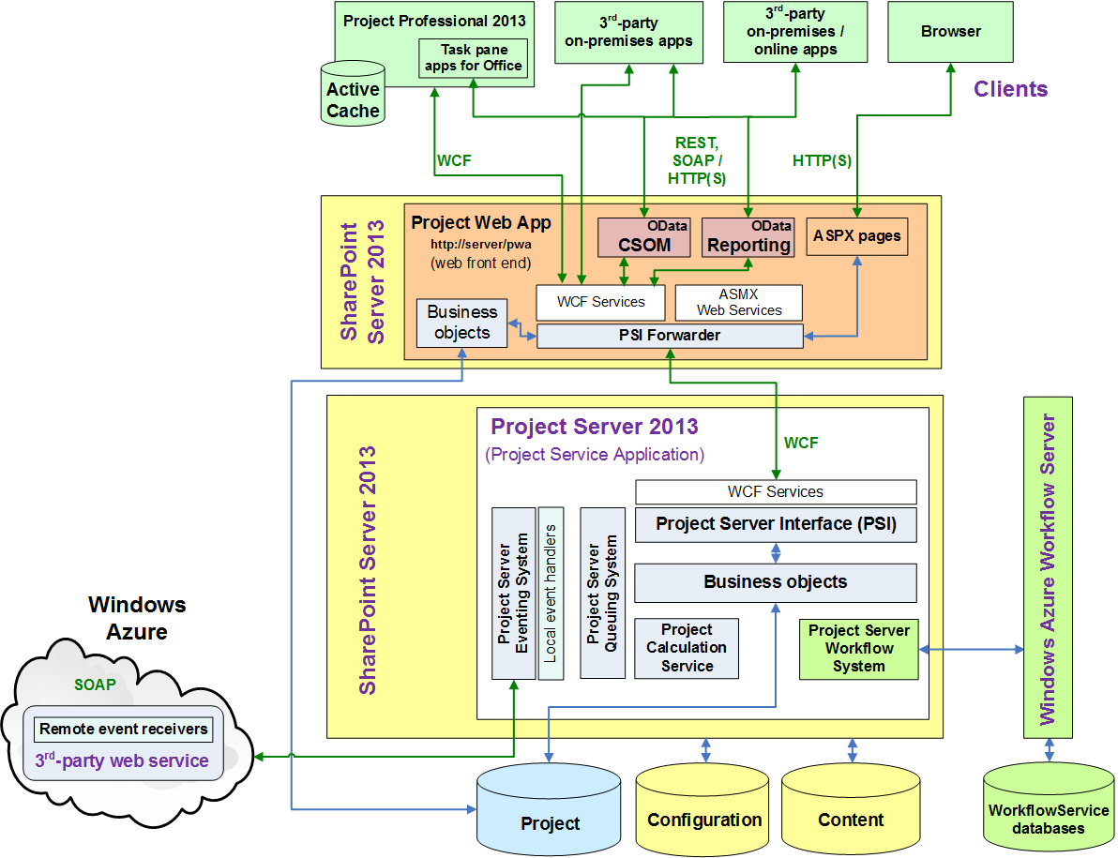
Project Server 2013 Preview Architecture

Slide 10
How to build your workflows

Slide 11
General Approach
Determine the requirements
Design the workflow
Organize it into phases and stages, and determine the custom fields that the workflow will use.
In Project Web App, create the entities that the workflow requires:
Review the existing workflow phases; create phases as necessary.
Create the enterprise custom fields that the workflow will use
Edit or create the project detail pages (PDPs) that your workflow stages will use to collect information for the project
Create the necessary workflow stages; associate them with the correct phase

Slide 12
Designing the Workflow
With no code
Determine the requirements; plan/design the workflow
Create objects in Project Server 2013 (Custom Fields, Phases, Stages, PDPs)
(Optional) Design the Workflow in Visio 2013
Validate and Publish the Workflow in SharePoint Designer 2013
Associate the EPT with the workflow
Partner solutions
Nintex Workflow for Project Server (www.nintex.com)

Slide 13
Code – Visual Studio
SharePoint/Project 2010 Workflows:
Create traditional Workflow Foundation v3.5
SharePoint/Project specific activities available to developers
SharePoint 2013 Workflows:
Based on Workflow Foundation v4.0

Slide 14
Workflow Tooling Compared
 | SharePoint Designer | Visual Studio
Reusability | Create reusable WF | Create WF templates
Include in SP App
Custom Code
Custom Actions | Consume, not create | Yes; underlying activities
Visio Integration
Debugging

Slide 15
Implementing your workflows

Slide 16
Demand Management Workflow with Visio 2013 and SharePoint Designer 2013
demo

Slide 17
Declarative vs. Programmatic Workflows
Declarative workflows are recommended
Both supported by SharePoint Designer & Visual Studio
No underlying knowledge of WF API required
New activities for calling Web services should be used when custom code is required
Programmatic / Coded Workflows:
Supported in WF 3.5 (SharePoint 2010 model)
Supported in Windows Azure Workflow Server
Leverages OAuth & REST / CSOM to talk to SharePoint

Slide 18
Custom Actions and Visual Studio
How to: Build and deploy workflow custom actions
http://msdn.microsoft.com/en-us/library/jj163911(v=office.15)
Sample : SharePoint 2013 workflow: Create a custom action (http://code.msdn.microsoft.com/SharePoint-2013-workflow-41e5c0f9).

Slide 19
Summary
Introduction to Demand Management
What’s new in Workflow
Implementing a Workflow

Slide 20
Next Steps
Study the Demand Management topics and workflow creation in the Project SDK http://msdn.Microsoft.com/project
Read the Blog post Demand Management, Now with SharePoint Designer http://blogs.office.com/project/archive/2012/09/18/demand-management-sharepoint-designer-project-server.aspx
Key resources
Product http://www.microsoft.com/project
Blog http://blogs.office.com/b/project/
TechNet http://technet.microsoft.com/projectserver
MSDN http://msdn.microsoft.com/project
Forums http://social.technet.microsoft.com/Forums/en-US/category/project

Slide 21

© 2012 Microsoft Corporation. All rights reserved. Microsoft, Windows, Windows Vista and other product names are or may be registered trademarks and/or trademarks in the U.S. and/or other countries.
The information herein is for informational purposes only and represents the current view of Microsoft Corporation as of the date of this presentation. Because Microsoft must respond to changing market conditions, it should not be interpreted to be a commitment on the part of Microsoft, and Microsoft cannot guarantee the accuracy of any information provided after the date of this presentation. MICROSOFT MAKES NO WARRANTIES, EXPRESS, IMPLIED OR STATUTORY, AS TO THE INFORMATION IN THIS PRESENTATION.

