Slide 1
What's new for developers- Part 1 – Project Desktop
Jan Kalis
http://blogs.msdn.com/jkalis
Product Marketing Manager
Microsoft Corporation

Slide 2
Agenda
Introduction
New Extensibility: apps for Office
Demo
VBA changes

Slide 3
Introduction
Project Extensibility relies and inherits many platform extensibility investments from Office 2013, Office365, SharePoint 2013 and SharePoint Online.
Same development tools and principles
Apps for Office extensibility (based on Web Extensibility Framework)
APIs (CSOM, JSOM, OData interfaces….)
Office/SharePoint Store opportunity

Slide 4


Developing for Microsoft the new Project
I have a great Idea!
I’ll publish my App in the Office Store
I like it – exactly what I was looking for!
Easy to acquire, try and validated by Microsoft!
Bring Server Data to the Desktop
Built on SharePoint and Office
Contextual information at my fingertips
Great
User
Experience

Slide 5
Project 2013 Desktop Extensibility
Project 2013 builds on Project 2010 extensibility
All customization options and extensibility platforms from Project 2010 are still here
Extensive customization options
(NEW) Project Reports (includes burndown reporting and built-in dashboards)
Custom Fields
Views
Visual Reports
Ribbon
Extensibility options
(NEW) Apps for Office
Object Model – VBA (Visual Basic for Applications) and Component Object Model (COM) Add-ins

Slide 6
apps for Office

Slide 7
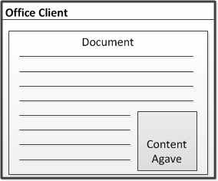
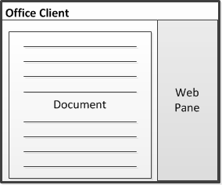
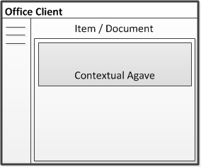
What is app for Office?
A Web page rendered inside an Office Client Application
Supported by the new Project
Content App
Task Pane
Contextual App
Adds embedded content/functionality into document
Assists user working with one or more documents
Senses the content and offers additional functionality

Slide 8
What is an App for Office?
A Web page loaded inside an Office Application
Embedded inline or as task pane within documents, mails or appointments.
Works in both Office Applications and Office Web Applications
Allow Office applications to leverage Web technologies
HTML 5 and CSS for rendering user interface
JavaScript and jQuery to add behavior
Calls to REST APIs to retrieve and update data from across network

Slide 9
WEF (Web Extensibility Framework)
Web Extensibility Framework (WEF) allows Web page to
…content to render inside Office Application
…code to run within a set of constraints
...code to interact with Office documents
…code to interact with Exchange items
WEF is the development platform used to build Apps for Office
Apps for Office provide basis for a component architecture
Apps for Office provide foundation for an Office Store and App Catalogs
Apps for Office can be deployed in private networks
"Agave" was a codename for Apps for Office in pre-release version

Slide 10
Apps for Office
Project desktop 2013 Preview specifics
Task Pane Experience
Can Read Data from document, can’t write into the MPP file
Does not support binding with MPP file or persistence of data in the MPP file
Specific Project set of APIs
Access to Tasks, Resources, Views, and Project containers
E.g. getTask(), getTaskProperty(), getSelectedTask()
Events for task, resource, view selection changed
E.g. taskSelectionChanged()

Slide 11
Apps for Office
Surfacing Project related data from SharePoint Server 2013 Preview and/or Project Server 2013 Preview in Office Desktop Applications
Possible Project scenarios
Team communication – calendars, discussions, including contextual Project documentation
Contextual data insights and analysis
Including Line of Business Application data
Resource management
Portfolio Management

Slide 12




Anatomy of an App for Office
Each App for Office is based on XML-based manifest
Manifest points to a Web page
Manifest defines the type of the App for Office
Manifest defines which Office applications it supports
Manifest defines required capabilities
App for Office
Catalog Server
Web Server
App for Office
App for Office
Manifest
<XML>
Web
Page
HTML+JS

Slide 13
Development Tools
Text Editor
HTML webpage(s) and related JavaScript files(s), CSS files and REST queries
XML manifest file
Microsoft Visual Studio 2012 + Microsoft Office Developer Tools for Visual Studio 2012
“App for Office 2013” templates
Allows comfortable debugging experience
Microsoft .NET Framework 4.5 on the development computer and on the deployment computers

Slide 14
Building “app for Office” for Project Professional 2013 Preview
demo

Slide 15
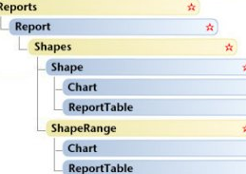
VBA changes object model additions
New classes: 7
Class members new: 292
New enumerations: 3
New enumeration members: 229
New classes are for
Chart
Report
Shape (Office Art)
More in the blog post from Jim Corbin
http://blogs.msdn.com/officedevdocs/archive/2012/09/12/what-s-new-for-developers-in-the-new-project-desktop-besides-task-pane-apps.aspx
Or
http://blogs.msdn.com/project_programmability/

Slide 16
Summary
Introduction
New Extensibility: app for Office
VBA changes

Slide 17
Next Steps
Sign-up for Project Online and Install Project Professional 2013
Read the blog http://blogs.msdn.com/project_programmability/
Study the New Project and Office SDK http://msdn.Microsoft.com/project and http://msdn.Microsoft.com/office
Admire the existing apps in the Store http://office.microsoft.com/store/
Understand the publishing process http://msdn.Microsoft.com/sharepoint
Key resources
Product http://www.microsoft.com/project
Blog http://blogs.office.com/b/project/
TechNet http://technet.microsoft.com/projectserver
MSDN http://msdn.microsoft.com/project
Forums http://social.technet.microsoft.com/Forums/en-US/category/project

Slide 18

© 2012 Microsoft Corporation. All rights reserved. Microsoft, Windows, Windows Vista and other product names are or may be registered trademarks and/or trademarks in the U.S. and/or other countries.
The information herein is for informational purposes only and represents the current view of Microsoft Corporation as of the date of this presentation. Because Microsoft must respond to changing market conditions, it should not be interpreted to be a commitment on the part of Microsoft, and Microsoft cannot guarantee the accuracy of any information provided after the date of this presentation. MICROSOFT MAKES NO WARRANTIES, EXPRESS, IMPLIED OR STATUTORY, AS TO THE INFORMATION IN THIS PRESENTATION.

