Slide 1
What's new for developers- Part 2 – Project Online and Project Server 2013
Jan Kalis
http://blogs.msdn.com/jkalis
Product Marketing Manager
Microsoft Corporation

Slide 2
Agenda
Overview
Terminology
Architecture
Remote Event Receivers
Introduction to CSOM (OData), JSOM
When to use CSOM
Comparing CSOM and PSI
How to use CSOM
Demos

Slide 3
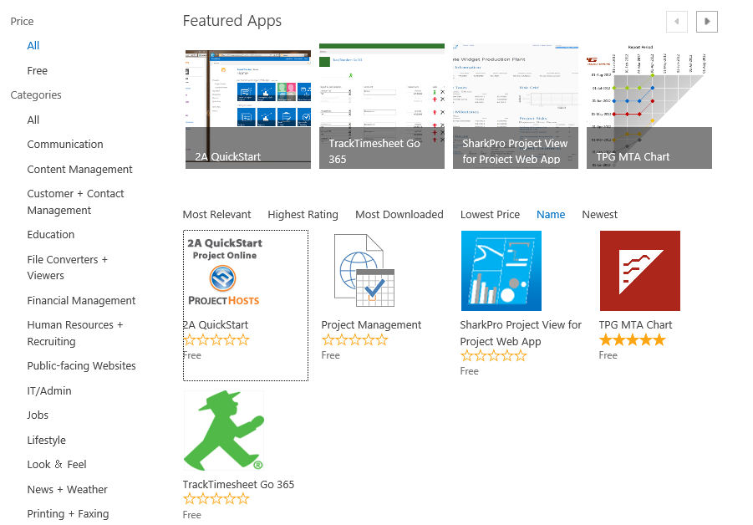
Introduction
Built on SharePoint
Project CSOM is an extension of SharePoint CSOM
Project apps work exactly like SharePoint apps
More Project Users
Investments made throughout Project will enable more customers to “grow up” from SharePoint
Bring Server to the Client
Apps for Office promote better integration between Server and Desktop

Slide 4
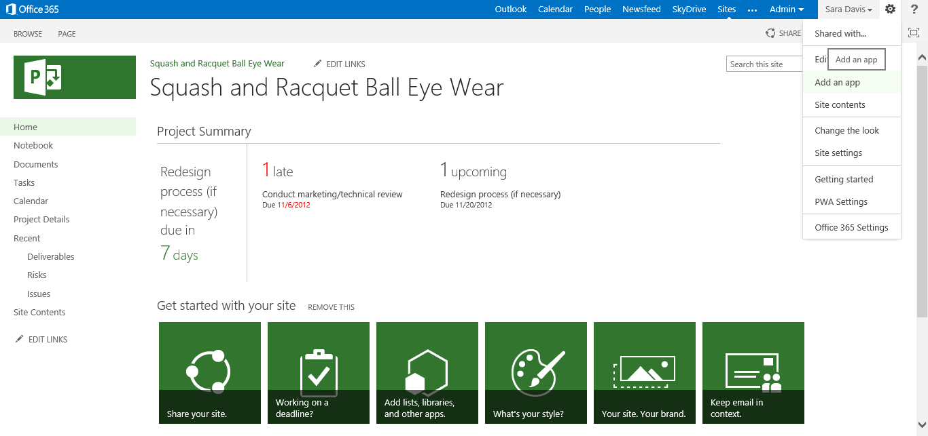

Slide 5
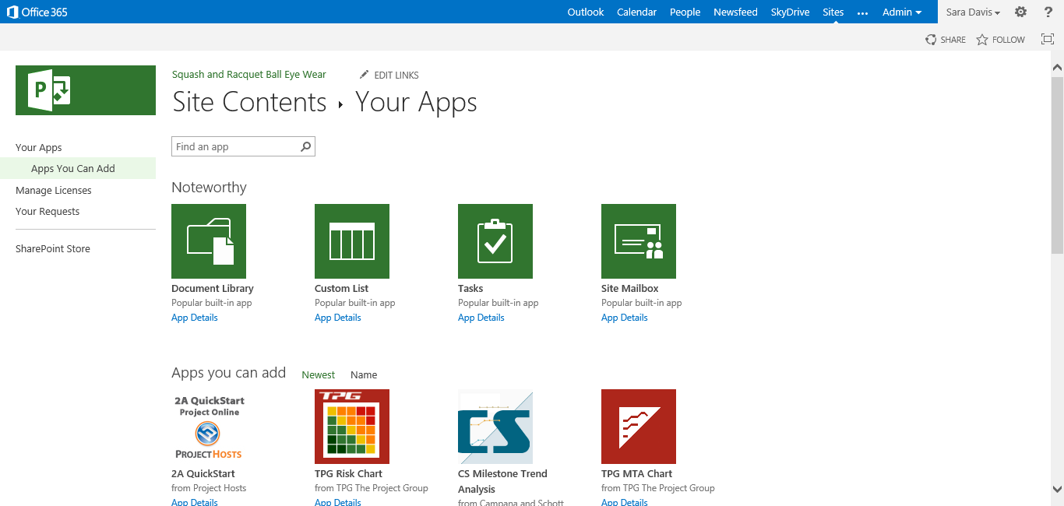

Slide 6
Project Online / Project Server Customizations and Extensibility
Project Server 2013 Preview extensibility builds on the Project Server 2010
Customization / no code:
Enterprise Custom Fields, Views (including Web Parts and Web Part Pages), Timesheets, (NEW OPTIONS) Security, (NEW OPTIONS) Reporting/Business Intelligence (BI), (NEW OPTIONS) Project “Demand Management”
Extensibility / code:
Web Services – Project Server Interface (PSI) & Event Handlers
(NEW) Client Side Object Model (CSOM) & Remote Event Receivers
(NEW OPTIONS) Project Workflow (based on SharePoint 2013 Workflow)
(EXTENDED) Project sites (SharePoint Sites)
Leverage other Advanced SharePoint Workloads (Excel Services, Visio Services, PerformancePoint,…)
(NEW) In-product Marketplace

Slide 7
SharePoint and Project Extensibility Compared
New Feature | SharePoint 2013 | Project 2013 | Notes
New App model | Full | Full | Apps can be published in the Marketplace
Client Side Object Model (CSOM) | Full | Full
JavaScript | Full | Full | Using CSOM
Windows Phone | Full | Full | Using CSOM
Silverlight | Full | Full | Using CSOM
Workflow | Full | Full | Including SharePoint Designer.
Server Object Model (WCF) | Full | Full – additional Web Services | Project Server Interface (PSI) web services interface
LINQ | Full | Partial | Yes, for custom web parts and some others
OData | Full | Full
Remote Event Receiver | Full | Full
Apps for Office | Full | Full
SharePoint Designer 2013 Preview | Full | Partial | Project Workflows, Project sites, No PWA Theming
Dedicated Reporting Database | Not included | Full | Including multi-dimensional OLAP database Available using ODATA when Online
Development platform with Visual Studio 2010, Visual Studio 2012 RC | Windows 7 and Windows Server 2008 R2 | Windows 7 and Server 2008 R2 and higher | Windows 7 and higher for CSOM development

Slide 8
Agenda
Overview
Terminology
Architecture
Remote Event Receivers
Introduction to CSOM (OData), JSOM
When to use CSOM
Comparing CSOM and PSI
How to use CSOM
Demos

Slide 9
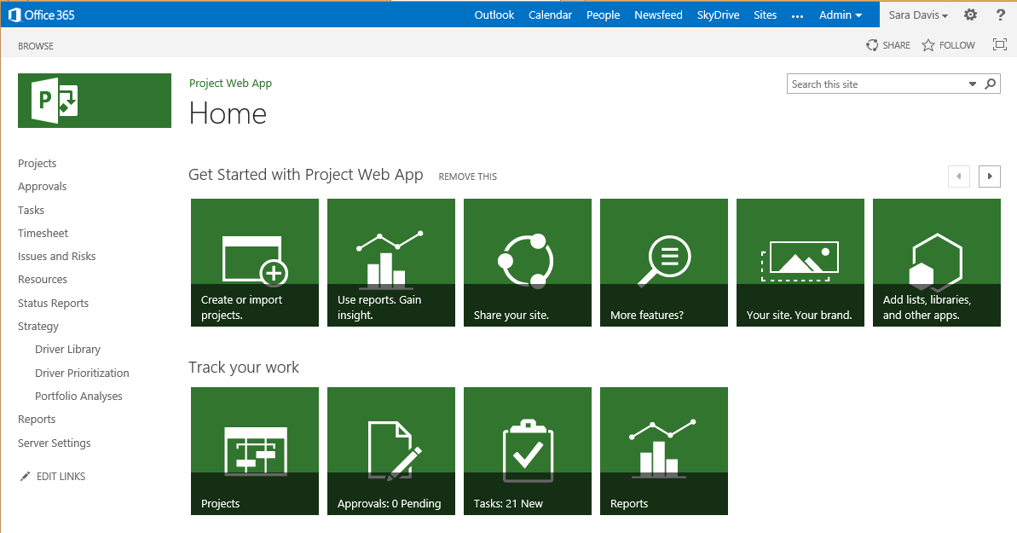
Terminology Used
Languages
XML
JSON
Protocols
HTTP
SOAP
OData
Architecture Style
REST (relies on XML and HTTP)
WCF: runtime + set of APIs
Object Models and set of API
CSOM
JSOM
Standards
OAuth

Slide 10
Agenda
Overview
Terminology
Architecture
Remote Event Receivers
Introduction to CSOM (OData), JSOM
When to use CSOM
Comparing CSOM and PSI
How to use CSOM
Demos

Slide 11
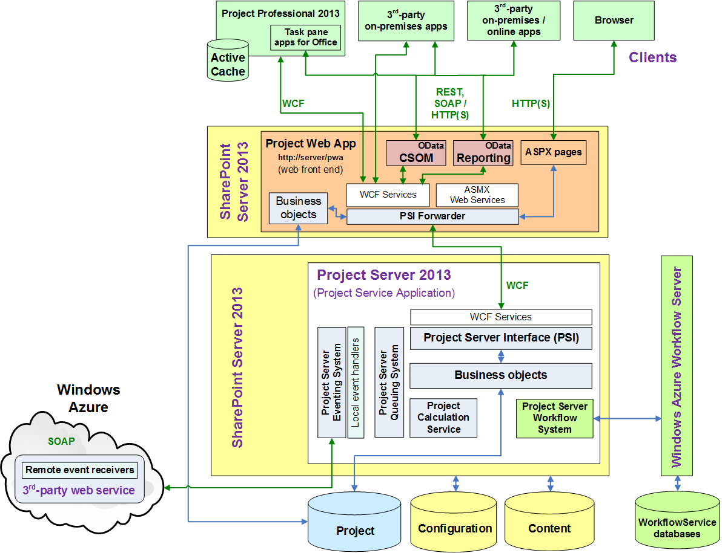
Project Server 2013 Architecture

Slide 12
Project Online Architecture
not directly accessible to via code

Slide 13
Differences between On premises and online
Online
Extensibility via SharePoint extensibility model
No full-trust code
Reporting is done via OData
No direct access to the SQL and OLAP databases
Access using CSOM (PSI interfaces do not support OAuth)
On Premises
Full access to databases
Full access to PSI and CSOM
Please refer to the Project SDK for most up-to-date information

Slide 14
Agenda
Overview
Terminology
Architecture
Remote Event Receivers
Introduction to CSOM (OData), JSOM
When to use CSOM
Comparing CSOM and PSI
How to use CSOM
Demos

Slide 15
What’s new in Event Handler (Receiver)?
In Project Server 2010
Event handlers are written in full-trust code deployed on Project Server computer
They run inside the Project Server Eventing System
In Project Server 2013 and Project Online you need to implement remote event receivers
An Project Server 2013 (on-premises) can use both full-trust event handlers and remote event receivers

Slide 16
Agenda
Overview
Terminology
Architecture
Remote Event Receivers
Introduction to CSOM (OData), JSOM
When to use CSOM
Comparing CSOM and PSI
How to use CSOM
Demos

Slide 17
What is CSOM, JSOM ?
CSOM is a Client-Side Object Model API
New and main extensibility model for Project Server
Could be leveraged through the following:
Microsoft .Net CSOM (language C# or VB#) (synchronous)
Microsoft SilverLight CSOM (asynchronous)
Windows Phone 7 CSOM (asynchronous)
JavaScript object model (JSOM) using JavaScript language
JSOM is JavaScript Object Model
Exposing the same objects as CSOM
Deployed as custom application page, app parts, and ribbon extensions
Calls to the server are asynchronous
Already available with SharePoint 2010`

Slide 18
OData access to CSOM
OData maps CRUD operations to HTTP verbs
Read operations mapped to HTTP GET
Insert operations mapped to HTP POST
Update operations mapped to HTTP PUT or HTTP MERGE
Delete operations mapped to HTTP DELETE
Use the _api entities and not the ProjectData (which is Read Only).
For example to select a Project
http://ServerName/ProjectServerName/_api/Projects

Slide 19
Accessing Data with Client OM
Client Application
Client Application
WPF/WinForm/Office
Silverlight
JavaScript
Client OM
XML
JSON
PSI Web Service
Client.svc
ProjectServer API
Project
database
Project server Application

Slide 20
List of CSOM client libraries and interfaces
Language | Name of the Library
Microsoft .NET client library | Microsoft.ProjectServer.Client.dll assembly
Silverlight library | Microsoft.ProjectServer.Client.Silverlight.dll assembly
Windows Phone 7 library | Microsoft.ProjectServer.Client.Phone.dll assembly
JavaScript library for web applications | PS.js file or PS.debug.js file

Slide 21
ProjectContext properties in JSOM
CSOM (.NET, Silverlight, and Windows Phone) | JSOM
CustomFields | customFields
EnterpriseProjectTypes | enterpriseProjectTypes
EnterpriseResources | enterpriseResources
EntityTypes | entityTypes
EventHandlers | eventHandlers
Events | events
LookupTables | lookupTables
Phases | phases
Projects | projects
Stages | stages
WorkflowActivities | workflowActivities
WorkflowDesigner | workflowDesigner

Slide 22
Primary Project Server entities: six classes
Base class
Contains the common properties for entities
Creation information class
Contains the properties used to create an entity
Includes the GetById for reading or for checking out
Draft class
Published class
Published Collection
Includes the Add, GetById and the Remove
Includes the read only properties
Includes the read/write properties for editing
Draft collection

Slide 23
When to use CSOM ?
The CSOM can be used both for Project Server Online solutions and for on-premises solutions
If you want/need OAuth CSOM is the only way for a programmatic access to Project Server Online
Suggested for new developments and to develop Project apps for the Office and SharePoint Store

Slide 24
Scenarios to use CSOM
Develop apps that extend Project Server
Automate the creation or management of entities in Project Server
Get data from the published tables of the Project database
Validate statusing and timesheet data
Integrate with accounting systems
Automate updates from team members
Evaluate Project Server data in remote event receivers
Support declarative Project Server workflows
App that requires to call another Project Server Service in its implementation (use of OAuth)

Slide 25
Comparing CSOM and PSI
Feature | CSOM | PSI
Complexity for methods and properties | Uses object name | Uses GUID, changeXml parameters, datasets
Accessibility | One WCF service: client.svc | 22 public web services
Initialization | ProjectContext | Using WCF reference or proxy assemblies
Platform | On Premises & Online | On Premises (Online limitation no OAuth support)
Scheduling Engine | Same as Project web app and Project Professional | Use QueueUpdateProject2
Project Entities | Restrictions exist - please refer to the Project SDK for most up-to-date information | Restrictions exist

Slide 26
Agenda
Overview
Terminology
Architecture
Remote Event Receivers
Introduction to CSOM (OData), JSOM
When to use CSOM
Comparing CSOM and PSI
How to use CSOM
Demos

Slide 27
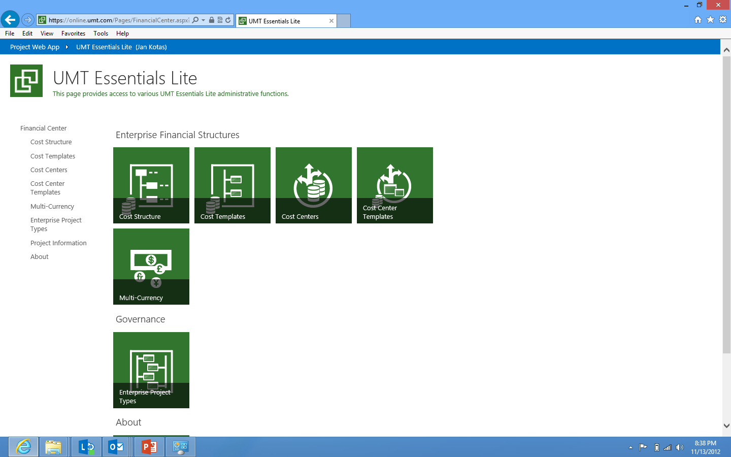

Slide 28
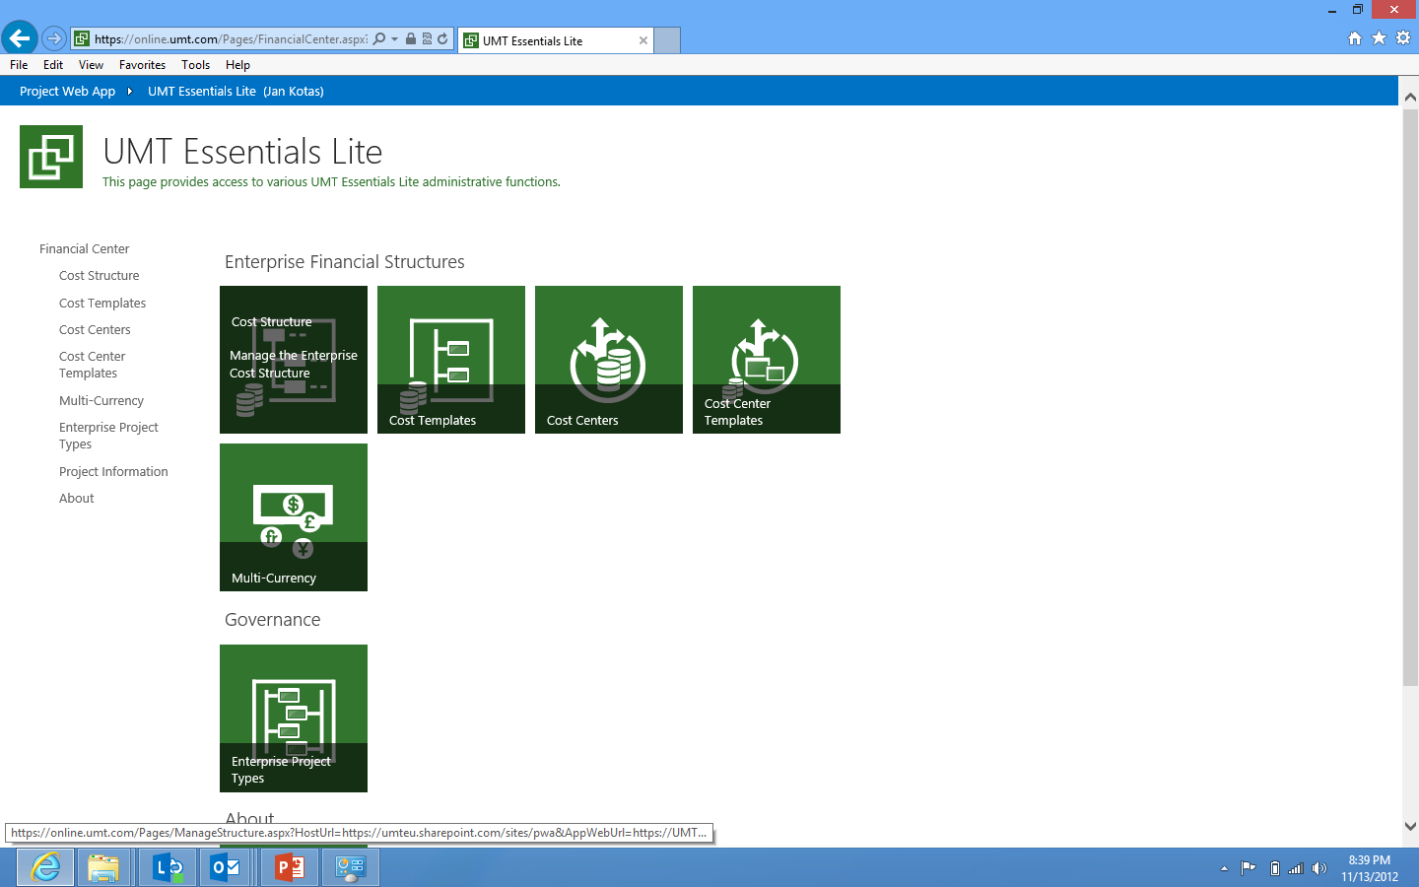

Slide 29
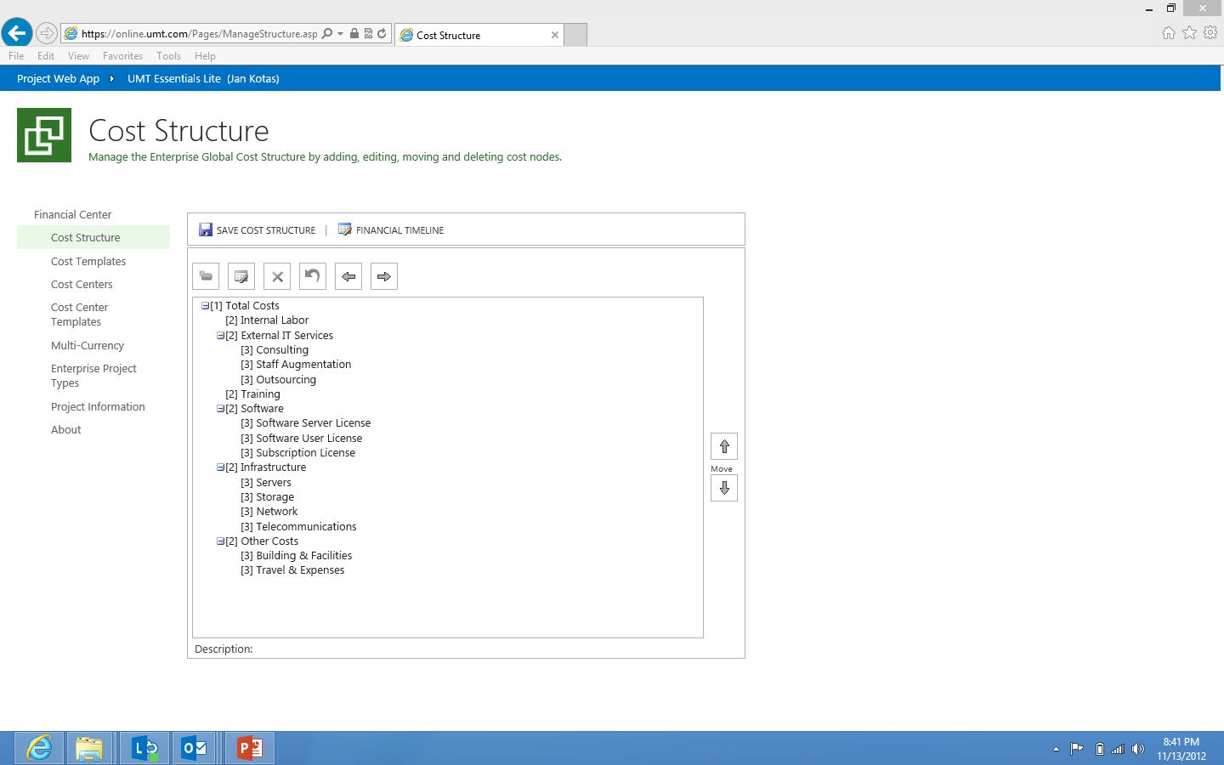

Slide 31
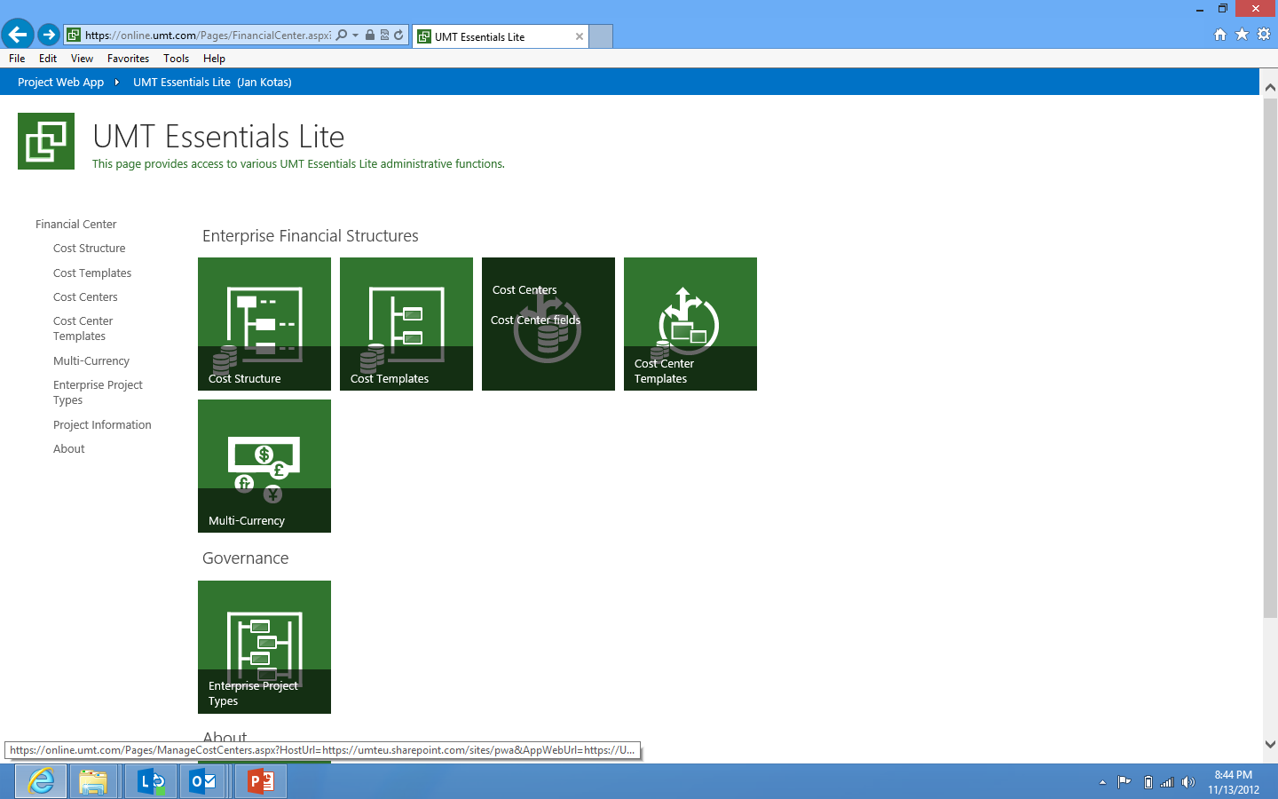

Slide 32
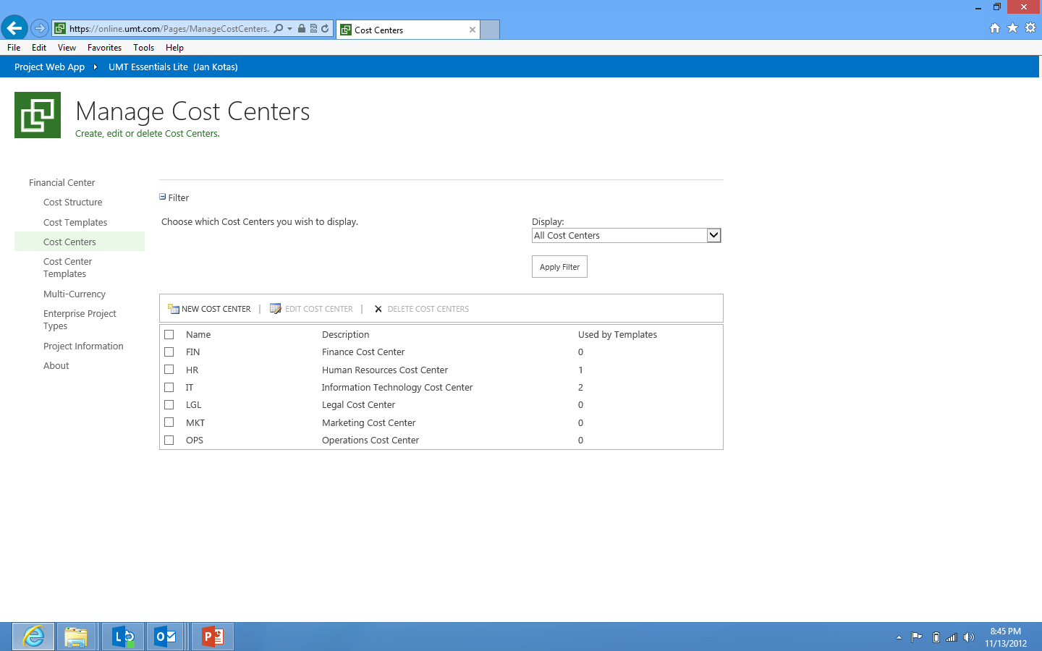

Slide 34
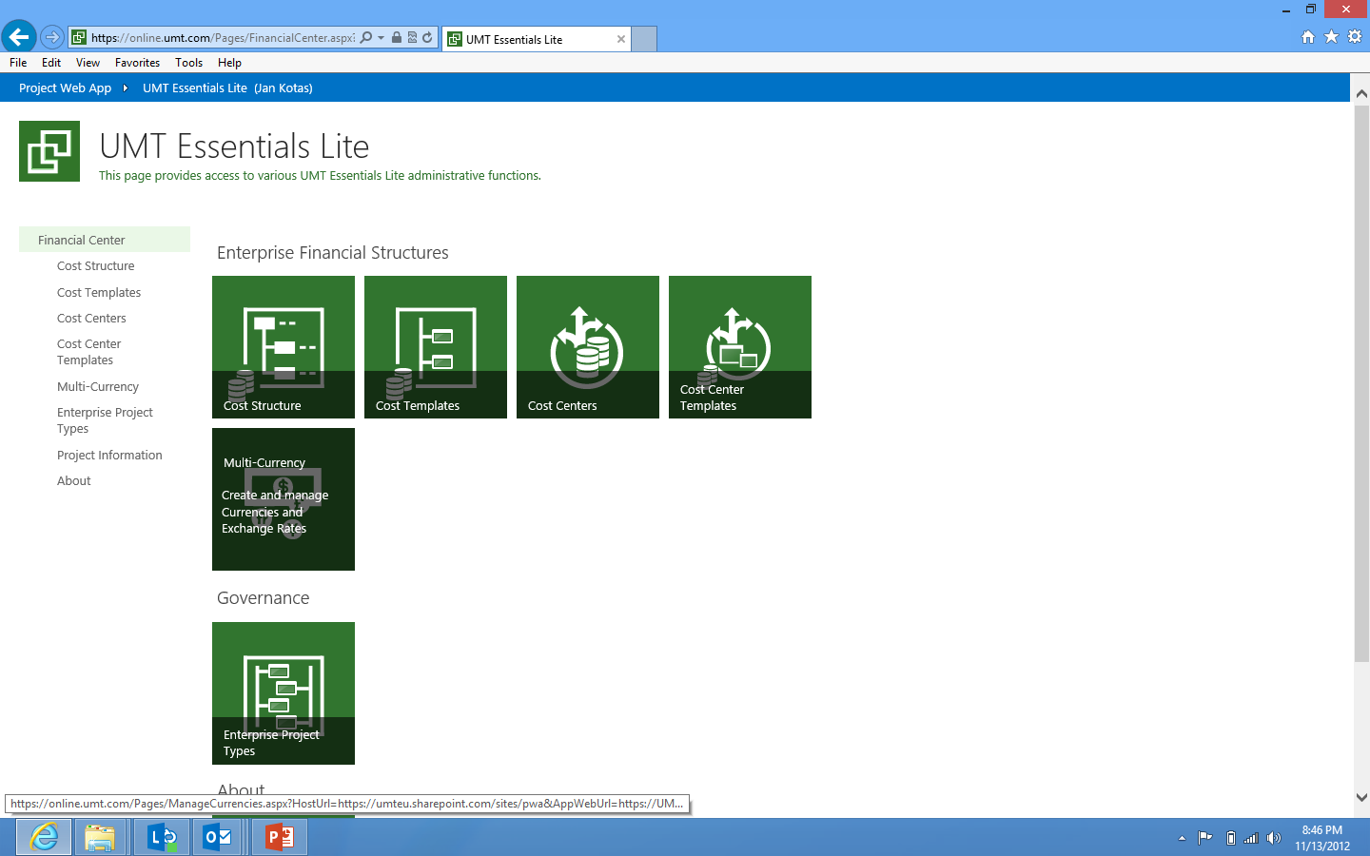

Slide 35
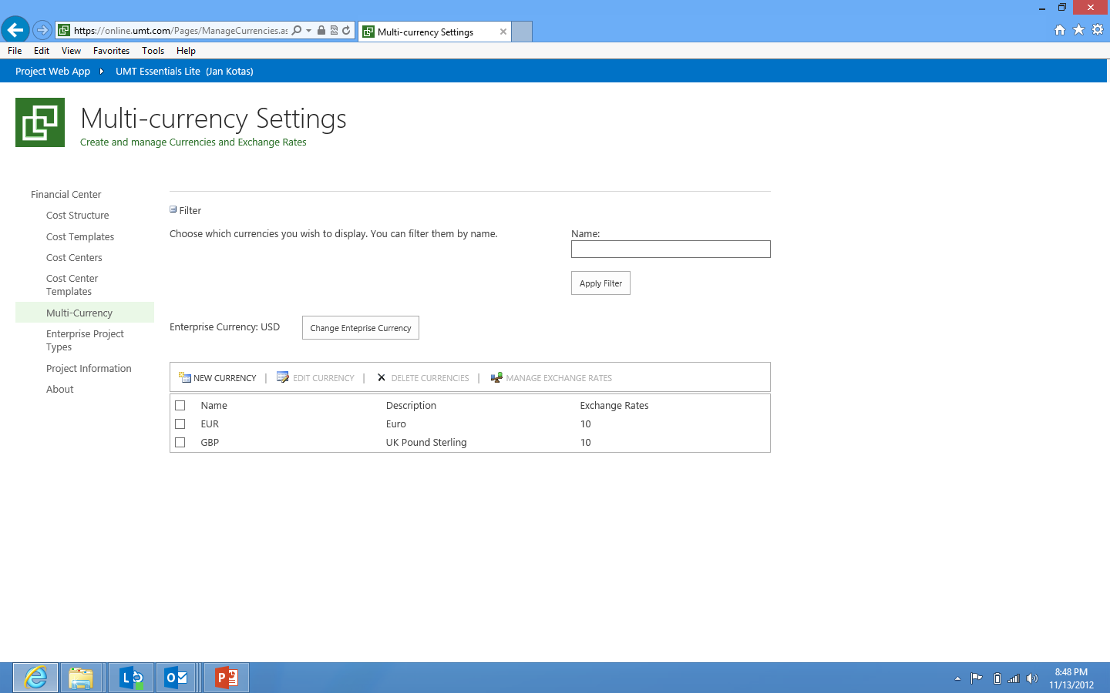

Slide 36


Slide 37
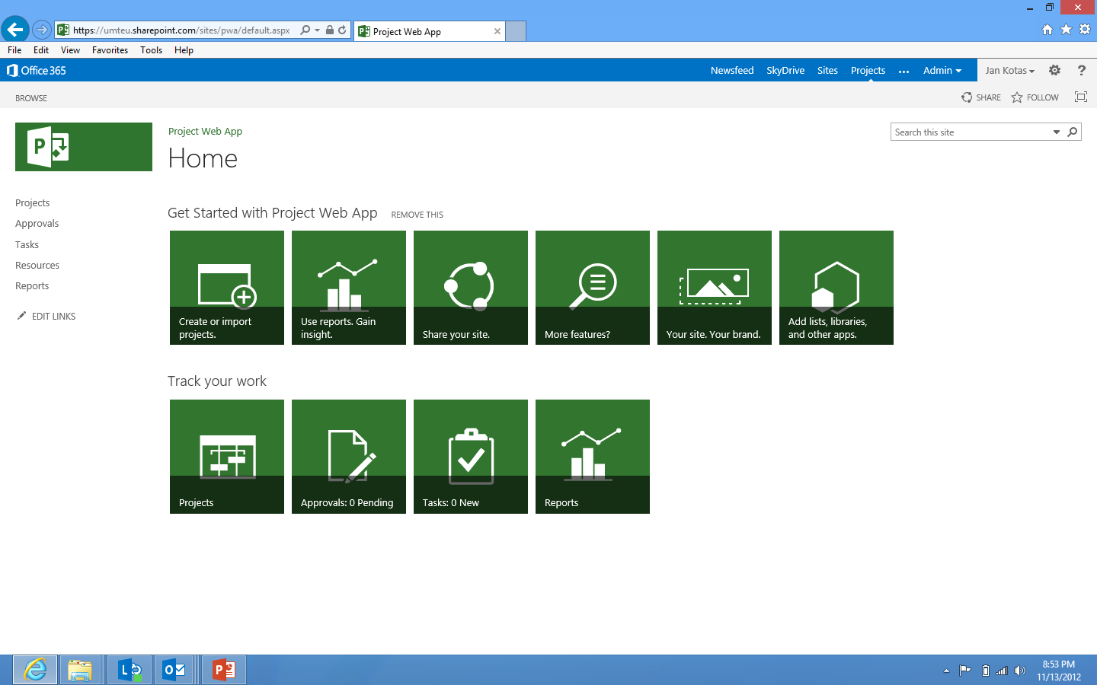

Slide 38
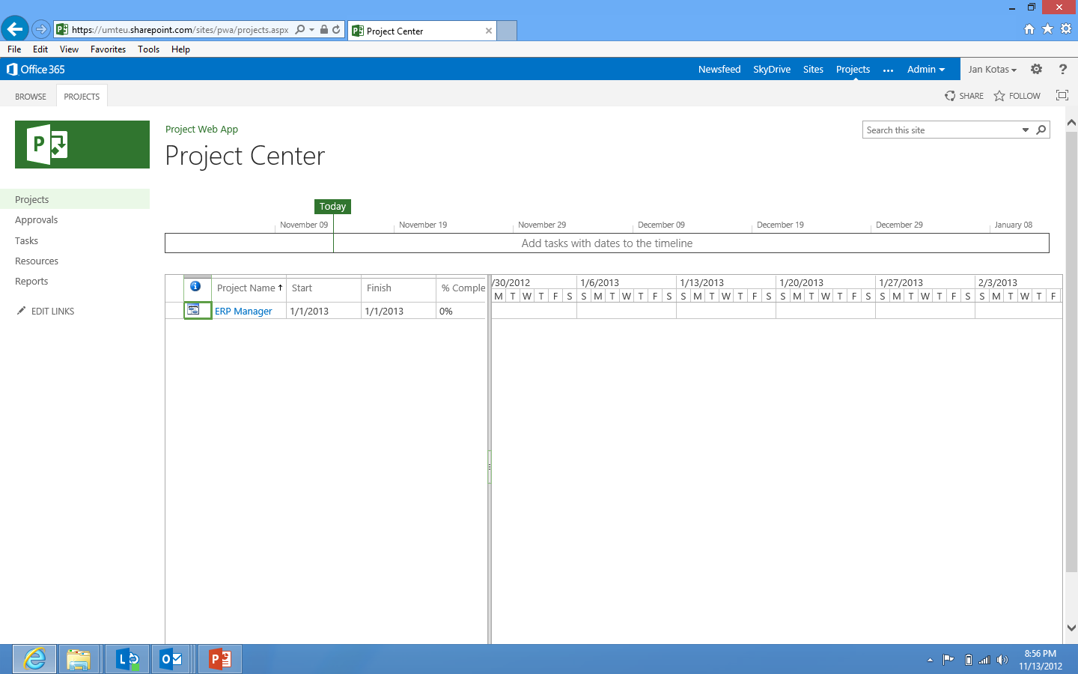

Slide 39
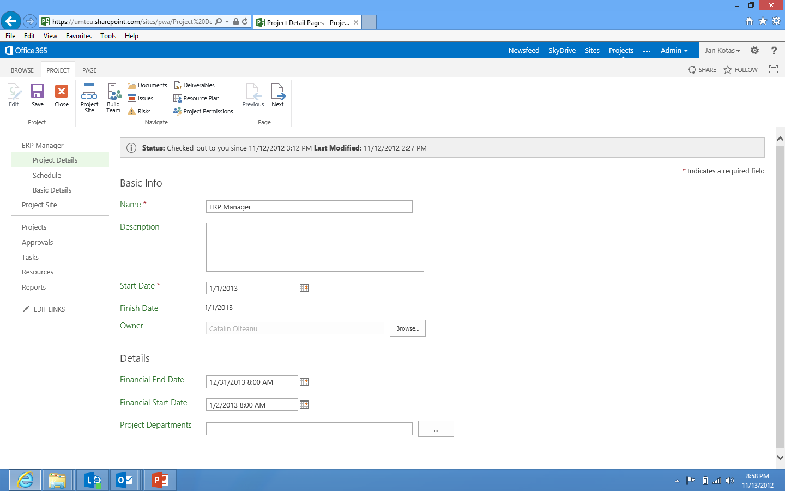

Slide 40
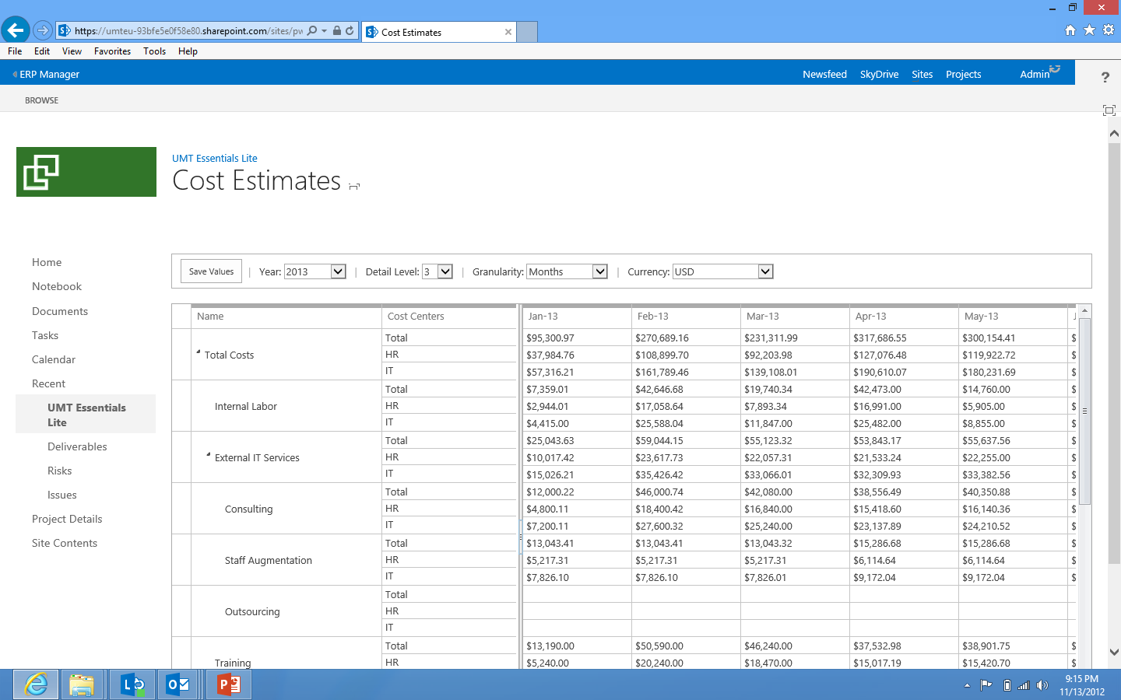

Slide 41
Read Projects using
CSOM and JSOM
demo

Slide 42
Summary
Overview
Terminology
Architecture
Remote Event Receivers
Introduction to CSOM (OData), JSOM
When to use CSOM
Comparing CSOM and PSI
How to use CSOM
Demos

Slide 43
Next Steps
Sign-up for Project Online and Install Project Professional 2013
Read the blog http://blogs.msdn.com/project_programmability/
Study the New Project, Office, SharePoint Developer Documentation http://msdn.Microsoft.com/project, http://msdn.Microsoft.com/office and http://msdn.Microsoft.com/sharepoint
Admire the existing apps in the Store http://office.microsoft.com/store/
Understand the publishing process http://msdn.Microsoft.com/sharepoint
Key resources
Product http://www.microsoft.com/project
Blog http://blogs.office.com/b/project/
TechNet http://technet.microsoft.com/projectserver
MSDN http://msdn.microsoft.com/project
Forums http://social.technet.microsoft.com/Forums/en-US/category/project

Slide 44

© 2012 Microsoft Corporation. All rights reserved. Microsoft, Windows, Windows Vista and other product names are or may be registered trademarks and/or trademarks in the U.S. and/or other countries.
The information herein is for informational purposes only and represents the current view of Microsoft Corporation as of the date of this presentation. Because Microsoft must respond to changing market conditions, it should not be interpreted to be a commitment on the part of Microsoft, and Microsoft cannot guarantee the accuracy of any information provided after the date of this presentation. MICROSOFT MAKES NO WARRANTIES, EXPRESS, IMPLIED OR STATUTORY, AS TO THE INFORMATION IN THIS PRESENTATION.

