Slide 1
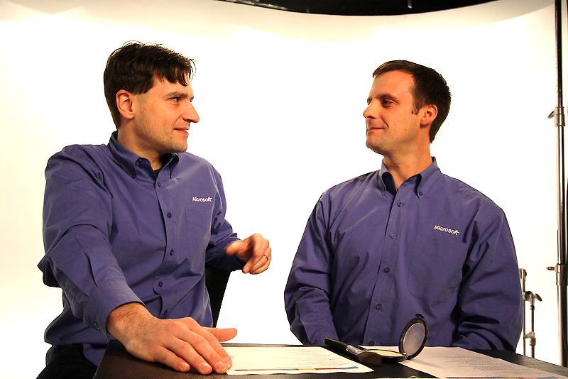
Who are we?
Christophe Fiessinger
http://blogs.msdn.com/chrisfie/
Twitter @CFiessinger
Jan Kalis
http://blogs.msdn.com/jkalis/
Twitter @MeetJKalis
Product Marketing Managers
Microsoft SharePoint/Project/Visio
Microsoft Corporation

Slide 2

Ignite was developed to ensure that key partners and customers can accelerate their adoption of new releases of Office, Office 365, Exchange, SharePoint, Lync, Project and Visio via Ignite events and Ignite online.

Slide 3
Understanding the Project Quick Start training
Differential content from previous release
Aims to cover all new areas
Does not go very deep, but enough to give you pointers for next steps
Other Ignite trainings available – SharePoint, Office, Office365, Lync, Exchange

Slide 4
Project Ignite Timeline
Project Ignite
RESTON
The Best of Project Ignite @ SPC12
Project Quick Start Training Recording Available
July 2012
August 2012
September 2012
October 2012
November 2012
December 2012
Spring 2013
Preview Ignite Recording publicly available
Project Ignite
SYDNEY
Project Ignite
WARSAW

Slide 5
Modules
Module | Name | Presenter
1 | What is the New Project Quick Start Training
2 | What's new in Project Pro for Office365 and Sync to SharePoint Online | Jan Kalis
3 | What's new with Microsoft's Project Portfolio Management (PPM) solution | Christophe Fiessinger
4 | Project Online Overview | Christophe Fiessinger
5 | Business Intelligence in Microsoft Project | Jan Kalis
6 | Timesheet and Statusing | Christophe Fiessinger
7 | What's new for IT Professionals - part 1 - Architecture | Christophe Fiessinger
8 | What's new for IT Professionals - part 2 - Deployment & Upgrade | Christophe Fiessinger
9 | What's new for IT Professionals - part 3 - Operations | Christophe Fiessinger
10 | Demand Management and Workflow | Jan Kalis
11 | Office Store Opportunity | Jan Kalis
12 | What's new for Developers - part 1 - Project Desktop Extensibility | Jan Kalis
13 | What's new for Developers - part 2 - Project Online and Server Extensibility | Jan Kalis

Slide 6
Partners demoing Project…
CIE/MEC (Customer Immersion Experience / Microsoft Experience Center)
All-up Microsoft Office “Hero” Demo
No demos just the Project Overview deck
Full Project Demos
Project Desktop, Project Online, Project Server
Partners can direct questions to ppmcomms@microsoft.com
Try FluentPro Project Migrator http://www.projectmigrator.com/

Slide 7
Next Steps
Key Resources
Product http://www.microsoft.com/project
Blog http://blogs.office.com/project
TechNet http://technet.microsoft.com/projectserver
MSDN http://msdn.microsoft.com/project
Forums http://social.technet.microsoft.com/Forums/en-US/category/project
Resources for Partners
Follow the Project Partner Blog http://blogs.msdn.com/jkalis/
PPM at the Microsoft Partner Network http://go.microsoft.com/?linkid=9812257

Slide 8

© 2012 Microsoft Corporation. All rights reserved. Microsoft, Windows, Windows Vista and other product names are or may be registered trademarks and/or trademarks in the U.S. and/or other countries.
The information herein is for informational purposes only and represents the current view of Microsoft Corporation as of the date of this presentation. Because Microsoft must respond to changing market conditions, it should not be interpreted to be a commitment on the part of Microsoft, and Microsoft cannot guarantee the accuracy of any information provided after the date of this presentation. MICROSOFT MAKES NO WARRANTIES, EXPRESS, IMPLIED OR STATUTORY, AS TO THE INFORMATION IN THIS PRESENTATION.

