Slide 1
Project Online Overview
Christophe Fiessinger
http://blogs.msdn.com/chrisfie | http://twitter.com/cfiessinger
Product Marketing Manager
Microsoft Corporation

Slide 2
Agenda
Office 365 Today
Project Online Overview
Get Started With Project Online
SaaS & IaaS
Project Online Preview FAQs

Slide 3
Project Online Overview
Microsoft Office 365 Today

Slide 4





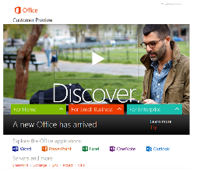





Microsoft Office 365 services
Providing anywhere access to your familiar office applications, email, calendar, HD video conferencing, enterprise social networking and most up-to-date documents, across your devices – from PCs to smartphones to tablets.
www.office365.com | SaaS/Software As A Service

Slide 5

What is Microsoft Office 365
Cloud-based productivity services hosted by Microsoft
“Fantastic devices and services for end users will drive our enterprise businesses (…) Microsoft is committed to delivering devices and services that people love and businesses need.”
88
24
99.9 percent
Industry standard
Fastest growing
32
365
88 countries & regions 32 languages
One of the fastest growing Microsoft offers ever
Secure & reliable, with
99.9% guaranteed uptime
3rd party verified industry standard compliance
Available 24 hours/day, 365 days/year
Steve Ballmer, CEO, Microsoft
October 9, 2012
http://www.globalfoundationservices.com

Slide 6
Microsoft Office 365 Today
Demo
http://www.Office365.com
http://www.microsoft.com/en-us/office365/trust-center.aspx
http://community.office365.com/en-us/wikis/office_365_service_updates/974.aspx

Slide 7
Project Online Overview
Project Online Introduction

Slide 8

Microsoft Project Online services
Office 365 Service
Target Audience
Project Online
For team members, project participants, business decision makers
Project Pro for Office 365
For project managers, resource managers
Project Online with Project Pro for Office 365
For project managers, resource managers, PMO, business decision makers
Purchase standalone or add to Enterprise/“E” plans

Slide 9
Project Online - top 10 benefits
Online Project Portfolio Management (PPM)
Get Started Quickly
Take Action
Improve Governance And Control
Effectively manage resources
Strengthen everyday collaboration
Seamlessly communicate
Make data-driven decisions
Improve IT Management
Quickly Innovate

Slide 10
Terms
Plans
Provisioning
Tenant
Project Online
Project Web App
Project Pro for Office 365
Project Online with Project Pro for Office 365

Slide 11
Project Online Overview
Get Started With Project Online

Slide 12
Get started with Project Online in 4 Steps
Sign up for Office 365
Get Started with Project Web App
Get Started with Project Pro for Office 365
Explore more features of Project Online
Resources
Get started with Project Online
Get Started with Project Online (Overview)
Get Started with Project Online (Demo)

Slide 13
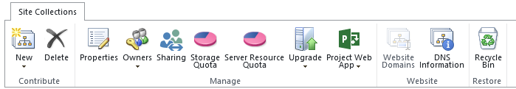
Step 1: sign up for Office 365
Sign up for a new Project Online Preview tenant here
Add users to Project Web App for Project Online
Create a user
Share PWA
SharePoint & Project Administration Center
Site Collections
Site Collection with Project Web App

Slide 14
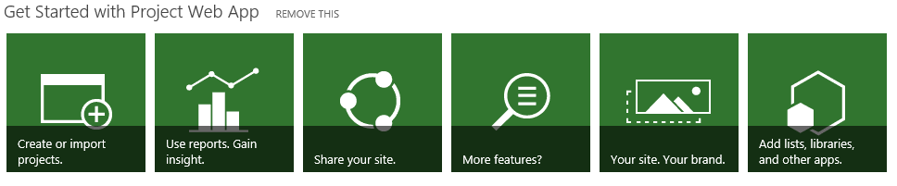
Step 2: get started with Project Web App
Create or import projects.
Use reports. Gain insight.
Share your site.

Slide 15
Step 3: get started with Project Pro for Office 365
Click-to-run: streaming technology, quickly installs Project Pro for Office 365 over the Internet, internal networks, local file systems or from offline media
No install necessary, instantly streamed using App-V
Always run the latest version of Microsoft Project
Login to have files and settings follow you
Runs side-by-side with existing Project applications

Slide 16
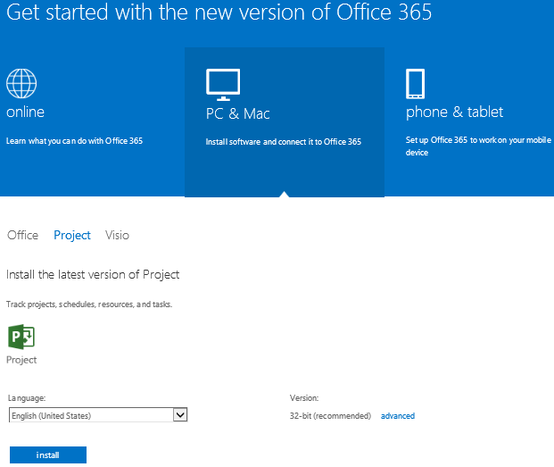
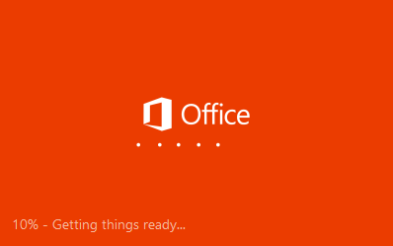
Project Click to Run

Slide 17
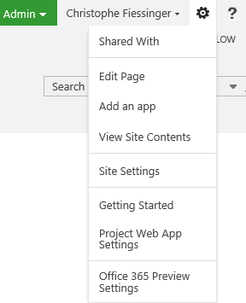
Step 4: Explore more features of Project Online
Edit Links
Project Web App Settings
Demand Management
Portfolio Management
SharePoint Store
Etc.

Slide 18
Getting started with Project Online
Demo
Microsoft Project Online

Slide 19
Project Online Overview
SaaS & IaaS

Slide 20

Project Server Cloud Continuum
Value Prop:
Auto HA, Fault-Tolerance
Friction-free scale
Self-provisioning, management at scale
Office 365 (SaaS)
Value Prop:
100% of API surface area
Easy migration of existing apps
Roll-your-own HA/DR/scale
Cost-efficiency
Project Online
Value Prop:
Full h/w control – size/scale
Roll-your-own HA/DR/scale
Project Server (IaaS)
Project Server (On-premise)
Hosted Project Server
Project Server
Control

Slide 21
Cloud Services
Packaged Software/
On-Premise
Infrastructure
(as a Service)
Software
(as a Service)
Applications
Applications
You manage
Applications
You manage
Data
Data
Data
Runtime
Runtime
Runtime
Managed by vendor
You manage
Middleware
Middleware
Middleware
O/S
O/S
O/S
Virtualization
Virtualization
Managed by vendor
Virtualization
Servers
Servers
Servers
Storage
Storage
Storage
Networking
Networking
Networking
Partner options

Slide 22
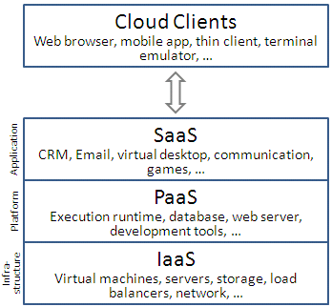
SaaS, IaaS, Partner-Hosted
Microsoft Gives You Options!
SaaS: Software As A Service > Office 365
IaaS: Infrastructure as a service > Windows Azure VM
On-Demand Hosting Services
SharePoint Deployment on Windows Azure Virtual Machines

Slide 23
Project Online Overview
Frequently Asked Questions

Slide 24
Project Online preview FAQ
Delivers full Project Portfolio Management (PPM) in the cloud
Connect Online to on-premise Line Of Business Apps
Achieve on-premise to Online migration
Track using ODATA and customize using CSOM
Preview is for temporary use only (see Preview FAQ)
Office 365 is an evergreen service. Customers need to stay current.
Use the Project Online Forum and Wiki for Questions & Answers
Azure VM (IaaS) vs. Project Online (SaaS)
It’s journey, additional guidance and white papers to come!

Slide 25
Project Online and Project Server 2013 Deltas
Reporting
No Direct Access to Project Service Database online & No OLAP database
Use the new Open Data Protocol (OData) for data mining
Windows Azure Integration
Workflows
Reporting
Exchange Integration
No calendar Out of Office integration in Project Online
Extensibility using OData, CSOM, SharePoint Store
Line Of Business Integration
No TFS nor Dynamics integration yet
But LOBI feasible using BCS & custom app depending on the scenario > Solution: Surface external data from AdventureWorks in SharePoint 2013 Preview and Office 2013 Preview (white paper)
Hybrid deployment (online & on-premise)

Slide 26
Project Online Migration Paths
Legacy on-premise PWA to Project Online
Project Online to on-premise
Manual migration
Semi-automated: http://fluentpro.com/productsprojectmigrator.html

Slide 27
Project Online Migration Best Practices
Refer to the existing Office 365 content
http://www.microsoft.com/en-us/office365/deployment-support.aspx
Cloud Migration: Office 365 Capability and Technical Fit Assessment (Whitepaper)
Engage an Online expert (partner or MCS)
More to come at General Availability (GA) & beyond!

Slide 28
Project Online Support
http://www.microsoft.com/en-us/office365/support.aspx
Premier Support
Forums

Slide 29
Summary

Slide 30
Microsoft Project Online Links
Get started with Project Online
Project Online Preview Wiki Portal
Project Online Forum
Others
http://www.microsoft.com/investor/reports/ar12/shareholder-letter/index.html
Trustworthy Computing – Cloud
http://www.globalfoundationservices.com/blog.aspx

Slide 31
Summary
Project Online is a landmark release
Signup for Project Online today!
Learn about Office 365
Key Resources
Product http://www.microsoft.com/project
Blog http://blogs.office.com/b/project/
TechNet http://technet.microsoft.com/en-us/projectserver/fp123546
MSDN http://msdn.microsoft.com/en-us/office/aa905469
Forums http://social.technet.microsoft.com/Forums/en-US/category/project

Slide 32

© 2012 Microsoft Corporation. All rights reserved. Microsoft, Windows, Windows Vista and other product names are or may be registered trademarks and/or trademarks in the U.S. and/or other countries.
The information herein is for informational purposes only and represents the current view of Microsoft Corporation as of the date of this presentation. Because Microsoft must respond to changing market conditions, it should not be interpreted to be a commitment on the part of Microsoft, and Microsoft cannot guarantee the accuracy of any information provided after the date of this presentation. MICROSOFT MAKES NO WARRANTIES, EXPRESS, IMPLIED OR STATUTORY, AS TO THE INFORMATION IN THIS PRESENTATION.

